Slide 1
Application Layer

Slide 2
What are Static Web Pages?
Static Web pages are very simple.
It is written in languages such as HTML, JavaScript, CSS, etc.
For static web pages when a server receives a request for a web page, then the server sends the response to the client without doing any additional process.
These web pages are seen through a web browser.
In static web pages, Pages will remain the same until someone changes it manually.

Slide 3
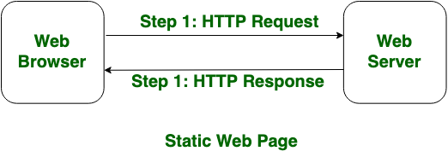

Slide 4
What are Dynamic Web Pages?
Dynamic Web Pages are written in languages such as CGI, AJAX, ASP, ASP.NET, etc.
In dynamic web pages, the Content of pages is different for different visitors.
It takes more time to load than the static web page.
Dynamic web pages are used where the information is changed frequently, for example, stock prices, weather information, etc.

Slide 5
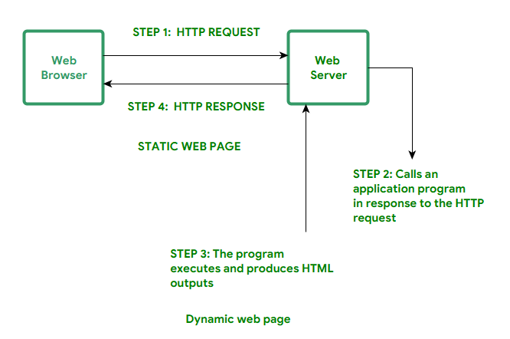

Slide 6
4a) Differentiate between static web objects and dynamic web pages
Static Web Page | Dynamic Web Page
In static web pages, Pages will remain same until someone changes it manually. | In dynamic web pages, Content of pages are different for different visitors.
In static web pages, Information are change rarely. | In dynamic web page, Information are change frequently.
Static Web Pages are simple in terms of complexity. | Dynamic web pages are complicated.
Static Web Page takes less time for loading than dynamic web page. | Dynamic web page takes more time for loading.
In Static Web Pages, database is not used. | In dynamic web pages, database is used.
Static web pages are written in languages such as: HTML, JavaScript, CSS, etc. | Dynamic web pages are written in languages such as: CGI, AJAX, ASP, ASP.NET, etc.
Static web pages does not contain any application program . | Dynamic web pages contains application program for different services.
Static web pages require less work and cost in designing them. | Dynamic web pages require comparatively more work and cost in designing them.

Slide 7
4b)Explain the concept of web Applications with suitable examples.
Web Applications
A web application is a software application that runs on a web server and is accessed by users through a web browser over a network such as the Internet. Unlike traditional desktop applications, a web application generally does not require the user to install the complete application on their device.

Slide 8
Suitable Examples
Online Banking
Users can check balances, transfer money, and view transactions through a browser.
E-Commerce
Websites such as online shopping platforms allow users to search for products, add items to a cart, and place orders.
Webmail
Email services allow users to send, receive, and manage emails through a web browser.
Social Media
Users can create posts, send messages, share images, and interact with other users.
Online Learning
Educational platforms provide lectures, assignments, quizzes, and learning materials through web applications.
Online Ticket Booking
Users can search for available flights, trains, buses, or movie tickets and make reservations online.

Slide 9
5a) Explain the working of HTTP and HTTPS protocols.Compare them with respect to communication,security and applications
HTTPS is just HTTP with encryption.
The primary distinction between these two names is that HTTPS is more secure than HTTP since it uses TLS (SSL) encryption for all HTTP requests and responses, even the standard ones.
HyperText Transfer Protocol (HTTP)
Being a stateless application-layer protocol, HTTP does not retain session information between requests, which limits its ability to handle complex client-server interactions without additional mechanisms like cookies or sessions.

Slide 10
HyperText Transfer Protocol (HTTP) is a protocol used which transfer hypertext over the Web.
HTTP has been the most widely used protocol for data transfer over the Web.
Hyper-text exchanged using HTTP goes as plain text which makes it less secure.
The web server delivers data to the user in the form of web pages when the user initiates an HTTP request.
Connection between the web browser and the server ends after the transaction is finished. This makes HTTP a stateless protocol.

Slide 11
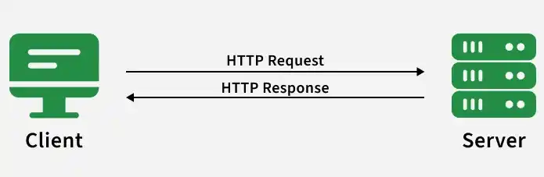

Slide 12
Hypertext Transfer Protocol Secure (HTTPS)
HTTPS ensures end-to-end encryption and authentication by leveraging TLS/SSL, safe guarding data from eavesdropping and tampering during transmission.
HTTPS is used for secure communication as Hypertext Transfer Protocol (HTTP) doesn't.
Data can be transferred using this protocol in an encrypted format.
The HTTPS protocol is mostly utilized in situations when entering login credentials is necessary. Modern browsers like Chrome distinguish between the HTTP and HTTPS protocols based on distinct markings.
HTTPS employs an encryption mechanism called Secure Sockets Layer (SSL), also known as Transport Layer Security, to enable encryption.

Slide 13
Feature | HTTP | HTTPS
Security | Data is sent as plain text — easy to intercept. | Data is encrypted — safer from hackers.
Port | Uses port 80 by default. | Uses port 443 by default.
Trust | Browsers may label it “Not Secure.” | Shows a padlock in the address bar.
Speed | Slightly slower on old systems. | Often faster due to newer protocols and optimizations.
Use case | Suitable for public or non-sensitive info. | Best for sensitive data like payments, logins, personal info.

Slide 14
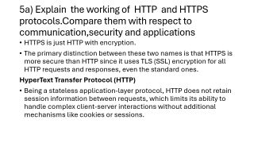
Explain the concept of web privacy.
Web privacy refers to protecting a user's personal information, online activities, and communication while using the Internet and web applications.
In computer networks, web privacy ensures that unauthorized people, websites, organizations, or attackers cannot improperly collect, monitor, or misuse user data.
Importance of Web Privacy
When a user browses the Internet, information such as IP address, browsing history, location, login details, and online activities may be exposed or collected. Web privacy helps protect this information from unauthorized access.

Slide 15
Common Threats to Web Privacy
Tracking: Websites and advertising networks may track users' browsing activities using cookies and other technologies.
Eavesdropping: Attackers on an insecure network may intercept data transmitted between a user and a server.
Phishing: Fake websites or messages may trick users into revealing passwords or financial information.
Data collection: Websites and online services may collect personal information about users.
Malware: Malicious software can steal sensitive information from a user's device.
IP address exposure: An IP address can provide information about a user's network and approximate location.

Slide 16
Discuss the importance of web privacy in internet communication.
Web privacy is the protection of a user's personal information, online activities, and communications while using the Internet. It is an important aspect of secure Internet communication because large amounts of sensitive information are exchanged through websites and online services.
Importance of Web Privacy
Protects personal information
Web privacy prevents unauthorized access to information such as names, addresses, phone numbers, passwords, and account details.
Protects sensitive communications
Encryption technologies such as HTTPS/TLS help prevent attackers from reading data exchanged between users and web servers.

Slide 17
Prevents identity theft
Strong privacy and security measures reduce the risk of attackers obtaining personal information and using it to impersonate users.
Prevents unwanted tracking
Websites and advertising networks can track browsing behavior. Privacy controls can limit unnecessary tracking and collection of user data.
Maintains confidentiality
Privacy ensures that information intended for a particular user or organization is not unnecessarily exposed to third parties.
Provides data security
Privacy mechanisms help reduce the risk of data breaches, interception, and misuse of personal information.

Slide 18
Explain Content Delivery and discuss how Content Delivery Networks (CDNS)improve internet performance.
Content Delivery is the process of delivering digital content such as web pages, images, videos, audio, software, and files from a server to users over a computer network or the Internet.
The main goal of content delivery is to provide content to users quickly, reliably, and efficiently, even when many users access it at the same time.

Slide 19
How Content Delivery Works
User Request: A user requests content through a web browser or application.
Server Identification: The request is directed to the appropriate server.
Content Retrieval: The server retrieves the requested content from storage.
Data Transmission: The content is divided into packets and transmitted through the network.
Delivery to User: The user's device receives the packets and reconstructs the content for display or playback.

Slide 20
Ways CDNs Improve Internet Performance
Reduces latency
CDN servers are distributed around the world. Delivering content from a nearby server reduces the physical distance data must travel and therefore reduces response time.
Faster content delivery
Frequently requested files such as images, videos, CSS, and JavaScript can be cached at edge servers, allowing them to load faster.
Reduces network congestion
Instead of sending every request to one origin server, a CDN distributes requests across many servers. This reduces congestion.
Reduces load on the origin server
Cached content does not need to be repeatedly downloaded from the original server, allowing it to handle other requests more efficiently.

Slide 21
Improves scalability
CDNs can handle large numbers of users simultaneously, which is especially useful during traffic spikes.
Improves reliability and availability
If one CDN server becomes unavailable, requests can often be routed to another available server.
Improves video and media streaming
Large files and streaming content can be delivered from nearby edge servers, reducing buffering and improving playback quality.
Provides better user experience
Faster page loading and reduced delays make websites and applications more responsive.

Slide 22
Internet Traffic and Its Characteristics
Internet traffic refers to the flow of data packets between computers, mobile devices, servers, and other network devices over the Internet.
Every activity such as browsing websites, sending emails, streaming videos, downloading files, and using online applications generates Internet traffic.

Slide 23
Characteristics of Internet Traffic
High Volume
The Internet carries a very large amount of data every second because millions of users and devices communicate simultaneously.
Variable Traffic
Internet traffic is not constant. The amount of traffic changes depending on the time of day, number of users, and type of online activity.
Burstiness
Traffic often occurs in short, sudden bursts rather than at a constant rate. For example, a popular website may receive a sudden increase in requests.

Slide 24
Different Data Types
Internet traffic consists of different types of content, such as:
  Text and web pages
  Images
  Audio
  Video
  Files
  Real-time application data
Different Bandwidth Requirements
Different applications require different amounts of bandwidth. Text-based websites need relatively little bandwidth, while HD video streaming requires much more.
Delay Sensitivity
Some applications are highly sensitive to network delay. Video calls, online gaming, and voice communication require low latency, while email can tolerate greater delays.

Slide 25
Relationship Between Content Delivery and Internet Traffic
Content delivery is the process of transferring digital content such as web pages, images, videos, audio, and files from servers to users. Internet traffic is the flow of data packets across the Internet between users, servers, and network devices.
The two are closely related because the way content is delivered directly affects the amount, speed, and distribution of Internet traffic.

Slide 26
Content generates Internet traffic
Whenever a user accesses a website, watches a video, downloads a file, or uses an online application, data is transmitted through the Internet. This creates network traffic.
Large content creates more traffic
Video streaming, high-resolution images, and large file downloads require much more bandwidth than simple text webpages.
Content delivery affects traffic distribution
If all users obtain content from a single origin server, a large amount of traffic is concentrated on that server. This can cause congestion and slower performance.

Slide 27
CDNs reduce network traffic to origin servers
A Content Delivery Network (CDN) stores copies of frequently requested content on servers located closer to users. Requests can then be served from nearby servers rather than repeatedly contacting the origin server.
Caching improves efficiency
When content is cached, repeated requests can be handled locally or by a nearby edge server. This reduces unnecessary data transmission across long network paths.
Traffic affects content delivery performance
Heavy Internet traffic can cause congestion, packet loss, increased latency, and slower downloads or streaming. Efficient content delivery mechanisms help minimize

Slide 28
Compare Client Server architecture and Peer to Peer networks with suitable examples.
Client-Server Architecture vs Peer-to-Peer Networks
Client-Server architecture and Peer-to-Peer (P2P) networks are two common approaches to organizing communication and resource sharing in computer networks.
1. Client-Server Architecture
In a client-server architecture, a central server provides services or resources to multiple clients.
Server
/ | \
/ | \
Client Client Client
Example: When you access a website, your browser acts as a client and sends requests to the web server. The server processes the requests and sends back the required webpage.
Other examples include email servers, online banking systems, and database servers.

Slide 29
Peer-to-Peer Network
In a P2P network, computers communicate directly with one another. Each computer can act as both a client and a server.
Peer A ----- Peer B
\ /
\ /
Peer C
|
Peer D

Slide 30
Example: In a P2P file-sharing system, different computers can exchange pieces of a file directly with one another rather than downloading everything from one central server.

Slide 31
Feature | Client-Server | Peer-to-Peer
Architecture | Centralized | Decentralized
Main components | Clients and dedicated servers | Peers
Role of computers | Client requests; server provides | Each peer can request and provide
Resource management | Controlled by server | Distributed among peers
Server dependency | High | Low or none
Scalability | Limited by server capacity | Generally highly scalable
Management | Easier to manage centrally | More difficult to manage
Security | Easier to enforce centrally | More difficult to control
Failure | Server failure can affect many clients | Failure of one peer usually does not affect the entire network
Cost | Requires dedicated server infrastructure | Can use existing peer resources
Performance | Depends heavily on server capacity | Depends on participating peers
Examples | Web servers, email, banking systems | File sharing, blockchain networks

Slide 32
Evolution of the Internet
The Internet has evolved from a small research network into a global communication and information system connecting billions of devices.
Its development can be understood through several important stages.

Slide 33
1. ARPANET – 1960s and 1970s
The early foundation of the Internet was ARPANET (Advanced Research Projects Agency Network), developed in the United States.
It was created to connect research institutions and universities.
The first ARPANET connection was established in 1969.
It introduced the concept of packet switching, where data is divided into packets and transmitted across a network.
Initially, only a small number of institutions were connected.
2. Development of TCP/IP – 1970s and 1980s
A major step was the development of TCP/IP (Transmission Control Protocol/Internet Protocol).
TCP/IP provided a common set of communication rules for different networks.
On January 1, 1983, ARPANET adopted TCP/IP as its standard protocol.
This helped different networks communicate with each other and contributed to the development of the modern Internet.

Slide 34
3. Domain Name System – 1980s
As the number of Internet-connected computers increased, remembering numerical IP addresses became difficult.
The Domain Name System (DNS) was introduced to map human-readable domain names, such as example.com, to IP addresses.
This made Internet resources easier to access.
4. World Wide Web – 1989–1990s
Tim Berners-Lee developed the World Wide Web (WWW) while working at CERN.
The Web introduced important technologies such as:
HTML – for creating webpages
HTTP – for transferring web resources
URLs – for identifying web resources
The Web made the Internet much easier for ordinary people to use.

Slide 35
5. Commercial Internet – 1990s
During the 1990s, the Internet moved beyond research and academic institutions.
Internet Service Providers (ISPs) began offering public Internet access.
Web browsers made browsing easier.
Search engines and websites became increasingly popular.
Businesses began establishing an online presence.
E-commerce started developing.
This period marked the beginning of widespread public Internet use.
6. Web 2.0 – 2000s
The Internet became more interactive and user-driven.
Users could not only consume information but also create and share content.
Examples included:
Social networking
Blogs
Wikis
Online video sharing
Online collaboration
Cloud-based services
Web applications became an important part of everyday Internet use.

Slide 36
7. Mobile and Wireless Internet – 2010s
The growth of smartphones, mobile networks, Wi-Fi, and 4G changed how people accessed the Internet.
People could access websites and applications from almost anywhere.
Popular activities included:
Mobile banking
Social media
Video streaming
Online shopping
GPS and location-based services
Mobile applications
8. Modern Internet – 2020s and Beyond
Today, the Internet connects a huge variety of devices and services.
Major developments include:
5G networks
Cloud computing
Internet of Things (IoT)
Artificial intelligence
Edge computing
High-speed fiber networks

