Slide 1
Content Driven News-FEED
Editor++
-notes with news

Slide 2

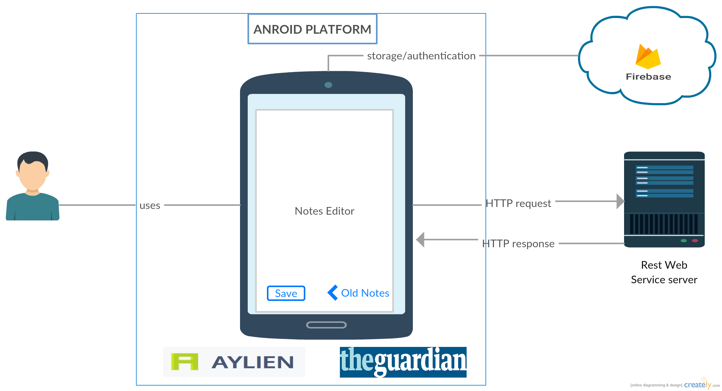
Architecture
Firebase Storage
Guardian NEWS API
ANDROID Platform
AYLIEN TEXT ANALYSIS API

Slide 3
FUTURE SCOPE
Pushing notifications to users on receiving updated news related to THE content
ADDING RESEARCH PAPER Recommendations
BOOKMARKING CONTENT FOR USER’S FUTURE REFERENCE

