Slide 1
Toasts in Android

Slide 2
Toasts
In this Video, I’m going to develop an Android application using Toasts.
Toasts are simple popups that contain a quick little message.

Slide 3
App Development
First create a simple toast with a message.
1
Let’s create an advanced toast with both image and message.
2

Slide 4
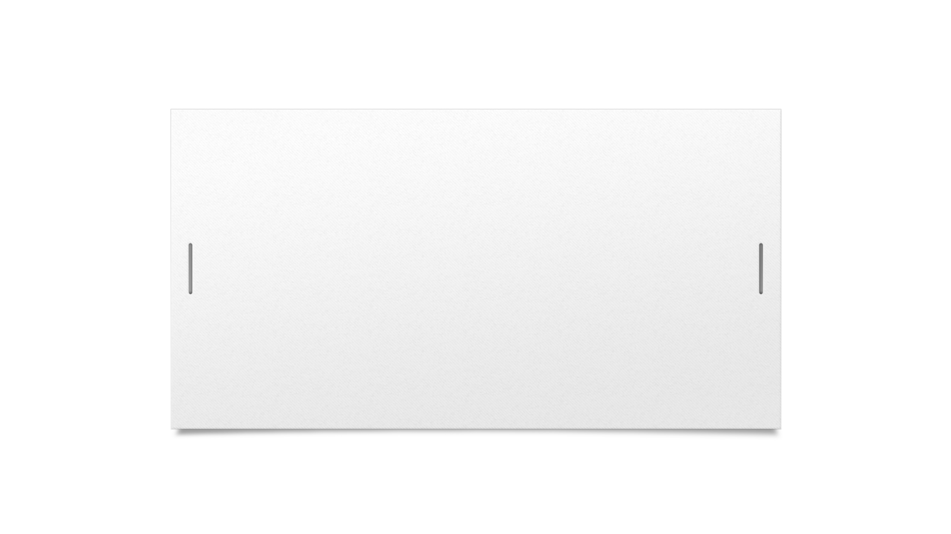

Thanks for Watching Plzz Like and subscribe

