Slide 1
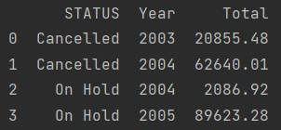
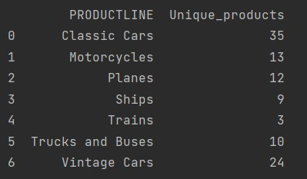
Data Flow
Initially, the data sets are loaded, Normalized and converted to pandas dataframe.
Data Quality checks are done on each dataset. Then all datasets are merged as one dataset.
Then Discount is calculated using merged file and results are saved in Discount.csv file.
Count of Unique Products in ‘PRODUCTLINE‘ is calculated using merged file and results are stored in Unique_products.csv
From merged dataframe Year,Month & Date is extracted & new dataframe is created ‘df_with_Date_Time’
‘df_with_Date_Time’ is saved into partitions based on Date column in parquet format into Sales_data folder
Then Total value of Cancelled orders or orders on hold calculated segmented by year is calculated and results are stored in ‘Total_value.csv’
Lastly, count of classic cars is calculated on monthly and yearly basis. Monthly count output is saved in
Classic_cars_price_month.csv and yearly count in Classic_cars_price_year.csv
Total Value of cancelled and On-hold orders
Number of Unique products in each product line

Slide 2
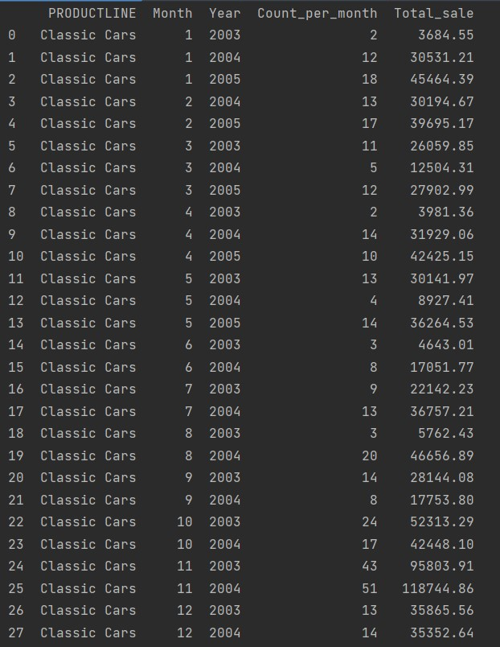
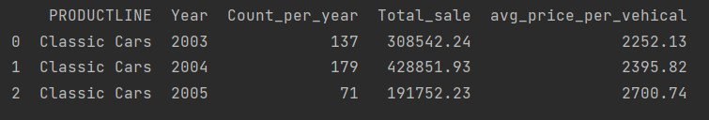
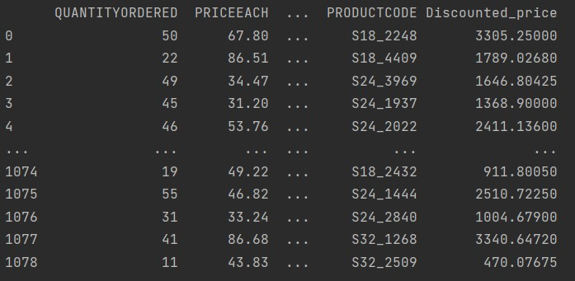
Count of classic car per year, total sales & average price of vehicle each year
Count of classic car per month per year and total sales
Discounted percent for each vehicle

