Slide 1
Scripts in a Frame: A Two-Tiered Approach for Archiving Deferred Representations
By: Dr. Justin F. Brunelle
Presented by Girish Kathireddy

Slide 2
Topics Covered
Introduction
Background
Related work
Understanding the challenges of archiving JavaScript
Measuring JavaScript in the archives
Measuring archive quality
A two-tiered approach for crawling deferred representations
Future work
Framework
Answers Research Question 1
Answers Research Question 2
Answers Research Question 3

Slide 3
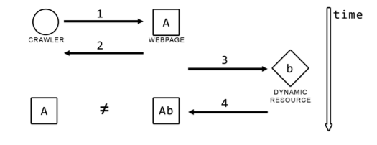
Deferred Representations
user interaction
client-side events
Tools stop here

Slide 4
Crawls
Heritrix
PhantomJs

Slide 5
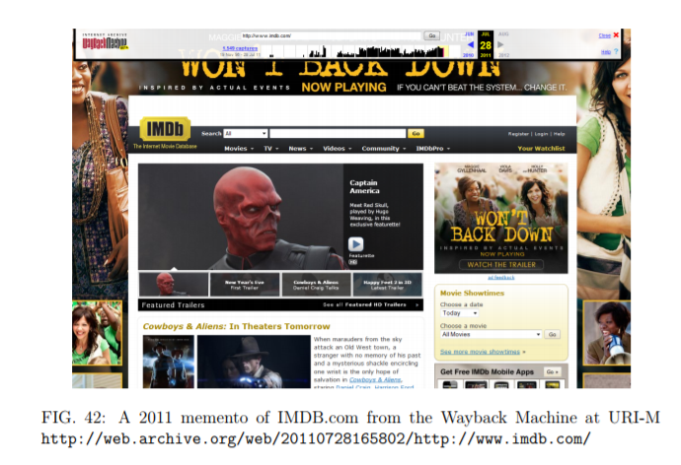
ZOMBIES
Momento (2011)
2012

Slide 6
Research Questions
To what extent does JavaScript impact archival tools?
How do we measure memento quality?
How can we crawl, archive, and play back deferred representations?

Slide 7
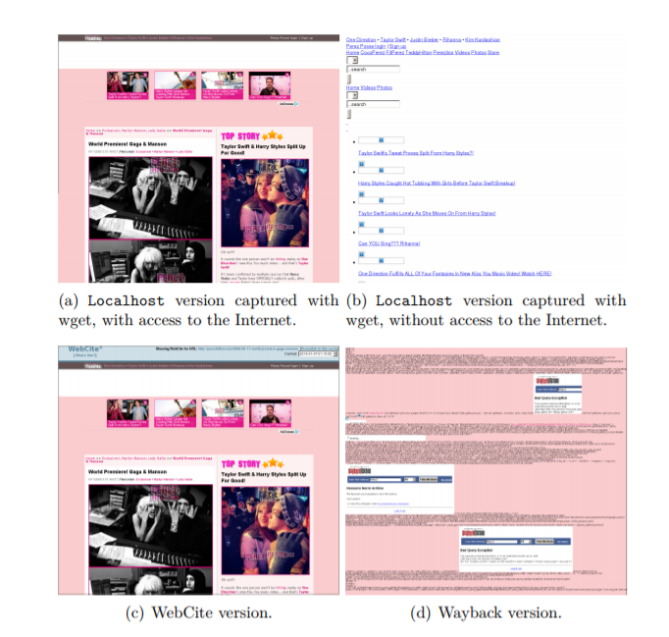
To what extent does JavaScript impact archival tools?
Measure the Impact of Javascript

Slide 8
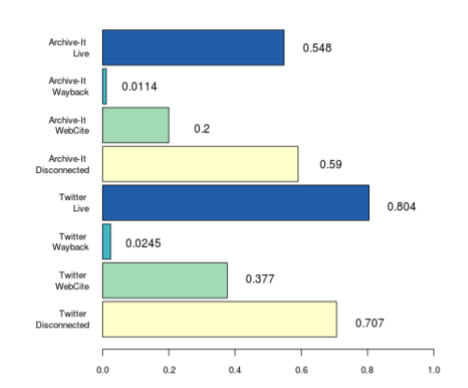
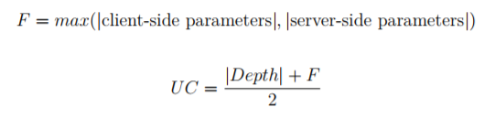


Experiment Design
1000 URIs from Twitter
1000 URIs from Archive-it
Uri complexity
Content complexity

Slide 9
Experiment Results
Measures | Twitter URI | Archive-It
URI Complexity | 0.377 | 0.166
Content complexity | 4.78 | 2.16
Response Codes | 38.2% more HTTP non-200 response | 30.9% HTTP 200 response codes
Perfectly archived | 4.2% | 34.2%

Slide 10
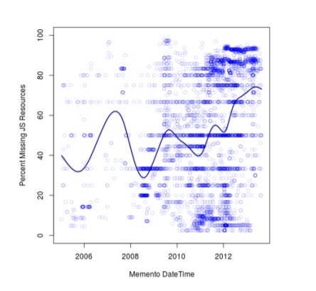
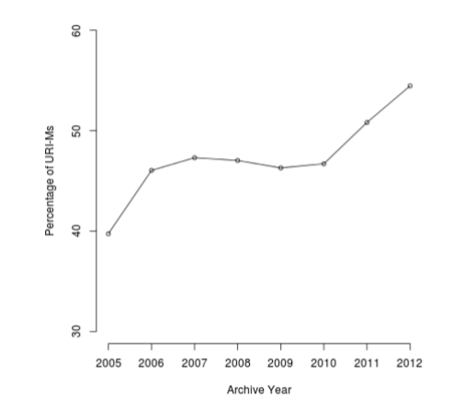

Slide 11
From 2005-2012
JavaScript is responsible for 52.7% of all missing embedded resources
33.2% more missing resources in 2012 than in 2005
JavaScript negatively impacts the archives

Slide 12
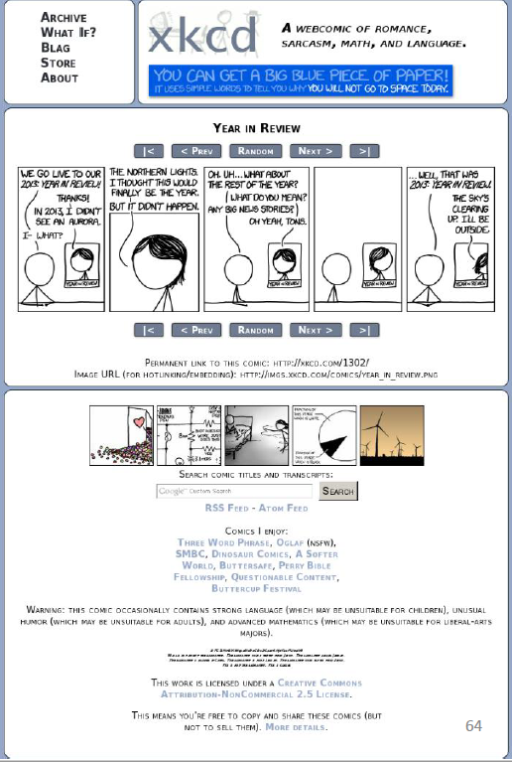
How do we measure memento quality?

Slide 13
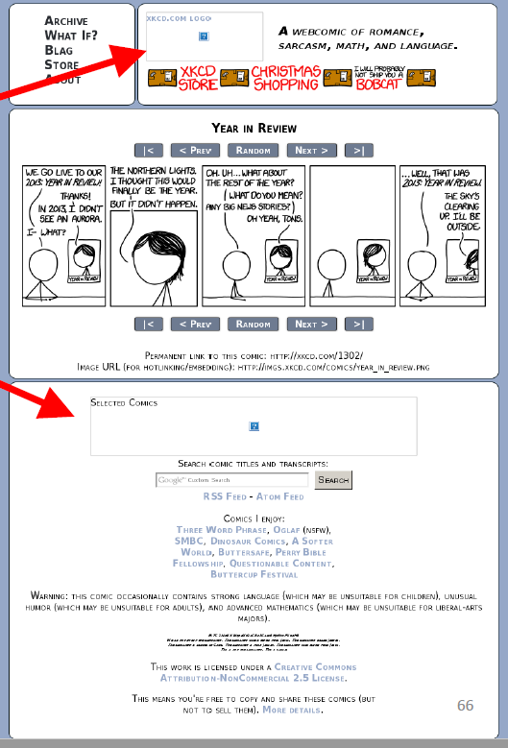
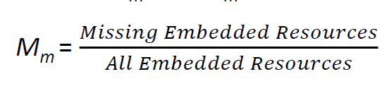
M_{m =0.29}

Slide 14
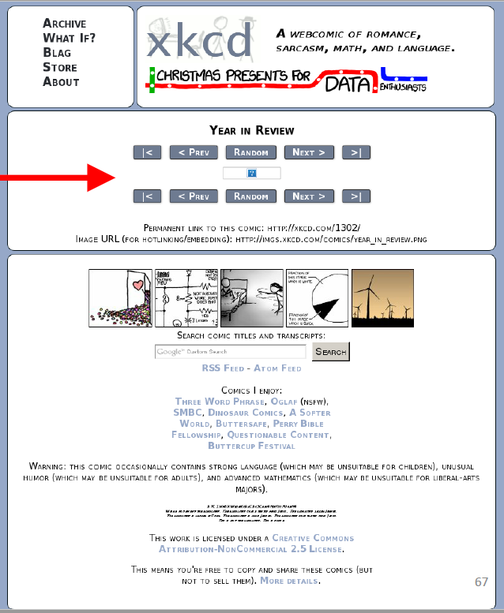
M_{m = 0.24}

Slide 15

D_{m}
Position
Image (Size, Position)
Style Sheet
Multimedia

Slide 16
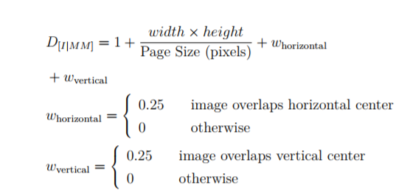
Image damage calculation

Slide 17
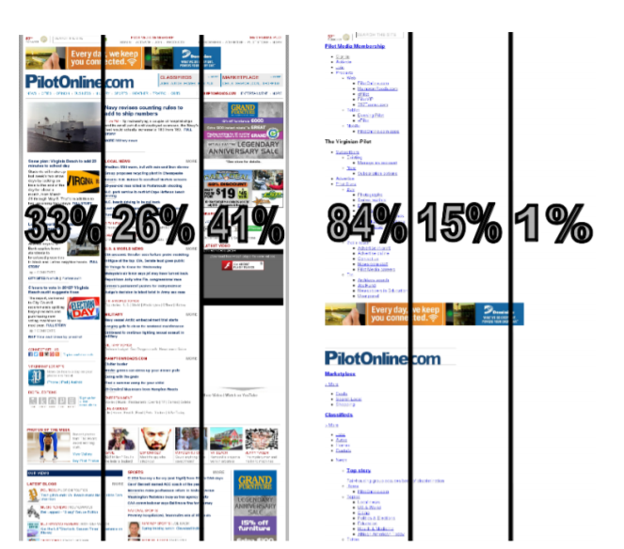
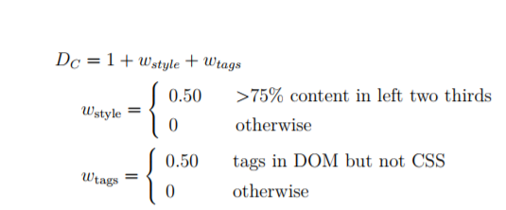
Style sheet damage calculation

Slide 18
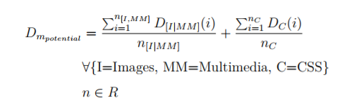
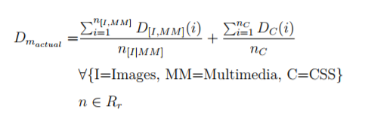
D_{m}

Slide 19
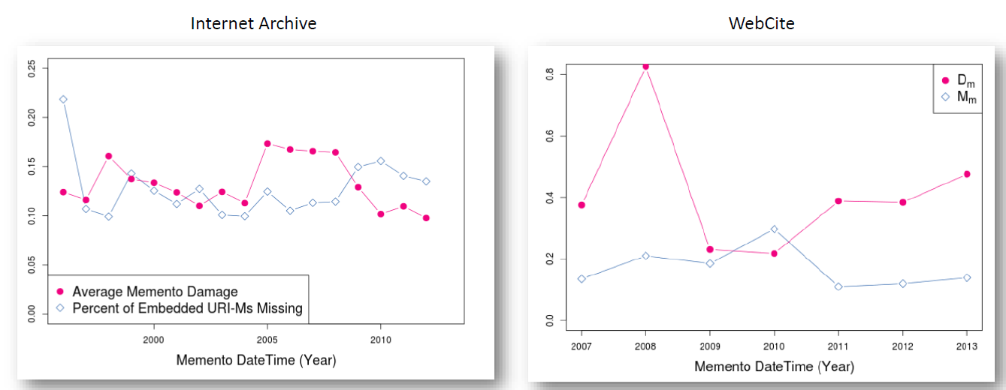

Slide 20
How can we crawl, archive, and play back deferred representations?

Slide 21
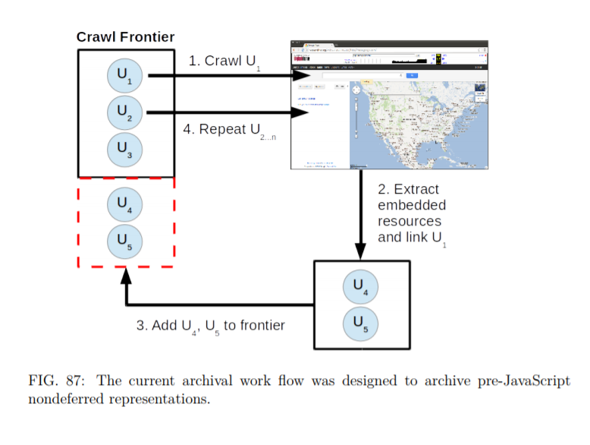
Current Work Flow

Slide 22
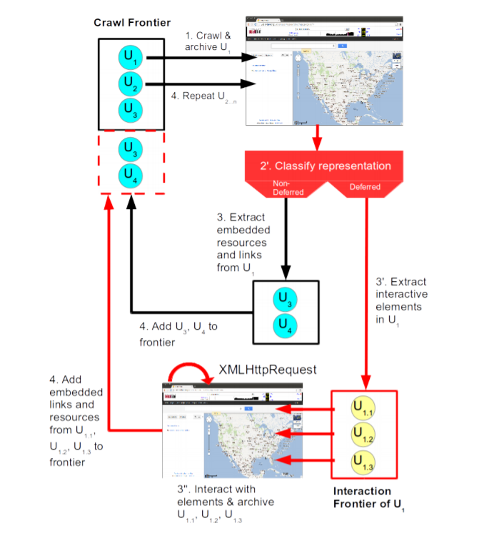
Two-tiered crawling approach
Data Mining Techniques
Descendants : FSM

Slide 23
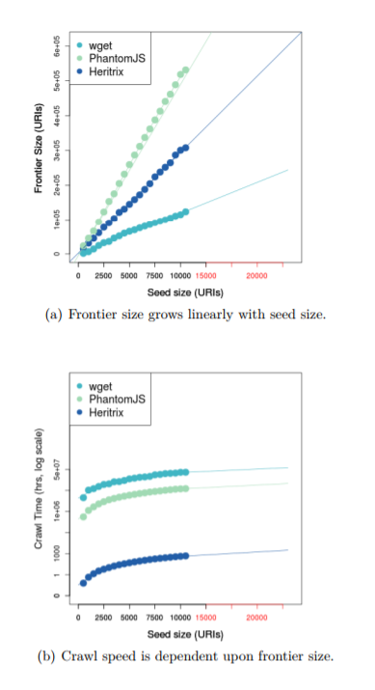
PhantomJS discovers more embedded resources
Heritrix is faster

Slide 24
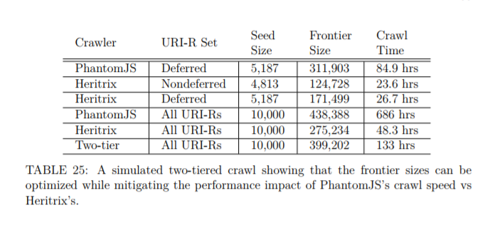
Experiment
10000 URI
Faster by 5.2 times ( PhantomJS)
Slower by 2.7 times (Heritrix)
Frontier Size :1.8 times larger (Heritrix)

Slide 25
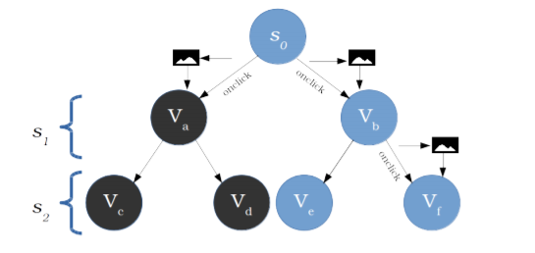
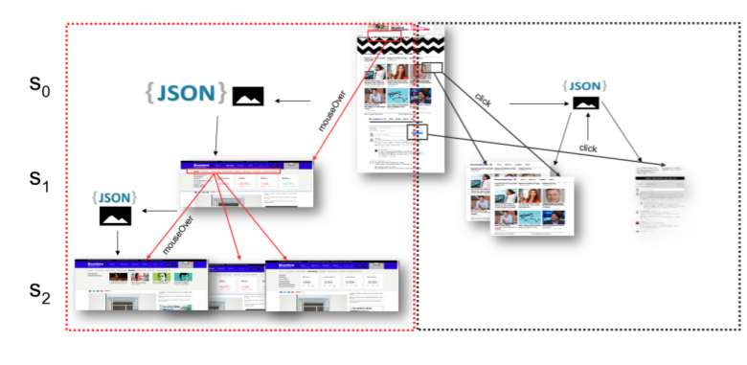
Identifying Descendants
Interaction Trees are 2 Levels Deep

Slide 26
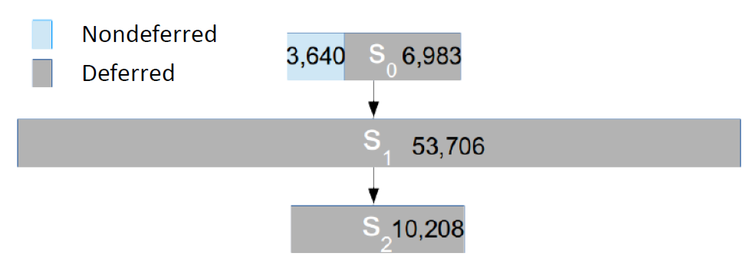

Slide 27
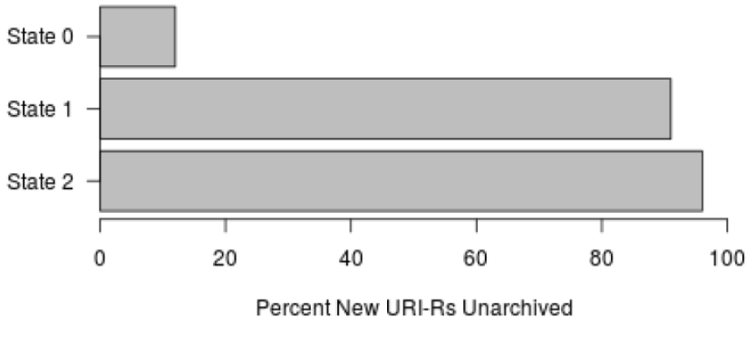
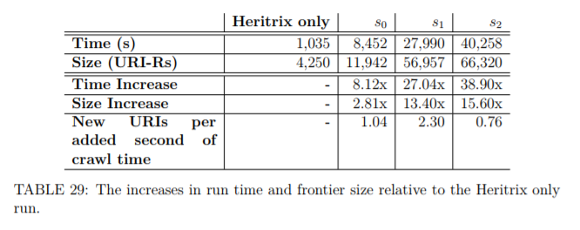
Archival coverage
High benefits from S1

Slide 28
Storage Impact
11.4 times larger for deferred vs nondeferred
Totals 5.12 times more storage per URI-R for total dataset

Slide 29
Future work
Modeling User Interactions
Halting problem
Random walks through the archives

