Slide 1
Quantifying and Reducing Execution Variance in STM via Model Driven Commit Optimization
Girish Mururu
Ada Gavrilovska
Santosh Pande

Slide 2
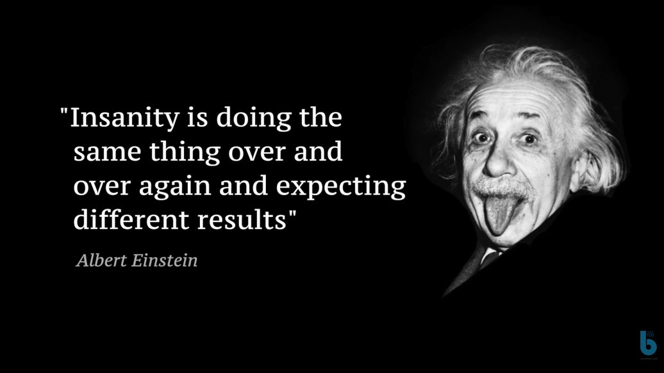

Slide 3

Computers can do the same thing over and over again emitting different results
Are computers sane or Insane?

Slide 4
Are Computers Sane or Insane ?
Computers are Non-deterministic regardless of being used to do sane or insane things

Slide 5
Non-determinism
Variant behavior exhibited during repeated execution with same input
Different sources
Architecture, OS, runtime

Slide 6
Non-determinism
Optimizing Non-determinism
Debugging
Robustness
Repeatability

Slide 7
Execution Time Variance
Execution time varies across runs due to non-determinism
In sequential programs, execution timings vary due to:
co-executing programs
context switches
Architectural causes
Branches, cache misses, TLB misses

Slide 8
Execution Time Variance in Parallel Programs
Threads in parallel programs experience
interference
resource sharing
scheduling decisions
Parallel Programs experience more non-determinism and timing variance

Slide 9
Soft-real Time Apps
Expect loose bound on timing variance
For smooth user experience - bounds on
Frame rates (lower)
Jitters (higher )
Example - Games, Multimedia

Slide 10
Transactional Memory
Soft real-time Apps can be developed using TMs
A clean abstraction for parallel programming
HTM, STM, HybridTM
Additional complexities with locks is avoided
Deadlocks, livelocks, lock convoying, priority inversion
Speculative execution increases variance

Slide 11
Software Transactional Memory (STM)
A transaction is committed only after validation
Invalid transactions are aborted and retried
Aborts are unbounded
Aborts add to non-determinism

Slide 12
Software Transactional Memory (STM)
Unbounded non-determinism unlike lock based programs
Non-determinism adds to variance in execution time
31% variance in frame rate processing in Syn-Quake, a STM version of Quake3 game

Slide 13
Solution - approach
Bounding the collective number of aborts of a given thread
prioritizes a thread – loses speculation and fairness
Prior work
Irrevocable transactions - no rollbacks
For handling I/O
Deadline aware scheduling for STM
Meets deadline of certain transactions

Slide 14
Solution - approach
A global solution to minimize the execution variances across all concurrent threads
More complex than bounded aborts
Context sensitive solution
More context data -> performance degrades
Less data -> does not work

Slide 15
Solution
Model based on a probabilistic automaton
Capture the state of concurrency of threads
Determine the most common commit paths emanating from that state

Slide 16
Definitions
Thread Transactional State (TSS): tuple of thread IDs and transaction IDs of aborts and commits e.g. <a1b2c3>,<d4>
Thread-State Automaton: a finite automaton of TSSs
Transition Probability: TSA edge transition
Non-determinism: number of TSSs

Slide 17
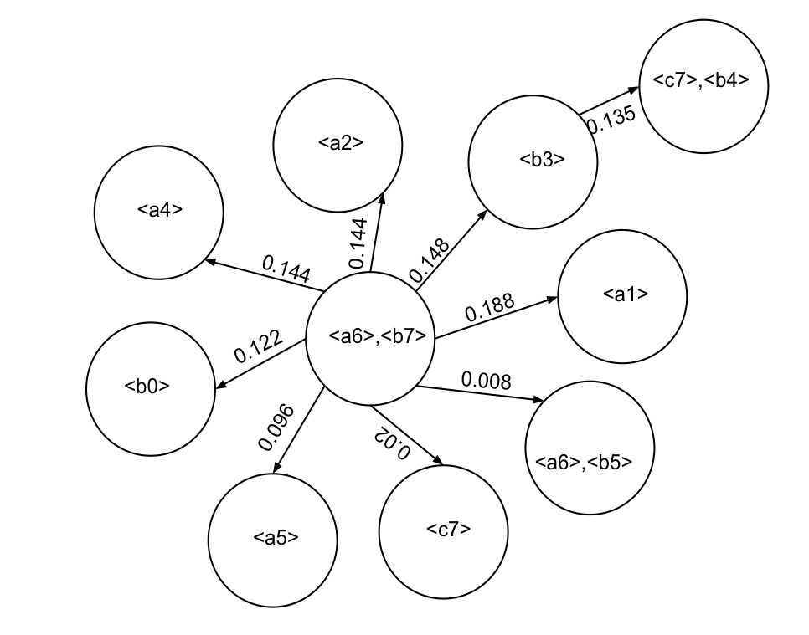
State Model
Excerpt from kmeans model
Stochastic automata
Transition probability - frequency of a transition
Transition function - input current state

Slide 18
State Model
<c7>,<b4>
0.135
<a2>
<b3>
0.148
0.144
<a4>
0.188
<a1>
0.144
<a6>,<b7>
0.122
0.008
0.096
<a6>,<b5>
<b0>
0.02
<a5>
<c7>

Slide 19
Framework
Training
Input
Profile Execution
Transaction Sequence
Model Generation
Model
Model Analysis
Non-Optimizable
Stop
Model
Test
Input
Guided Execution
Less Variant Execution
Out

Slide 20
Model Analysis
Generate a metric over such possible transitions
Traverse the possible transitions from each state
Difference between guided and unguided execution

Slide 21
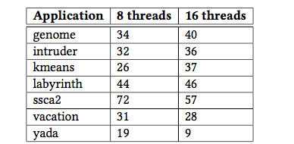
Model Analysis
For each state
Lower the better

Slide 22
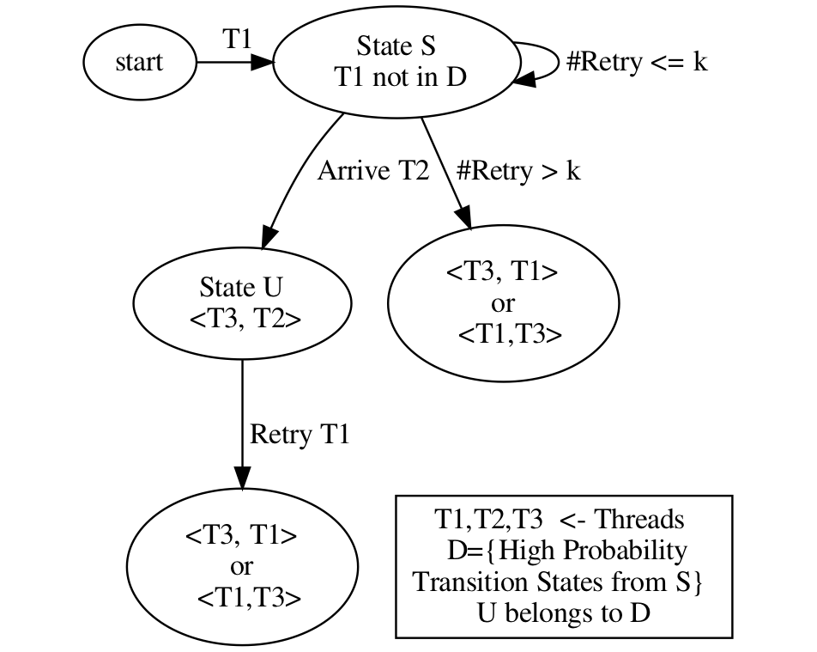
Guided Execution
Reduces the number of possible transitions before commit
Reduces the number of new states formed during execution
Holds back the thread with low transition probability

Slide 23
Experiments
STAMP benchmark suite with TL2
8 core and 16 core intel machines
Threshold transition = P/4, in which P = highest probability of a transition
Dedicated core for each thread
Bitwise storage of model within a state indexed hash-table

Slide 24
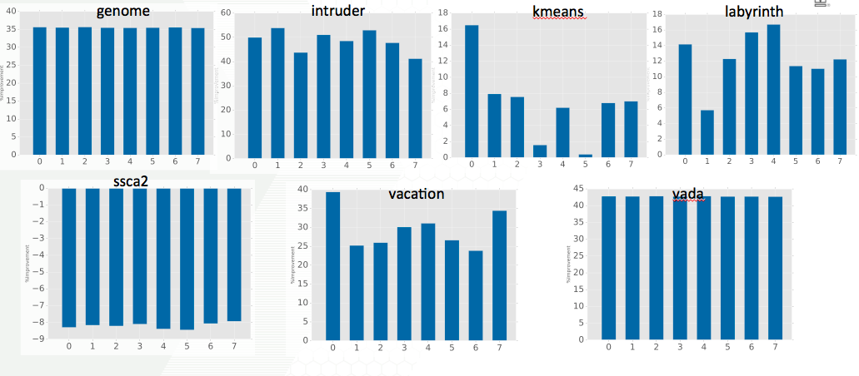
Execution Time Variance (8 threads)

Slide 25
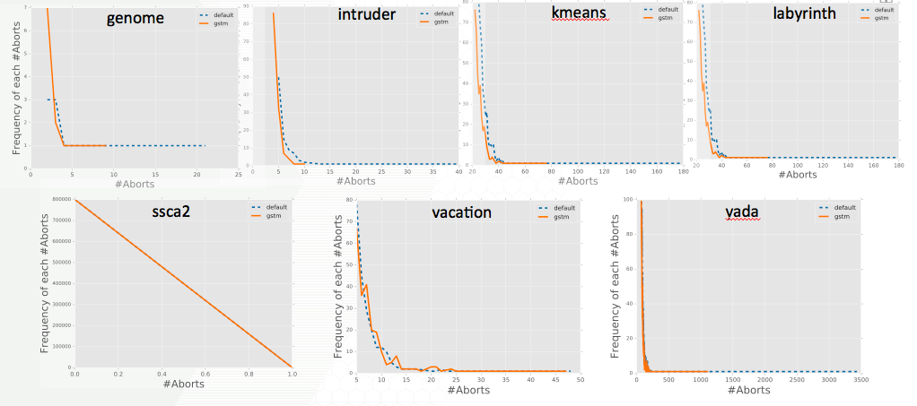
Tail of Abort Distribution (8 threads)

Slide 26
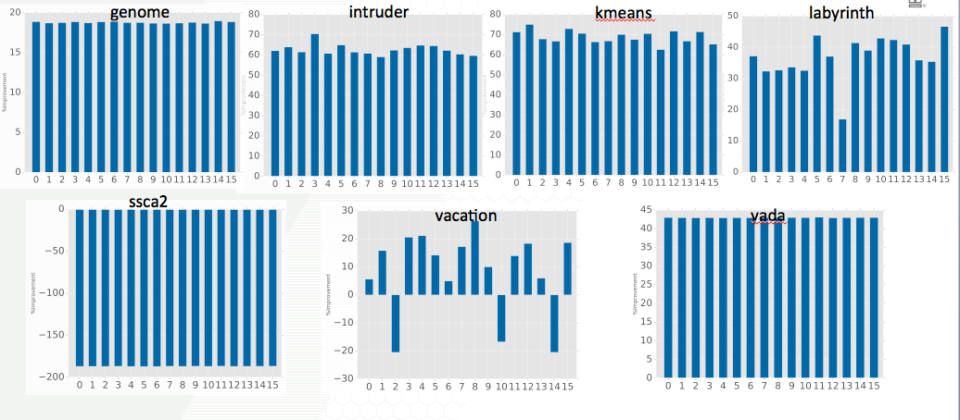
Execution Time Variance (16 threads)

Slide 27
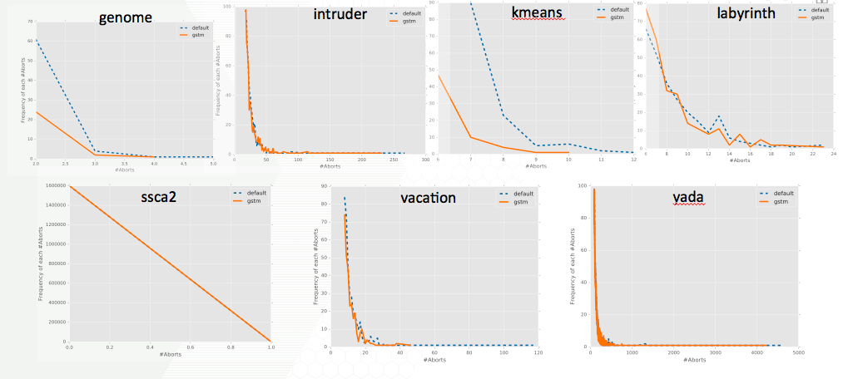
Tail of Abort Distribution (16 threads)

Slide 28
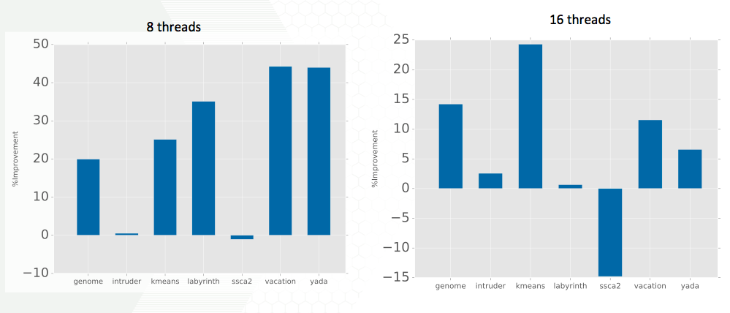
Reduction in Non-determinism

Slide 29
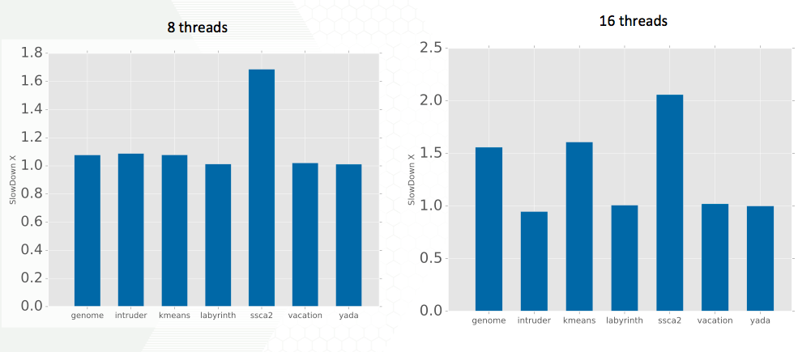
Timing Performance

Slide 30
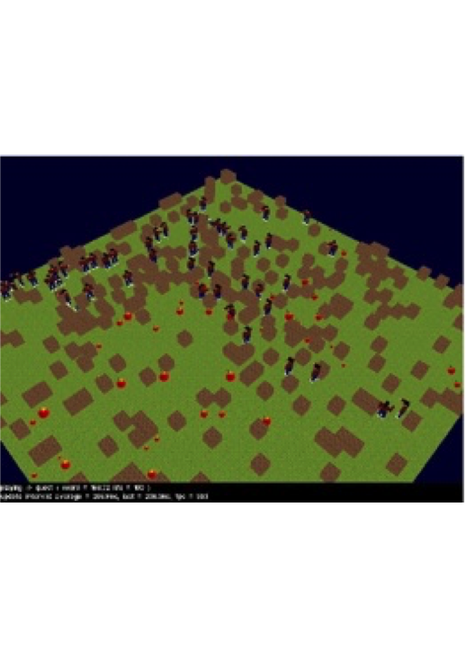
SynQuake - STM version of Quake3
SynQuake: a 2D version of the real world Quake 3 multiplayer game
SynQuake employs a fine grained consistency at object level
SynQuake is faster than lock-based version of the game and is also scalable

Slide 31
LibTM in SynQuake
LibTM: an object based STM
4 conflict detection mechanisms (Fully Pessimistic to Fully optimistic)
2 conflict resolution mechanisms ( wait-for-readers, abort readers)
SynQuake uses fully optimistic conflict detection and abort-readers conflict resolution mechanisms

Slide 32
SynQuake Inputs
Quests are specific areas in the map that attracts players thus simulating:
A high interest area in the game play
Associated different player movement pattern

Slide 33
SynQuake Experiments
Experiments were conducted with 1000 players
Training input 4worst_case.quest and 4moving.quest
Testing input 4quadrants.quest and 4center_spread6.quest
The training set was selected to have a representative behavior

Slide 34
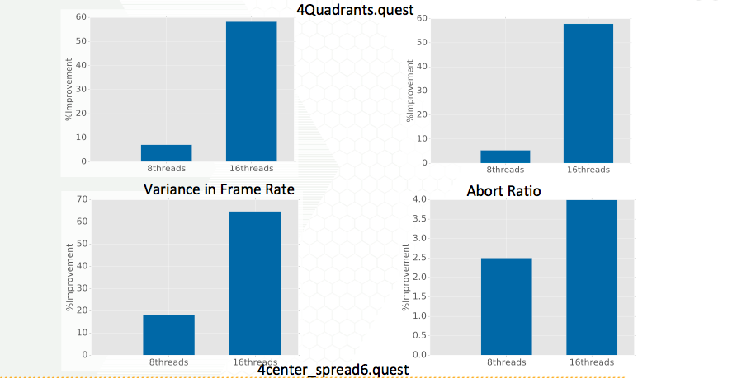
SynQuake Results

Slide 35
SynQuake Execution Time
8 threads
Speedup of 35% for 4Quadrants.quest
Speedup of 10% for 4center_spread6.quest
16 threads
Slowdown of 1% for 4Quadrants.quest
Speedup of 3% for 4center_spread6.quest
Object based STM - no spurious conflicts
Training input captures behavior

Slide 36
Summary
Minimizing execution variance is required as STM gets adopted
GSTM - utility of the model is checked for optimization
Reduction in variance in STAMPS
Up to 74% in 16 cores
Up to 53% in 8 cores
Max slowdown of 1.6x
Reduction in variance frame rate processing in SynQuake without slowdown

Slide 37
Thank You

