Slide 1

Capstone Project
MACHINE LEARNING - REGRESSION
YES BANK STOCK CLOSING PRICE PREDICTION
By
Girish R

Slide 2
Table of Content
Problem Statement
Knowing the data set
Data Wrangling
Data Cleaning
Data Analysis and Visualization
Data Transformation
Model creation
Summary
Conclusion

Slide 3
Problem Statement
Yes Bank is a well-known bank in the Indian financial domain. Since 2018, it has been in the news because of the fraud case involving Rana Kapoor.
Owing to this fact, it was interesting to see how that impacted the stock prices of the company and whether Time series models or any other predictive models can do justice to such situations and to predict the closing values of the stocks.

Slide 4
KNOWING THE DATASET
In this dataset, we have been provided with data which consists of total 5 columns and
185 rows of variables including ‘Date’, ‘Open’, ‘High’, ‘Low’, ‘Close’.
‘Date’ variable provides the time period of data which is dated from month of July 2005 to November 2020.
‘Open’ is the price at which the financial security opens in the market when trading begins.
‘High’ is the highest price at which a stock trades over the course of a trading session.
‘Low’ is the lowest price at which a stock trades over the course of a trading session.
‘Close’ is the last price at which a stock trades during a regular trading session.

Slide 5
Data Wrangling
Data Wrangling was carried out on given dataset which involved the process of cleaning, organizing, structuring, and enriching the raw data to make it more useful for analysis and visualization purposes. During this process we changed the format and data type of date feature into datetime.
Date | Open | High | Low | Close | Date | Open | High | Low | Close
Jul-05 | 13.00 | 14.00 | 11.25 | 12.46 | 2005-07-01 | 13.00 | 14.00 | 11.25 | 12.46
Aug-05 | 12.58 | 14.88 | 12.55 | 13.42 | 2005-08-01 | 12.58 | 14.88 | 12.55 | 13.42
Sep-05 | 13.48 | 14.87 | 12.27 | 13.30 | 2005-09-01 | 13.48 | 14.87 | 12.27 | 13.30
Oct-05 | 13.20 | 14.47 | 12.40 | 12.99 | 2005-10-01 | 13.20 | 14.47 | 12.40 | 12.99
Nov-05 | 13.35 | 13.88 | 12.88 | 13.41 | 2005-11-01 | 13.35 | 13.88 | 12.88 | 13.41

Slide 6
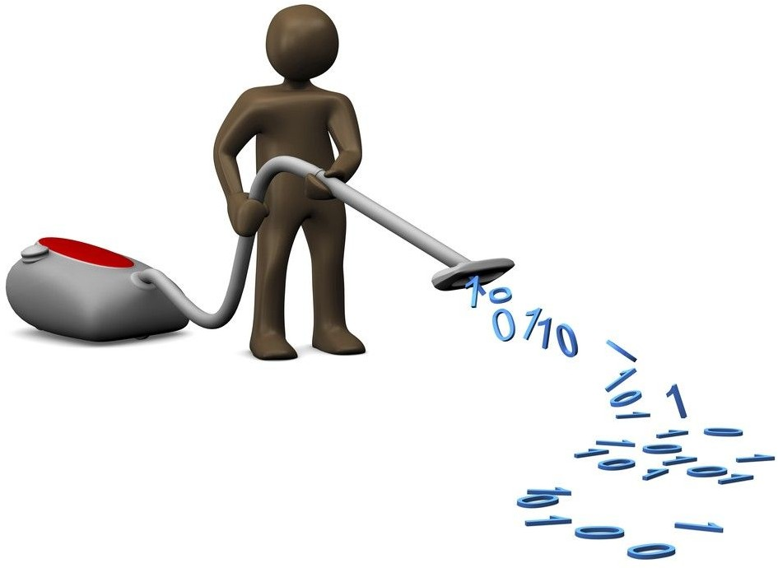
Data Cleaning
We analysed the dataset for duplicate values, null values, missing values and it was observed the the data showed absence of any such data which means that there were no duplicate, missing or null values present in the given dataset.
Date Open High Low Close
0
0
0
0
0

Slide 7
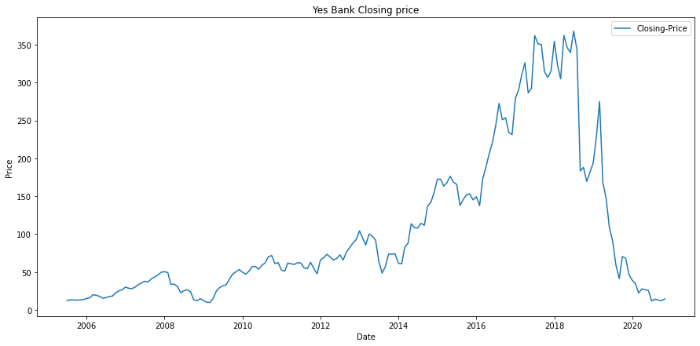
Data Visualization
We can see from the chart that there was a good price increase from July 2005 to 2018 and that there was an uptrend, making it an excellent opportunity to invest. Around July 2005, the price ranged between 5 and 10 rupees, and by 2018, it had risen to a peak of more than 350 rupees.
After the Rana Kapoor scandal, which occurred in 2018, the stock price started to decline and there was a sharp downward trend; in or near 2020, the price returned to its level of roughly 5 to 10 rupees per share from July 2005.

Slide 8
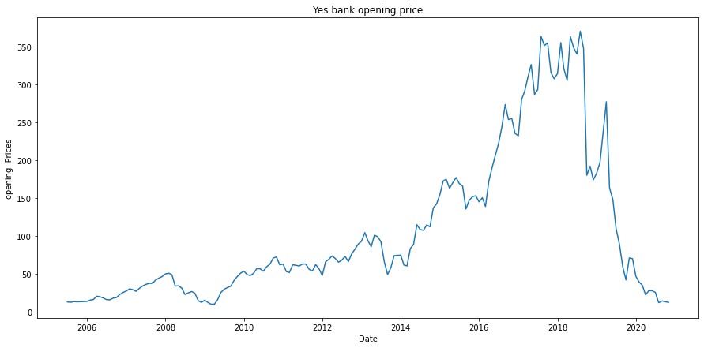
Data Visualization
So, in this graph, we can see that the graph for Yes Bank's opening price and closing price have the same result. The opening price began to rise in 2014 and reached a high in 2018. However, it began to fall steadily after 2018, eventually reaching zero in 2020, the same year as Yes Bank's closing price.

Slide 9
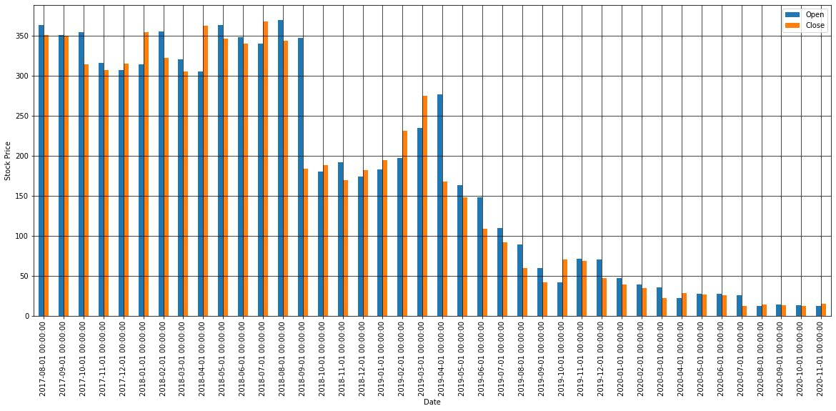
Data Visualization
From the below chart we can understand that 6 times opening price had reached its peak of above 350 Rs in the month of August 2017, September 2017, October 2017, February 2018, May 2018, August 2018.
The closing price reached its peak 4 times of above 350 Rs, in the month of August 2017, January 2018, April 2018, July 2018.
The opening and closing prices were at lowest during these 4 months - August 2020, September 2020, October 2020, November 2020.

Slide 10
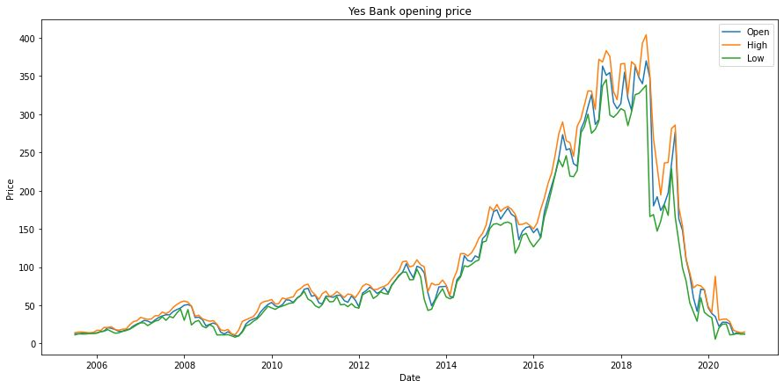
Data Visualization
From the below chart we can see that there was a good price rise from July 2005 till 2018 and it was a good time to invest as there was a up trend. The price between 5 Rs - 10 Rs in around July 2005 and reached a peak price of above 350 Rs in the year 2018.
After Rana Kapoor fraud which was done in 2018 the stock price started to fall and there was a severe down trend, in around 2020 the price reached its July 2005 rate of around 5 Rs - 10 Rs.

Slide 11
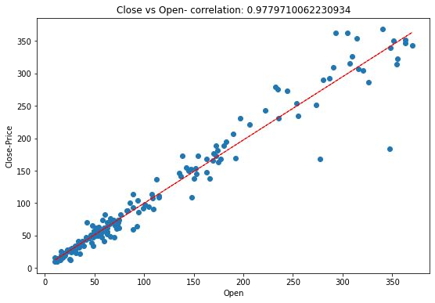
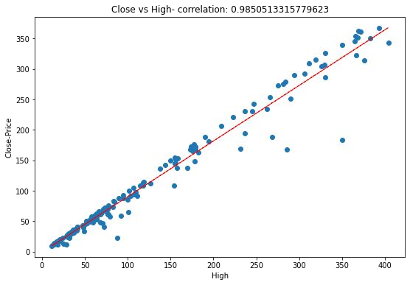

Scatter plot to find correlation between different attributes of given dataset:

Slide 12
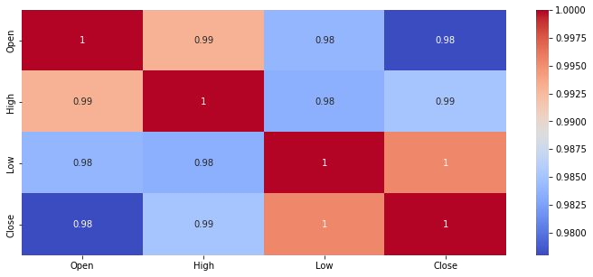
Correlation (Heatmap)
By analysing the heatmap we can say that the relation between low and close is the highest, followed by high and close, and least is open and close.

Slide 13
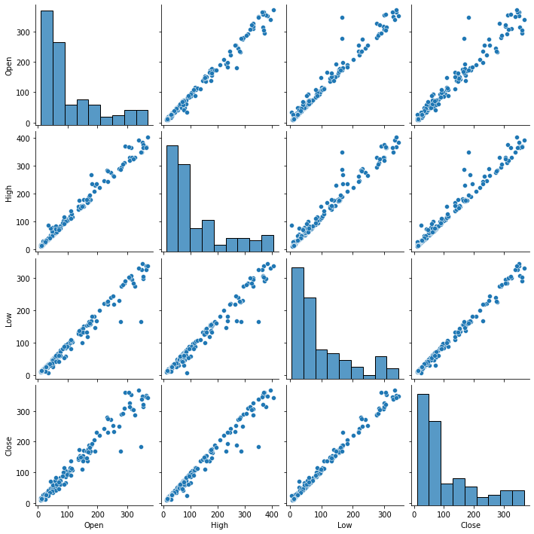
Pair Plot
We can use the Seaborn Pairplot to visualise pairwise relationships between variables in a dataset. This creates a nice visualisation and aids in data comprehension by condensing a large amount of data into a single figure.

Slide 14
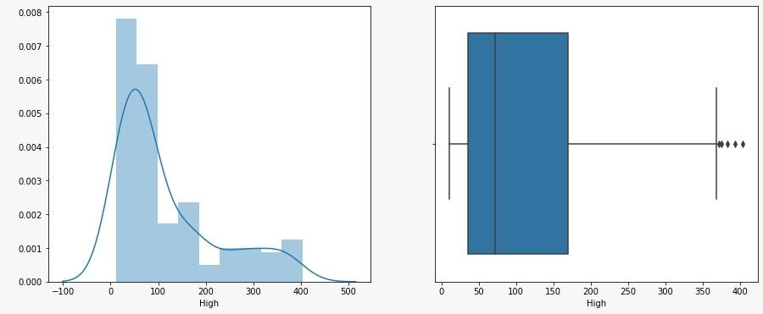
Data Transformation
Data transformation of distribution was carried out using log transformation as the data was moderately right skewed.

Slide 15
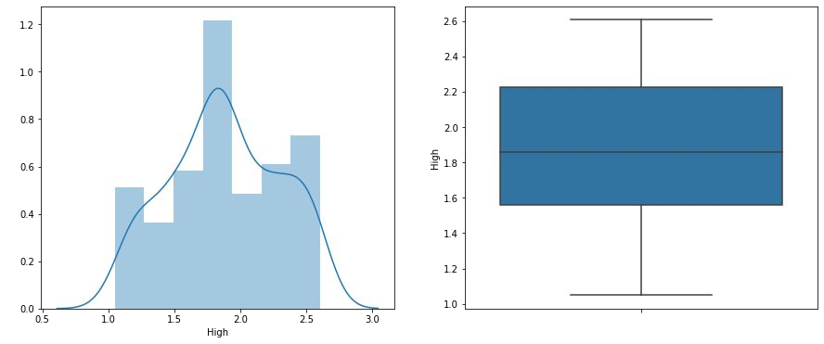
After Transformation
After transformation we can see our all dataset features high,low and open are now normally distributed with no outliers as well and are ready for fitting in our model.

Slide 16
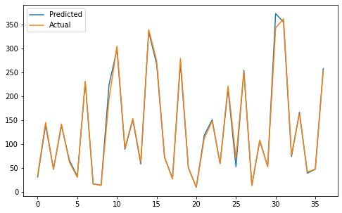
Model Creation
Testing accuracy was determined using three different models of which Linear regression and Ridge regression were more accurate and gave 99% as a result, while Lasso regression showed less accuracy of 67%.

Slide 17

Summary
At first we did the data wrangling followed by data cleaning and data transformation and then the Modeling part.
In EDA part of our dataset we conclude that:
The graphs for Yes BANK opening price and closing price has same result.
Stock's closing price decreased after year 2018 which was mainly because of Rana Kapoor case which hit the stock price badly.
The analysis points out that the stock price of the YES BANK falls down after the year 2018 and it is not beneficial for investors to invest their money.

Slide 18
From scatter plot we can concluded that bivariate analysis shows high correlation of close price with other features.
All histogram plot shows that all are right skewed.
From heatmap we can conclude that all the features showing high correlation between each other. We implemented linear regression and the accuracy of our linear regression model is 99.78%.
For data transformation we used log Transformation because it was moderately right skewed.
After that we visualised the performance of our linear regression model and the graph shows that we achieved the almost best fit model for our dataset.

Slide 19
Conclusion
From the above data analysis we can conclude that the stocks were closing at a high price until the fraud case by Rana Kapoor happened in 2018.
Till then it was a great time period for people to invest in stocks of YES BANK but after that a huge downtrend took place which resulted in decline of the closing prices of the stocks. From our linear regression model and the graph we conclude that it can predict future stock price with almost 99% accuracy.

Slide 20
THANK YOU!!!

