Slide 1
Linear Regression

Slide 2
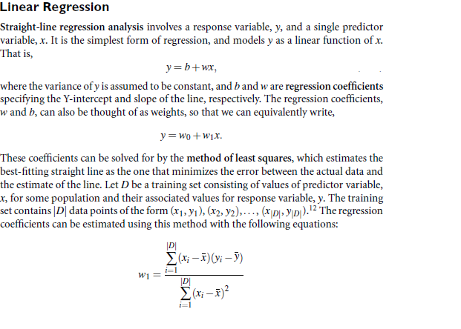
Linear Regression

Slide 3
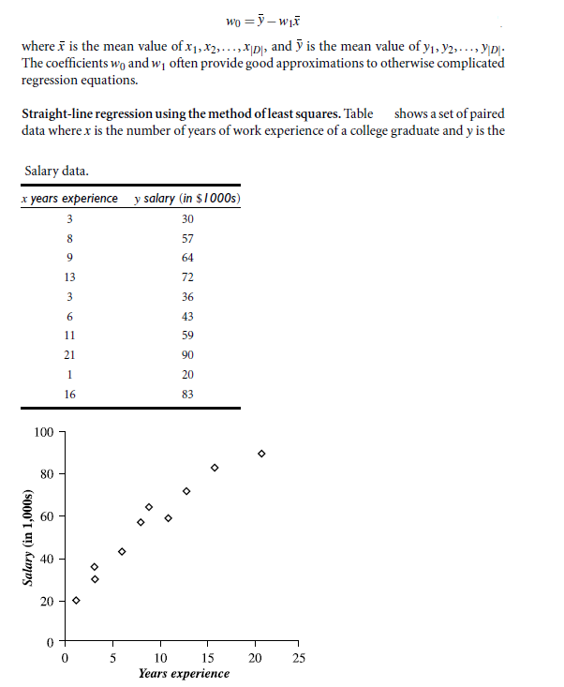
Linear Regression contd.

Slide 4
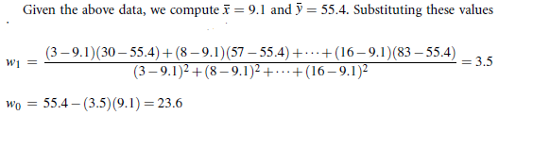
Linear Regression contd.

Slide 5
Grid Search
Grid search constructs, evaluates and stores a model for every possible hyper parameter combination. It then returns the best score for the metric used and also the model built with the hyper parameter combination for which the best score is obtained.
For example if we consider K-Nearest Neighbor Classifier, optimum value for K i.e. number of nearest neighbors to use could be found using grid search. K=list(range(1,25))
p_grid=dict(n_neighbors=K)
grid_search = GridSearchCV(knn, p_grid, cv=5, scoring='accuracy')

