Slide 1
Machine Learning Concepts

Slide 2
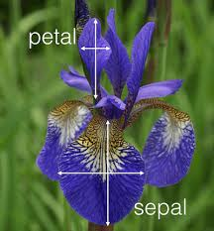
IRIS Dataset – Sepal Length, Width, Petal Length, Width

Slide 3
Normalization
Min-max normalization: to [new_min_{A}, new_max_{A}]
Ex. Let income range $12,000 to $98,000 normalized to [0.0, 1.0]. Then $73,000 is mapped to
Z-score normalization (μ: mean, σ: standard deviation):
Ex. Let μ = 54,000, σ = 16,000. Then
Normalization by decimal scaling
Where j is the smallest integer such that Max(|ν’|) < 1

Slide 4
Backpropagation Algorithm

