Slide 1

GreatMart | Online e-Commerce Platform
Project Presentation
Course Code: CSE378
Presented By
Girish Mondal
Student ID : 17CSE063
Session : 2017-18
Supervised By
Dr. Mrinal Kanti Baowaly
Associate Professor
Department of CSE
Bangabandhu Sheikh Mujibur Rahman Science and Technology University
Thursday, 19th May, 2022

Slide 2
Presentation Outline
Introduction
Motivation
Related Work
Features
Specification and Design
Implementation
User Manuals
Future Work
Conclusion

Slide 3
Introduction
Now we are living in the ocean of science and technology. This is possible for the purposes of programing. The main purpose of this project is to make an e-commerce platform where all the user can buy their daily needs within a second without hustle.
In my web application there will be two different user.
Customer
Admin

Slide 4
Motivation
The motivations comes to me online marketplace because a few months ago I have seen few e-commerce business holders start their business in locally during pandemic that time I decided to start my new project through online.
Online business is awesome for everyone you can buy the product through online and I can sell product through online.

Slide 5
Related Work
Remotely order like an e-commerce Electronic commerce is like of e-commerce. This is not important to denote how website product is selling. Facebook like an e-commerce as I see most of the people are buying their product using Facebook. Like this project there are a lot of project available. There are some projects with different activities in our country. They are
Daraz
Picaboo
Monarch Mart etc.

Slide 6
Features
Registration, Email Verification and Login
Forget Password
User Dashboard
Admin Dashboard
Payment Gateway
Searching Product
Admin Control
Different Products Based on Categories
Showing User about Best Selling Products
Showing User about Top Rated Products

Slide 7
Specification and Design
Software specifications:
Operating System : Windows 7, 8, 10 or Linux
Software : Visual Studio, PyCharm
Technical specifications:
Programming Language : Python, JavaScript
Frontend : HTML, CSS, Bootstrap
Version Control : Git
Framework : Django
Payment Gateway : Paypal Sandbox API
Email Server : Gmail Smtp server
Database : PostgreSQL

Slide 8
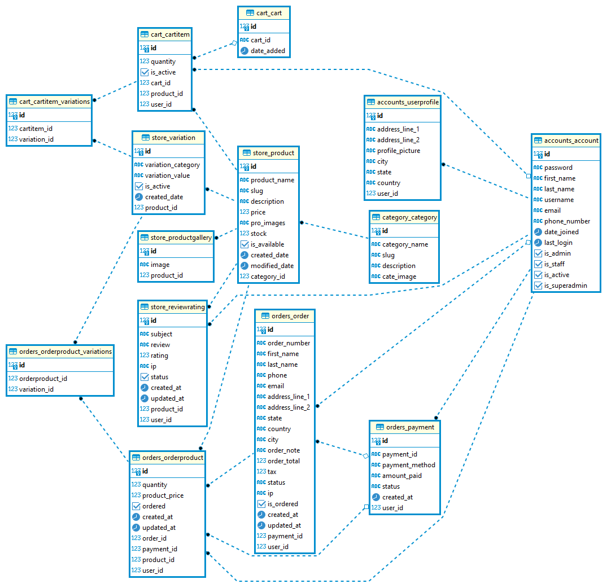
Specification and Design (cont…)
To develop my web application at first I design my database using ER-Diagram and then I design the use case diagram of this project also.
ER- Diagram:

Slide 9
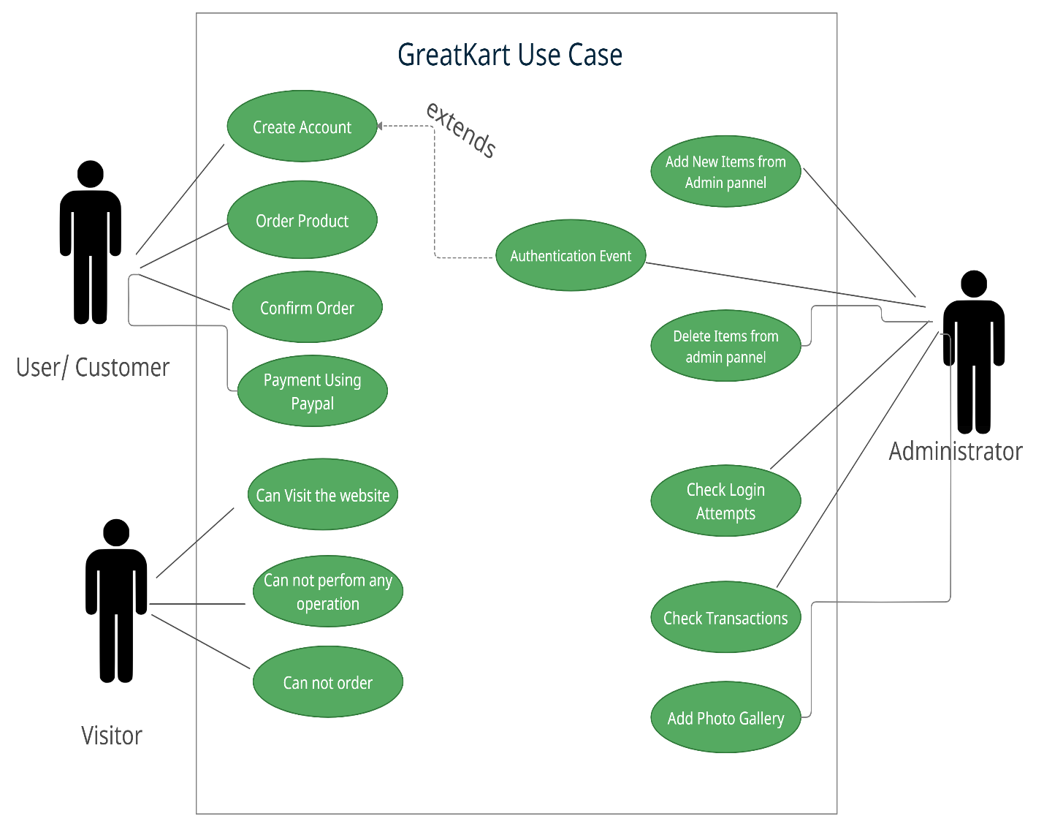
Specification and Design (cont…)
Use case Diagram :

Slide 10
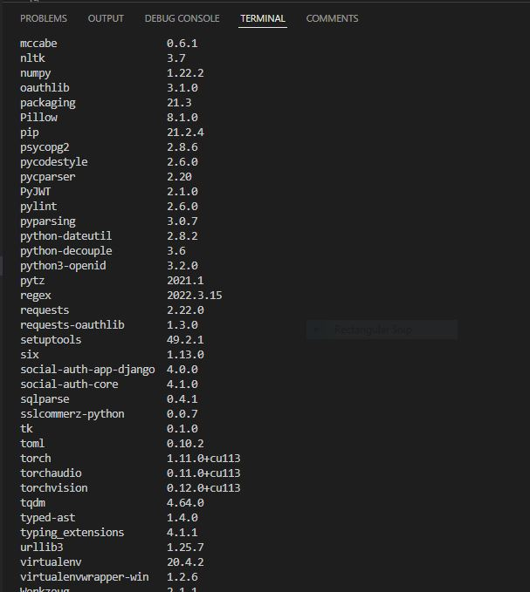
Implementation
Implementing this project is not a very short time project. It is created by python language using Django Framework. It needs some tools to complete this project such as Visual Studio, PyCharm.
The version of python should be higher than 3.7 and Django version should be higher than 3.0. There are some library and packages which needs to be installed.

Slide 11
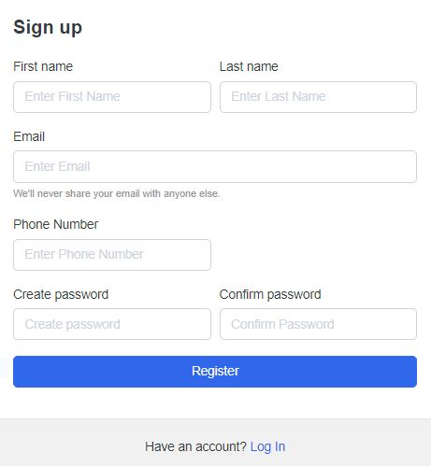
User Manuals
Registration, Email Verification and Login:
Here is the picture of registration form how anyone can register to the website. The user needs to give his/her name, email, phone number and password.

Slide 12
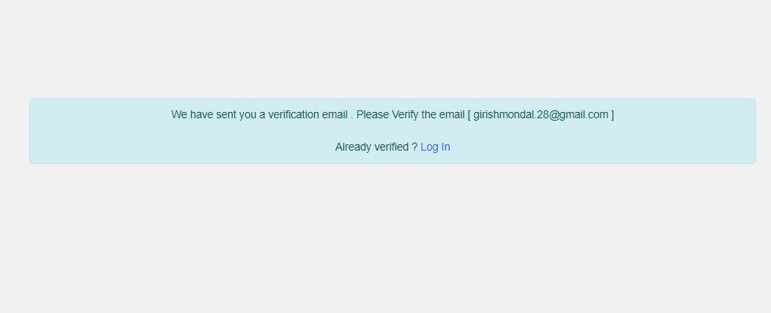
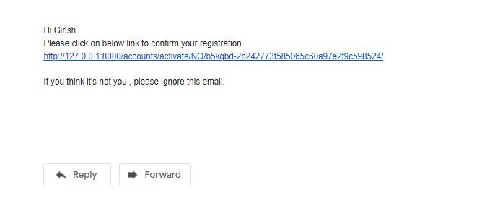
User Manuals (cont…)
Email Verification:
After registration, there will be generated link in users email. The mail looks like this in the picture.

Slide 13
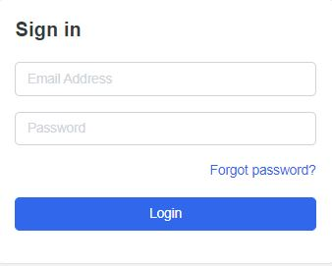
User Manuals (cont…)
Login:
And the login looks like this picture in below. User has to give their mail and password in which they are registered and verified.

Slide 14
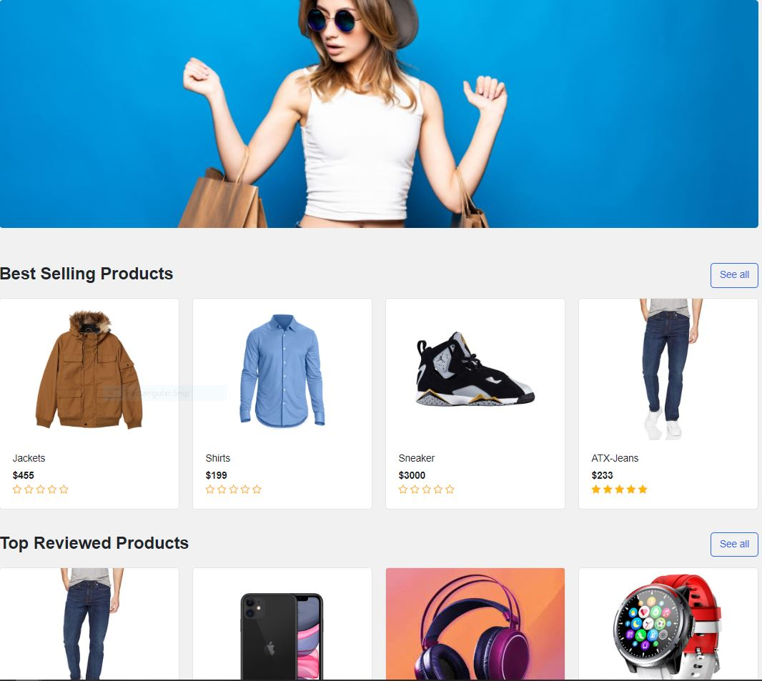
User Manuals (cont…)
Homepage:
After successfully registered and login the user can see the homepage or landing page of the website. Although they can visit the site but can’t order anything.

Slide 15
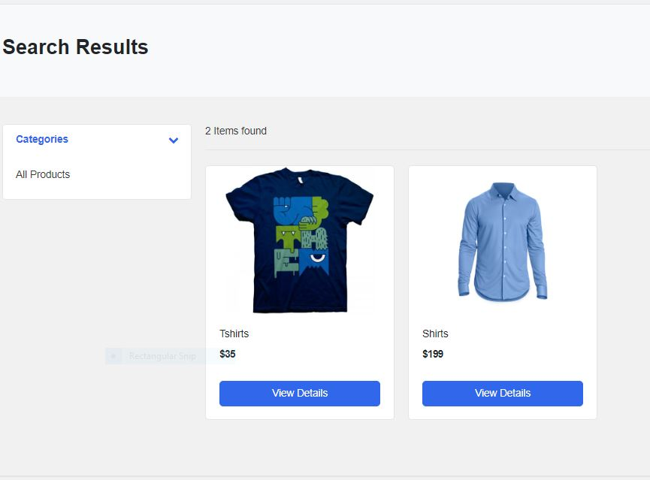
User Manuals (cont…)
Search:
The user can search any product which are available in the database of the site. Here is the example of it.

Slide 16
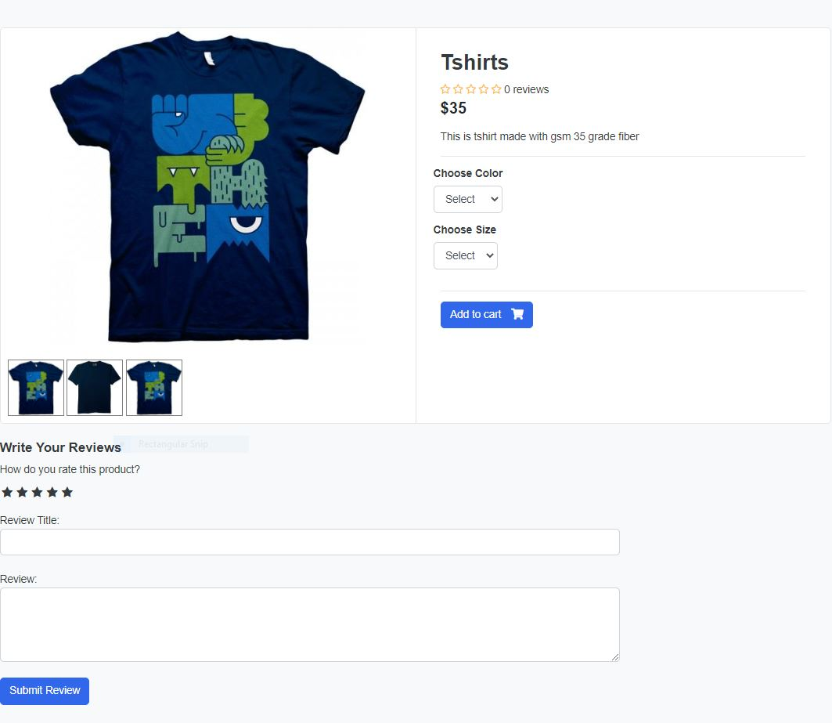
User Manuals (cont…)
Product Details Page:
Here the details of a product are shown like what kind of product it is, what variation it has, what description it has and review and comments of that product.

Slide 17
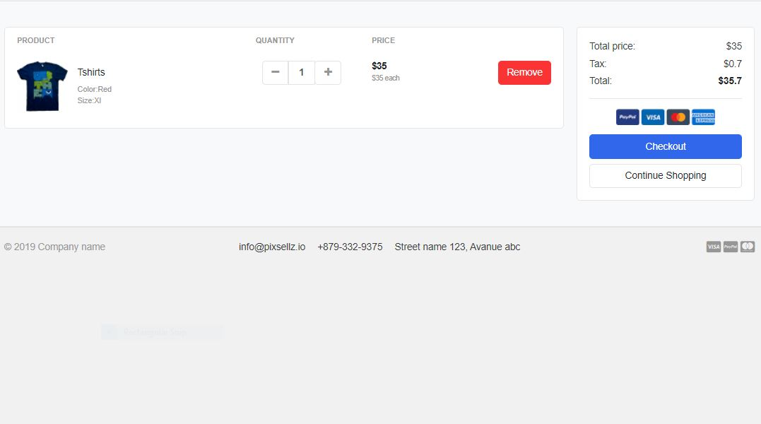
User Manuals (cont…)
Cart Page:
Here all products available which are added by the user. They can go to checkout page through this.

Slide 18
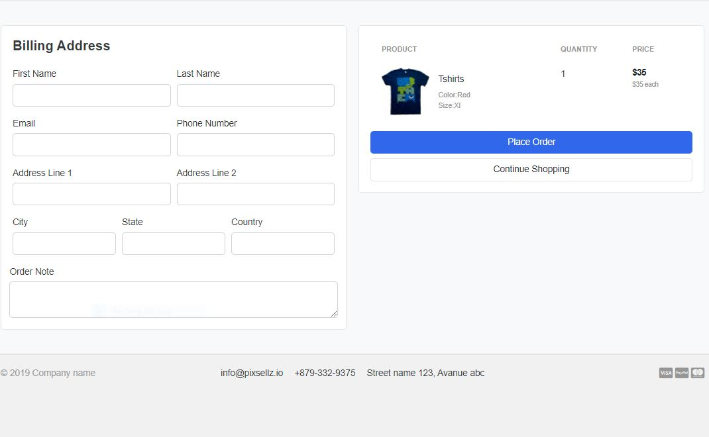
User Manuals (cont…)
Checkout Page:
The user needs to fill up the form to get the payment page.

Slide 19
User Manuals (cont…)
Place Order Page:
The user needs to place the order and make payment. Here is the example

Slide 20
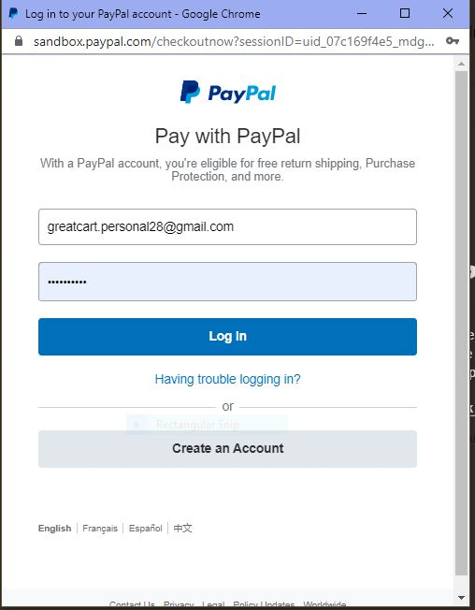
User Manuals (cont…)
Payment Gateway Page:
Here I use paypal sandbox for payment gateway. This is open source and gives developer dummy money to work with.

Slide 21
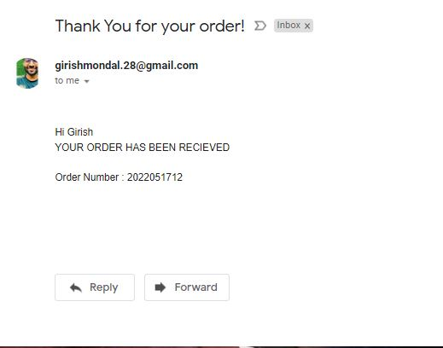
User Manuals (cont…)
Email sent on orders:
An email sent to the users gmail account after successful order. The email looks likes in the picture below.

Slide 22
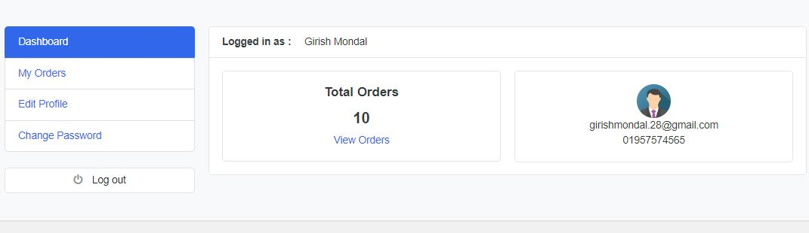
User Manuals (cont…)
User Dashboard:
The user dashboard looks like these in the picture. The user can see how many orders they have, and track them. They can change password from here and modify their information.

Slide 23
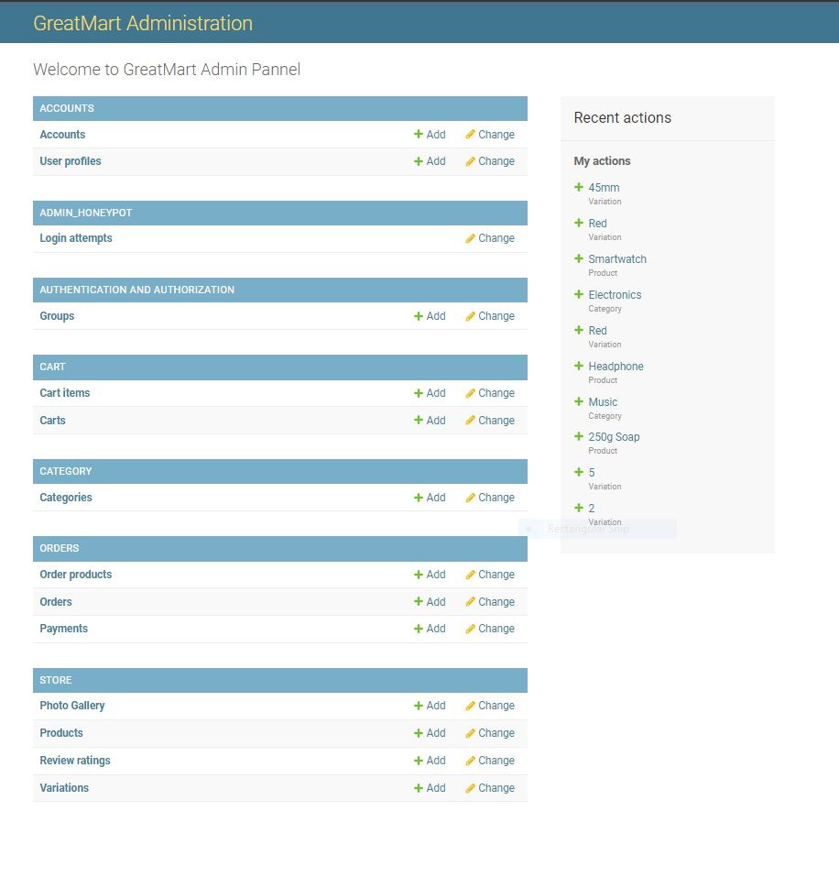
User Manuals (cont…)
Admin Dashboard:
In admin dashboard they can see all the events happening to the website. They can change the events or create events. They can see user profile, they can add products, edit products details, delete them. They can add product gallery.

Slide 24
Future Work
Every project in this world gets its upgraded version. So I thought I would also develop this project in the future. I want to add machine learning and Natural Language Processing to make it more user friendly and more optimized.
I also add a Chatbot for my website for supporting the user in future. I will improve the design of this project because technology gets upgraded day by day. I will also develop a mobile application for this.

Slide 25
Conclusion
E-commerce still represents one of the business methods that take advantage if done the right way, even if the stock market and commodities fell, but E-Commerce still able to survive and receive high transaction. E-commerce has a tremendous opportunity in the course of or business in Bangladesh.

Slide 26
Thank You

