Slide 1
Student Management System
Project Presentation
Presented By
Girish Mondal
Student I’D : 17CSE063
Session : 2017-18

Slide 2
About the project
It is a semester course project .
Course Code : CSE178
Course Title : C++ Project
Supervised By :
Maimuna Begum Kali
Lecturer ,
Dept. of Computer Science & Engineering ,
Bangabandhu Sheikh Mujibur Rahman Science & Technology University , Gopalganj

Slide 3
Introduction
“Student Management System” is a C++ based project . It’s like a simple database . Anyone can add , delete , modify his data in this project. For using it he must to have a basic knowledge about file handling of C++.

Slide 4
Works With
Editor (Code::Blocks)
C plus plus programming language
Referrence websites :-
1. https://www.wikipedia.org
2. https://www.elprocus.com/computer-science- projects-engineering-students/

Slide 5
Features of the project
Index
Add Student
Student List
Edit Information
Search Information
Delete Information

Slide 6
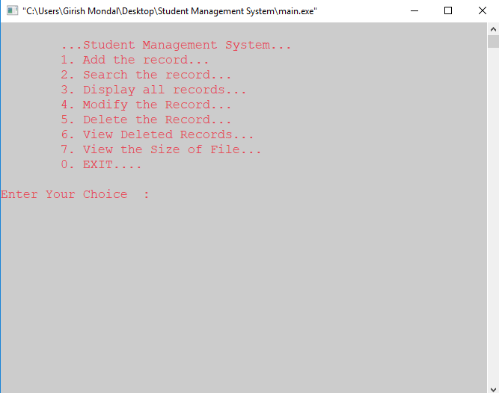
Index page

Slide 7
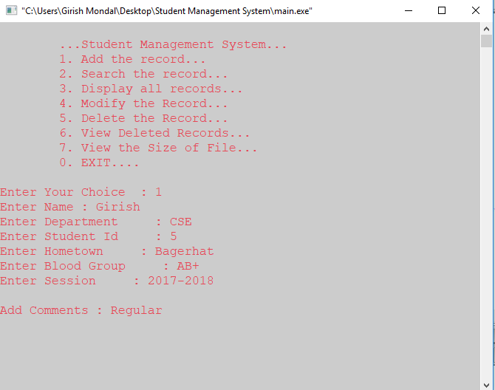
Adding Student’s Information

Slide 8
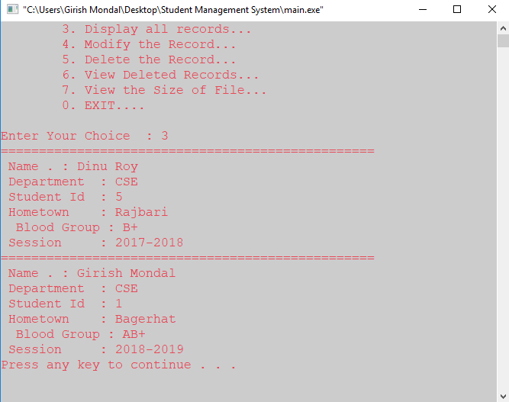
Student’s Information list

Slide 9
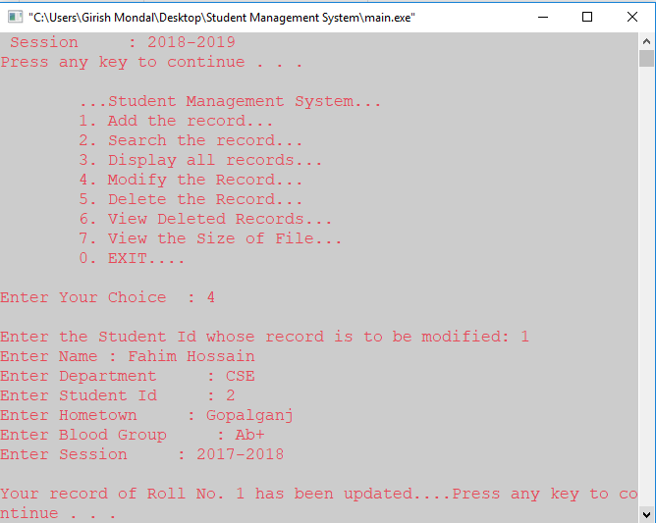
Edit Student’s information

Slide 10
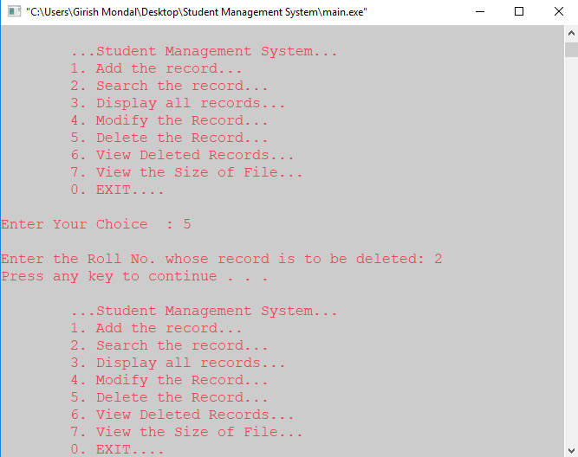
Delete Student’s Information

Slide 11
Limitation
It has some limitations. I think if every topic has some basic ingormation ,it will be better.

Slide 12
Future Plan
There is a system for running code. It will be closed from anywhere.
I will add graphics in future to look it better and I will improve my code to perform well.

Slide 13
Thank you

