Slide 1
WEBREEL

Slide 2
Technology used
Frontend and backend

Slide 3
frontend
Html
Css
Javascript
Bootstrap

Slide 4
backend
Imdb api
Moviename database api
Json
Nodejs

Slide 5
Snaps of website

Slide 6
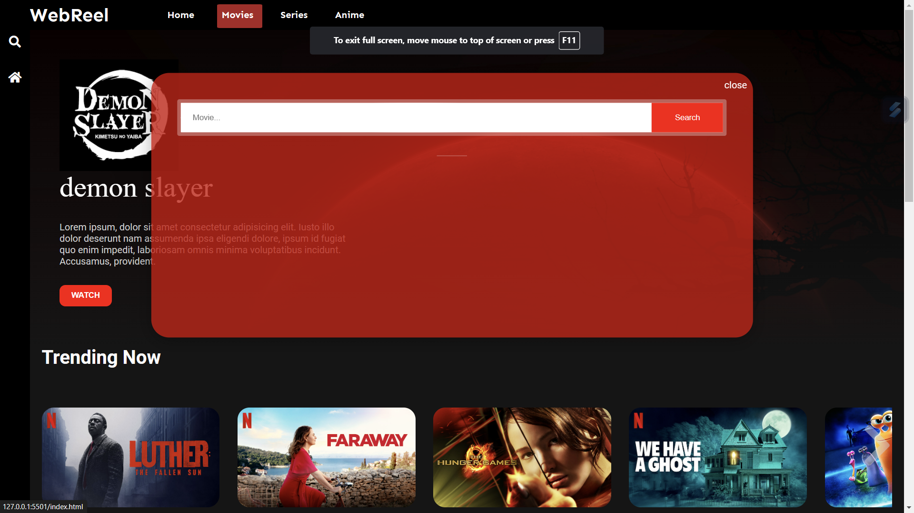

Slide 7
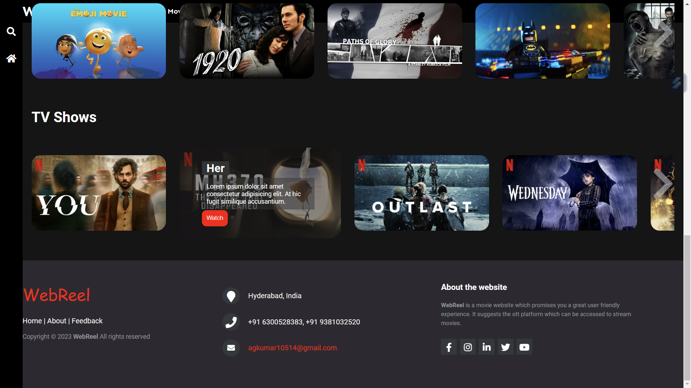

Slide 8
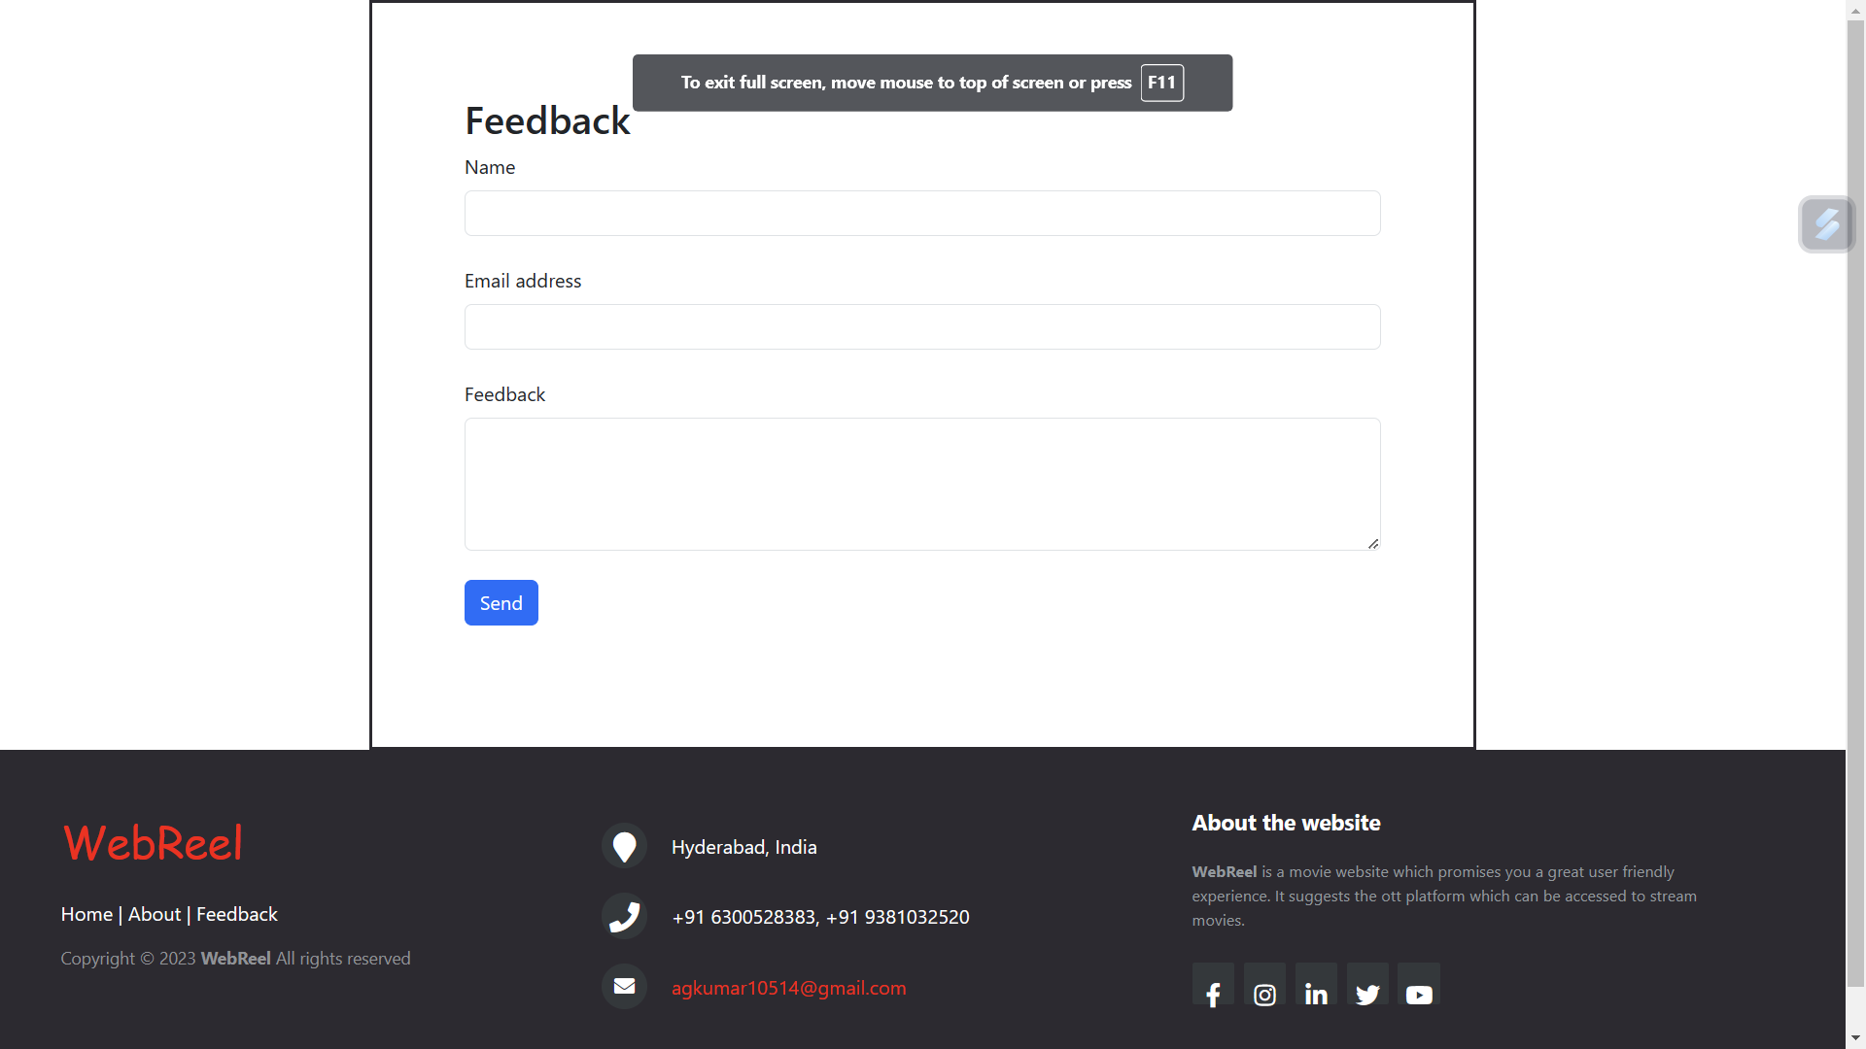

Slide 9
