Slide 1
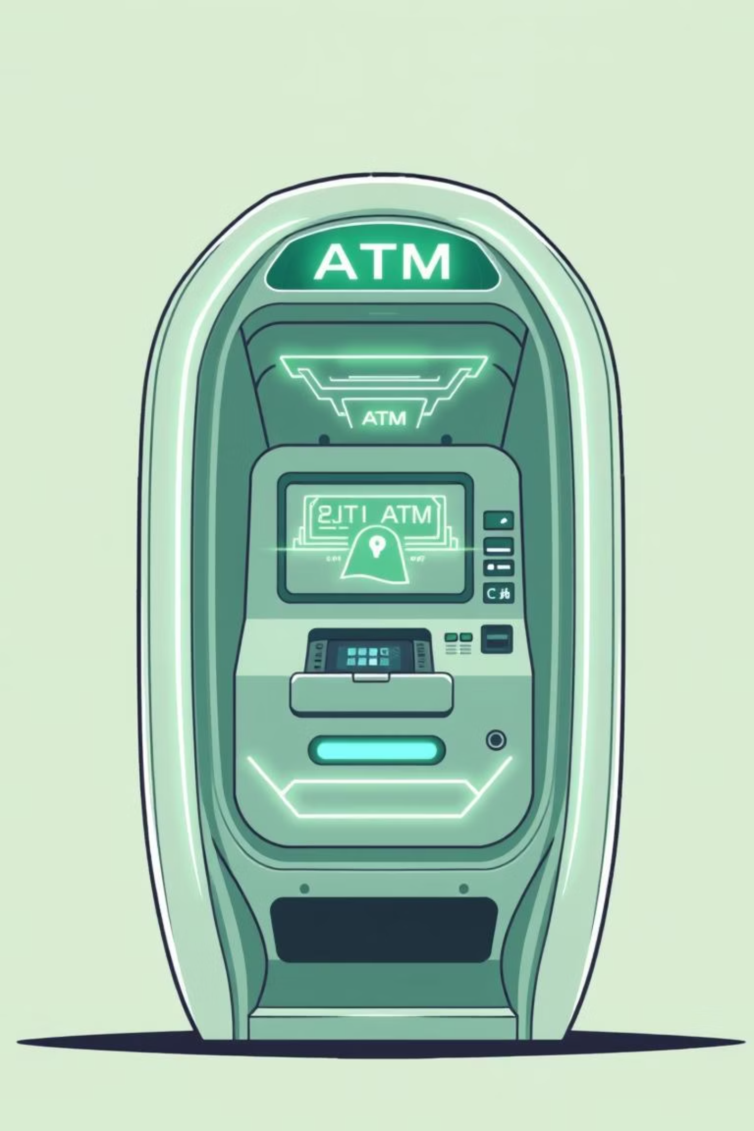
Smart ATM Cash Distribution Optimizer
Final Year Project Presentation
Presented by:
Devraj (2022CSB1077)
Girish (2022CSB1083)
CP302 - IIT Ropar
Under Guidance of Prof. Apurva Mudgal

Slide 2

Addressing Inefficiencies in Cash Distribution
The Problem:
ATMs frequently run out of cash or are overstocked, leading to significant operational inefficiencies for banks.
Banks struggle with optimizing cash distribution from central vaults to multiple ATMs.
Current systems often follow static schedules, not demand-driven allocations
The core issue lies in the unpredictable nature of cash demand and the high costs associated with both cash shortages and excess inventory. This project aims to bridge this gap with an intelligent, algorithm-driven solution.
Optimizing cash distribution from central vaults to a network of ATMs presents a complex logistical challenge.
Current systems often rely on static schedules, failing to adapt to dynamic, demand-driven allocations.

Slide 3
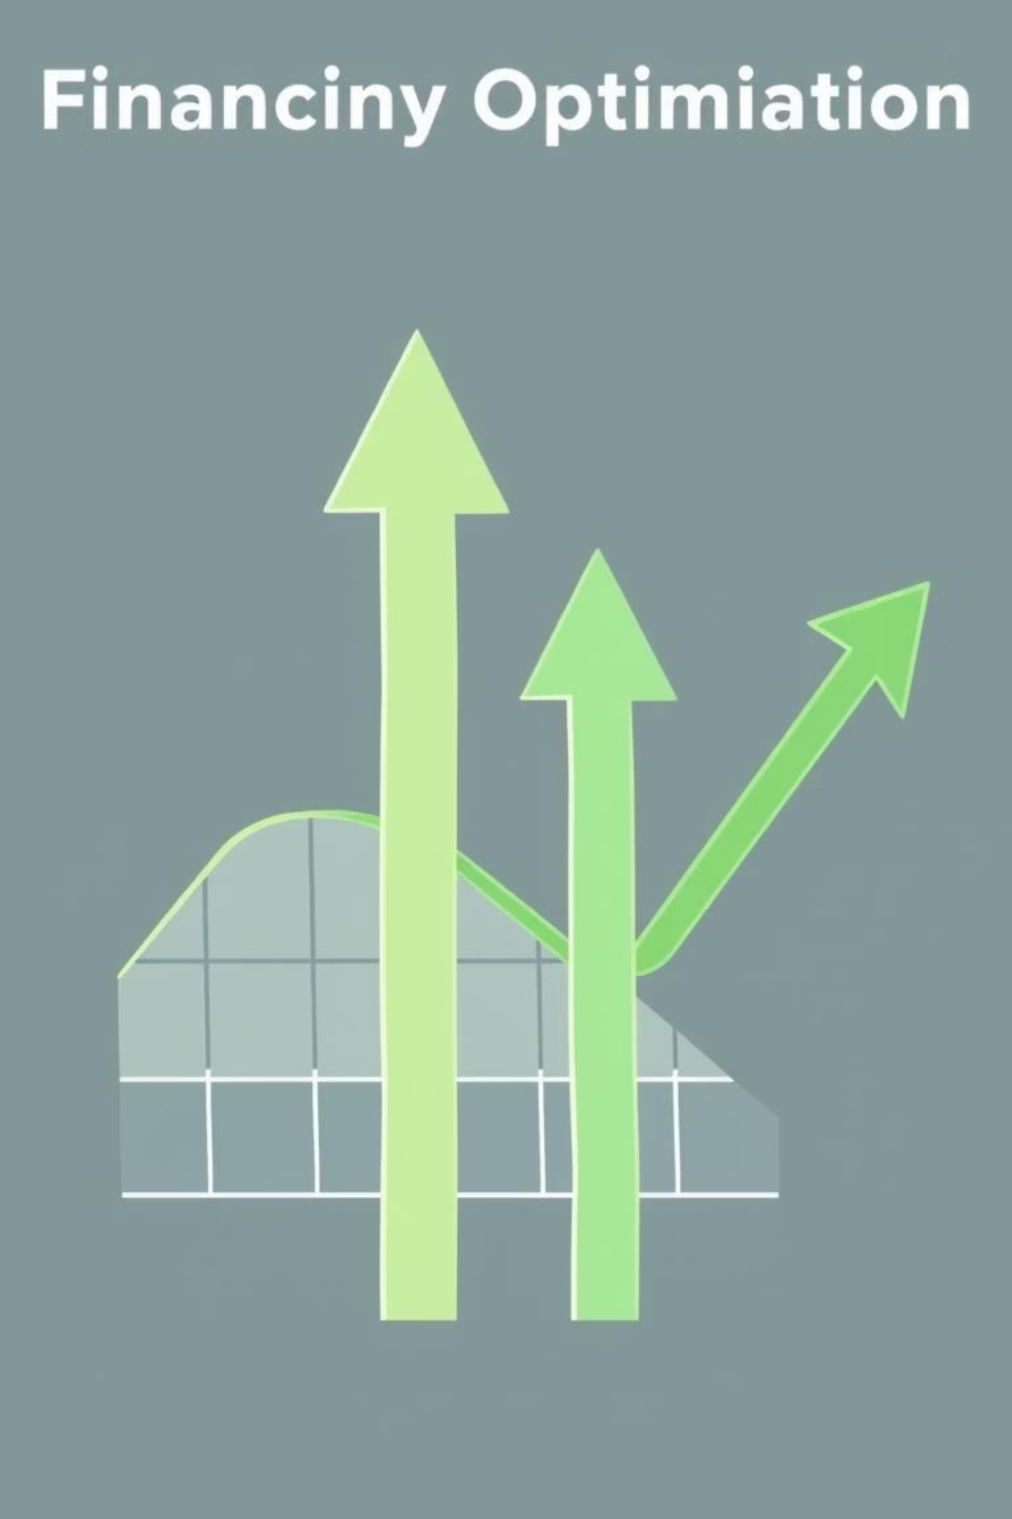
Project Objectives & Core Features
Key Objectives:
Develop an algorithm-based system for optimized cash distribution.
Prevent cash shortages and minimize idle cash across the ATM network.
Provide comprehensive analytics and real-time reporting for informed decision-making.
Core Features Overview:
ATM & Vault Management:
Optimized Allocation Algorithm:
Demand Forecasting:
Transaction Handling & Reports:

Slide 4
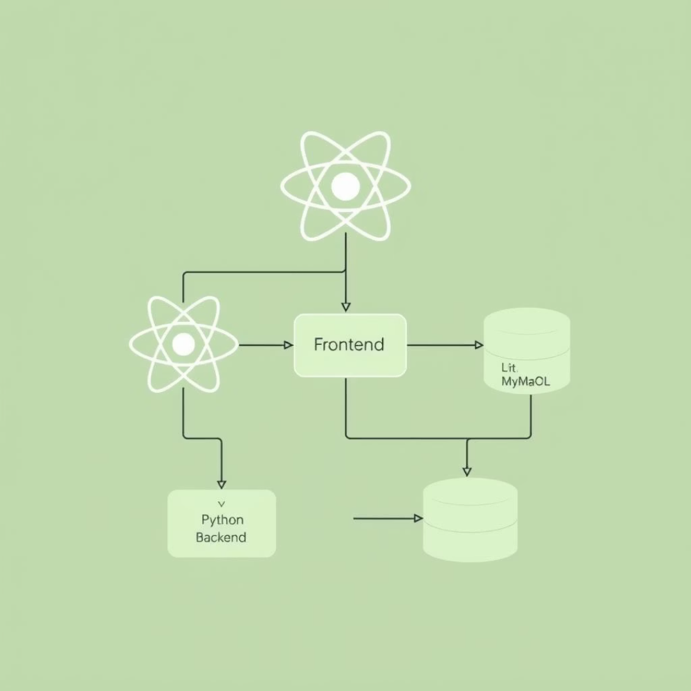
Algorithms & System Architecture
Algorithmic Backbone:
System Design & Technologies:
Greedy Algorithm & LP
1
Optimal allocation of cash from vaults to ATMs.
Sorting Algorithms
2
Merge Sort/Quick Sort for efficient report generation.
Binary Search/Hashing
3
Rapid ATM lookup and data retrieval.
Graph Theory
Frontend: Intuitive user interface developed with React.js for seamless interaction.
4
Modeling intricate vault-ATM network mappings.
Backend: Robust server-side logic powered by Python or Node.js
for high performance.
Queues/Stacks
5
Streamlined transaction processing and management.
Database: Reliable data storage using SQLite for development, scalable to MySQL for production environments.

Slide 5

Impact and Future Directions
Real-Life Relevance:
Significantly reduces banking operational costs by optimizing cash flow.
Virtually eliminates ATM cash-outs, enhancing customer satisfaction.
Introduces dynamic allocation capability, moving beyond rigid static systems.
Enhances financial stability and resource utilization for banks.
Future Enhancements:
ML-based Demand Forecasting
Vehicle Routing Optimization
Role-based Multi-level Access Control

Slide 6

System Scope: Prototype & Limitations
What Our Prototype Covers:
Beyond Current Scope (Future Work):
Comprehensive Management
Full-Scale Deployment
Vault and ATM inventory management.
Multi-Bank Integration
Predictive Demand
Advanced Route Optimization
Initial demand forecasting capabilities.
Optimized Distribution
Core algorithm for cash allocation.
Insights & Analysis
Essential reports and analytics.

Slide 7
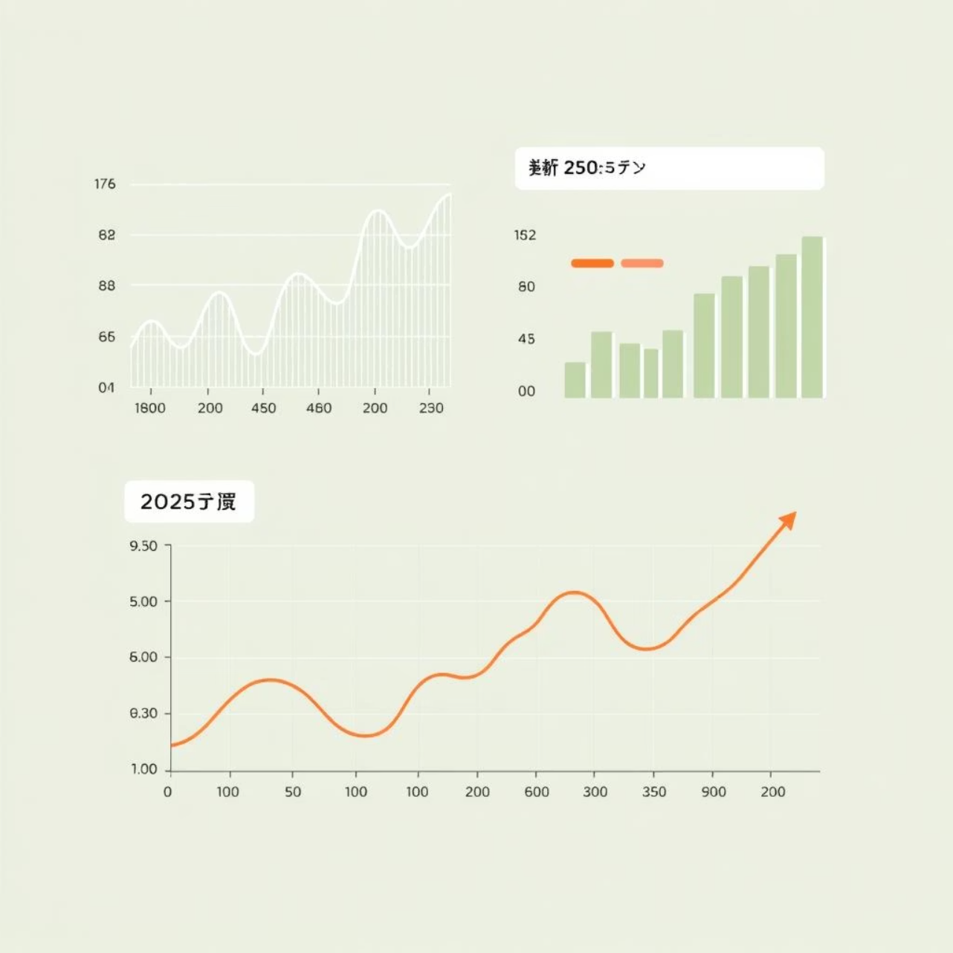
Machine Learning for Enhanced Demand Forecasting
Leveraging ML for Accuracy:
Our system incorporates machine learning to predict cash demand more accurately, moving beyond simple historical averages. This proactive approach significantly reduces the risk of both cash-outs and overstocking.
Time-series regression models
Historical withdrawal patterns
Seasonal and temporal trends

Slide 8





Advanced Optimization Algorithms
Greedy Approaches
Implemented for rapid, near-optimal cash allocation decisions in dynamic environments.
Linear Programming
Utilized for precise cost minimization, considering various constraints and objectives.
Cost-Benefit Analysis
Balancing the penalties of cash shortages against operational costs of cash transportation and storage.
Graph-based Min-Cost Max-Flow
Potential exploration for highly complex, multi-source, multi-destination cash distribution networks.

Slide 9
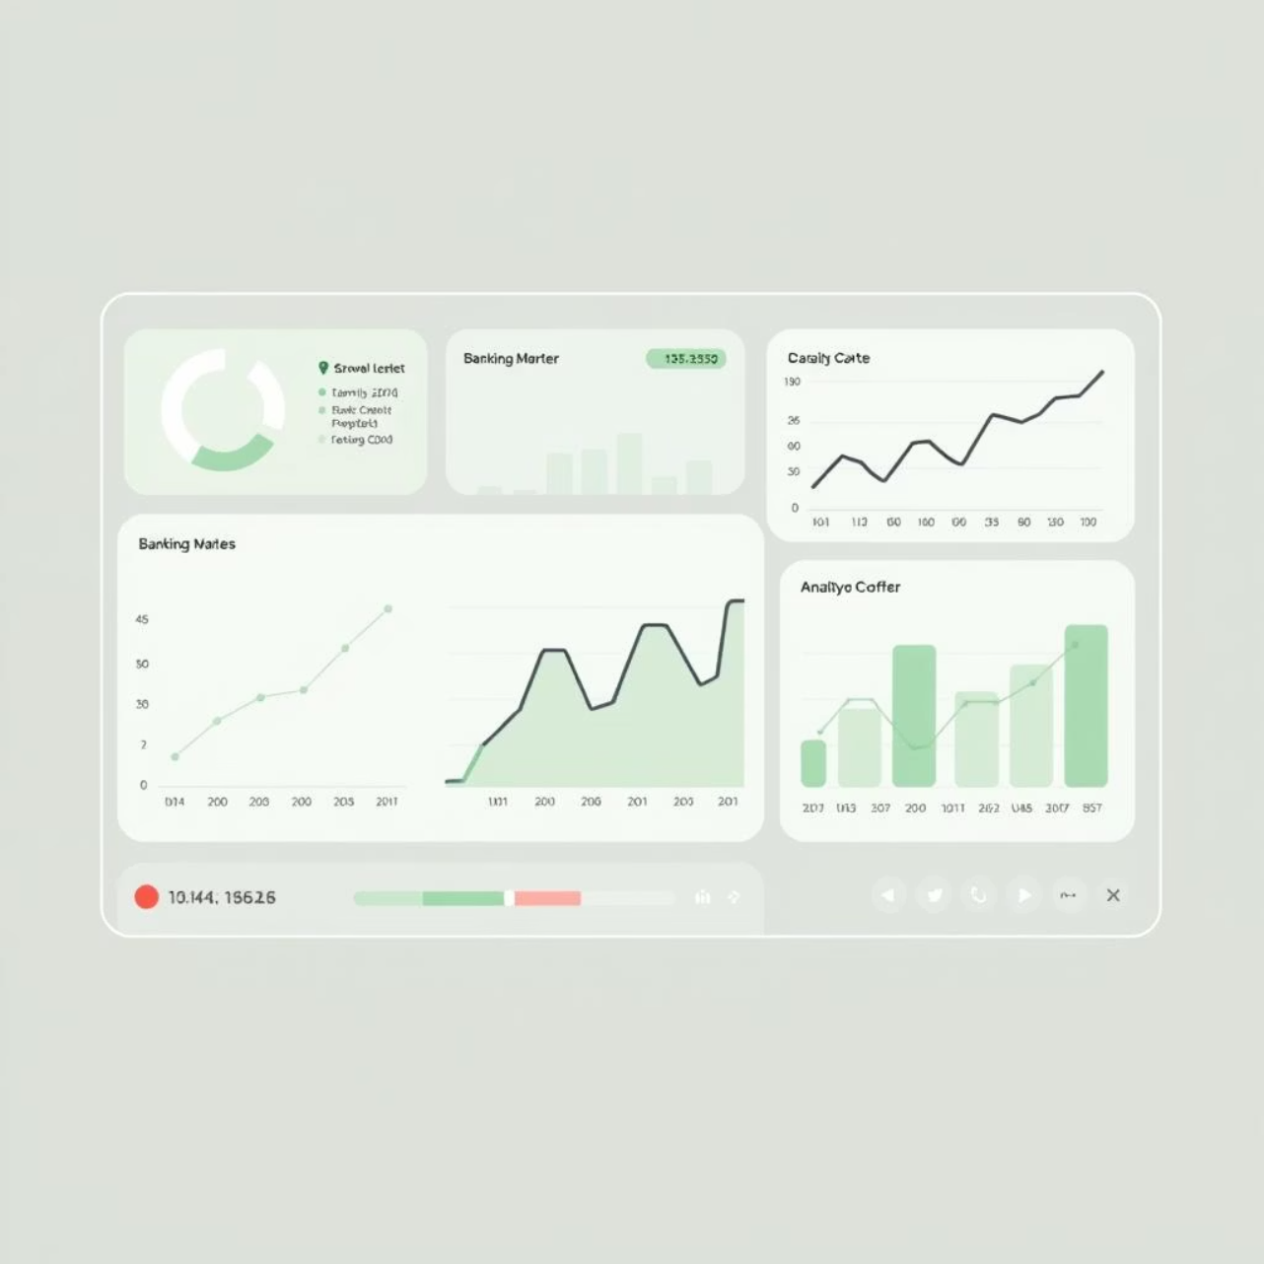
Interactive Reports & Analytics Dashboard
Our dashboard provides comprehensive insights into the entire cash distribution network, enabling banks to monitor performance and make data-driven decisions.
ATM Cash Status Summary:
Vault-to-ATM Allocation Details:
Visualization of Shortages vs. Idle Cash:
Efficiency Metrics:

Slide 10
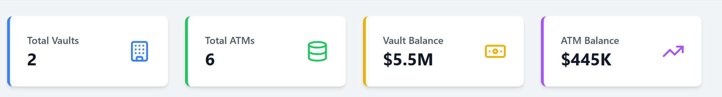
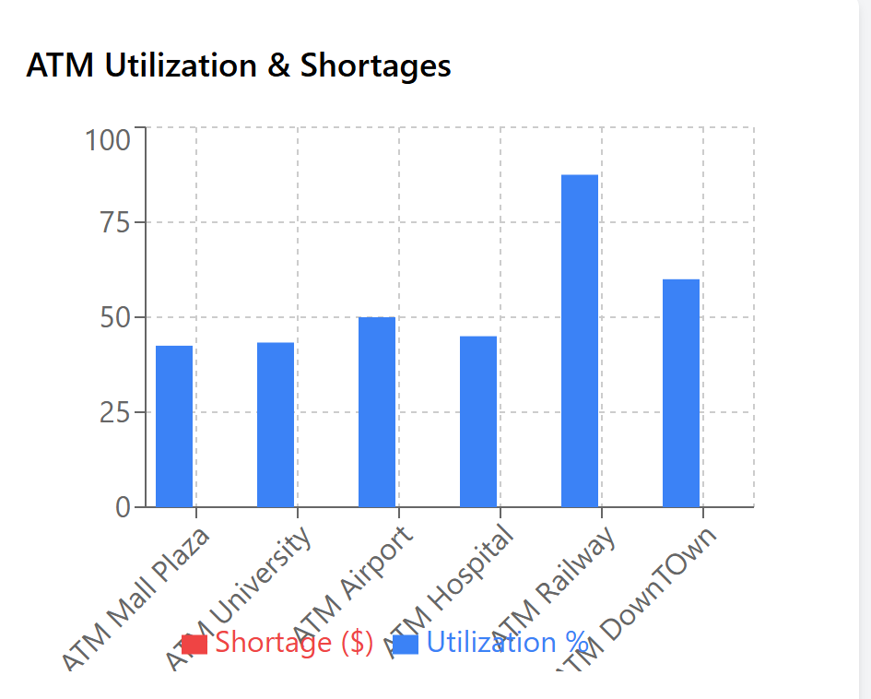

System Demonstration
Prototype UI
Interactive dashboard and detailed reports illustrating
system functionality.
Allocation Graphs
Visual representation of optimal ATM cash distribution
paths and quantities.

Slide 11
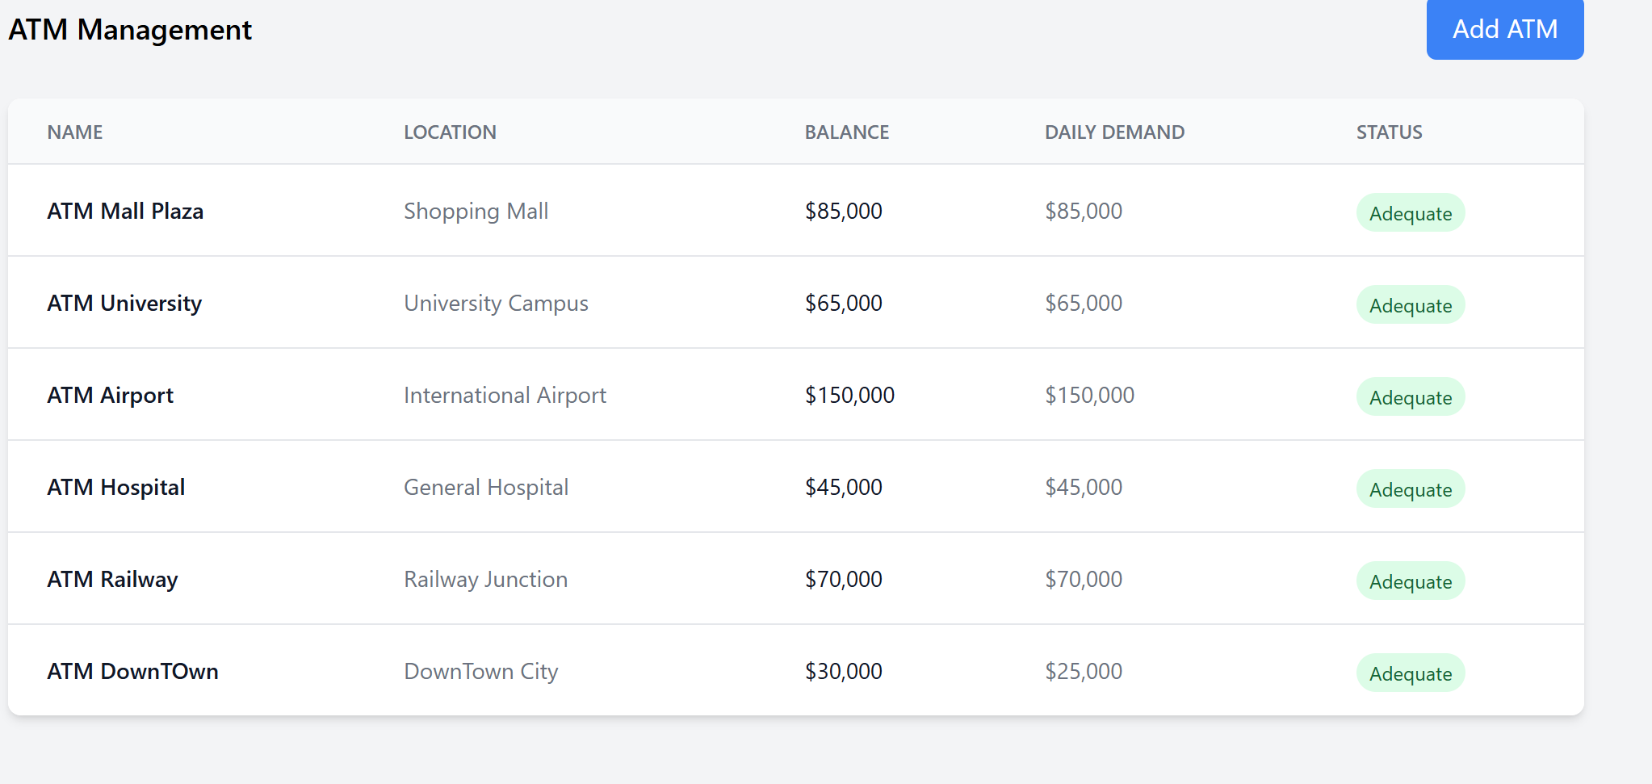
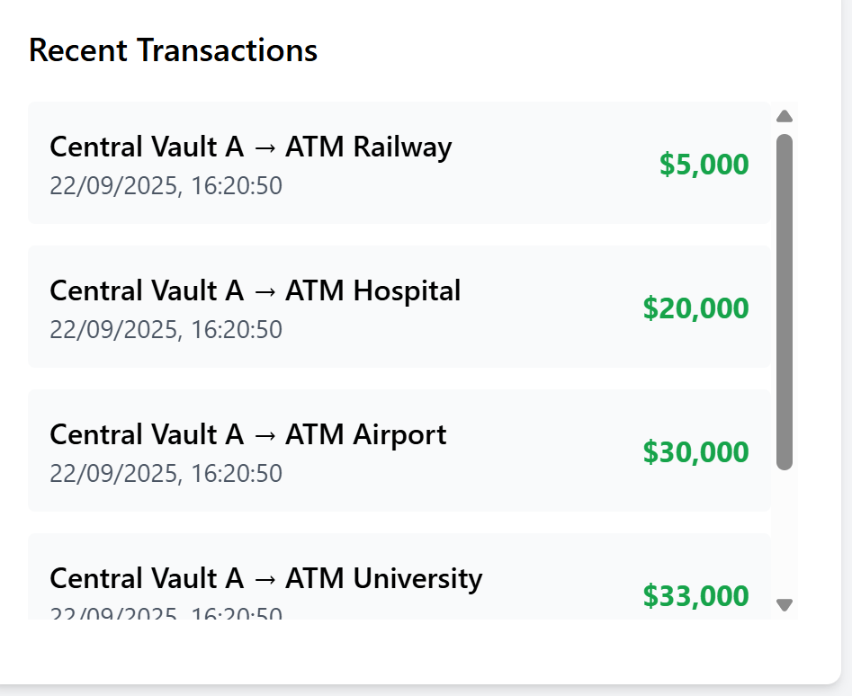
System Demonstration
Forecast vs. Actual
Comparison of predicted and actual cash usage to assess
forecasting accuracy.
System Outputs
Snapshots of real-time transactions and the system’s
intelligent allocation decisions.

Slide 12





Future Enhancements in ATM Cash Management
To elevate our demand-driven ATM cash distribution system, we envision integrating advanced technologies and sophisticated optimization techniques.
Advanced ML Forecasting
Leveraging LSTM and ARIMA models for highly accurate demand forecasting, predicting cash needs with unprecedented precision.
Dynamic Emergency Allocation
Implementing real-time algorithms for swift and efficient allocation of cash in unforeseen emergency situations, minimizing downtime.
Multi-Objective Optimization
Employing complex algorithms to simultaneously optimize for cost reduction, service level enhancement, and heightened security measures.
Intelligent Route Optimization
Developing sophisticated route optimization for cash vans, ensuring the fastest, safest, and most cost-effective delivery paths.

Slide 13
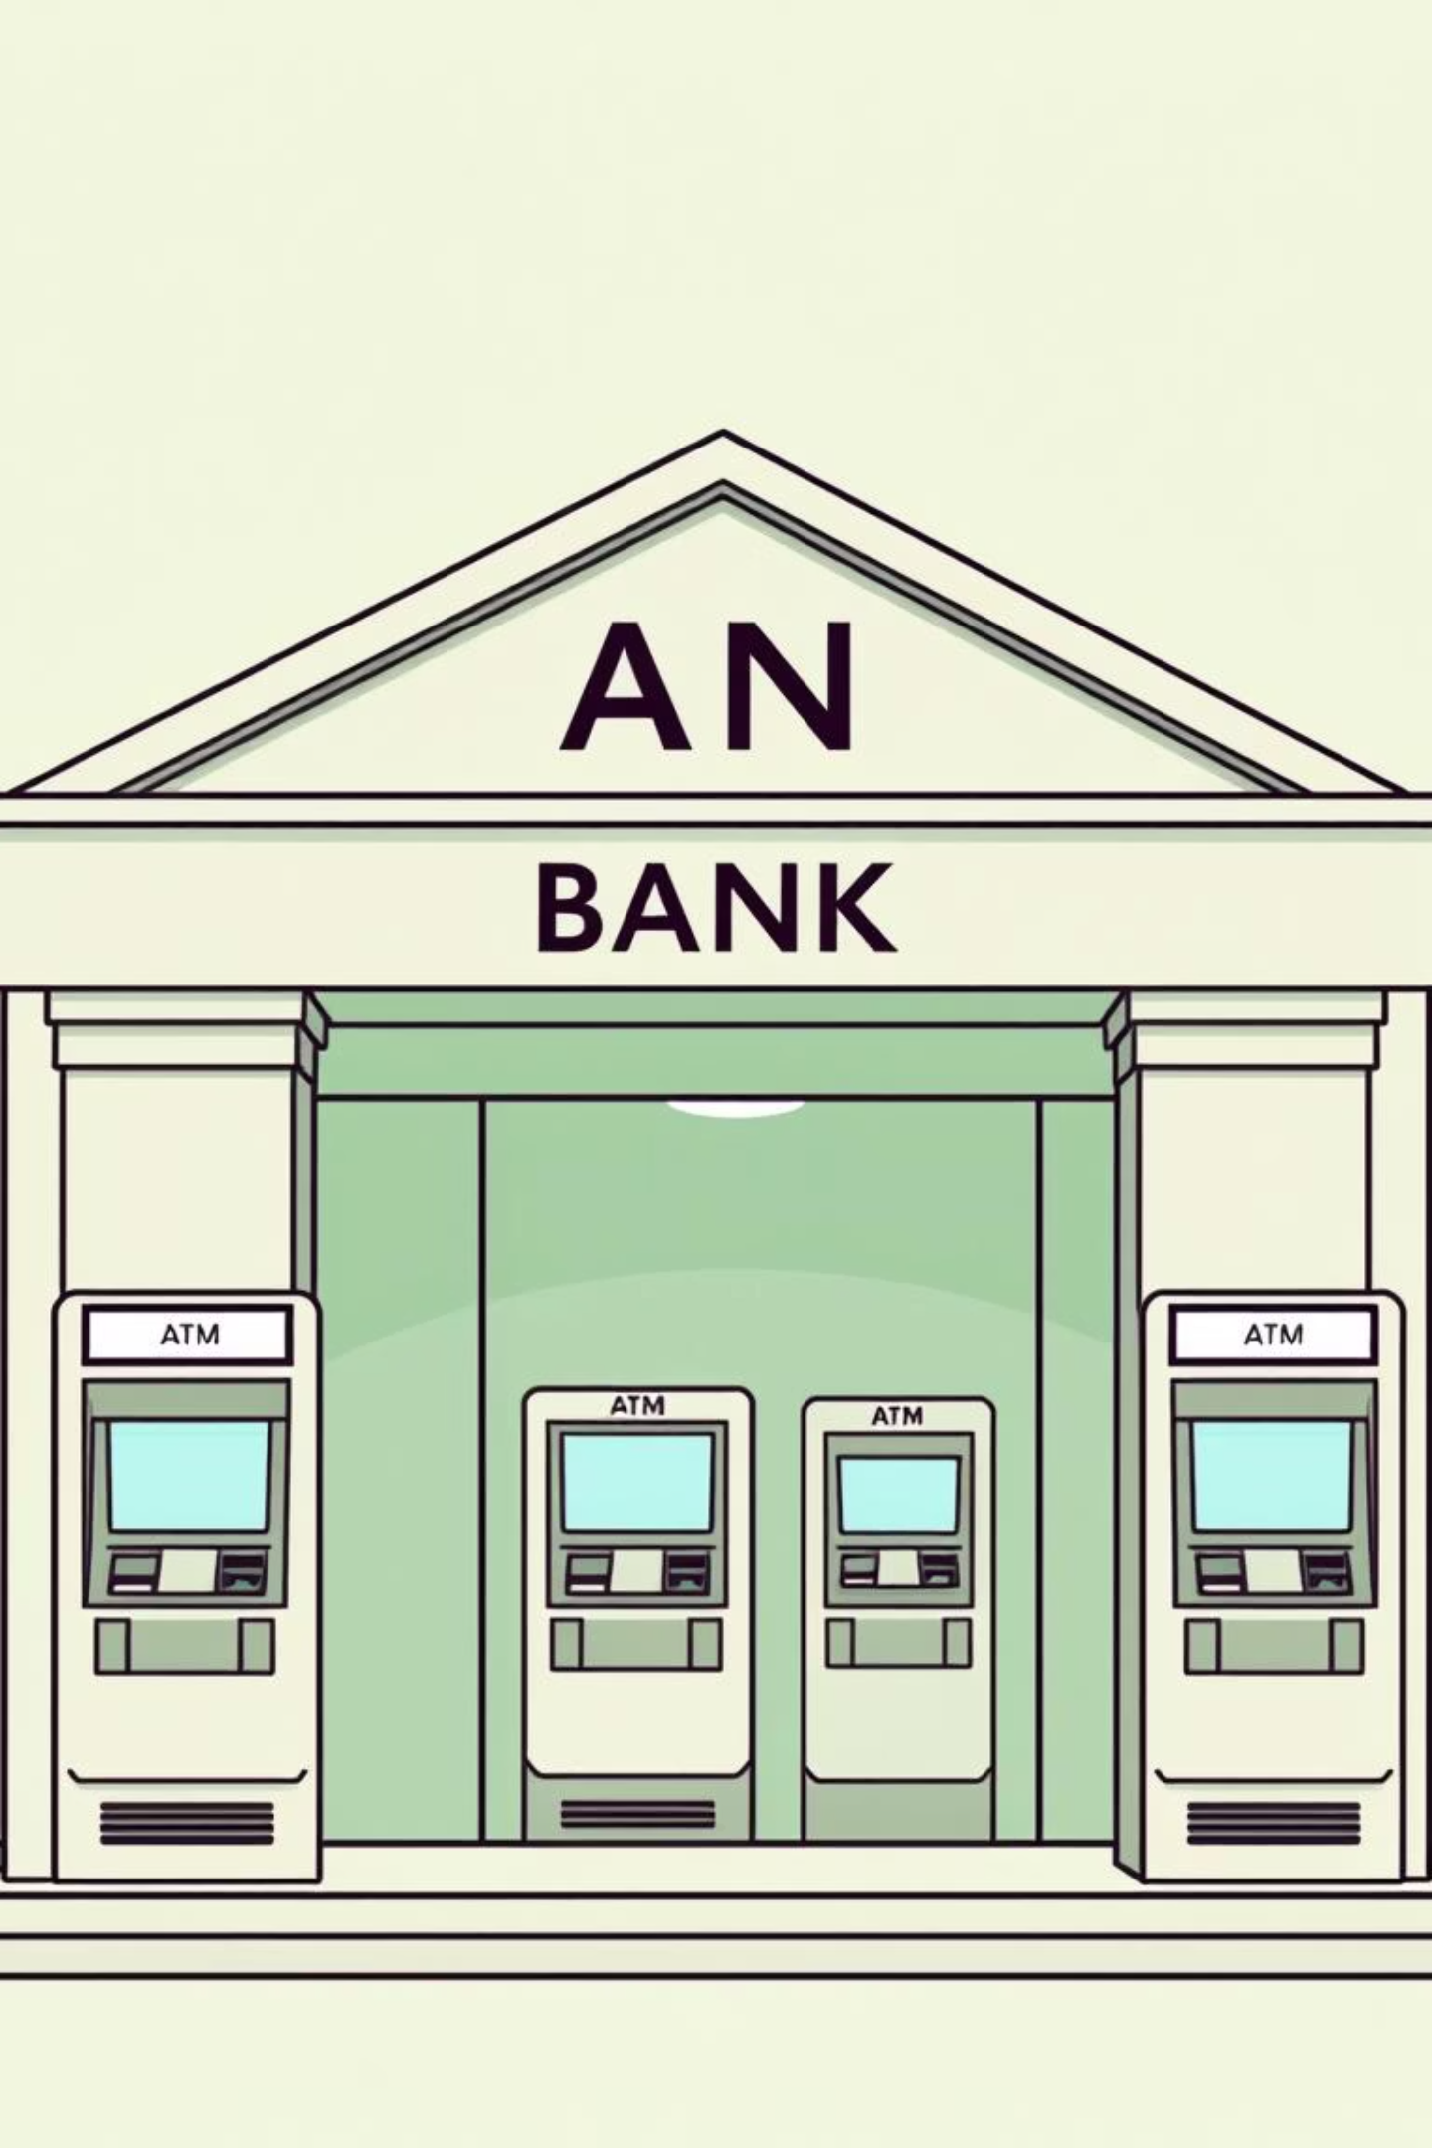




Conclusion: Pioneering ATM Cash Distribution
Our journey culminated in the successful development of a robust, demand-driven ATM cash distribution system, poised to revolutionize banking operations.
Innovative System Developed
A novel demand-driven ATM cash distribution system has been successfully
engineered, addressing key industry challenges.
Optimized Efficiency & Cost Reduction
The system dramatically improves operational efficiency and significantly reduces associated costs through intelligent allocation.
Feasibility Demonstrated
Our prototype has conclusively proven the system's feasibility and potential
for real-world application.
Future Expansion
The next step involves scaling this solution to integrate with large-scale banking networks worldwide, setting new industry standards.

