Slide 1
Birds Classification based on Bird Sound
Presented by:
Girish Lumdeo Rane
(Signal Processing)
(MIS : 121997014)
Guided by :
Dr. Mrs. Priti P. Rege
Professor(E&TC Dept.)
COEP
05/11/2020
College of Engineering, Pune

Slide 2
CONTENTS:
Problem Statement
Introduction
Literature Survey
Aim and Objective
Dataset
Feature Extraction
Feature Selection
Classification
Results
Conclusion
Reference
College of Engineering, Pune

Slide 3
Problem Statement
To propose a system that aims to automatically recognize bird species or even individual birds by their sound in field conditions.
College of Engineering, Pune

Slide 4
Introduction
Birds can be heard even in big cities.
Most common species by their sound and experts can recognize hundreds of species only by their sound.
Recognition of bird species by their sounds is a typical pattern recognition problem.
College of Engineering, Pune

Slide 5
Literature Survey:
TITLE | CONCLUSION
Speaker recognition using mel-frequency cepstrum coefficients and sum square error | The use of Mel Frequency Cepstral Coefficients with Vector Quantization for speaker verification. VQ is used to produce a vector of each speech signal.
Investigation of Different CNN-Based Models for Improved Bird Sound Classification, | Different types of time-frequency representations called Mel, harmonic and percussive spectrogram. CNN fused model gives balanced accuracy of 86.31 %.
College of Engineering, Pune

Slide 6
TITLE | CONCLUSION
Bird sound recognition using a convolutional neural network | Developed a methodology to classify species using spectrogram. A pre-trained MobileNet CNN model was used to differentiate species. STFT of each audio file given to input to CNN model. This experiment shows the color map of the spectrogram gives more advantages than a normal spectrogram.
Bird species recognition using unsupervised modeling of individual vocalization elements. | Suggested tonal-based features to identify tonal bird sounds. The Gaussian mixture model is used to model 95 bird species. Each bird sound contains white noise and environmental noise. The Tonal-based approach provides better performance compared to Mel Frequency Cepstral Coefficients.
College of Engineering, Pune

Slide 7
TITLE | CONCLUSION
Analysis of LFCC Feature Extraction in Baby Crying Classification using KNN | Designed a new feature extraction technique called Linear Frequency Cepstral Coefficients (LFCC). LFCC uses a Linear Filter bank K-nearest neighbour algorithm is implemented to detect baby is crying or not.
Acoustic Classification of Bird Species. | This paper has proposed a method identifying birds by their sounds using Mel Frequency Cepstral Coefficients (MFCC) and Gammatone Frequency Cepstral Coefficients (GFCC) for classification. The feature set is evaluated using the Support Vector Machine and Artificial Neural Network.
College of Engineering, Pune

Slide 8
Aim and Objective
To create a dataset of bird sound.
To study and Extract features from bird sound.
To select optimum feature for bird classification.
To perform classification of bird species using different machine learning algorithms.
To compare the performance of various classification algorithms.
College of Engineering, Pune

Slide 9
Dataset
Sr. No. | Bird species | Scientific name | Number of Files
1 | Red-whiskered Bulbul(RB) | Pycnonotus jocosus | 236
2 | Great Tilt(GT) | Parus major | 243
3 | Willow Warbler(WW) | Phylloscopus trochilus | 262
4 | European Pied Flycatcher(EF) | Ficedula hypoleuca | 264
5 | Common Blackbird(CB) | Turdus merula | 256
6 | Common Redstart(CR) | Phoenicurus phoenicurus | 188
7 | Greenish Warbler(GW) | phylloscopus torchiloides viridanus | 207
8 | Blue Jay(BJ) | Cyanocitta cristata | 276
9 | Common Snipe(CS) | Gallinago gallinago | 244
10 | Whistling Duck(WD) | Denfrocygna viduta | 182
 |  |  | Total 2358
College of Engineering, Pune

Slide 10
Feature Extraction
Mel – Frequency Cepstral Coefficients (MFCC)
Linear Frequency Cepstral Coefficient (LFCC)
Gammatone frequency cepstral coefficient (GFCC)
College of Engineering, Pune

Slide 11
Feature Extraction Block Diagram
Pre-Emphasis
Framing
Windowing
Speech Signal
FFT
Coefficients
DCT
Log
Filter Bank
Fig. 1: Block Diagram of Feature Extraction
College of Engineering, Pune

Slide 12
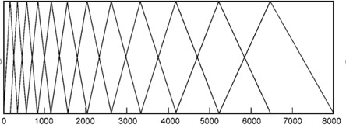

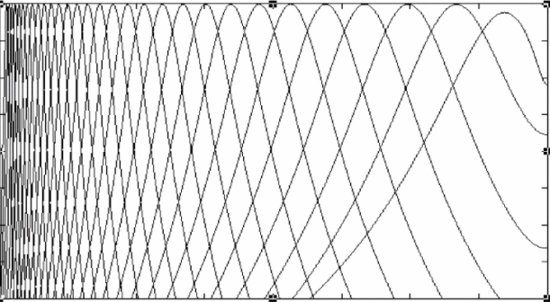
Mel Filter bank
Mel Filter Bank
Linear Filter Bank
Gammatone Filter Bank
College of Engineering, Pune

Slide 13
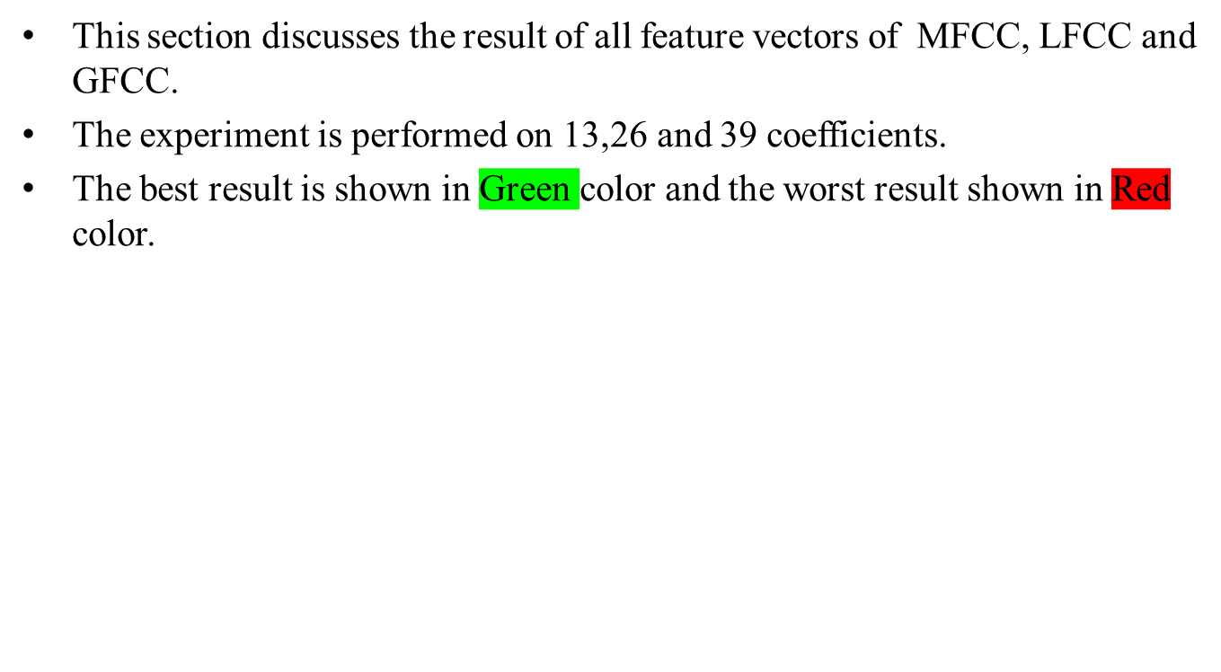
Result of Feature Extraction
College of Engineering, Pune

Slide 14
Support Vector Machine
The main goal of the support vector machine is to find a hyperplane between two classes.
To separate two different classes, the margin between two classes is maximum.
College of Engineering, Pune

Slide 15
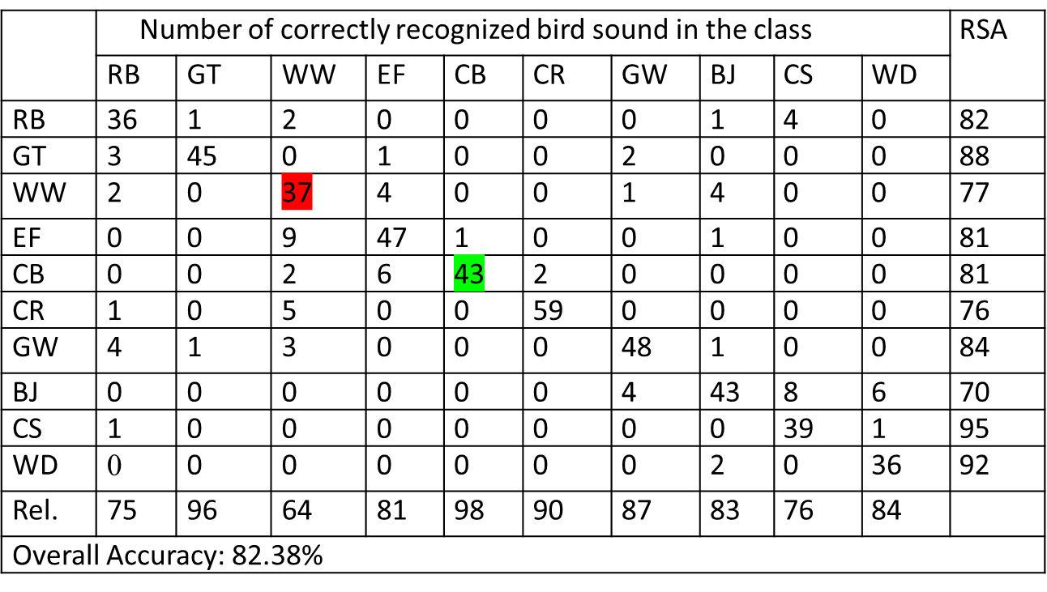
Result of MFCC
Table 1: Recognition of result with MFCC (13) features
College of Engineering, Pune

Slide 16
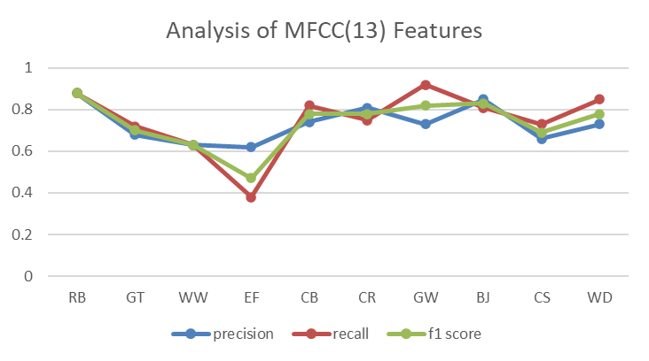
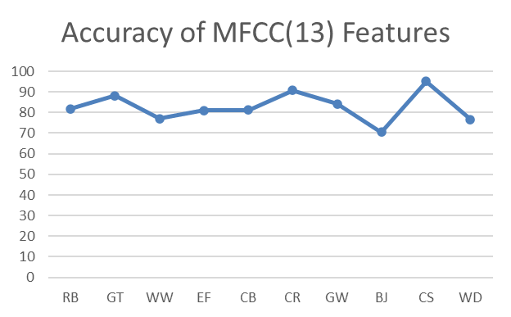
Fig 2 : Analysis and Accuracy of MFCC (13) Features
College of Engineering, Pune

Slide 17
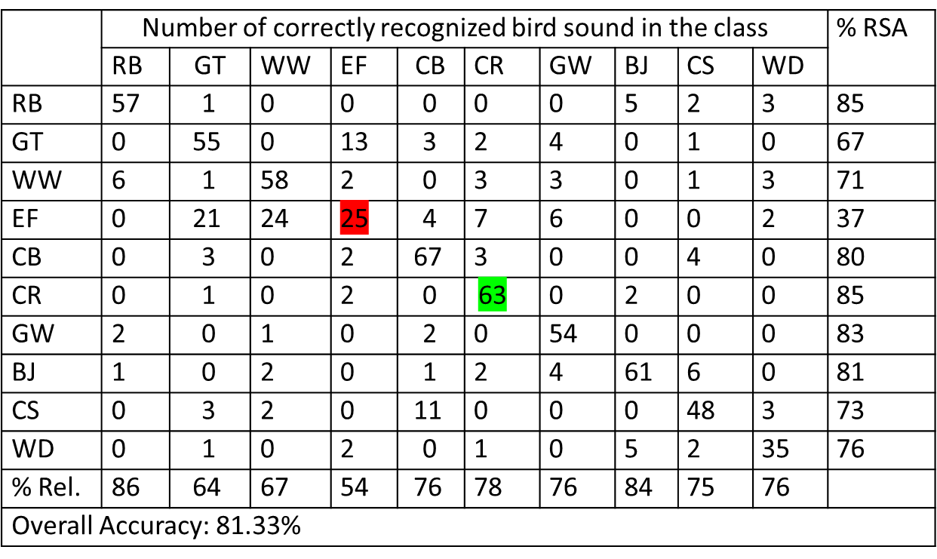
Table 2 : Recognition of result with MFCC (26) features
College of Engineering, Pune

Slide 18
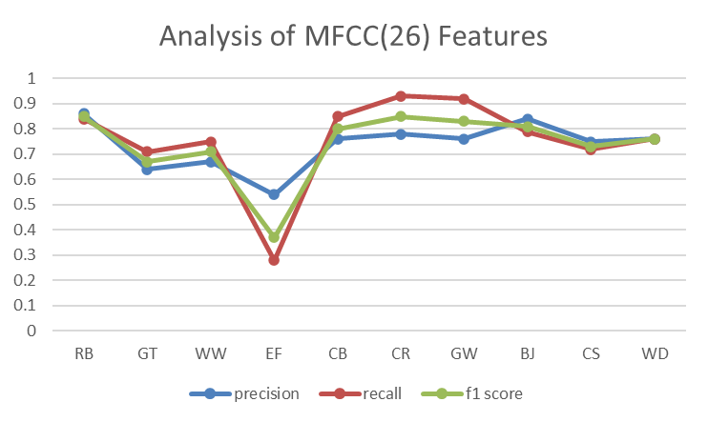
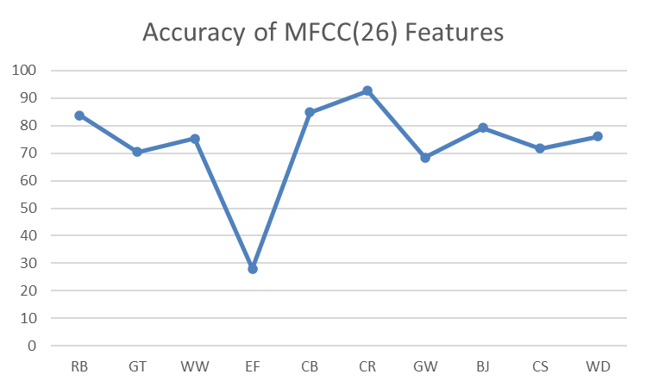
Fig 3 : Analysis and Accuracy of MFCC (26) Features
College of Engineering, Pune

Slide 19
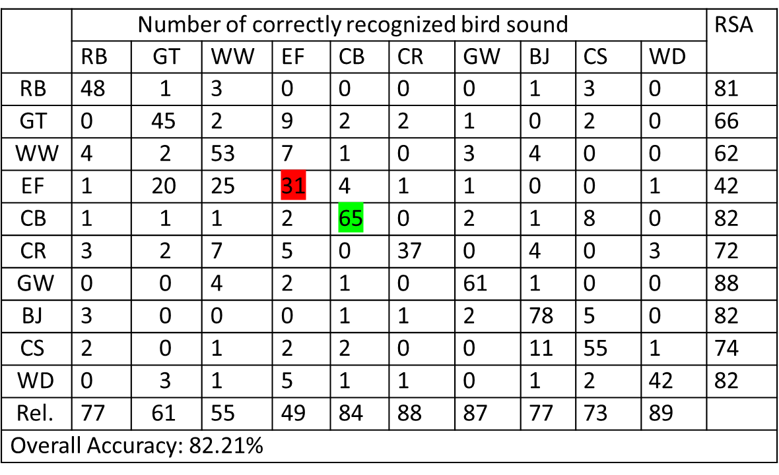
Table 3 : Recognition of result with MFCC (39) features
College of Engineering, Pune

Slide 20
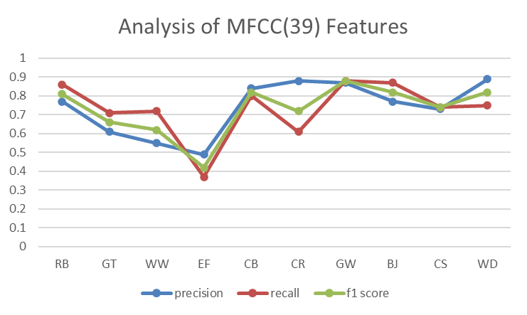
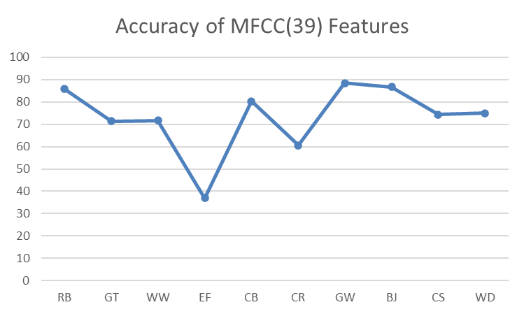
Fig 4 : Analysis and Accuracy of MFCC (39) Features
College of Engineering, Pune

Slide 21
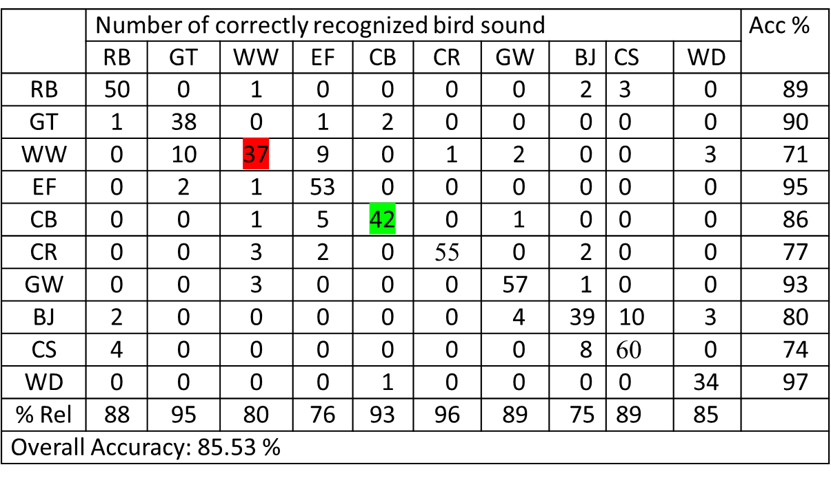
Result of LFCC
Table 4 : Recognition of result with LFCC (13) features
College of Engineering, Pune

Slide 22
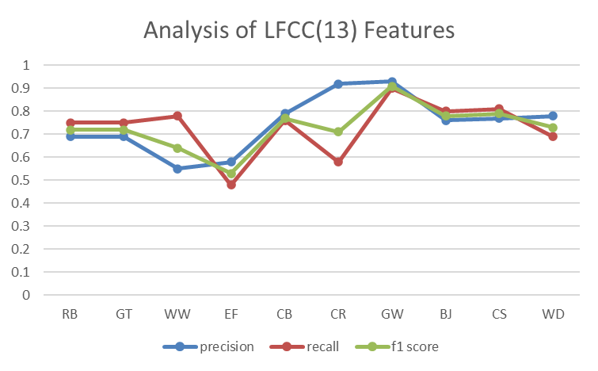
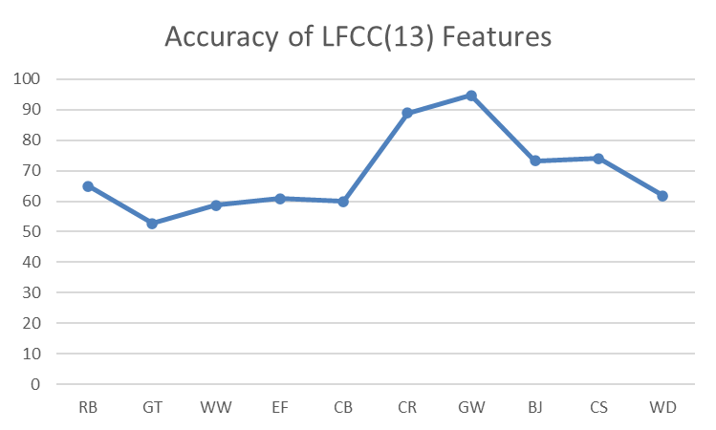
Fig 5 : Analysis and Accuracy of LFCC (13) Features
College of Engineering, Pune

Slide 23
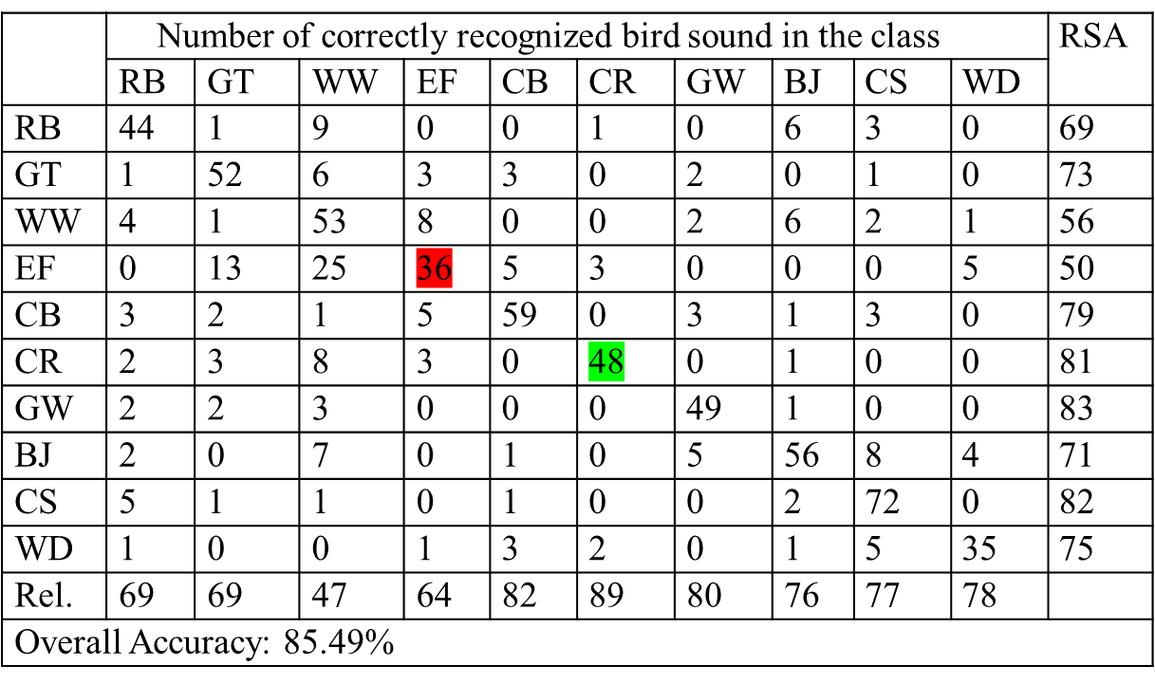
Table 5 : Recognition of result with LFCC (26) features
College of Engineering, Pune

Slide 24
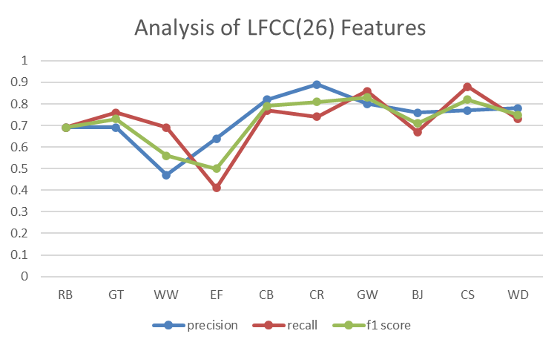
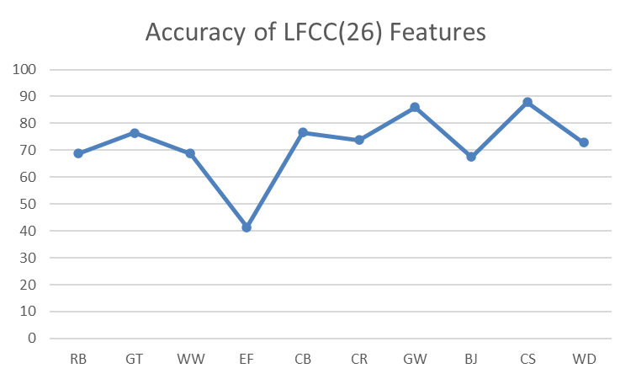
Fig 6 : Analysis and Accuracy of LFCC (26) Features
College of Engineering, Pune

Slide 25

Table 6: Recognition of result with LFCC (39) features
College of Engineering, Pune

Slide 26
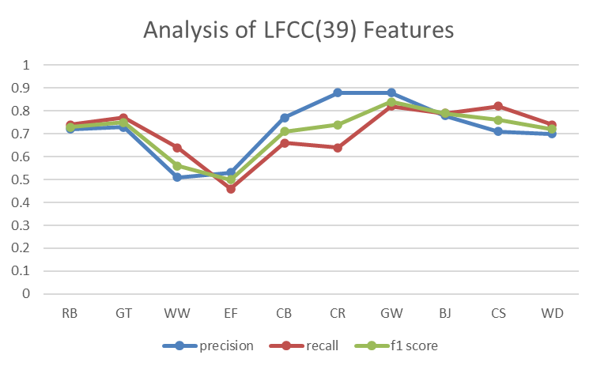
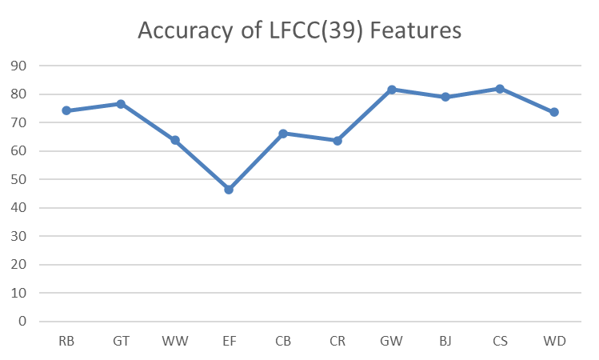
Fig 7 : Analysis and Accuracy of LFCC (39) Features
College of Engineering, Pune

Slide 27
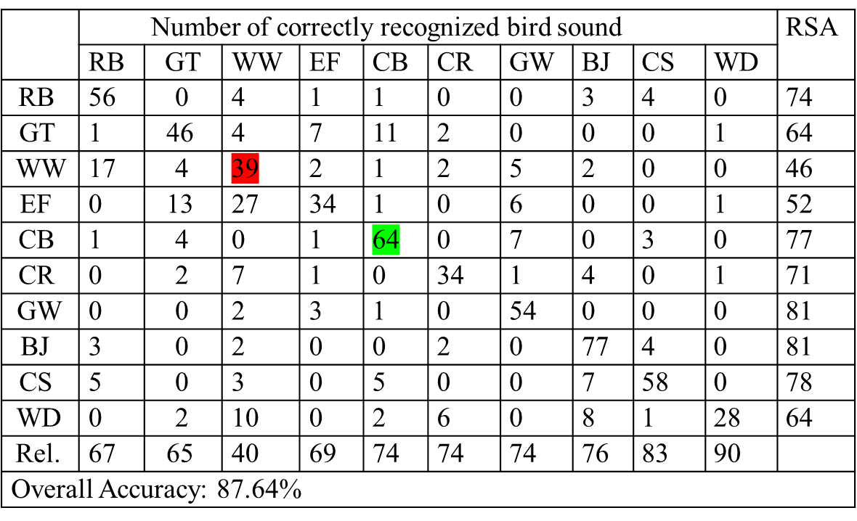
Result of GFCC
Table 7: Recognition of result with GFCC (13) features
College of Engineering, Pune

Slide 28
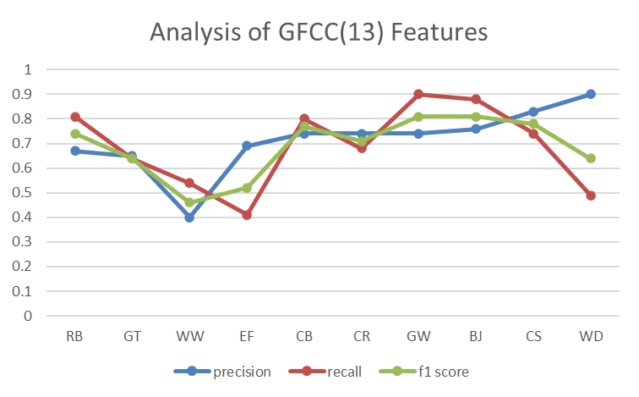
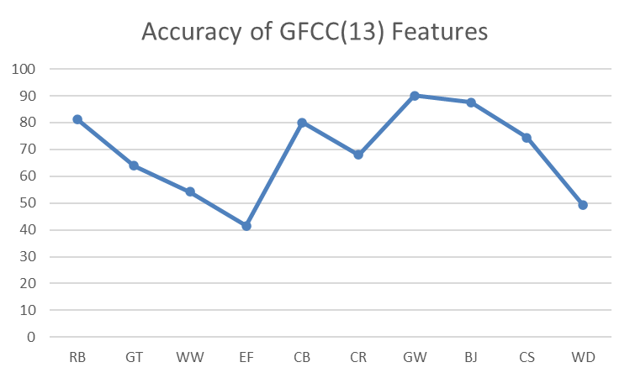
Fig 8 : Analysis and Accuracy of GFCC (13) Features
College of Engineering, Pune

Slide 29

Table 8: Recognition of result with GFCC (26) features
College of Engineering, Pune

Slide 30
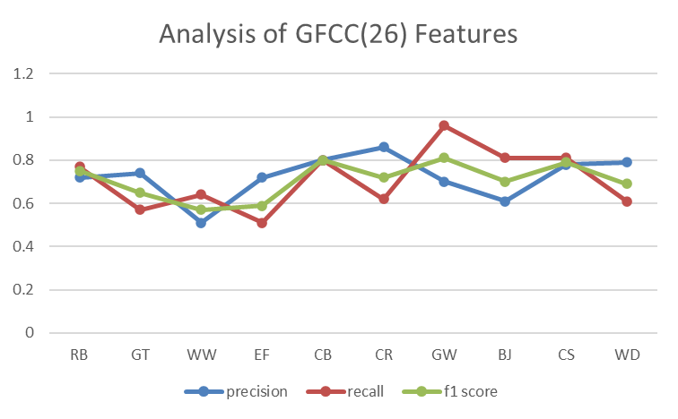
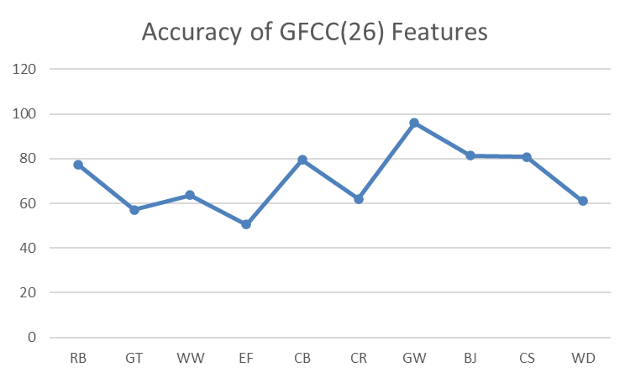
Fig 9 : Analysis and Accuracy of GFCC (26) Features
College of Engineering, Pune

Slide 31

Table 9: Recognition of result with GFCC (39) features
College of Engineering, Pune

Slide 32
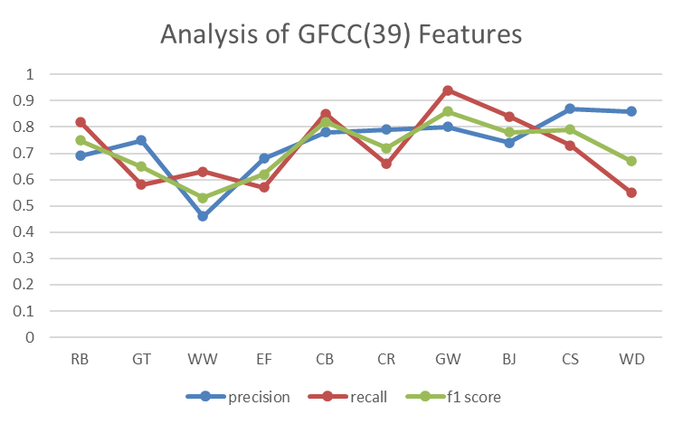
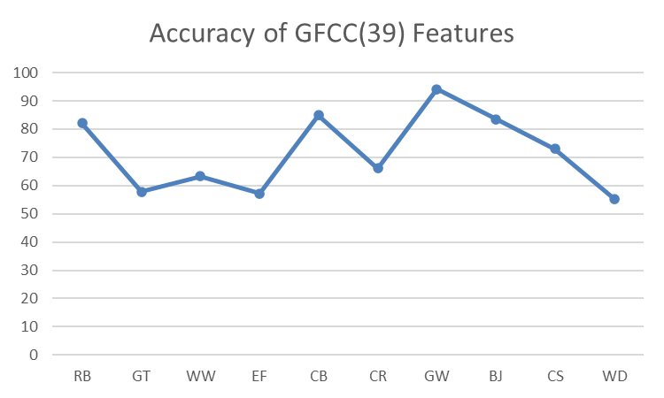
Fig 10: Analysis and Accuracy of GFCC (39) Features
College of Engineering, Pune

Slide 33
Table 10: Overall Accuracy of Feature Extraction
Sr No. | Feature vector | MFCC | LFCC | GFCC
1 | 13 coefficients | 82.38 | 85.53 | 87.64
2 | 26 coefficients | 81.33 | 85.49 | 87.44
3 | 39 coefficients | 82.21 | 85.88 | 85.88
College of Engineering, Pune

Slide 34
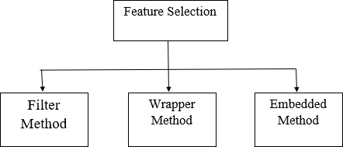
Feature Selection
Feature selection selects only the relevant features and discards all irrelevant and noisy feature.
Improves the efficiency and accuracy of the model
Fig 11: Block Diagram of Feature selection methods
College of Engineering, Pune

Slide 35
Recursive Feature Elimination (RFE)
RFE generally removes the least important features and retains the remaining feature.
The most commonly used technique under wrapper method are Forward selection, Backward elimination, Bi-directional elimination.
Recursive Feature Elimination (RFE) algorithm select features recursively.
College of Engineering, Pune

Slide 36
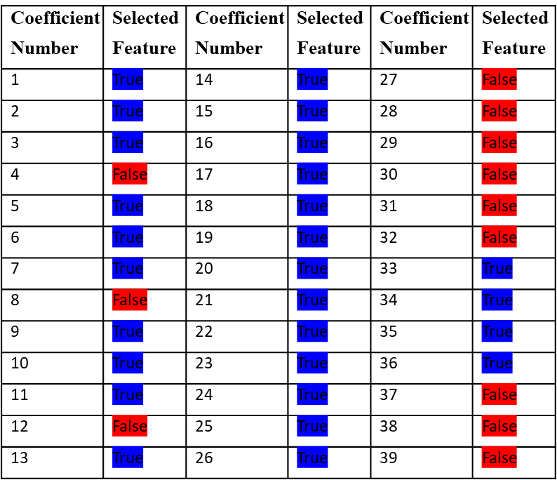
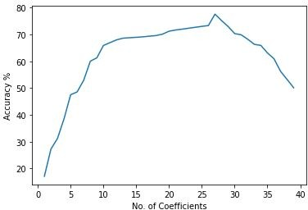
Table 11: Feature Selection
Figure 12:Accuracy vs number of features selected
College of Engineering, Pune

Slide 37
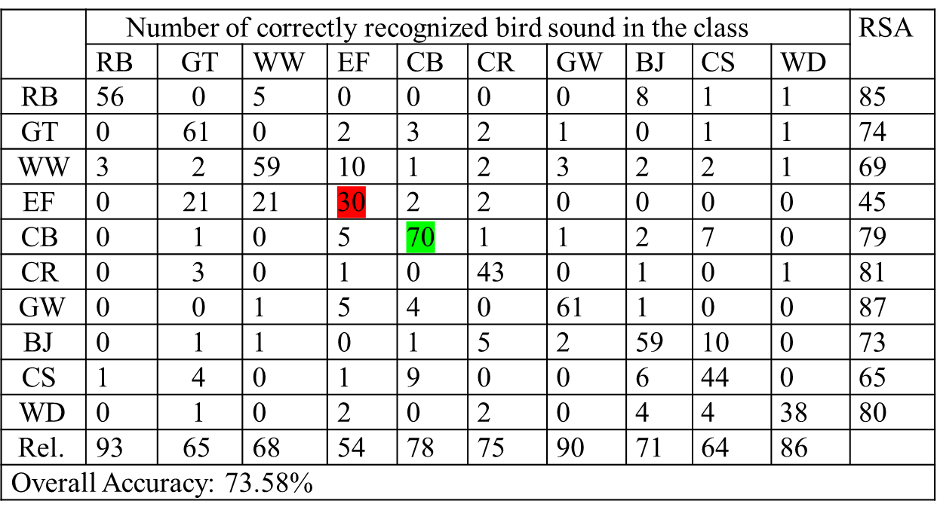
Result of MFCC
Table 12:Recognition of result with MFCC (27) features
College of Engineering, Pune

Slide 38
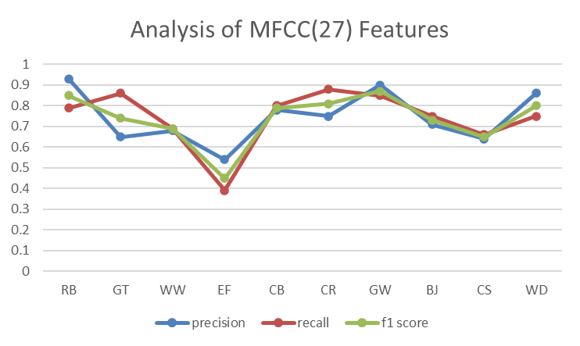
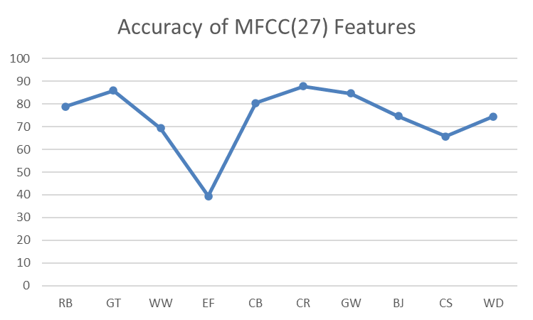
Fig 13 : Analysis and Accuracy of MFCC (27) Features
College of Engineering, Pune

Slide 39
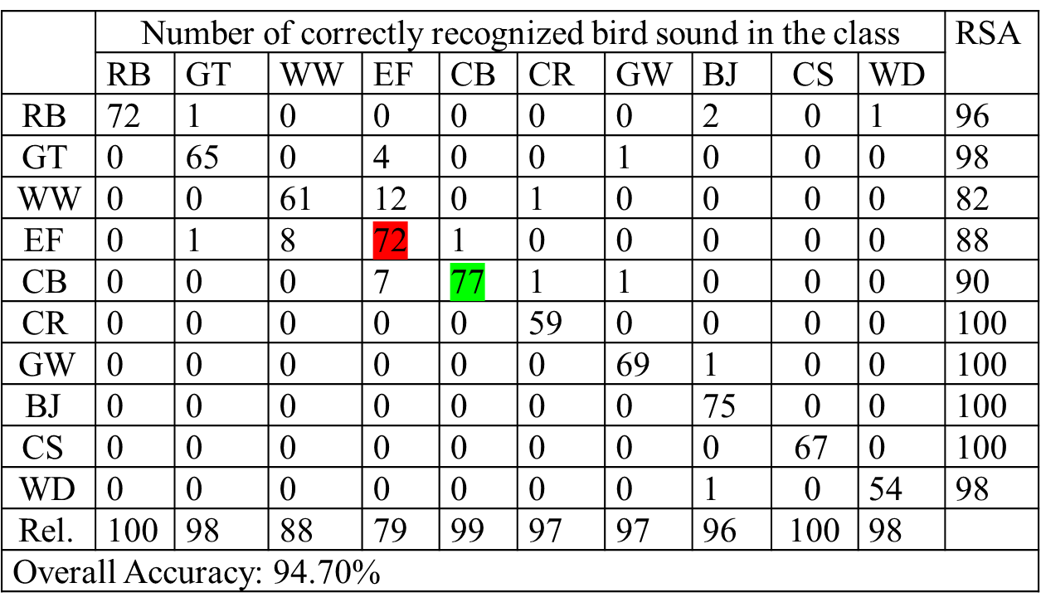
Table 13:Recognition of result with MFCC (27) features with KNN algorithm
College of Engineering, Pune

Slide 40
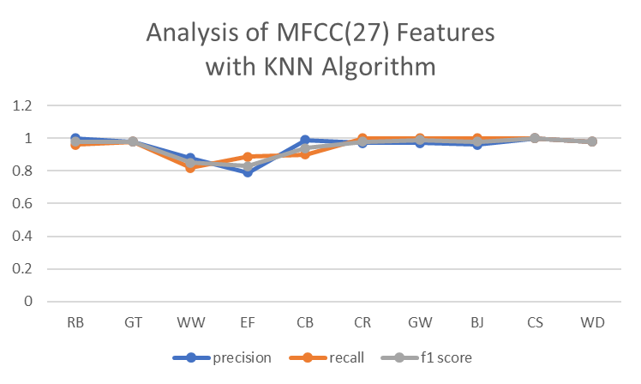
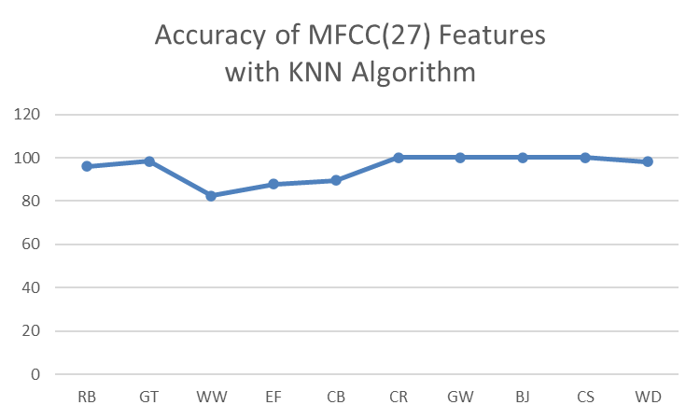
Fig 14 : Analysis and Accuracy of MFCC (27) Features with KNN Algorithm
College of Engineering, Pune

Slide 41
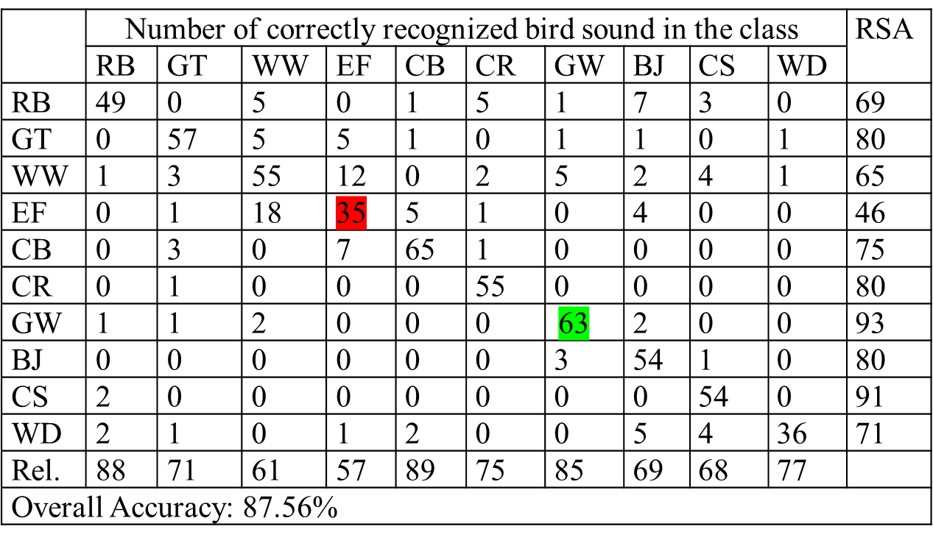
Result of LFCC
Table 14 :Recognition of result with LFCC (27) features
College of Engineering, Pune

Slide 42
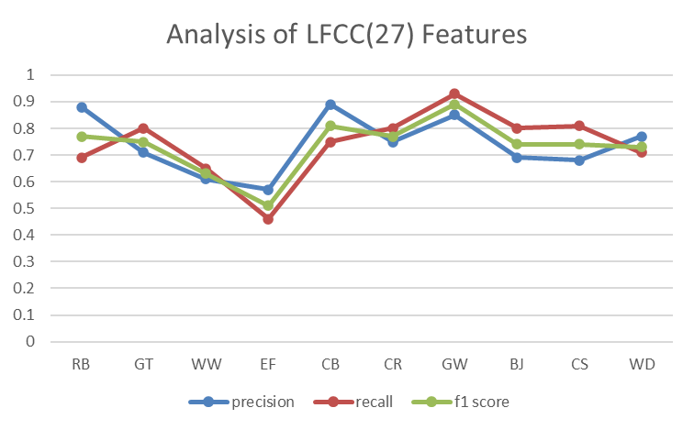
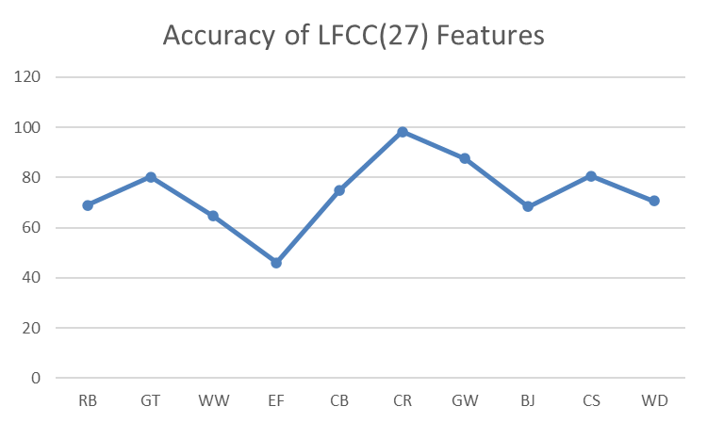
Fig 15: Analysis and Accuracy of LFCC (27) Features
College of Engineering, Pune

Slide 43

Table 15:Recognition of result with LFCC (27) features with KNN algorithm
College of Engineering, Pune

Slide 44
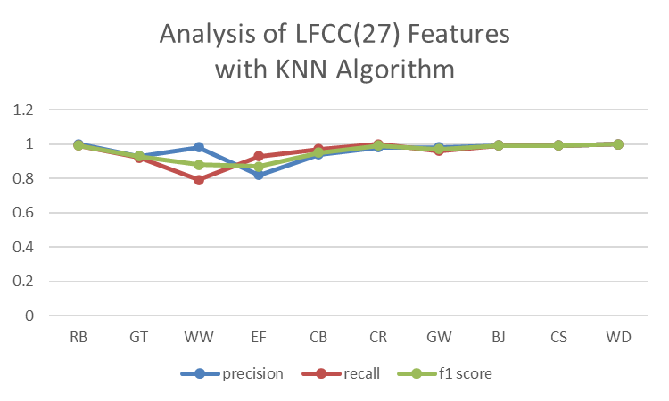
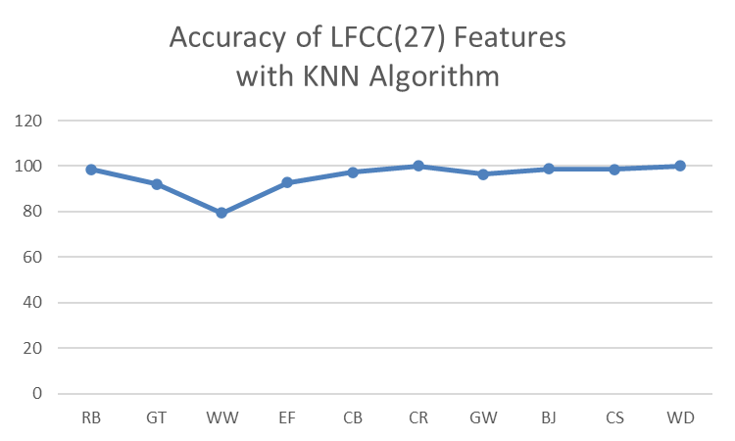
Fig 16 : Analysis and Accuracy of LFCC (27) Features with KNN Algorithm
College of Engineering, Pune

Slide 45
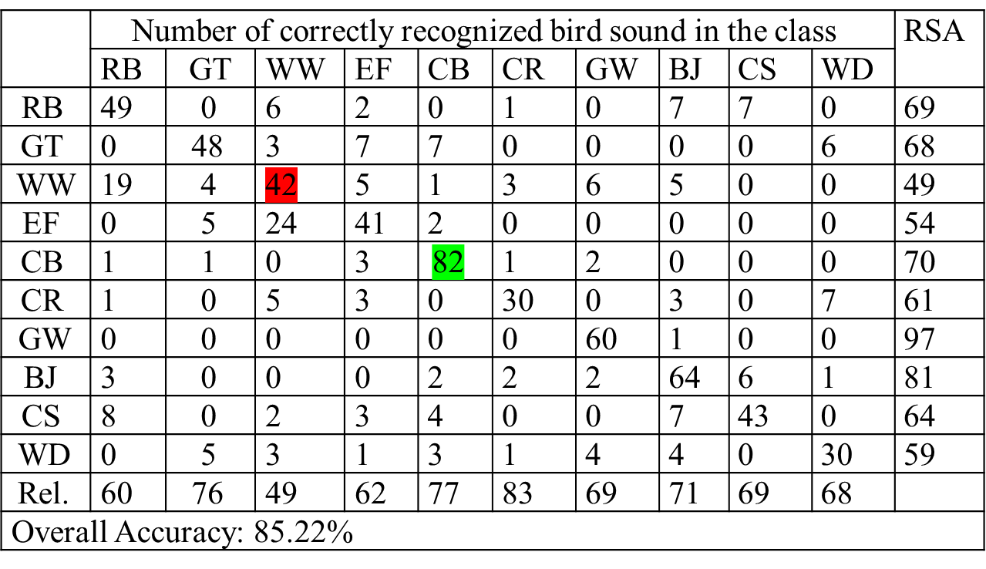
Result of GFCC
Table 16 :Recognition of result with GFCC (27) features
College of Engineering, Pune

Slide 46
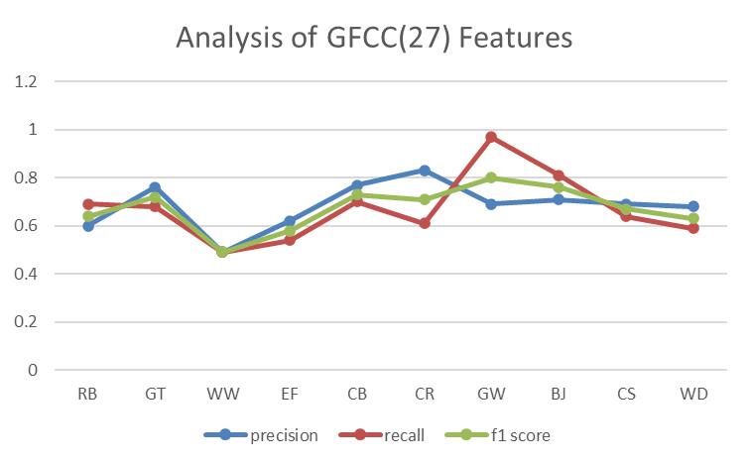
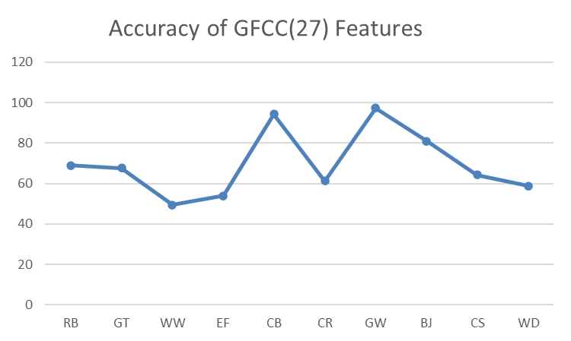
Fig 17 : Analysis and Accuracy of GFCC (27) Features
College of Engineering, Pune

Slide 47
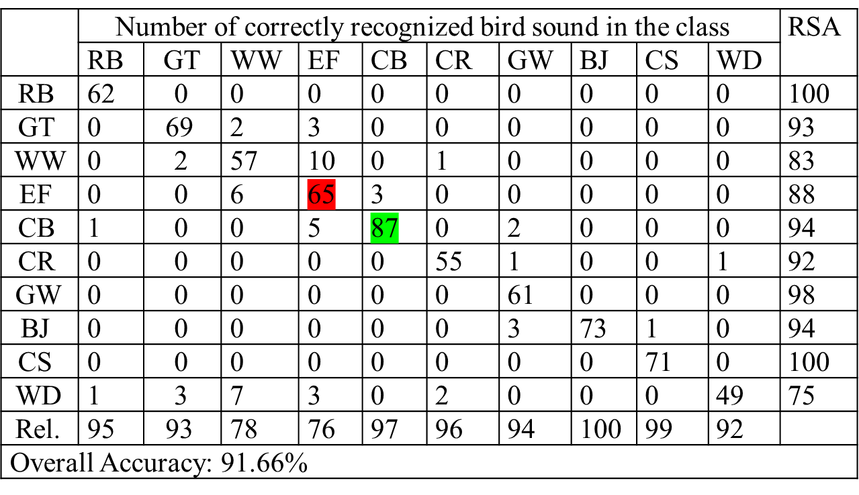
Table 17:Recognition of result with GFCC (27) features with KNN algorithm
College of Engineering, Pune

Slide 48
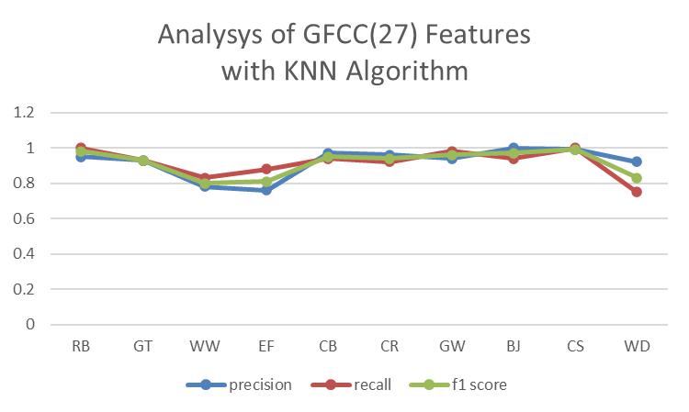
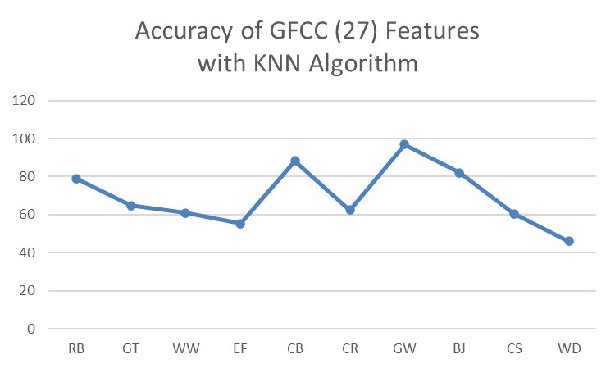
Fig 18 : Analysis and Accuracy of GFCC (27) Features with KNN Algorithm
College of Engineering, Pune

Slide 49
Table 18 :Overall Accuracy of Feature Selection
Sr. No. | Feature set | KNN | SVM
1 | MFCC | 94.7 | 73.58
2 | LFCC | 95.05 | 87.56
3 | GFCC | 91.66 | 85.22
College of Engineering, Pune

Slide 50
K-Nearest Neighbors
Supervised machine learning algorithm used for regression and classification.
Each query point considers the closest k value and predicts the maximum possible class.
It is also used for identifying similar objects.
For each bird audio signal, the mean value of the feature is extracted to form a vector.
College of Engineering, Pune

Slide 51
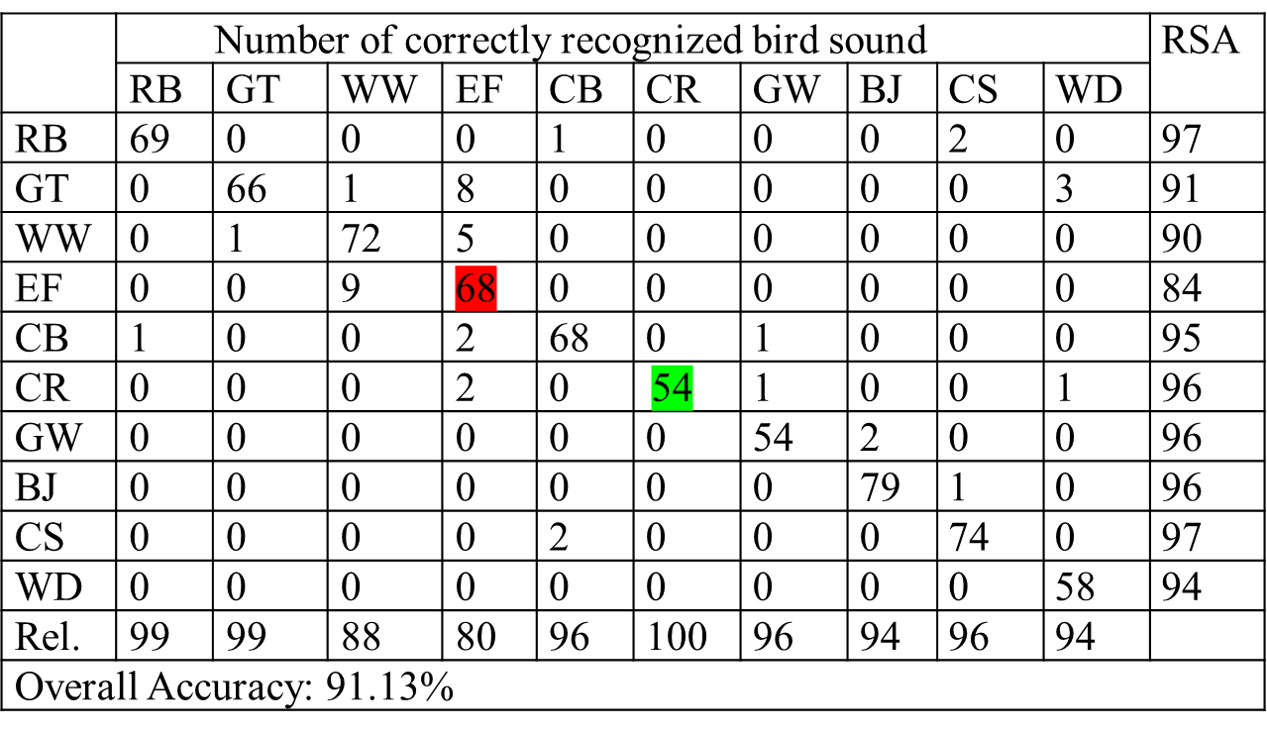
Result of MFCC
Table 19:Recognition of result with MFCC (13) features with KNN algorithm
College of Engineering, Pune

Slide 52
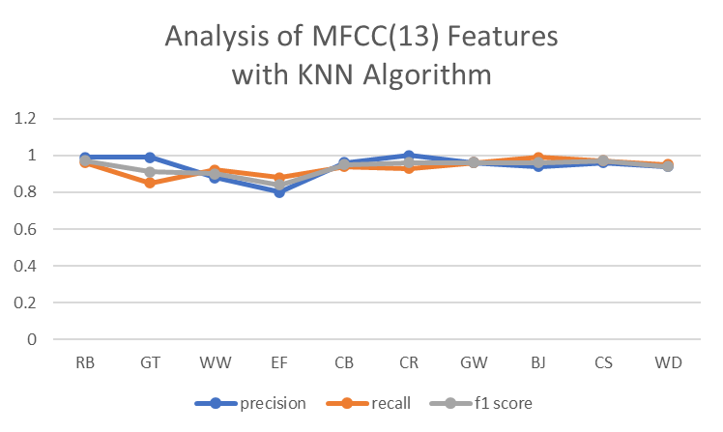
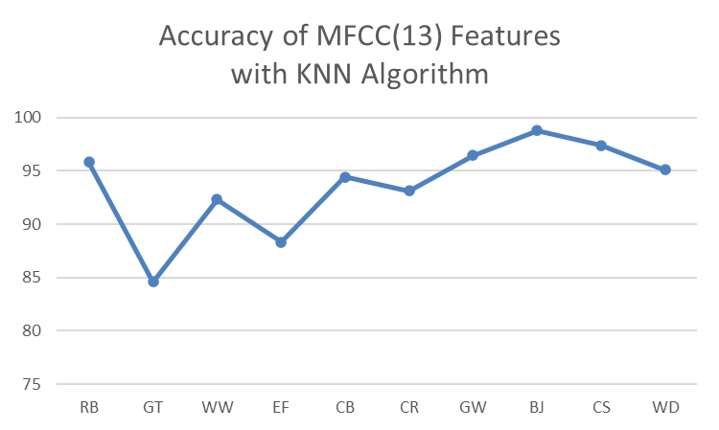
Fig 19 : Analysis and Accuracy of MFCC (13) Features with KNN Algorithm
College of Engineering, Pune

Slide 53

Table 20:Recognition of result with MFCC (26) features with KNN algorithm
College of Engineering, Pune

Slide 54


Fig 20 : Analysis and Accuracy of MFCC (26) Features with KNN Algorithm
College of Engineering, Pune

Slide 55

Table 21:Recognition of result with MFCC (39) features with KNN algorithm
College of Engineering, Pune

Slide 56


Fig 21 : Analysis and Accuracy of MFCC (39) Features with KNN Algorithm
College of Engineering, Pune

Slide 57

Result of LFCC
Table 22:Recognition of result with LFCC (13) features with KNN algorithm
College of Engineering, Pune

Slide 58


Fig 22 : Analysis and Accuracy of LFCC (13) Features with KNN Algorithm
College of Engineering, Pune

Slide 59

Table 23:Recognition of result with LFCC (26) features with KNN algorithm
College of Engineering, Pune

Slide 60


Fig 23 : Analysis and Accuracy of LFCC (26) Features with KNN Algorithm
College of Engineering, Pune

Slide 61

Table 24:Recognition of result with LFCC (39) features with KNN algorithm
College of Engineering, Pune

Slide 62


Fig 24 : Analysis and Accuracy of LFCC (39) Features with KNN Algorithm
College of Engineering, Pune

Slide 63

Result of GFCC
Table 25:Recognition of result with GFCC (13) features with KNN algorithm
College of Engineering, Pune

Slide 64


Fig 25: Analysis and Accuracy of GFCC (13) Features with KNN Algorithm
College of Engineering, Pune

Slide 65

Table 26:Recognition of result with GFCC (26) features with KNN algorithm
College of Engineering, Pune

Slide 66


Fig 26 : Analysis and Accuracy of GFCC (26) Features with KNN Algorithm
College of Engineering, Pune

Slide 67

Table 27:Recognition of result with GFCC (39) features with KNN algorithm
College of Engineering, Pune

Slide 68


Fig 27 : Analysis and Accuracy of GFCC (39) Features with KNN Algorithm
College of Engineering, Pune

Slide 69
Table 28:Overall Accuracy of Feature Extraction using KNN algorithm
Sr No. | Feature vector | MFCC | LFCC | GFCC
1 | 13 coefficients | 91.13 | 91.8 | 91.64
2 | 26 coefficients | 91.5 | 91.76 | 92.32
3 | 39 coefficients | 93.64 | 91.9 | 91.61
College of Engineering, Pune

Slide 70

Artificial Neural Network
ANN contains three layers called the Input layer, hidden layer and output layer.
The ReLU (Rectified Linear Unit) activation function assigns value zero if the negative and same value is positive.
Figure_28: Block Diagram of ANN Model
College of Engineering, Pune

Slide 71



Result of MFCC
Figure 29:Training and Validation Accuracy and loss of 13 MFCC coefficients
Figure 30:Training and Validation Accuracy and loss of 26 MFCC coefficients
College of Engineering, Pune

Slide 72



Figure 31:Training and Validation Accuracy and loss of 39 MFCC coefficients
Figure 32:Training and Validation Accuracy and loss of 27 MFCC coefficients
College of Engineering, Pune

Slide 73



Result of LFCC
Figure 33:Training and Validation Accuracy and loss of 13 LFCC coefficients
Figure 34:Training and Validation Accuracy and loss of 26 LFCC coefficients
College of Engineering, Pune

Slide 74



Figure 35:Training and Validation Accuracy and loss of 39 LFCC coefficients
Figure 36:Training and Validation Accuracy and loss of 27 LFCC coefficients
College of Engineering, Pune

Slide 75



Result of GFCC
Figure 37:Training and Validation Accuracy and loss of 13 GFCC coefficients
Figure 38:Training and Validation Accuracy and loss of 26 GFCC coefficients
College of Engineering, Pune

Slide 76



Figure 39:Training and Validation Accuracy and loss of 39 GFCC coefficients
Figure 40:Training and Validation Accuracy and loss of 27 GFCC coefficients
College of Engineering, Pune

Slide 77
Table 29:Overall Accuracy of Feature Extraction using ANN algorithm
Sr No. | Feature vector | MFCC | LFCC | GFCC
1 | 13 coefficients | 91.6 | 92.03 | 92.67
2 | 26 coefficients | 92.07 | 91.66 | 92.87
3 | 39 coefficients | 91.94 | 91.88 | 92.33
4 | 27 coefficients | 94.7 | 92.6 | 87.88
College of Engineering, Pune

Slide 78

Convolutional Neural Network
The layers of CNN contain the Input layer, a hidden layer and an output layer.
It also includes multiple convolution layers, pooling layers. The convolution network is a 2-D convolution layer.
Figure 41:Block Diagram of CNN Architecture
College of Engineering, Pune

Slide 79




Result of MFCC
Figure 42:Training and Validation Accuracy and loss of 13 MFCC coefficients
Figure 43:Training and Validation Accuracy and loss of 26 MFCC coefficients
College of Engineering, Pune

Slide 80




Figure 44:Training and Validation Accuracy and loss of 39 MFCC coefficients
Figure 45:Training and Validation Accuracy and loss of 27 MFCC coefficients
College of Engineering, Pune

Slide 81




Result of LFCC
Figure 46:Training and Validation Accuracy and loss of 13 LFCC coefficients
Figure 47:Training and Validation Accuracy and loss of 26 LFCC coefficients
College of Engineering, Pune

Slide 82




Figure 48:Training and Validation Accuracy and loss of 39 LFCC coefficients
Figure 49:Training and Validation Accuracy and loss of 27 LFCC coefficients
College of Engineering, Pune

Slide 83




Result of GFCC
Figure 50:Training and Validation Accuracy and loss of 13 GFCC coefficients
Figure 51:Training and Validation Accuracy and loss of 26 GFCC coefficients
College of Engineering, Pune

Slide 84




Figure 52:Training and Validation Accuracy and loss of 39 GFCC coefficients
Figure 53:Training and Validation Accuracy and loss of 27 GFCC coefficients
College of Engineering, Pune

Slide 85
Table 30:Overall Accuracy of Feature Extraction using CNN algorithm
Sr No. | Feature vector | MFCC | LFCC | GFCC
1 | 13 coefficients | 91.6 | 92.03 | 92.67
2 | 26 coefficients | 92.07 | 91.66 | 92.87
3 | 39 coefficients | 91.94 | 91.88 | 92.33
4 | 27 coefficients | 94.7 | 92.6 | 87.88
College of Engineering, Pune

Slide 86
Table 31:Classification accuracy of Different Feature set and classifiers
Sr.No | Feature Set | Length of Feature Vector | Accuracy
 |  |  | KNN | SVM | ANN | CNN
1 | Mel Frequency Cepstral Coefficients | 13 | 91.13% | 82.38% | 91.60% | 91.13%
 |  | 26 | 91.50% | 81.33% | 92.07% | 90.36%
 |  | 39 | 93.64% | 82.21% | 91.94% | 92.70%
 |  | 27 | 94.70% | 73.58% | 94.70% | 93.60%
2 | Linear Frequency Cepstral Coefficients | 13 | 91.80% | 85.53% | 92.03% | 91.67%
 |  | 26 | 91.76% | 85.49% | 91.66% | 90.67%
 |  | 39 | 91.90% | 85.88% | 91.88% | 92.80%
 |  | 27 | 95.05% | 87.56% | 92.60% | 93.80%
3 | Gammatone Frequency Cepstral coefficients | 13 | 91.64% | 87.64% | 92.67% | 91.58%
 |  | 26 | 92.32% | 87.44% | 92.87% | 91.18%
 |  | 39 | 91.61% | 85.88% | 92.33% | 90.18%
 |  | 27 | 91.66% | 85.22% | 87.88% | 93.44%
College of Engineering, Pune

Slide 87
Conclusion
Three sets of classifiers and feature sets are selected to classify bird species.
Gammatone Frequency Cepstral Coefficients with feature selection technique gives an accuracy of 93.44 %.
Linear Frequency Cepstral Coefficients with feature selection techniques offers maximum accuracy of 95.05 %.
The Recursive Feature Elimination (RFE) algorithm further improves the accuracy.
CNN with MFCC as features gives the highest accuracy compared to LFCC and GFCC.
College of Engineering, Pune

Slide 88
Research Paper
Conference Name | 8th International Conference on Signal Processing and Integrated Networks (SPIN 2021)
Paper Title | Bird Classification Based on Bird Sounds
Status | ACCEPTED
Acceptance Notification | 13-07-2021
Conference Date | 26-27 August 2021
IEEE Conference Record Number | 52536
College of Engineering, Pune

Slide 89
References:
[1] A. Charisma, M.R. Hidayat and Y.B. Zainal (2017). Speaker recognition using mel- frequency cepstrum coefficients and sum square error (3rd International Conference on Wireless and Telematics (ICWT), 2017),pp. 160-163.
[2] J. Xie, K. Hu, M. Zhu, J. Yu and Q. Zhu (2019). Investigation of Different CNN-Based Models for Improved Bird Sound Classification, vol. 7, pp. 175353- 175361
[3] A. Incze, H. Jancs´o, Z. Szil´agyi, A. Farkas and C. Sulyok,(2018). Bird sound recognition using a convolutional neural network,Proc. IEEE 16th Int. Symp. Intell. Syst. Inform. (SISY), pp. 000295-000300,
[4] P. Jancovic, M. K  ok¨ uer, M. Zakeri, and M. Russell, (2016). Bird species recognition using HMM-based unsupervised modelling of individual syllables with incorporated duration modelling, in International Conference on Acoustics, Speech and Signal Processing (ICASSP,pp. 559–563.
[5] Lee, Chang-Hsing & Lee, Yeuan-kuen & Huang, Ren-zhuang.(2006). Automatic Recognition of Bird Songs Using Cepstral Coefficients.Journal of Information Technology and Applications Vol. 1 No. 1,May, 2006, pp.17-23.
[6] Patole R., Rege P. (2021). Acoustic Classification of Bird Species. Advances in Signal and Data Processing. Lecture Notes in Electrical Engineering, vol 703. Springer, Singapore.
College of Engineering, Pune

Slide 90
[7] Trifa VM, Kirschel AN, Taylor CE, Vallejo EE (2008). species recognition of antbirds in a Mexican rainforest using hidden Markov models. IJ Acoust Soc Am. ;123(4):pp2424-2431.
[8] Dewi, Sita & Prasasti, Anggunmeka & Irawan, Budhi.(2019) Analysis of LFCC Feature Extraction in Baby Crying Classification using KNN (IEEE International Conference on Internet of Things and Intelligence System (IoTaIS),pp.86-91)..
[9] Jianyu Miao, Lingfeng Niu(2016)„ A Survey on Feature Selection Procedia Computer Science,Volume 91,Pages 919-926.
[10] S´anchez-Maro˜no N., Alonso-Betanzos A., Tombilla-Sanrom´an M.(2007) Filter Methods for Feature Selection – A Comparative Study ( Intelligent Data Engineering and Automated Learning - IDEAL,vol 488
[11] Guyon, I., Weston, J., Barnhill, S. et al..(2002) Gene Selection for Cancer Classification using Support Vector Machines. Machine Learning 46, pp. 389–422
[12] Rassak S, Nachamai M(2016) Survey study on the methods of bird vocalization classification IEEE international conference on current trends in advanced computing (ICCTAC),pp 1-8.
College of Engineering, Pune

Slide 91
[13] Valero X, Alias F(2012) Gammatone cepstral coefficients: Biologically inspired features for non-speech audio classification. IEEE Trans Multimedia 14(6): pp1684–1689.
[14]Towards Datascience Homepage https://machinelearningmastery.com/feature-selection-with-real-and-categorical-data/
[15] X. Chen and J. C. Jeong(2007) recursive feature elimination. Sixth International Conference on Machine Learning and Applications pp. 429-435.
College of Engineering, Pune

Slide 92
Thank You
College of Engineering, Pune

