Slide 1
TDD Implementation for Digital communications technology customer

Slide 2
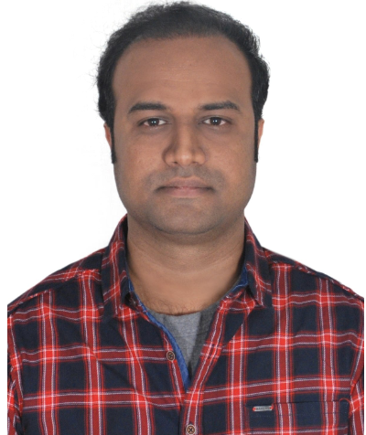
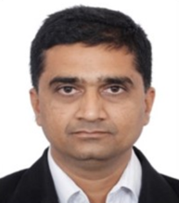
Introduction
Jagadesh Durairaj
Lead Consultant, TDD Coach
Supports organizations and teams in adopting Agile Way of Working and technical practices likes TDD
Manjunath Navalgund
Principle Consultant,
Rich experience in Agile methodologies including Scrum, Kanban, SAFe,LeSS, Spotify, XPetc

Slide 3
Table of Contents
01
What is TDD
02
Client – Context & Objectives
03
Implementation Plan
04
TDD Implementation Approach
05
TDD Implementation Steps
06
Accomplishments
07
Lesson learned

Slide 4
What is Test-Driven Development
TDD is a development concept when the tests are written before the code. In practice, developer starts the development process by writing unit-test before writing actual code implementation.
Write failing
test
Make It pass
Refactor
Add a test, run the test and see it fails
Write code
Run the test and see it passes
Refactor code
Repeat

Slide 5
Client - American multinational digital communications technology
Context
The client manufactures, and sells networking hardware, software, telecommunications equipment and other high-technology services and products
The client is actively working towards enhancing their Agile Engineering practices as a crucial aspect of their Agile transformation and the leadership is currently pursuing Test Driven Development (TDD).
Objective
Implement a new working methodology to improve the overall quality and efficiency of deliverables
Enhancing code quality and increasing code coverage with the primary goal of minimizing the quantity of reported defects
Embracing a shift left mindset is crucial in achieving these goals

Slide 6

Implementation Plan
Curated Content & setting
Mock project
Process setup
Leadership Enablement
Training for Teams
Sustenance
Improved metrics
Train and Coach next batch
Pre-Work
Training
Coaching
Repeat
3 Weeks
17 Hours
2 Months
Trainer On-boarding.
Interaction with leads, team members
Develop team specific Training content and Mock project
Setup Process – Metrics baselining
Concepts
Live Demonstration
Hands-On exercices
Sprint Simulation using live mock project
Best practice sharing
Coaching each tracks by TDD coaches
Setting metrics framework to gauge progress/success
Establish Sustenance.
Activities
Notes:
.8-10 weeks → Effort or 4 weeks duration?

Slide 7
TDD Implementation Approach
The pilot team for implementing the TDD approach was identified through an initial assessment.
Commencing the training and coaching sessions for both leaders and the pilot team.
Baseline metrics have been established for the pilot team.
The TDD approach was initially introduced to pilot team and gradually expanded over time(4 Teams)
Training was planned and conducted for all 4 teams
One on one with developer to evaluate and identifying the user story for TDD implementation.
Participating in a Scrum ceremony aids us in keeping track of the story for TDD implementation.

Slide 8
TDD Implementation Steps
Capture before metrics data
Overall and Individual class level(code analytic for the application, SonarQube -code coverage / technical debt/ code complexity)
Add new sub-task under the story listing all scenario to be tested (discuss with QA to figure more use case)
TDD approach (write test - implement enough code to pass - refactor)
Refactor - Look for code smell and cyclomatic fixes for that class
Kindly follow below steps while committing the code.
Once done with executing first unit testing failed case, commit the code with the message "<Jira Number>_TDD - Unit Test1".
Once actual implementation done for the test case, commit the code with the message "<Jira Number>_TDD - Actual Implementation1"
Repeat above 2 steps for the further unit test cases.
Once refactored code is available, (addressing code smell, cyclomatic complexity, and optimizing code) - commit the code with the message "<Jira Number>_TDD - Refactor".
Upon completion of the development testing, conduct a review with either a peer or a lead
Capture after change metric - Overall and Individual class level(code analytic for the application, SonarQube -code coverage / technical debt/ code complexity.

Slide 9
Accomplishments
Enhance code quality and reduce Technical Debt
Improve the Code Coverage
Defect Density - The early detection of defects aids in reducing the number of defects.
DRE – Detecting the bugs early in the development process allows the team to achieve a higher Defect Removal Efficiency

Slide 10
Lesson Learned
Required significant shift in culture to adopt TDD which was enabled by TDD coach.
The process of monitoring the pull request with commit messages was established to adhere TDD approach.
Once the developer gains more confidence in the functionality and ensures that the existing functionality is not being impacted, they can address any code smells that may arise.
Teams should have proper backlog story for TDD.

Slide 11
THANK YOU
© 2018 Infosys Limited, Bangalore, India. All Rights Reserved. Infosys believes the information in this document is accurate as of its publication date; such information is subject to change without notice. Infosys acknowledges the proprietary rights of other companies to the trademarks, product names and such other intellectual property rights mentioned in this document. Except as expressly permitted, neither this documentation nor any part of it may be reproduced, stored in a retrieval system, or transmitted in any form or by any means, electronic, mechanical, printing, photocopying, recording or otherwise, without the prior permission of Infosys Limited and/ or any named intellectual property rights holders under this document.
© 2018 Infosys Limited, Bengaluru, India. All Rights Reserved. Infosys believes the information in this document is accurate as of its publication date; such information is subject to change without notice. Infosys acknowledges the proprietary rights of other companies to the trademarks, product names and such other intellectual property rights mentioned in this document. Except as expressly permitted, neither this documentation nor any part of it may be reproduced, stored in a retrieval system, or transmitted in any form or by any means, electronic, mechanical, printing, photocopying, recording or otherwise, without the prior permission of Infosys Limited and/ or any named intellectual property rights holders under this document.

