Slide 1

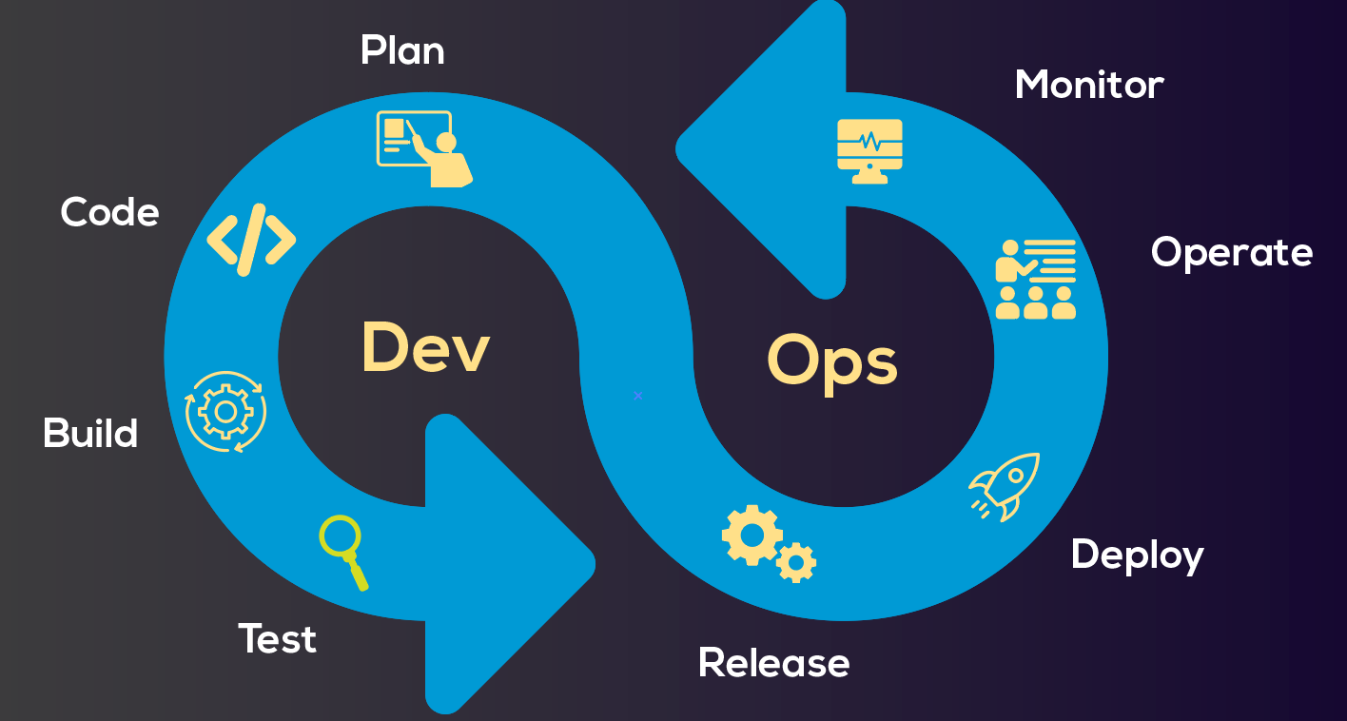
DevOps Team Responsibilities
AWS Account Management
Infrastructure Management
CI/CD (Continuous Integration/Continuous Deployment)
Test Tools

Slide 2




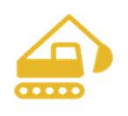


DevOps Cycle Stage | DevOps Cycle Stage | Tools and Technologies
 | Infrastructure management | Terraform, Terragrunt, Helm, Docker
 | Planning & management | Jira
 | CI/CD | Jenkins
 | Version Control | Bitbucket
 | Development | Swift, Kotlin, JavaScript, Python, Shell script
 | Building | Gradle, Maven, npm, Node.js, Xcode
 | Testing | Selenium, Vividus, Fastlane
 | Code quality and security | SonarQube, Checkmarx

Slide 4
Category | Service | Description
Networking | VPC (Virtual Private Cloud) | Isolated network environment for resources.
 | Route 53 | Scalable DNS and domain name registration service.
 | Internet Gateway | Allows communication between instances in your VPC and the internet.
 | NAT (Network Address Translation) | Enables instances in a private subnet to connect to the internet.
 | Transit Gateway | Connects multiple VPCs and on-premises networks through a central hub.
 | Availability Zone | A distinct location within a region with its own power, networking, and connectivity.
 | Endpoint | A private connection to AWS services, accessible only within your VPC.

Slide 5
Category | Service | Description
Compute | EKS (Elastic Kubernetes Service) | Managed Kubernetes service for container orchestration.
 | EC2 (Elastic Compute Cloud) | Scalable virtual servers in the cloud.
Storage | S3 (Simple Storage Service) | Object storage service for scalable data storage.
 | EBS (Elastic Block Store) | Block storage service for use with EC2 instances and persistent volume for EKS EC2.
Security & Encryption | KMS (Key Management Service) | Manages cryptographic keys for your applications and services.
 | ACM (AWS Certificate Manager) | Manages SSL/TLS certificates for secure communication.
Container Management | ECR (Elastic Container Registry) | Container registry for storing and managing Docker images.

