Slide 1


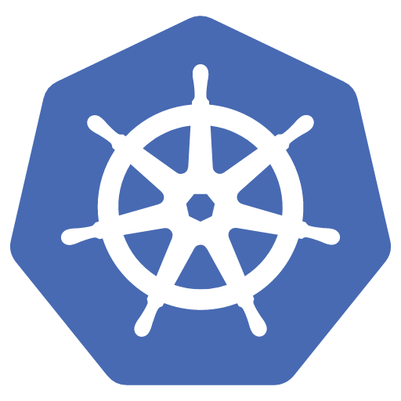



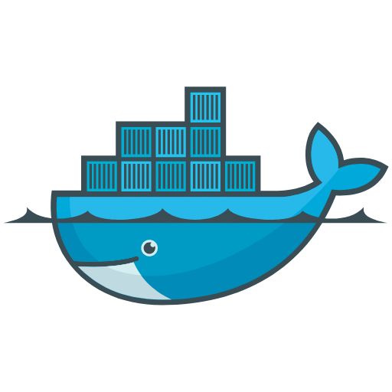
Jenkins Setup & Update Process
Context
Jenkins is deployed on Amazon EKS (Elastic Kubernetes Service), with infrastructure provisioning managed through Terragrunt and Terraform. The Jenkins deployment utilizes a Docker image stored in AWS ECR (Elastic Container Registry) and is orchestrated via Helm packages
Bitbucket
Terraform
AWS EKS
Helm chart
Jenkins
Docker image

Slide 2
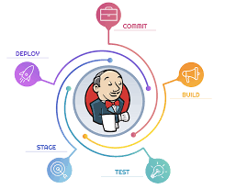
Objective
Primary Goal:
The main objective is to update Jenkins to the latest stable version while ensuring the stability and functionality of the existing CI/CD pipelines.
Secondary Goals:
To improve security by addressing vulnerabilities in the current Jenkins version.
To leverage new features and enhancements in the updated Jenkins version.
To ensure compatibility with the latest plugins and integrations.

Slide 3

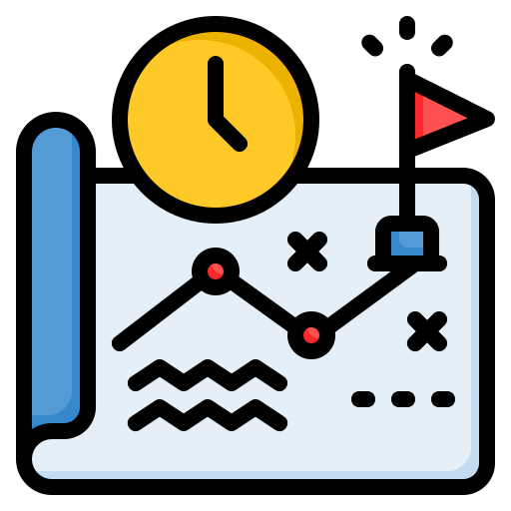
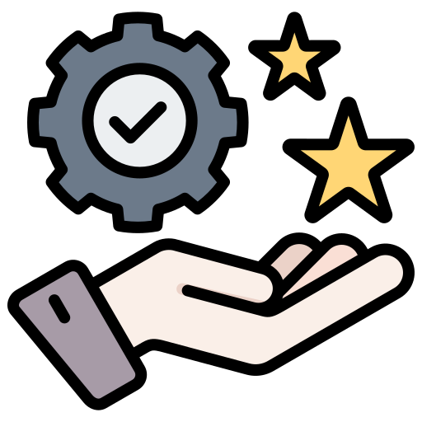

Approach
Assessment:
Evaluate the current Jenkins setup, including installed plugins, job configurations, and custom scripts, to ensure compatibility with the new version.
Planning:
Develop a comprehensive plan for updating Jenkins, including backup strategies, rollback plans, and testing.
Execution:
Implement the update in a controlled manner, expecting downtime or worst case scenarios.
Validation:
Post-update, perform rigorous testing to confirm that all Jenkins jobs and integrations work as expected.

Slide 4
Implementation Steps
Build and Push Image:
Build the updated version Docker image using docker file.
Tag the new image appropriately and push it to AWS ECR.
Helm Chart Update
Modify the “values.yaml” file in Helm chart configuration to use the new image which is stored on ecr.
Ensure that any configuration changes required for the new Jenkins version are included.
Push new package of helm chart to ecr.
Update Terraform in helm chart changes and apply. Pre-check using terraform plan if need.

Slide 5
Post-Update
Ensure that all Jenkins jobs, pipelines, and integrations are functioning correctly after the update.
Verify that new jobs are running successfully.
Verify that PVC has successfully attached.

