Slide 1

Beginning Java for Android Session 2: Android— a handheld robot
Izzy Johnston
izzycjohnston@gmail.com
@izzy_johnston

Slide 2

What is Android?
Software Stack
Operating System
Middleware
Applications
Founded in 2003, bought by Google in 2005
Open source Software Development Kit
SDK to the initiated

Slide 3
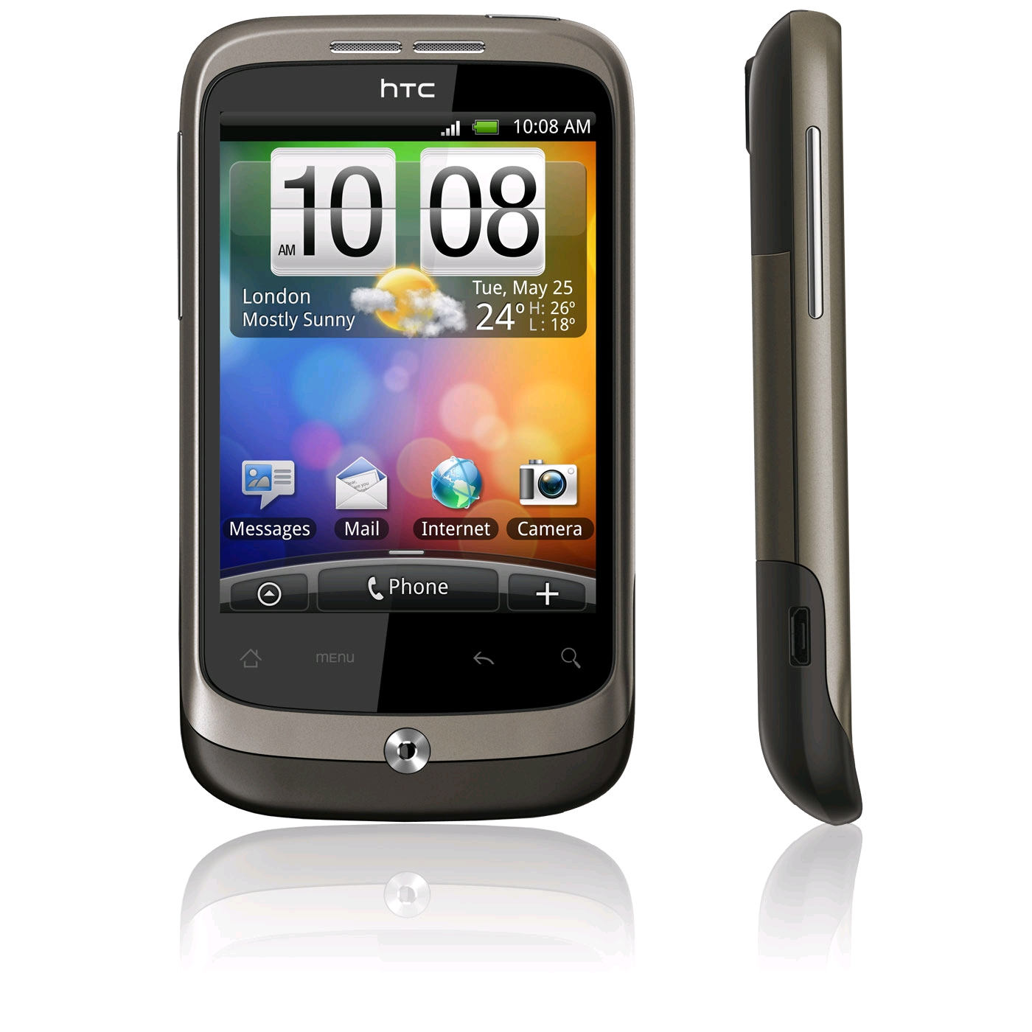
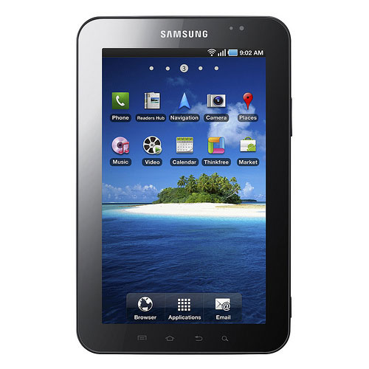
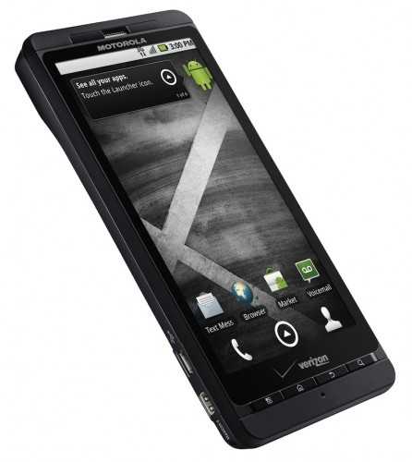

What you need to know
Multiple devices
OS and device are not synonymous
Phones, Tablets, Nook e-reader
Apps written in Java
Can call external APIs
Webkit, Geo-referencing, OpenGL

Slide 4


Getting Started
Tell Eclipse that you will be using the Android SDK
Create a New Android project
Using the Android SDK is like using specific lego blocks.
Fancier ones. Like Technic.

Slide 5
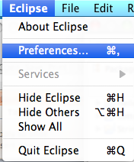
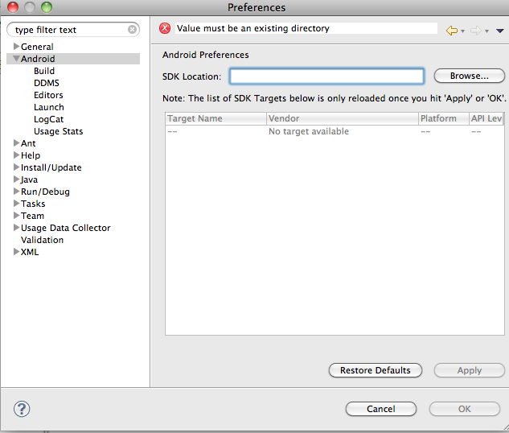

Slide 6
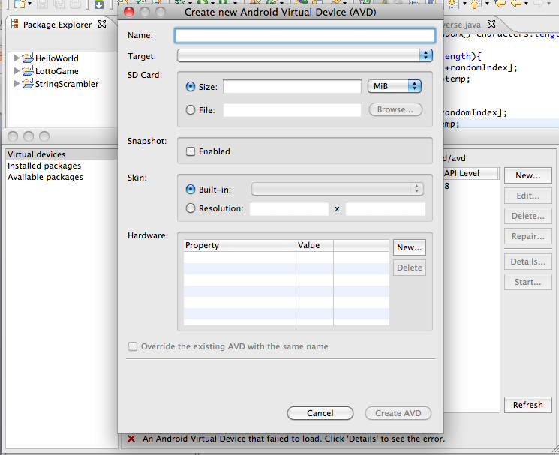
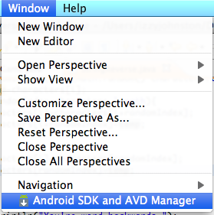

Slide 7
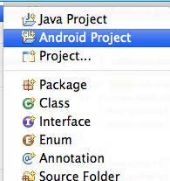
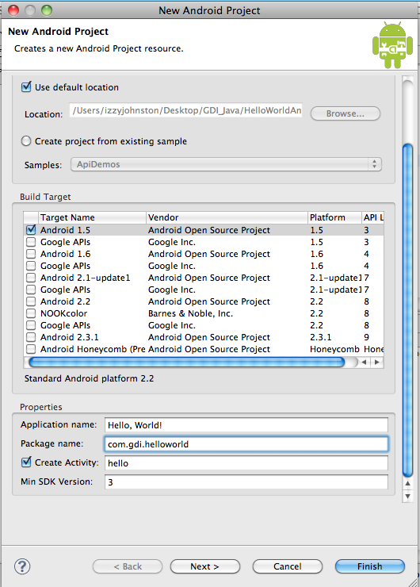
Application Name—what it will say by the icon
Package—unique identifier of whole app
Activity—automatically generated class

Slide 8
File Structure
src—contains the guts, all classes of app
gen-generated Java files
Build SDK
assets—non-Java files
res—layouts, images, etc.
AndroidManifest.xml—ever important permissions

Slide 9
Your First Android App
package com.gdi.helloworld;
import android.app.Activity;
import android.os.Bundle;
public class hello extends Activity {
/** Called when the activity is first created. */
@Override
public void onCreate(Bundle savedInstanceState) {
super.onCreate(savedInstanceState);
setContentView(R.layout.main);
}
}

Slide 10
Android Manifest File
<?xml version="1.0" encoding="utf-8“ ?>
<manifest xmlns:android="http://schemas.android.com/apk/res/android"
package="com.gdi.helloworld"
android:versionCode="1"
android:versionName="1.0">
<uses-sdk android:minSdkVersion="3" />
<application android:icon="@drawable/icon" android:label="@string/app_name">
<activity android:name=".hello" android:label="@string/app_name">
<intent-filter>
<action android:name="android.intent.action.MAIN" />
<category android:name="android.intent.category.LAUNCHER" />
</intent-filter>
</activity>
</application>
</manifest>

Slide 11
Layouts
Absolute Layout
pixel by pixel
Relative Layout
relative to other objects
Table Layout
simple table
Linear Layout
either horizontal or vertical
All layouts can be nested inside each other

Slide 12
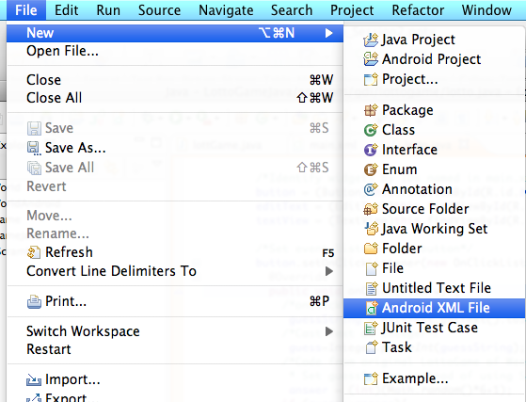
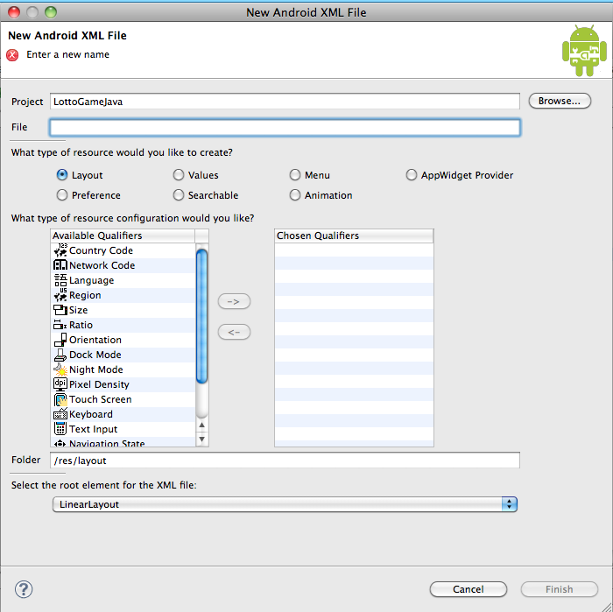

Slide 13
Showing Information to the User
Views
TextView
ImageView
SurfaceView
Attributes and values
android:background="#ffffff"
android:text="@string/hello"
android:text="HEY THERE!"

Slide 14
Adding an ImageView
<ImageView android:layout_height="wrap_content"
android:src="@drawable/android"
android:id="@+id/imageView1"
android:layout_width="fill_parent">
</ImageView>

Slide 15

Adding attributes
LinearLayout:
android:background="#ffffff"
TextView:
android:textColor="#000000"

Slide 16
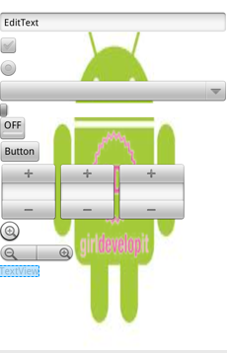
Getting data from the user
EditText
CheckBox
RadioButton
Spinner
Slider
ToggleButton
Button
DatePicker
Zoom
ZoomControl

Slide 17
LottoGame for Android!
Create new Android Project
Name it LottoGameAndroid
package com.gdi.lottogame
Choose a name for the App and the first class
Add a EditText, a Button, and a TextView
Add the property to LinearLayout
android:background="@drawable/android"

Slide 18
Layout for LottoGame
<?xml version="1.0" encoding="utf-8"?>
<LinearLayout xmlns:android=http://schemas.android.com/apk/res/android android:orientation="vertical" android:layout_width="fill_parent" android:layout_height="fill_parent" android:background="@drawable/android">
<EditText android:text="EditText" android:layout_width="fill_parent" android:layout_height="wrap_content" android:id="@+id/editText1"></EditText>
<Button android:text="Button" android:id="@+id/button1" android:layout_width="wrap_content" android:layout_height="wrap_content"></Button>
<TextView android:id="@+id/textView1" android:layout_width="wrap_content" android:layout_height="wrap_content" android:text="TextView"></TextView>
</LinearLayout>

Slide 19
Connecting to Widgets
Above public class{
import android.widget.Button;
import android.widget.EditText;
import android.widget.TextView;
Above @Override
Button button;
EditText editText;
TextView textView;

Slide 20

Event Listeners
onClick()
onDrag()
onFocus()
onLongClick()
onScale()

Slide 21
Event Listeners for LottoGame
import android.view.View;
import android.view.View.OnClickListener;
button = (Button)this.findViewById(R.id.button1);
button.setOnClickListener(new OnClickListener() {
@Override
public void onClick(View v) {
}
});

Slide 22
Getting and Setting Text
editText = (EditText)this.findViewById(R.id.editText1);
textView = (TextView)this.findViewById(R.id.textView1);
onClick(View v){
guessString = editText.getText().toString();
textView.setText(guessString);
guessString = editText.getText().toString();
guess=Integer.parseInt(guessString);
guess=guess-6;
guessString=Integer.toString(guess);
textView.setText(guessString);

Slide 23
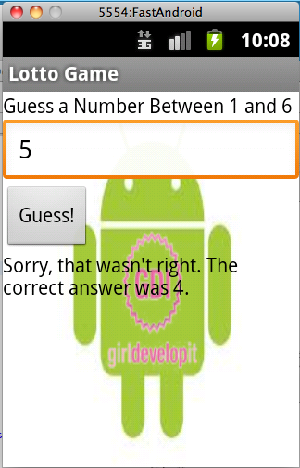
Using LottoGame from Last week
guessString="Congratulations! You guessed right!";
guessString="Sorry, that wasn't right. The correct answer was " + answer+".";
textView.setText(guessString);

Slide 24
Homework
Use what you learned about getting user data today to create a version of StringScrambler for the Android
Bonus: Play with other widgets that get user data

Slide 25
Questions?
?

