Slide 1

Beginning Java for Android Session 3: Drawing—a high tech Pre-K class
Izzy Johnston
izzycjohnston@gmail.com
@izzy_johnston

Slide 2
Quick Review
Object Oriented Programming
Classes, Methods, States
Android SDK
Getting User Data
Giving User Data
Math class
String class

Slide 3
Canvas
Class from Java API
updated for Android SDK
Draw images, shapes, text
Import android.graphics.Canvas
On a View or a SurfaceView
Allows constant iteration
can be animated and interacted with

Slide 4
Paint
Color objects solid or with gradients
Style stroke and font
import android.graphics.Paint
import android.graphics.Color
Color Types
Hexadecimal (#000000)
Integer (Color.BLACK)
RGB (0, 0, 0)

Slide 5
What shapes can we draw?
Circle---
drawCircle(int xPosition, int yPosition, int radius, Paint paint);
Color---
drawColor(int color);
Line---
drawLine(float startX, float startY, float stopX, float stopY, Paint paint);
Point---
drawPoint (float x, float y, Paint paint);
Rectangle---
drawRect (float xLeft, float yTop, float xRight, float yBottom, Paint paint);
Bitmap---
drawBitmap(Bitmap bitmap, float xLeft, float yTop, Paint paint);

Slide 6
Draw Shapes on Canvas
Create new Android application, called ShapesCanvas
com.gdi.shapescanvas
Default activity ShapeCanvas

Slide 7
Creating a new class
private class Rectangle extends View{
private final float x;
private final float y;
private Paint rectPaint = new Paint(Paint.ANTI_ALIAS_FLAG);
public Rectangle(Context context, float x, float y) {
super(context);
this.x = x;
this.y = y;
}

Slide 8
Implementing Canvas
@Override
protected void onDraw(Canvas canvas) {
super.onDraw(canvas);
float centerX=canvas.getWidth()/2;
float centerY=canvas.getHeight()/2;
int topX=(int)(centerX-(x/2));
int topY=(int)(centerY-(y/2));
int botX=(int)(centerX+(x/2));
int botY=(int)(centerY+(y/2));
rectPaint.setColor(Color.GREEN);
canvas.drawRect(topX, topY, botX, botY, rectPaint);
}
}
Because drawRect needs the coordinates of the upper left and the bottom right corners, we have to generate them.

Slide 9
Drawing on our screen
Rectangle myRectangle = new Rectangle(this, 20,40);
setContentView(myRectangle);
To think about:
Fair warning, your homework will be to do everything we did today for a circle

Slide 10
What Styles can we add?
One Color---
setColor(int color);
A two-color, linear gradient---
setShader(new LinearGradient(int xStart, int yStart, int xEnd, int yEnd, int color1, int color2, Shader.TileMode.MIRROR);
A two-color, linear gradient---
setShader(new RadialGradient(int xCenter, int yCenter, int radius, int color1, int color2, Shader.TileMode.MIRROR);

Slide 11
Dressing up our rectangle
Add 2 new parameters to Rectangle method
color1 and color2
rectPaint.setColor(color1);
OR
rectPaint.setShader(new LinearGradient(topX,botY,topX,botY, color1, color2, Shader.TileMode.MIRROR));
OR
rectPaint.setShader(new RadialGradient(centerX, centerY, 7, color1, color2, Shader.TileMode.MIRROR));
Don't forget to add colors when we call our rectangle in the main method!

Slide 12
Drawables
More static objects
Can be placed on Canvas or ImageView
More easily created, less easily manipulated
Angry Birds vs. background images
Allows for some animation
Not meant to be iterated constantly

Slide 13
Drawing with Drawables
Create new Android application, called ShapesCanvas
com.gdi.shapedrawable
Default activity ShapeDrawable
Add an ImageView to main.xml

Slide 14
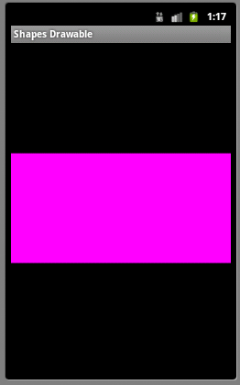
Creating a ShapeDrawable
ShapeDrawable rectangle = new ShapeDrawable ();
rectangle.setShape(new RectShape());
rectangle.setIntrinsicHeight(100); rectangle.setIntrinsicWidth(200);
rectangle.getPaint().setColor(color.MAGENTA);
ImageView iView = (ImageView)findViewById(R.id.imageView1);
iView.setImageDrawable(rectangle);

Slide 15
What else can we draw?
OvalShape()—oval width and height defined like RectShape
ArcShape(int startDegree, int endDegree)
Path p =new Path();
p.moveTo(50, 0);
p.lineTo(25, 100);
p.lineTo(100, 50);
p.lineTo(0, 50);
p.lineTo(75, 100);
p.lineTo(50, 0);
PathShape(Path path, int middleX, int middleY);

Slide 16
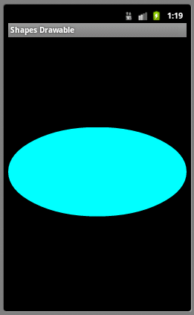
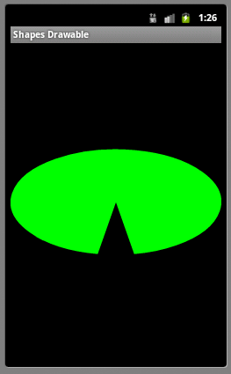
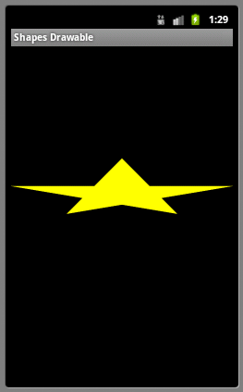

Slide 17
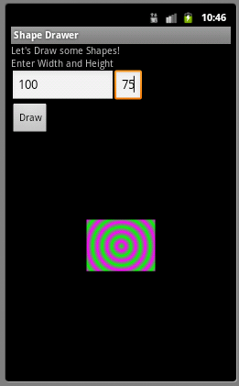
Letting users pick the size
Add two EditText widgets to the main.xml
Add one button
Create an onClick method that gets the height, width
Create myRectangle with those values

Slide 18
Letting users pick the size
button = (Button) findViewById(R.id.button1);
widthText = (EditText) findViewById(R.id.editText1);
heightText = (EditText) findViewById(R.id.editText2);
button.setOnClickListener(new OnClickListener() {
@Override
public void onClick(View v) {
String widthString=widthText.getText().toString();
width=Integer.parseInt(widthString);
String heightString=heightText.getText().toString();
height=Integer.parseInt(heightString);
[…]
rectangle.setIntrinsicHeight(width);
rectangle.setIntrinsicWidth(height);
[…]
}
});

Slide 19
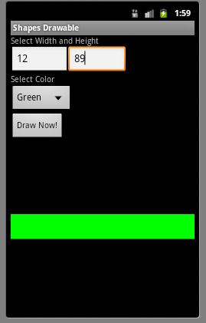
Letting Users Pick the Color
Add a spinners in main.xml
Populate them with an array of strings
Get the user choice onClick
Use the user's choice to add color

Slide 20
Letting Users Pick the Color
Spinner—
android:entries="@array/colors"
Strings—
<string-array name="colors">
<item name="green">Green</item>
<item name="blue">Blue</item>
<item name="magenta">Magenta</item>
<item name="cyan">Cyan</item>
</string-array>

Slide 21
Letting Users Pick the Color
colorSpinner= (Spinner)findViewById(R.id.spinner1);
int colorPos=colorSpinner.getSelectedItemPosition();
if (colorPos==0){
color=Color.GREEN;
}
else if(colorPos==1){
color=Color.BLUE;
}
else if(colorPos==2){
color=Color.MAGENTA;
}
else{
color=Color.CYAN;
}
[…]
rectangle.getPaint().setColor(color);
[…]

Slide 22
In Class and Homework
Create new applications (or add to your existing one) to create circles, ovals, or paths in Canvas and with ShapeDrawable
Experiment with Paint Color and Gradient
Think of one other widget we could use to get user data and apply it to the shapes we are drawing.

Slide 23
Questions?
?

