Slide 1

Beginning Java for Android Session 4: Finding yourself
Izzy Johnston
izzycjohnston@gmail.com
@izzy_johnston

Slide 2
Android Location
Geocoder
Forward and Reverse Geocoding
Converting addresses to Latitude and Longitude
Address
Set of strings to represent location
LocationManager
Access to System Geo Location Software and Hardware

Slide 3
Using Android Location
Add permissions to Manifest File
<uses-permission android:name="android.permission.ACCESS_FINE_LOCATION" />
<uses-permission android:name="android.permission.ACCESS_COARSE_LOCATION" />
<uses-permission android:name="android.permission.INTERNET" />
Import classes into Activity File
import android.location.Address;
import android.location.Geocoder;
import android.location.LocationManager;

Slide 4
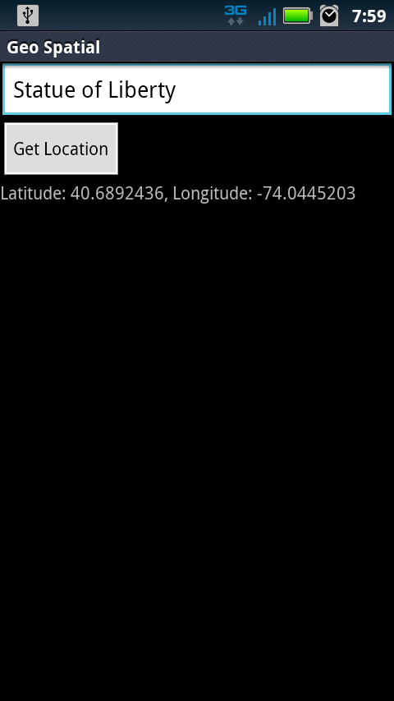
Preparing the Layout
Add EditText to take Address
Add Button
Add TextView to display Latitude and Longitude

Slide 5
Giving and getting Geo Data
myGeoCoder = new Geocoder(this);
button.setOnClickListener(new OnClickListener() {
public void onClick(View v) {
String addressInput = address.getText().toString();
try {
List<Address> foundAdresses = myGeoCoder.getFromLocationName(addressInput, 5);
if (foundAdresses.size() == 0) {
latLong.setText("Sorry, we could not find that address");
}

Slide 6
Giving and Getting Data, cont.
else {
for (int i = 0; i < foundAdresses.size(); i++) {
Address x = foundAdresses.get(i);
lat = x.getLatitude();
lng = x.getLongitude();
latLong.setText("Latitude: "+lat+", Longitude: "+lng);
}
}
}
catch (Exception e) {
}
}
});

Slide 7
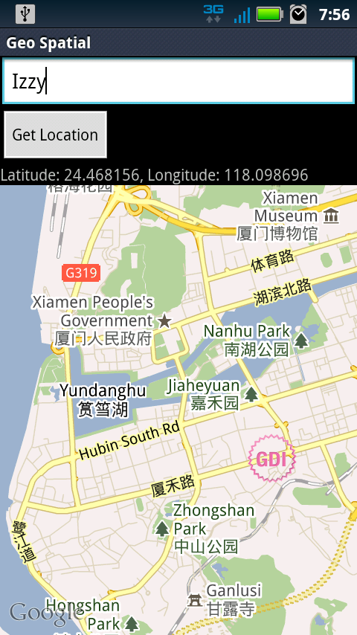
Google Maps APIs
Map Imaging
Allows addition of Views not in SDK
Can call Maps according to geo-location
Show Markers

Slide 8
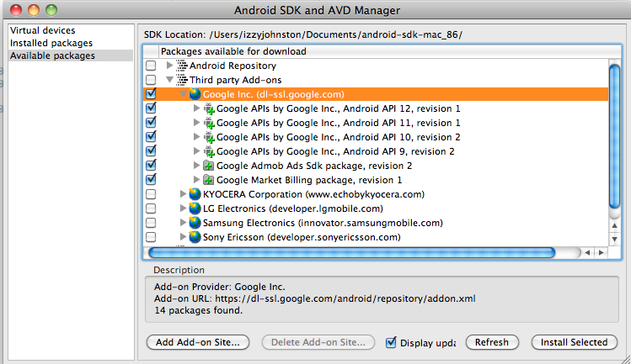
Adding Third Party APIs
Map Imaging
Allows addition of Views not in SDK
Can call Maps according to geo-location
Show Markers

Slide 9
Calling Google Maps
Add Library in Manifest File
<uses-library android:name="com.google.android.maps" />
Import classes into Activity File
import com.google.android.maps;
import com.google.android.maps.MapActivity;
import com.google.android.maps.MapController;
import com.google.android.maps.MapView;
Extend MapActivity
public class FindMe extends MapActivity

Slide 10
Adding MapView to main.xml
<com.google.android.maps.MapView
android:id="@+id/mapView1"
android:layout_width="fill_parent"
android:layout_height="fill_parent"
android:clickable="true"
android:apiKey="0kb_7ZLOgkqpspHjVyoGK0KLPYvJP_cW-Nvalvw"
/>
Obtaining a MapKey
http://code.google.com/android/add-ons/google-apis/mapkey.html

Slide 11
Show MapView
MapView myMap = (MapView) findViewById(R.id. mapView1);
myMap. setSatellite(false) ;
myMap.setBuiltInZoomControls(true);
MapController myController = myMap.getController();
myController.setZoom(10);
GeoPoint myGeoPoint = new GeoPoint((int) (lat*1000000), (int)( lng*1000000);
myController.animateTo(myGeoPoint);

Slide 12
Adding a Marker
ImageView myMapMarker = new ImageView(this) ;
MapView.LayoutParams myMapMarkerParams = new
MapView.LayoutParams( LayoutParams.WRAP_CONTENT,
LayoutParams. WRAP_CONTENT,
myGeoPoint, MapView. LayoutParams. TOP_LEFT ) ;
myMapMarker. setImageResource(R. drawable. marker) ;
myMap. addView(myMapMarker, myMapMarkerParams);

Slide 13
What Now?
Great Resources
http://developer.android.com
http://www.anddev.org/
http://stackoverflow.com
http://download.oracle.com/javase/1,5.0/docs/api/
How to get Published??
Signing: http://developer.android.com/guide/publishing/app-signing.html
Versioning: http://developer.android.com/guide/publishing/versioning.html
Preparing: http://developer.android.com/guide/publishing/preparing.html
Publishing: http://developer.android.com/guide/publishing/publishing.html

Slide 14
Questions?
?

