Slide 1
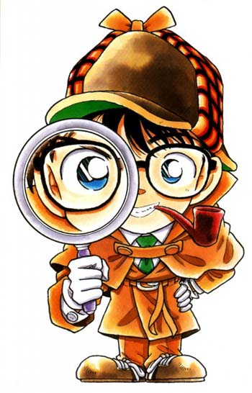
Mission: Find the evidence
Next

Slide 2
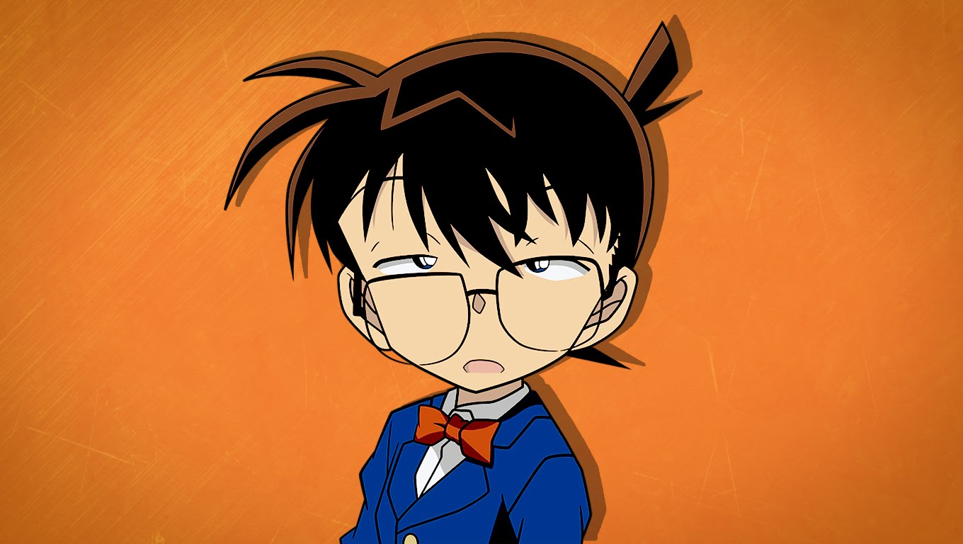
It’s on the internet, so it must be true…
Next

Slide 3
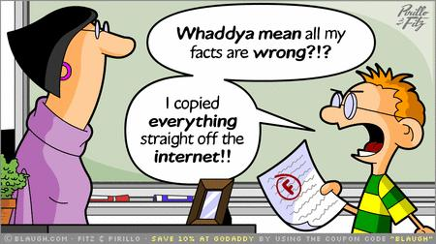
Or not…
Instructions
Read through each slide
Click Next to advance forward
Be sure to explore each link
This presentation will help you complete Mission Assignment 1: Investigation Information.
Next

Slide 4
Who (is providing the information)?
A good detective wants to know who is providing the information. Is this person credible (believable)?
Click on this website. Can you find the author and the publisher?
Harrison Ford could have died (click to view)
Next

Slide 5

Quiz
Who is the author? Who is the publisher?
Harrison Ford/The Guardian
Milton Keynes/The BBC
Andrew Marshall/ The BBC
Hannah Ellis-Petersen/ The Guardian
A
B
C
D

Slide 6

Correct!
Great Detective Work!
Click to continue
Hannah Ellis-Petersen is the author of this article and it was published online by The Guardian

Slide 7

Sorry – try again
Click to try again

Slide 8
Who is providing the information
Questions to ask
Can you locate the author? Hint: look for an “about” or “contact” link
Who is this person? Are they qualified to provide the information. If you are unsure, Google them
Is the author an expert? Auto mechanic on a page with tips on caring for your car, Doctor on the Web MD site, etc.
Who published the page? Always ask why. Is this a news story or are they trying to sell you something?
Is there contact information?
Next

Slide 9
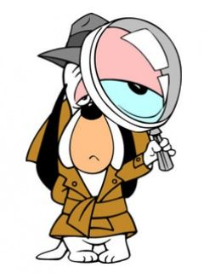
What: is this useful information?
Once you have identified a good informant (source) you need to decide if that informant has any information you can use.
Next

Slide 10

What : is this useful information?
Questions to ask:
Is the information accurate?
Does the author cite their sources?
Is this information fact or opinion?
What is the purpose of the web page?
Next

Slide 11
Quiz
Which of these sites would you use to write an essay about Ancient Egypt?
Website A
Website B
A
B

Slide 12
Correct!
Great Detective Work!
Click to continue
Website A is correct!
The information is factual
The website lists sources
The information is useful and accurate

Slide 13
Sorry – try again
Click to try again

Slide 14
When? It is a question of currency
Websites don’t have a statute of limitations but you want to be sure your information is current, accurate, and up-to-date.
Next

Slide 15
When?
Can you find the date the site was created or last updated?
Hint: look in the ‘About’ section or at the bottom of the page
Do the links to other sites work?
Outdated links often mean outdated information
Does the date of the information matter to your research?
If you are looking for information on Ancient Egypt, the date might not be as important as if you were researching current internet apps
Questions to ask:
Next

Slide 16
Quiz
Website A
Website B
Based on when the information was created or last updated, which site is going to give you the most current information?
Look at these two websites:
Website A
Website B

Slide 17
Correct!
Great Detective Work!
Click to continue
Website B is correct!
The information was created in June of 2016

Slide 18
Sorry – try again
Click to try again

Slide 19

Where is the information coming from?
Look to the URL for clues!
.com usually a commercial site. Anyone can have this extension.
.net a company or person who runs and Internet network
.org not-for-profit organizations
.edu colleges, universities, and other educational institutions; may also host personal websites
.gov agency of the US government.
Next

Slide 20
Where?
.com is for businesses and they are often selling something
.net is available for anyone and anyone can put anything they want on the internet
.org has a strong possibility of having bias. These sites often have a specific mission and are trying to convince visitors to agree
.edu can host personal websites for students and faculty and may not be objective
.gov usually has good statistics but promotes the views of the government
Be aware of bias! URL’s can offer clues:
Next

Slide 21
Quiz
Website A
Website B
Look at these two websites:
Both of these websites are about the planet Mars. Which is more reliable?
Website A
Website B

Slide 22
Correct!
Great Detective Work!
Click to continue
Website B is correct!
The information is from a .gov site and there are no ads trying to sell you anything.

Slide 23
Sorry – try again
Click to try again

Slide 24
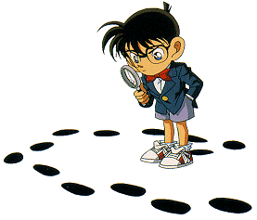
Why was the site created?
Remember, ANYONE can put ANYTHING on the internet. Be sure to investigate why the information is there.
Next

Slide 25
Why?
Is the site trying to sell you something?
They may not be giving you the whole story; be sure to check product reviews and comments from people who have used the site
Is the site trying to educate or inform you?
Be sure to verify information and look for sources
Is the site sounding off or is the information balanced?
If the site sounds highly opinionated –beware! The perspective isn’t likely to take in multiple perspectives
Is the site trying to get you to support a cause?
You will want to verify the facts and research other sites before deciding
Questions to ask:
Next

Slide 26
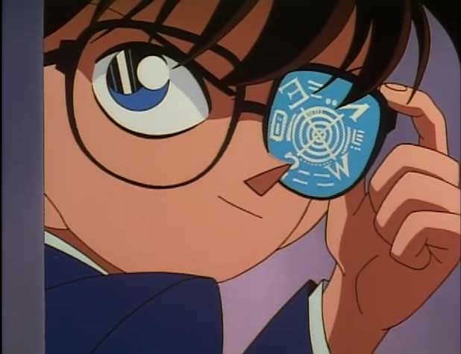
Mission Successful!
Be sure to complete TIP Assignment 1: Investigation Information by the due date
Or better yet…
Do it now!!

