Slide 1

PowerPoint Templates provided by PresentationPoint.com
Software solutions for digital signage and data driven presentations
www.PresentationPoint.com

Slide 2
COPYRIGHT NOTICE:
You are allowed to use these templates in your own organization and modify them as you like. You cannot sell or give them to others. Instead, direct them to PresentationPoint.com to download their own copy.

Slide 3
USING THIS TEMPLATE FOR DIGITAL SIGNAGE?
Check out iPoint
THE POWERPOINT DIGITAL SIGNAGE SOLUTION

Slide 4
NEED TO CONNECT THIS TEMPLATE TO DATA?
Check out DataPoint
OUR POWERPOINT
ADD-ON FOR DATA

Slide 5
WANT TO ADD WEATHER AND NEWS TO YOUR TEMPLATE?
Try Dynamic Elements
POWERPOINT ADD-ON
FOR NEWS AND WEATHER

Slide 6
WANT TIMERS & CLOCKS
ON YOUR TEMPLATE?
Try Dynamic Time
POWERPOINT ADD-ON FOR CLOCKS, TIMERS AND COUNTDOWNS

Slide 7

City
City
City
City
20°
25°
22°
21°
70 %
20 mph
10 %
10 mph
10 %
11 mph
25 %
15 mph
Use DataPoint to automatically update weather information.
You can remove this note
Tue
Wed
Thu
Tue
Wed
Thu
Tue
Wed
Thu
Tue
Wed
Thu
19°
18°
18°
22°
24°
25°
22°
21°
22°
18°
17°
17°
+++ Newsticker +++ Newsticker +++ Newsticker +++ Newsticker +++Newsticker +++Newsticker +++
Notes:
7

Slide 8
26°
23°
22°
21°
19°
17°
19°
Mon
Tue
Wed
Thu
Fri
Sat
Sun
Today
6:10am
Sunrise
40%
Clouds
8:24pm
Sunset
Use DataPoint to automatically update weather information.
You can remove this note
22°
+++ Newsticker +++ Newsticker +++ Newsticker +++ Newsticker +++ Newsticker +++ Newsticker +++Newsticker +++Newsticker

Slide 9
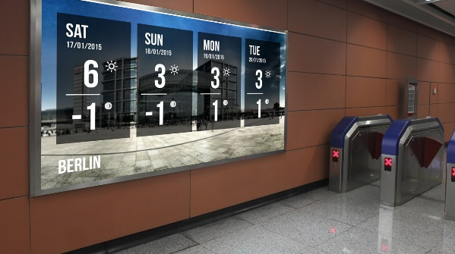
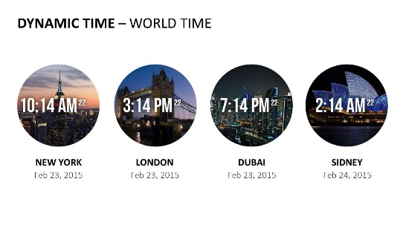


Do More With PresentationPoint Products
Real-time weather and forecasts
Add a clock or countdown to your presentations
Live RSS feed in your PowerPoint
Notes:
9

