Slide 1
Buzzing into Bee Health: A Machine Learning Approach to Predictive
Apiculture
Team:
Gishnavi Kolli - 700747572
Keerthi Reddy Gannapureddy - 700743921
Baddam Navaneetha - 700746829

Slide 2
Role/Responsibilities and Contribution
Gishnavi:
Conducted comprehensive research and created an in-depth report detailing all aspects of the project, demonstrating a holistic understanding of the objectives and methodology involved.
Gishnavi significantly contributed by focusing on dataset understanding and preprocessing, including various tasks such as image augmentation, resizing, and implementing Principal Component Analysis (PCA).
Keerthi:
Primarily responsible for understanding, implementing, and optimizing two key algorithms used in this project - Random Forest and Linear Support Vector Machine (SVM).
Keerthis conducted the initial analyses of the dataset using these models, and played a crucial role in documenting the process and outcomes in the project reports.
Navaneetha:
Worked on the application, programming, and evaluation of the Kernel SVM algorithm on both the regular and augmented datasets.
Navaneetha was instrumental in conducting the final evaluation of all the models, performing an intrinsic error analysis, and ultimately selecting the best-performing model.

Slide 3
Motivation
Automated Health Monitoring: We're developing an automated, non-invasive system that uses machine learning to predict bee health from image data. This addresses the urgent need for effective and efficient bee health monitoring.
Empowering Beekeepers: Our system will provide beekeepers with crucial insights for early detection of health issues. This scalable solution also enables large-scale, consistent monitoring of bee populations.
Conservation Technology: By accurately predicting bee health, our project contributes to the development of more targeted and effective conservation interventions. This will bolster efforts to preserve bee populations and our broader ecosystem.
Integration of ML and Ecology: The ultimate aim of our project is to merge machine learning and ecological conservation. We're paving the way for innovative, technology-driven tools for ecological preservation and future research at the intersection of these crucial fields.

Slide 4
Objectives
Data Acquisition and Preparation
To gather a suitable dataset representing both healthy and unhealthy bees and to pre-process the collected data.
Model Selection and Training
Investigate and compare various machine learning models suitable for classification tasks and to train the selected models using the prepared dataset, focusing on optimizing their performance.
Model Validation and Selection
Evaluating performance of each model, making use of metrics such as precision, recall, F1-score, and confusion matrix and to select the model that yields the best performance.
Error Analysis
To investigate the errors made by the best performing model and understand their potential causes and to assess the impact of these errors on the overall model performance.
Improvement and Augmentation
To apply data augmentation techniques if necessary, to increase the size and diversity of the dataset and to re-train and re-evaluate the models using the augmented dataset, aiming for improved performance.
Final Evaluation and Reporting
To evaluate the best performing model using a holdout dataset and to interpret the results and draw conclusions on the model's ability to predict a bee's health condition.
To prepare and present a comprehensive report, including all steps, results, discussions, and conclusions of the project.

Slide 5
Problem Statement
"In the era of declining bee populations, the ability to accurately assess bee health becomes vital for the conservation of these essential pollinators. Traditional methods are laborious, time-consuming, and can introduce significant observer bias. This project aims to leverage the power of machine learning to predict a bee's health status based on its image. The objective is to develop a robust and accurate model that can effectively interpret visual cues from various bee species and habitats. The model should account for varying lighting conditions, bee species, image qualities, and other factors influencing the clarity of visual indicators of bee health. The success of this project could transform bee health monitoring, offering a rapid, scalable, and non-invasive solution for beekeepers and researchers worldwide."

Slide 6
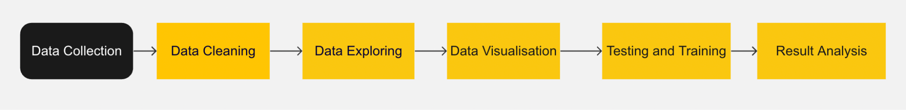
Proposal
Fig 1: Data Science and ML Cycle
Source: Miro

Slide 7
Data Collection
The Data Used for this project has been collected from open source repository for datasets(kaggle).
The Name of the Dataset is : The BeeImage Dataset: Annotated Honey Bee Images
The Dataset contains 5100+ images of the bees from various locations and their health status.
The attributes of the data set are:
file
date
time
location
zip code
subspecies
health
pollen_carrying
caste

Slide 8
Data Cleaning
We had to check for the NaN’s in our dataset luckily we didn’t have any of those values
Around 8% of the Data has missing values , so we replaced missing values to known values to retain the data
We Checked for unique values to remove unwanted columns
Rows such as zip code and caste were not required for our analysis so we dropped them.

Slide 9
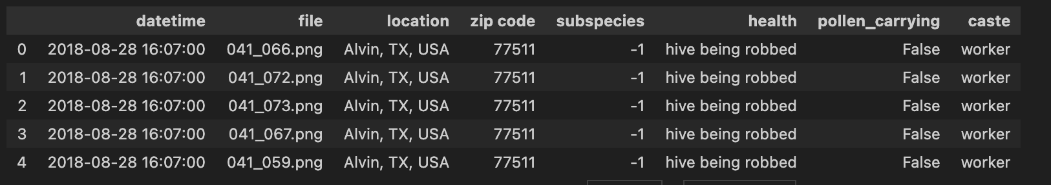
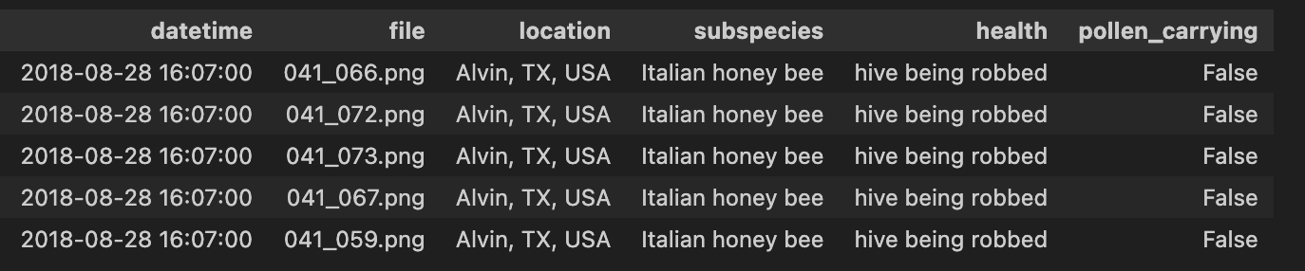
Fig 2. Top 5 Rows of the Original Data
Fig 3. Top 5 Rows of the Cleaned Data

Slide 10
Data Exploring
Imbalanced Data: Our analysis revealed a significant imbalance in class distributions - there's a higher count of healthy bees compared to unhealthy ones in our dataset. This is an expected scenario but indicates a need for stratification during our model development process.
Indicators of Health: As per the dataset, a sudden increase in bees not carrying pollen might be a sign of 'robber bees', an indicator of hive health issues. We aim to explore the correlation between bees carrying pollen and their health status.
Data Transformation for Pollen Carrying: To facilitate our analysis, we'll convert the 'pollen_carrying' attribute values: 'True' will be mapped to 1 (indicating pollen-carrying bees), and 'False' will be mapped to 0 (indicating non-pollen carrying bees). This step simplifies plotting a time series based on the capture dates of the bees.

Slide 11
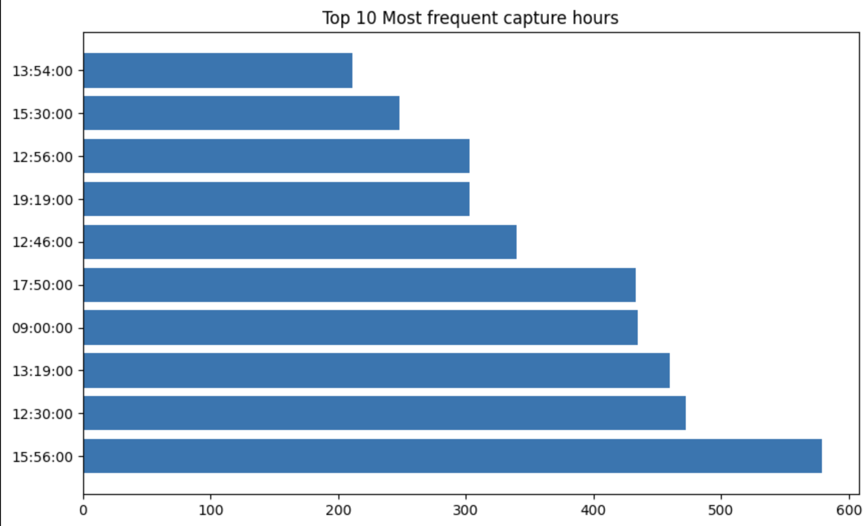
Fig 4. Top 10 Most Frequent capture ours of the images (Bar Chart)

Slide 12
Testing And Training
The processed data is then subjected to training subset which is feed to four different algorithms Logistic Regression, Random Forest Classifier, Linear SVM, and Kernel SVM.
Now onto hyperparameters. These are the grids that We have chosen for hyperparameter tuning for the models.
We have evaluated the performance of algorithms using different evaluation metrics like precision, recall, f1-score, support, and we have also generated confusion matrix and ROC Curve

Slide 13
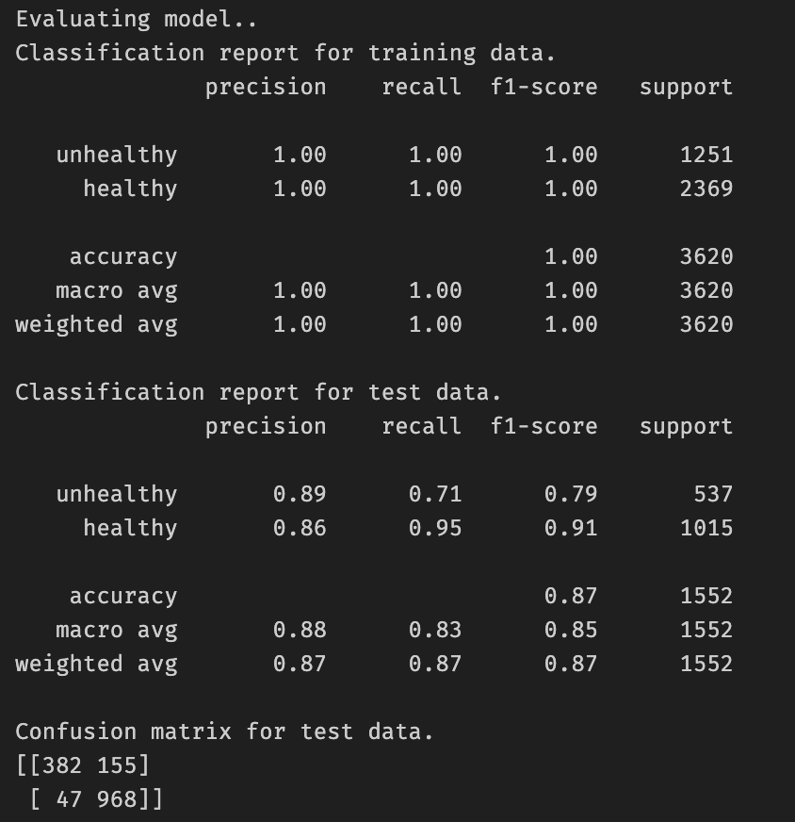
Similarly we have implemented other algorithms and have found values with variations
Because of using Augmentation, we have a bigger dataset compared to the initial original dataset.
These images have been placed in different folders in the images directory namely aug_healthy and aug_unhealthy.
We have considered the values of all this algorithms before concluding the best algorithm
Fig 5. Random Forest Results

Slide 14
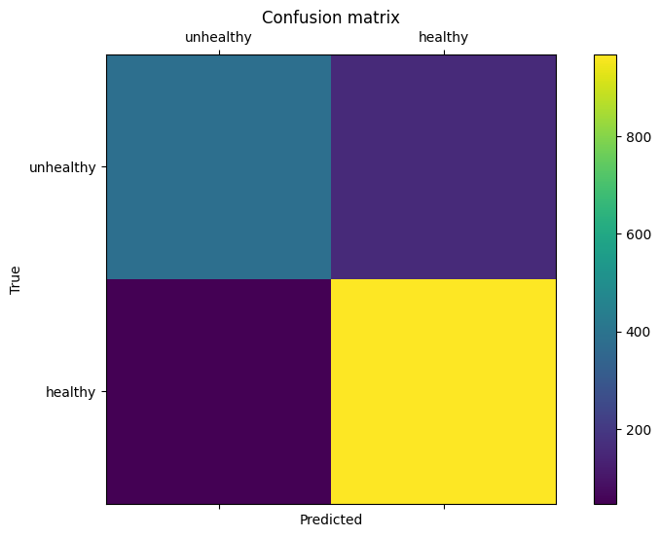
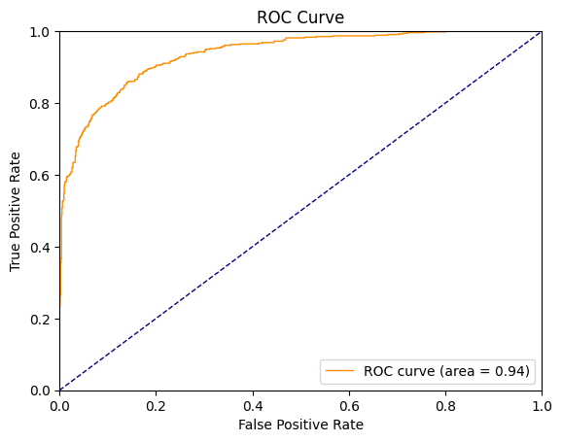
Fig 6. Confusion Matrix - Random Forest
Fig 7. ROC Curve - Random Forest

Slide 15
Results and Conclusion
The Kernel SVM model exhibited superior performance on the original, unaugmented dataset, emphasizing the importance of data quality and the effectiveness of SVM in high-dimensional, possibly non-linear environments.
Models trained on augmented datasets underperformed, possibly due to the introduction of noise during the augmentation process, indicating that faithful replication of characteristics is critical in data augmentation.
While all models demonstrated a low intrinsic error rate, the Kernel SVM model had the lowest error rate and the highest F1 score, asserting its robustness in handling complex classification tasks and its superiority in model selection.
We use three different datasets (augmented and non augmented) on 4 different models, the best results were achieved by the kernel SVM algorithm on the non-augmented original dataset.

Slide 16
Thank you!!!

