Slide 1
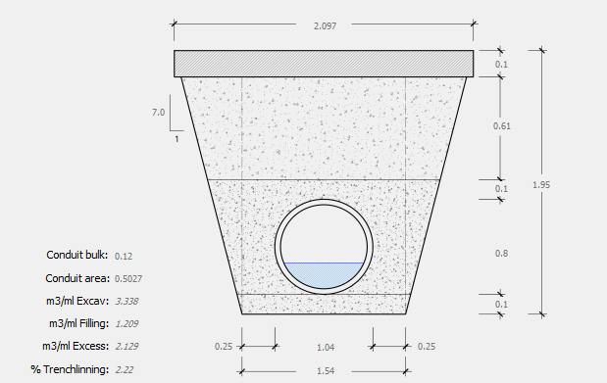
cat_soil
m3exc_cost
m3exc_cost
m3fill_cost
cat_arc
cost_unit
m2bottom_cost
m3protec_cost
cat_pavement
m2_cost
m3excess_cost
m2trenchl_cost
cat_pavement
Thickness
cat_soil
y_param
b
trenchlining
cat_arc
z1
estimated_depth
z2
width
area
bulk

