Slide 1
Team history
Kokoro Aoki / Syunsuke Katumata / Hinata Hommaru / Neo Miyama

Slide 2
- 4 ideas -
・Web site
・Hakoiri musume
・Climbing map
・Climbing goods

Slide 3
- Feedback from teachers -
・Value
・Passion
・Story
・Target / Purpose

Slide 4
- Improvements / Next plan -

Slide 5

Climbing map
<our strength: Gezanbutu>

Slide 6
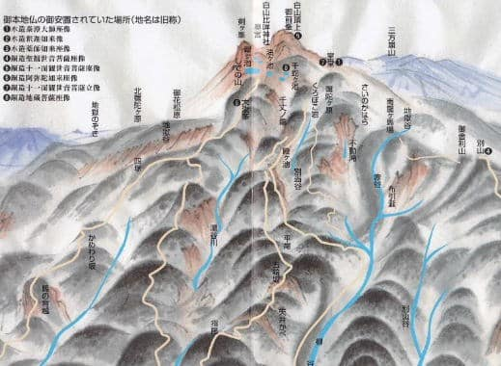
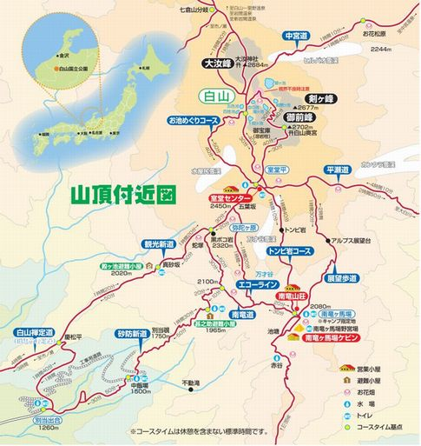

- Climbing map -
How to tell where was gezanbutu:
we don’t have answer.
Propose:
climber can enjoy climb and they can understand.
Target user:
mountain climber

Slide 7
- Conclusion -

