Slide 1
Product of our team
Kokoro Aoki
Neo Miyama
Hinata Hommaru
Shunsuke Katsumata
Kokoro Aoki Shunsuke Katumata
Hinata Hommaru Neo Miyama

Slide 2
Problem
・The Shiramine don’t have enough tourist.
600,000 people come to Turugi’s famous place
Only 60,000 people come to Shiramine place.
Turugi
600,000
people
Shiramine
60,000
people

Slide 3
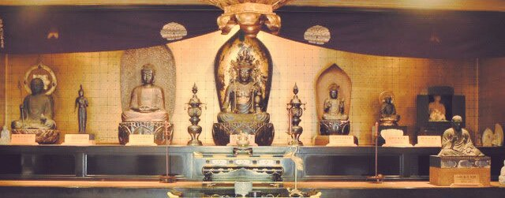
Valuable local resource
・Gezannbutu

Slide 4
Purpose
・The product should be to attract tourists.
Turugi
Shiramine
600,000
100,000
people
people

Slide 5
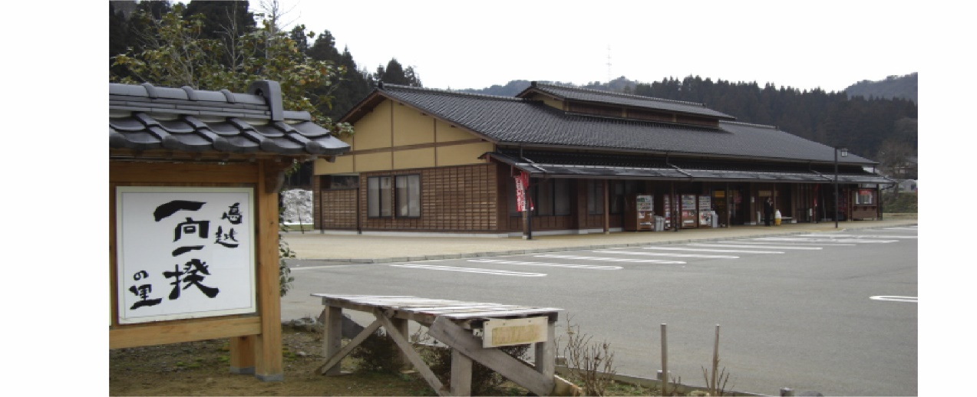
Target users
・The people who come to the Mitinoeki Sena and Mitinoeki
Ikkouikkinosato

Slide 6
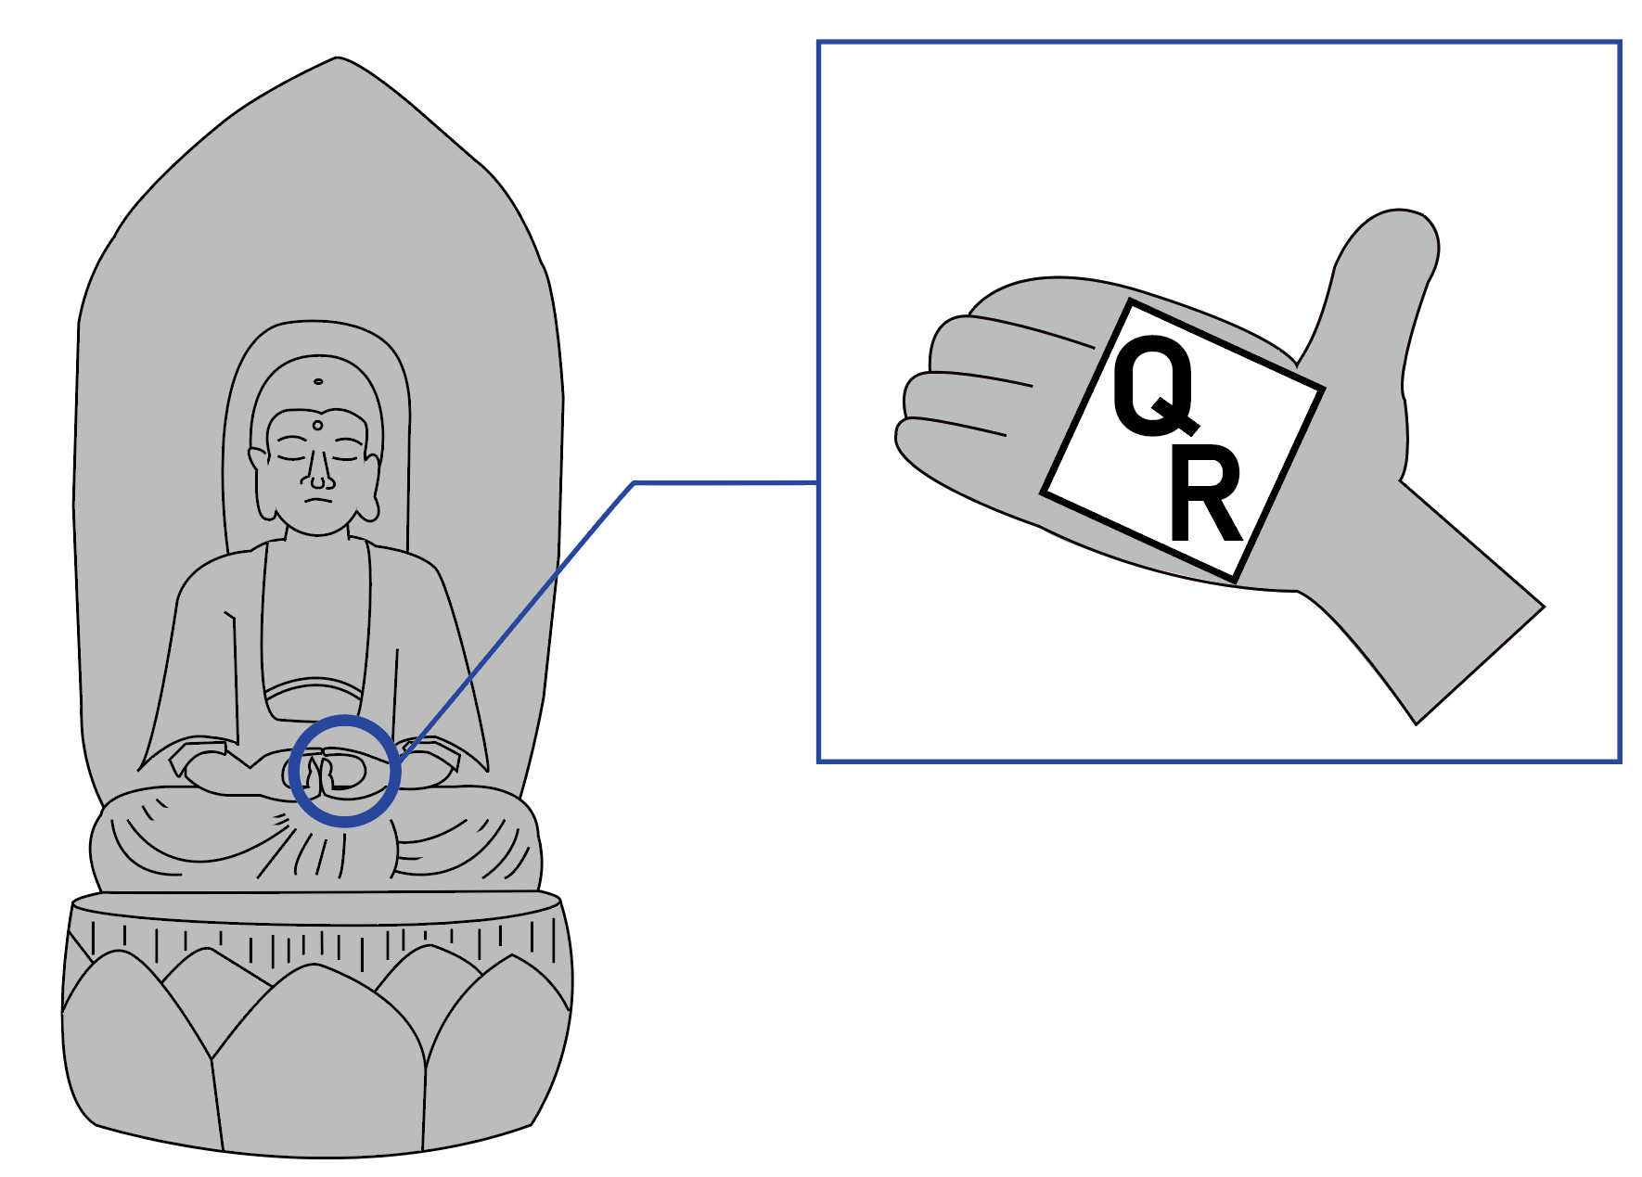
Idea
・We make a poster.

