Slide 1
WiFi Based Indoor Positioning System
Under the guidance of “RIP NO GUDIENCE” YASH 170303105066 PREET 170303105067 AKHIL 170303105070
DEEP 170303105071

Slide 2
Global Positioning System (GPS)
Prominent contributor in location tracking
Works efficiently in open areas
Used by many location tracking apps
Eg: Google Maps
Apple Maps OpenStreetMap

Slide 3
Indoor Positioning
GPS needs an unobstructed line-of-sight to 4 or more satellites.
Fails inside enclosed spaces
Increasing need for Indoor Positioning inside Malls, Airports etc
No common existing system for Indoor Positioning
– Google’s experimental Indoor Map

Slide 4
How can it be done ?
Radio Frequency Identification (RFID)
Bluetooth
WiFi
Motion Sensors & Position Sensors

Slide 5
Why choose WiFi ?
Commonly available inside buildings
All smart phones come with inbuilt WiFi adapters
WiFi signal strength varies with distance
Can be used as a distance indicator for positioning

Slide 6
Design Overview
Works in two phases.
Calibration phase
Positioning phase
Calibration phase
Location Fingerprinting
Positioning phase
Weighted K Nearest Neighbours Algorithm (WKNN)

Slide 7
Location Fingerprinting
Received Signal Strength (RSS) values from multiple routers act as a fingerprint for a location
Different locations are most likely to have unique fingerprints
Fingerprint of i^{th} location is denoted by r_{i}
r_{i} = {r_{i1,} r_{i2,} r_{i3},......,r_{im} }
r_{ij} = RSS value of j^{th} router from i^{th} location

Slide 8
Location Fingerprinting
Several locations are chosen and RSS values from them are recorded and form a radio map.
The recording at the i^{th} location is of the form
(qi,ri)
qi - the geometric coordinates (xi,yi) ri - the location fingerprint

Slide 9
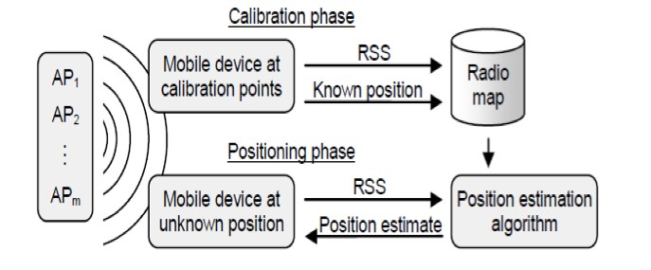
Location Fingerprinting
A position estimator algorithm is used to find the coordinates of unknown location
9

Slide 10
Weighted k Nearest Neighbour
The position estimator algorithm used is the Weighted k Nearest Neighbour (WkNN)
Finds the k nearest chosen locations from unknown location based on Euclidean distance
Calculates coordinates of unknown location as the weighted average of the nearest k points
10

Slide 11
Weighted k Nearest Neighbour
Weight is the inverse of the Euclidean distance
k can be considered as a tuning parameter in the algorithm
When k=1, algorithm acts as a simple look up table
11

Slide 12
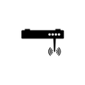
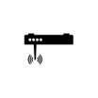

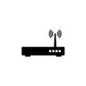
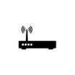
How the algorithm works
1
2
3
4
Suppose there are 4 routers in the floor
12

Slide 13

How the algorithm works
1
2
3
4
The signals emanating from routers leave a unique fingerprint at each location
13

Slide 14

How the algorithm works
1
2
3
4
The signals emanating from routers leave a unique fingerprint at each location
14

Slide 15

How the algorithm works
1
2
3
4
The signals emanating from routers leave a unique fingerprint at each location
15

Slide 16

How the algorithm works
1
2
3
4
The signals emanating from routers leave a unique fingerprint at each location
16

Slide 17



How the algorithm works
1
2
(0,10)
(10,10)
(20,10)
(30,10)
(0,0)
(10,0)
(20,0)
(30,0)
3
4
Choose 8 points on the floor and calibrate readings
17

Slide 18


How the algorithm works
1
2
Unknown Point
3
4
Calculate Euclidean distance from unknown point to all chosen points
18

Slide 19



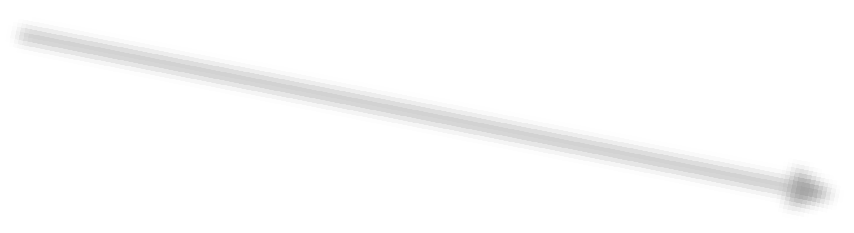


How the algorithm works
1
2
3
4
Euclidean distance between points x and y is calculated by sqrt((rx1-ry1)²+(rx2-ry2)²+(rx3-ry3)²+(rx4-ry4)²)
19

Slide 20

How the algorithm works
1
2
3
4
Nearest k points are chosen. Here k = 2.
20

Slide 21
How the algorithm works
1
2
(10,10)
60
40
(10,4)
(10,0)
3
4
Coordinate of unknown location is the weighted average of the 2 nearest points
21

Slide 22
Work Done
Prototype Android App created Performs calibration and positioning
Mapping done inside CSED Lab building
WkNN algorithm with k=1 used
Device position logs could be tracked from website

Slide 23
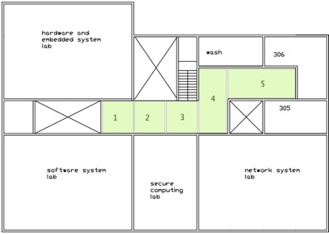
Work Done
Application could distinguish the grids shown in the figure

Slide 24
DEMO
AVAILABE SOON….
https://github.com/users/Preet-Dhorajiya/projects/1
24

Slide 25
Practical Difficulties
Fluctuating signal readings
Considered the average of 30 readings
Readings might contain temporary APs
Prepared a list of trusted APs to be used
User orientation can affect the readings
Orientation specific readings should be recorded (to be done)
Proper positioning of APs can reduce error

Slide 26
Work Remaining
WkNN should be modified to k>1 to increase accuracy
Ideal value of k needs to be figured
Readings taken should be normalised so as to work for all devices
Calibrated readings should be made available for all devices

Slide 27
Questions?

Slide 28
Thank You
28

