Slide 1
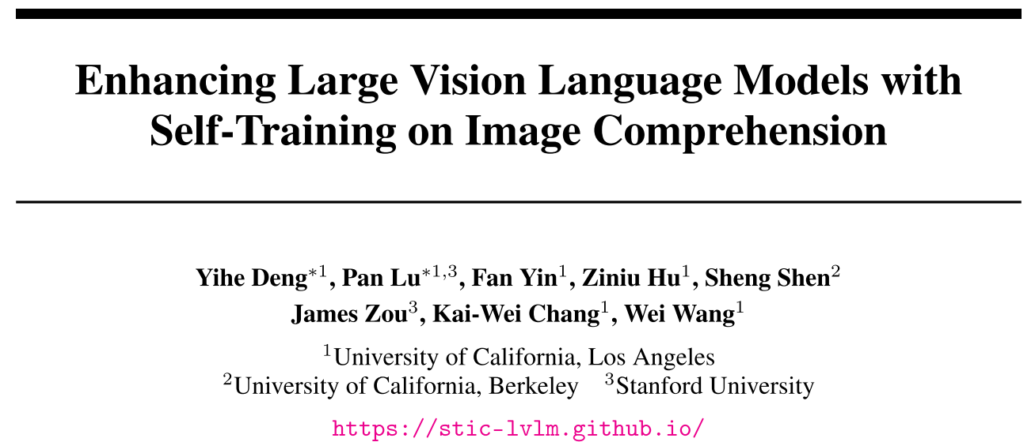

Slide 2
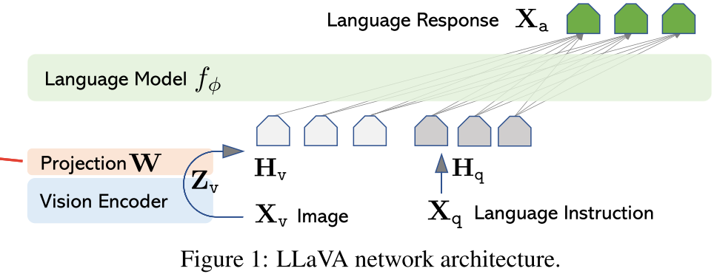
LLaVA

Slide 3
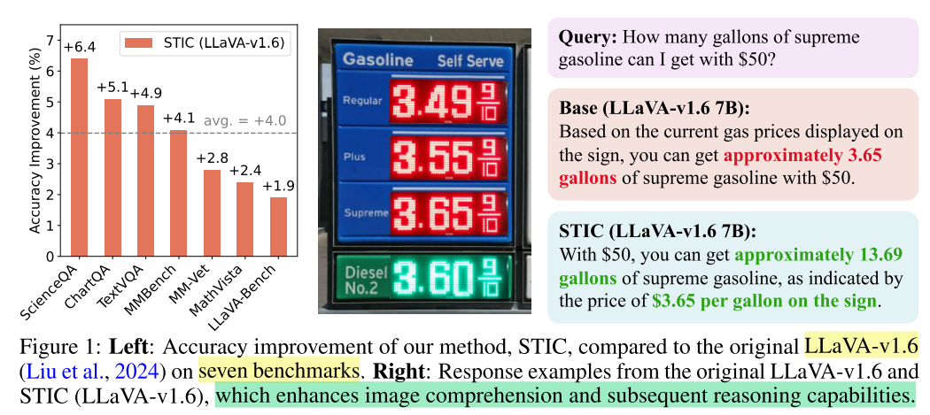
Introduction

Slide 4
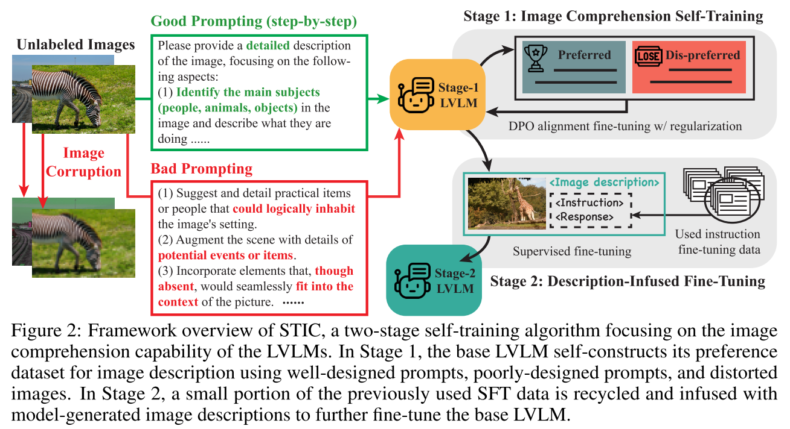
STIC

Slide 5
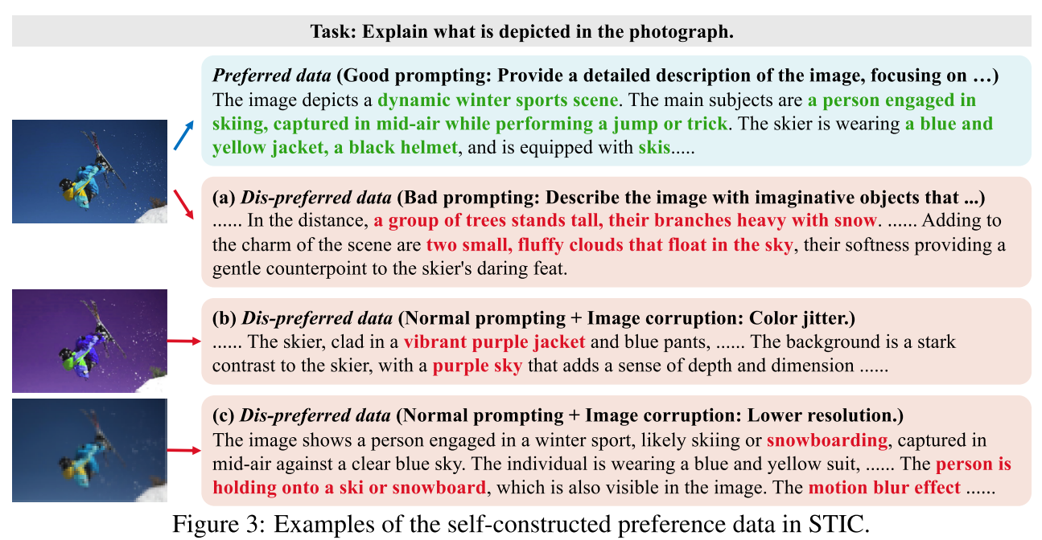

Slide 6



Problem Setting and Preliminaries
1.Generative vision language models.
2.Alignment fine-tuning.
DPO原文截取

Slide 7
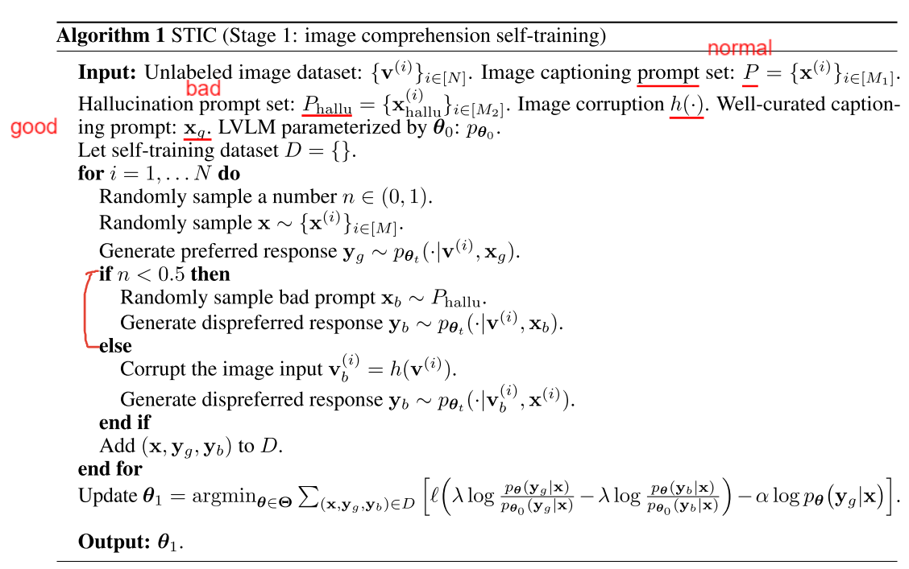
Method

Slide 8
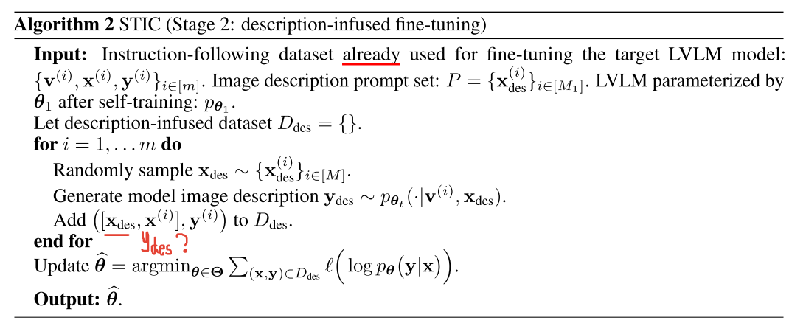

Slide 9
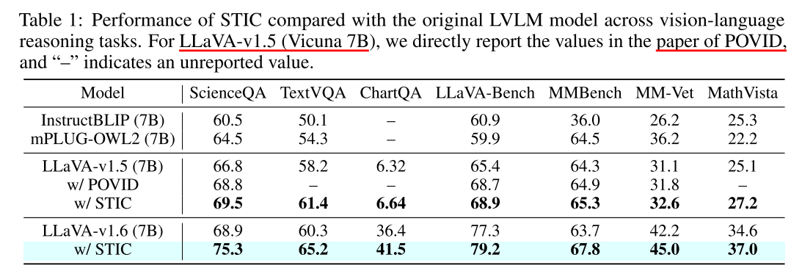
Result

Slide 10


Notes:
DaR 一个没有参与到训练当中，一个是参与到训练

Slide 11
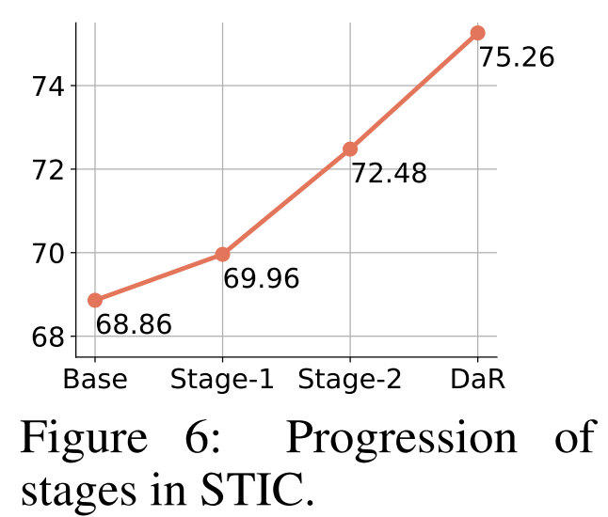
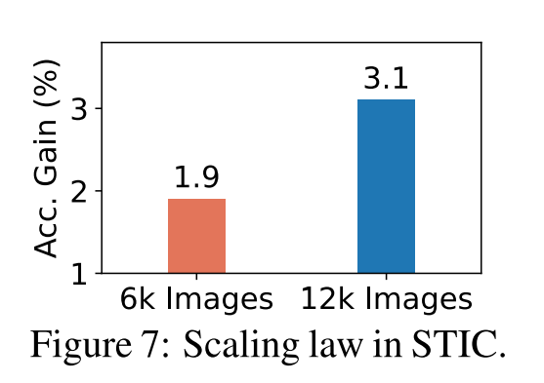
Notes:
F6 scienceQA

Slide 12
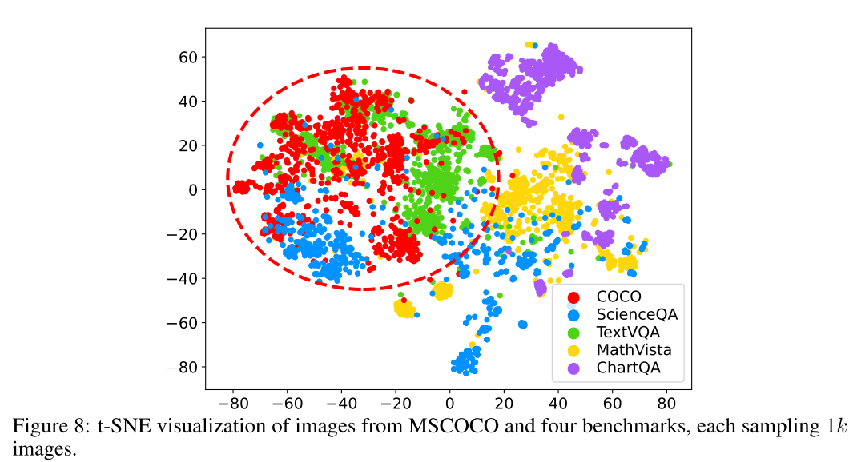

Slide 13
