Slide 1
EDA Project - King County USA
Samet Balli
How to utilise housing data to give more insights on client focused hypothesis

Slide 2
Introduction

Slide 3
Data Preview
The Housing data given contains:
id, date, price of house, No. of bedrooms, No. of bathrooms, floors in total
sqft living space , sqft lot space, waterfront, view count, conidition, grade, sqft_above, sqft_basement
built year, year house renovated, zip code, latitude+longitude coordinates of house
sqft_living15:The square footage of interior housing living space for the nearest 15 neighbors
sqft_lot15: The square footage of the land lots of the nearest 15 neighbors

Slide 4
Client - Larry SAnders
Searches for a house (buyer)
Characteristics
Waterfront
limited budget
nice
isolated
but central neighbourhood without kids (but got some of his own, just doesn't want his kids to play with other kids … because of germs)

Slide 5
Data that was used
The Data I worked with for the criteria of my client Larry was:
id
limited budget —> price
having kids —> no #bedrooms #bathrooms
Waterfront location —>waterfront
“nice house” —> good condition and/or good grade
central location —> latitude and longitude data for the
isolated from neighbours —> sqft_living1 & sqft_lot15

Slide 6
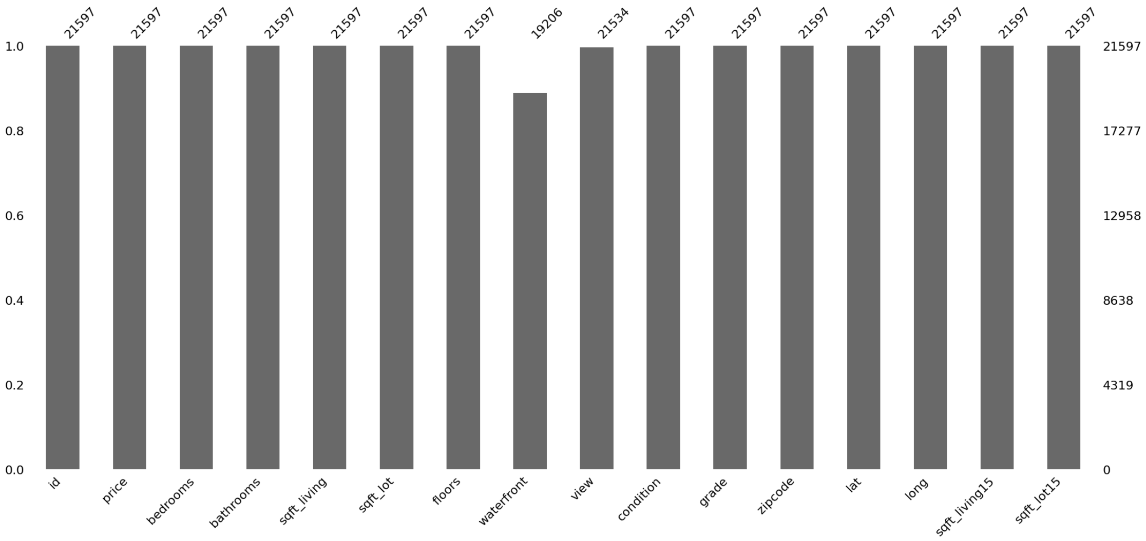
Data Overview
Waterfront and views are missing values
can be deleted as they are just 10%

Slide 7
If a house is located next to water, it will have a Higher Price

Slide 8
Comparison of house prices with and without Waterfront
Plot shows clearly that houses with waterfronts are typically higher priced. Hypothesis is approved

Slide 9
If Houses are central, They are higher priced.

Slide 10
Define Central
Defined a central area powered by google maps and populationdensity map from statisticatlas
central_latitude_range = (47.52, 47.77)
central_longitude_range = (-122.41, -122.08)

Slide 11
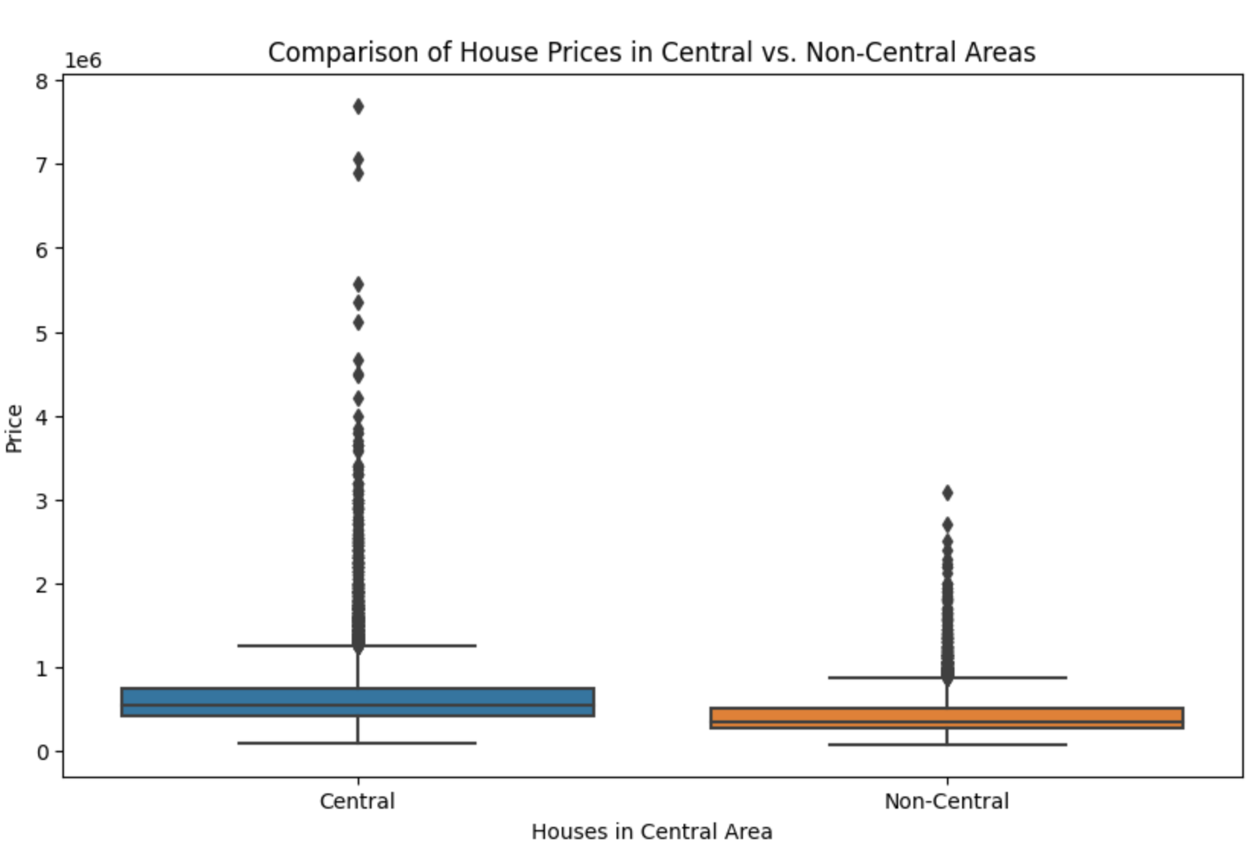
COmparison of House Prices Central vs. Non-Central
Plot shows that houses with central location are typically higher priced. Hypothesis is approved

Slide 12
IF Houses that have waterfront and central,
they are priced above the Median of the total price range of houses in king county.

Slide 13
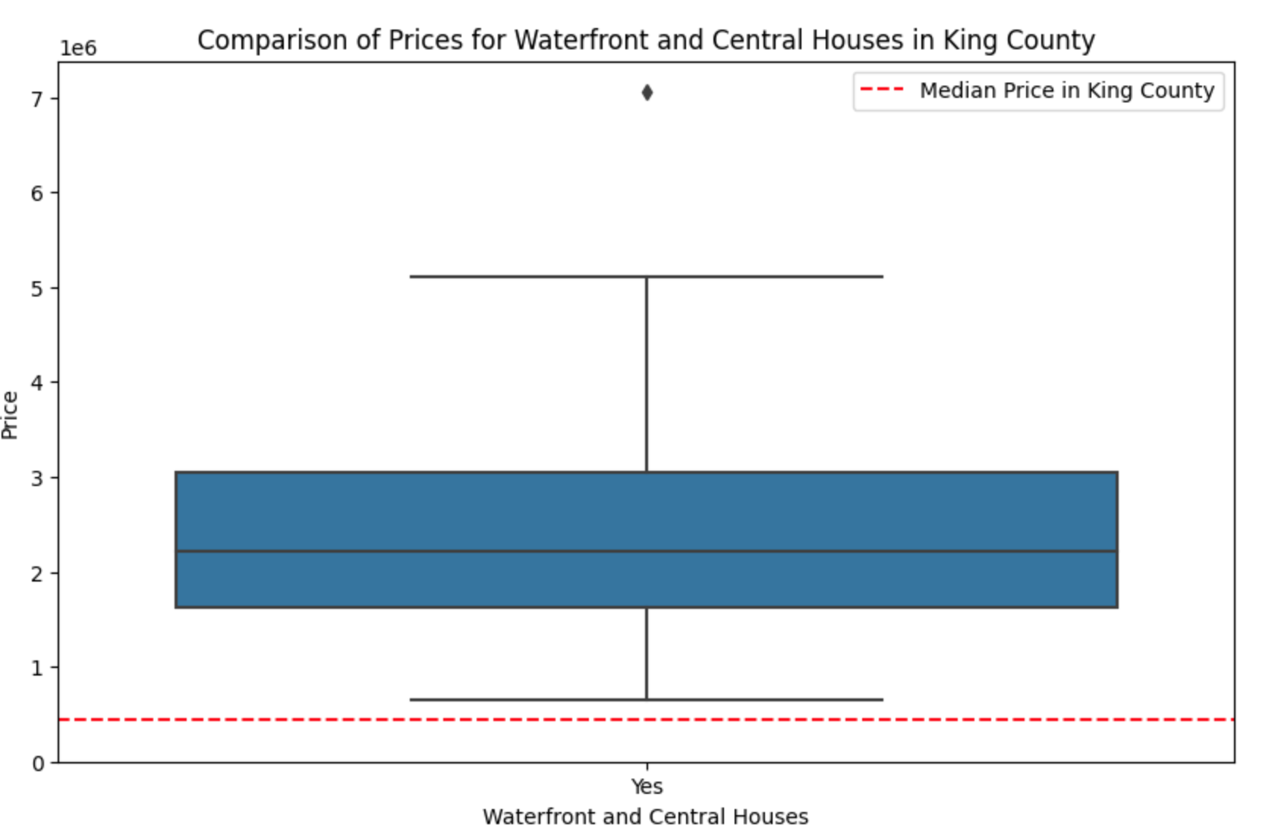
Comparison of Prices for Houses with Waterfront and central location
So this means all houses that are central and located next to the water are priced above the median prices in King County.

Slide 14
Adapting the the criteria
To accommodate at least some of the criteria of my Client
Defined the price budget to 750.000 $
no waterfront
Isolated defined by number (sqft_living15/sqft_lot15) > 0.4
nice condition: nice_condition_grade_threshold = 4 and/or nice_grade_threshold = 9
central : within defined coordinates
central_latitude_range = (47.52, 47.77)
central_longitude_range = (-122.41, -122.08)
Are there nice, central & isolated locations in the city center within the budget ?

Slide 15
Filtering the Data by these Criteria
Result of a list of 128 houses meeting these criteria.
Recommending the cheapest three to client and go from there
1. House id 7899800863 - 299.900 $
2. House id 9126100765 - 455.000 $
3. House id 2719100042 - 458500 $
all houses have 3 bedrooms and more than one bathroom

