Slide 1

A Custom shell - Ash
Demonstration of project - 1
Course code - CS3201
Shashi Bhushan Kumar
220101030
Semester - v
Department of Computer Science and Engineering
Indian Institute of Information Technology , Manipur
Under the Supervision of Dr. Khoirom Motilal Singh
Assistant Professor
Department of Computer Science and Engineering
Indian Institute of Information Technology , Manipur

Slide 2
Table of Contents
Introduction and Motivation
Proposed System
System Design
Implementation
Results and Conclusion

Slide 3
Introduction and Motivation
Operating System Principles: A Practical Exploration.
Graphical User Interface : The shell features a user-friendly interface built with Java Swing, offering intuitive navigation and easy access to all functionalities.
Command Execution: At the core of the shell is a C-based engine that efficiently executes a variety of commands. This ensures high performance and reliability for all operations.
Comprehensive Command Set: The shell supports 12 distinct commands, each with multiple options to cater to a wide range of tasks.
The journey from theoretical knowledge to practical application is a crucial step in mastering any field, particularly in the realm of operating systems. My motivation for developing this custom shell stems from a desire to bridge the gap between the concepts learned from textbooks and their real-world applications. By creating a tool that allows for hands-on interaction with system calls, I aim to deepen my understanding of various OS concepts and enhance my proficiency in system-level programming.
Introduction
Motivation

Slide 4
Proposed Solution
My Custom Shell is designed to provide a seamless and efficient command execution experience through a Java Swing graphical user interface. This solution leverages the Read-Evaluate-Process-Loop (REPL) paradigm to continuously accept and execute user commands until an exit command is issued. Below is a detailed breakdown of the solution:
Input Handling : The shell begins by accepting user input through a Java Swing-based graphical interface. This interface is designed to be intuitive, allowing users to easily enter commands and options.
Command Parsing : Once a command is entered, it is sent to the backend process where it is parsed. The parsing process involves identifying the command and its associated options to ensure accurate execution.
Executable Search : The parsed command is then used to locate the corresponding executable file. This search is conducted within the directories specified by the $execpath environment variable, ensuring that all potential executable locations are considered.
Command Execution : After locating the executable, the command is executed. The backend engine, built for robust performance, handles this execution efficiently, ensuring quick response times.
Output Display : The results of the command execution are displayed in two sections:Output Section: Provides immediate feedback to the user, displaying the results of the executed command.History Section: Maintains a log of all executed commands and their outputs, allowing users to review past actions.
Loop Continuation : After displaying the output, the shell prompts the user for new input, continuing the REPL cycle. This loop persists until the user enters the exit command, at which point the shell terminates.

Slide 5
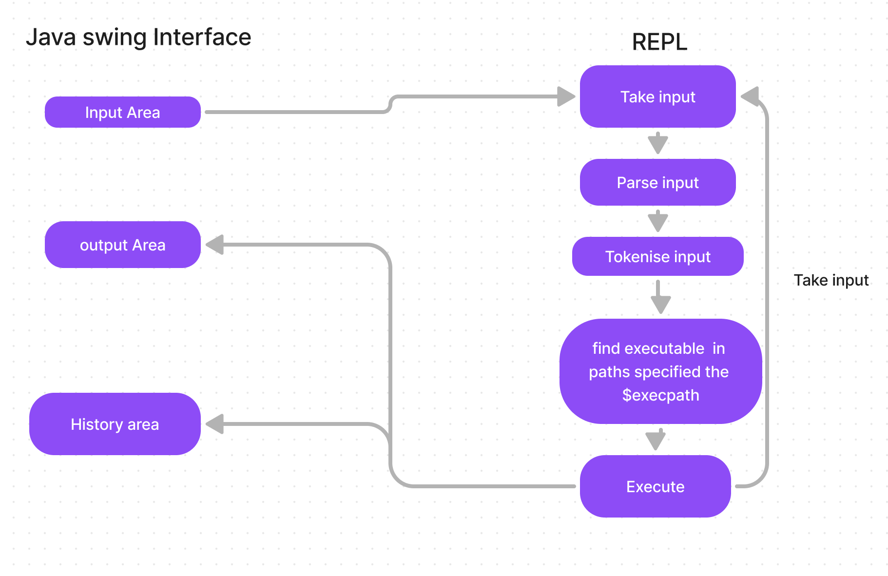
System Design
The Read-Evaluate-Process-Loop (REPL) paradigm is a fundamental concept used in the design of your custom shell. Here's how it applies to the execution process in your shell:
Read : The shell begins by reading user input through a Java Swing-based graphical interface.
Evaluate : Once the input is received, the shell evaluates the command. This involves parsing the command to understand what action is being requested .
Process : After evaluation, the shell processes the command by searching for the corresponding executable file. This search is conducted within directories specified by the $execpath environment variable.
Loop :After processing the command and displaying the output, the shell returns to the initial state, ready to read the next user input.
Fig. Showing the process flow diagram of shell execution.

Slide 6
Implementation
Major components of project :
Java swing interface : It is used to take input , display output in output Area and display history in history Area.
REPL module : it is module on which the shell is working . REPL stands for read , evaluate , process , loop.
$execpath variable : It is a environment variable containing the paths of folder that contain executable files
Manual folder : It is a folder that contains manual of different command that my shell have.
Tech Stack
Java swing :
Used for creating the graphical user interface (GUI) of the application.
Provides components like JFrame, JTextArea, JTextField, JPanel, and JLabel for building the interface.
2. Java :
The main programming language used for the GUI application.
Handles user input, manages command history, and interacts with the backend shell process.
3. C :
Used for implementing the backend shell process.
Manages command parsing, execution, and manual display functionality.

Slide 7
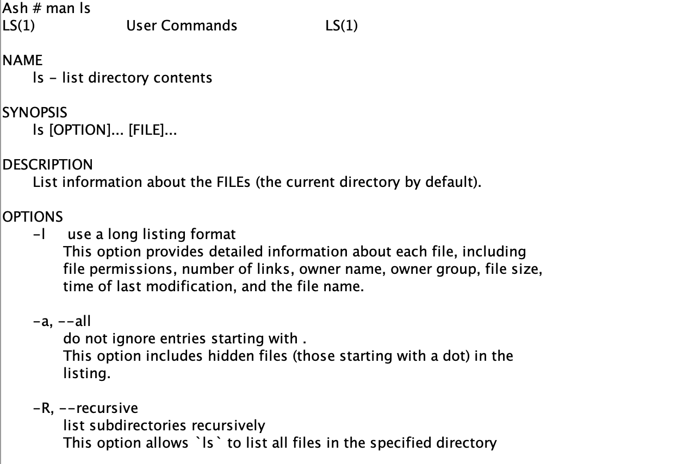
Results and Conclusion
It support 12 commands
ls
cd
mkdir
rm rm
rmdir
cp
touch
chmod
Pwd
man
Conclusion :
Embarking on the development of the Unix Shell has been a transformative learning experience, deepening my understanding of system calls and fundamental operating system concepts. This project has not only provided practical insights into how operating systems function but also inspired me to delve deeper into theoretical knowledge by revisiting and studying operating system literature.
The hands-on approach of building a custom shell has allowed me to apply theoretical concepts in real-world context, bridging the gap between academic learning and practical application. By creating a tool that simplifies the exploration of system calls, I aim to make these complex concepts more accessible to others, fostering a deeper appreciation and understanding of operating systems.
Upon successful submission of this project to the college, I intend to continue its development to explore its full potential and address any limitations identified during the initial phase.
Manual command for the ls command

