Slide 1
Mini Project – Web Based on ML Rain Prediction using ML
Presented by :
PRATHMESH GAIKWAID 19IT1047
SUPRIT GIRI 20IT5002
SHRISHAILENDRA PATIL 19IT1104
Guided by :
MRS. NILIMA DONGRE

Slide 2
INDEX
INTRODUCTION
OBJECTIVE
PROPOSED METHODOLOGY
SELECTED ALGORITHMS
TIMELINE
SYSTEM REQUIREMENTS
CONCLUSION
REFERENCES

Slide 3
INTROUDUCTION
The accurate and precise rainfall prediction is still lacking due to imprecise and inaccurate calculations for the rainfall prediction.
Therefore, the need is not to formulate only the rainfall predicting system but also a system that is more accurate and precise as compared to the existing rainfall predictors which could assist in diverse fields like agriculture, water reservation and flood prediction.
In some of areas which have water scarity , to establish rain water harvestor, prior prediction of rainfall should be done.
So, the system which we are proposing will be an end-to-end deployment project (Machine Learning app) where we will create a distinctive and efficient machine learning system for the prediction of rainfall.

Slide 4
OBJECTIVE
The main aim of this project is to detect whether it will rain or not on the next day with the help of using weather details that would be based on the previous findings and similarities and will give the output predictions that are reliable and appropriate.

Slide 5
PROPOSED METHODOLOGY
We build an ML model with the help of different ML and Auto ML techniques to predict whether it will rain or not on the next day.
The dataset which is used in this system have different attributes which will help us in predicting the outcome.
As it is an end-to-end system we will deploy our model using Flask API and Heroku.

Slide 6
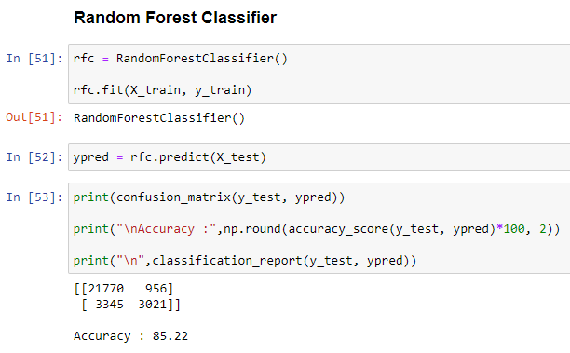
SELECTED ALGORITHMS
Random Forest Classifier :-
A random forest is a meta estimator that fits a number of decision tree classifiers on various sub-samples of the dataset and uses averaging to improve the predictive accuracy and control over-fitting.

Slide 7
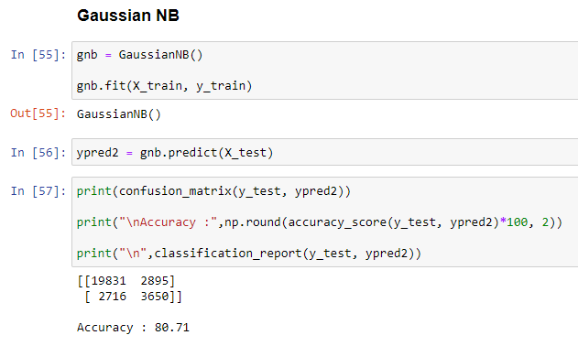
Gaussian Naive Bayes :
Gaussian Naive Bayes is a variant of Naive Bayes that follows Gaussian normal distribution and supports continuous data.

Slide 8
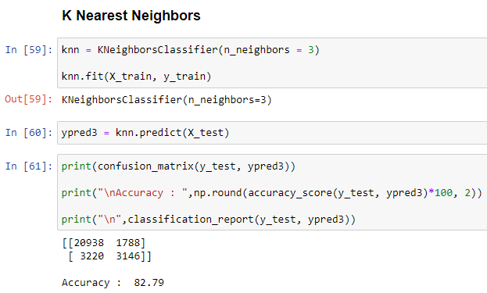
K-Nearest Neighbors :-
K-nearest neighbors is a classification (or regression) algorithm that in order to determine the classification of a point, combines the classification of the K nearest points. It is supervised because you are trying to classify a point based on the known classification of other points.

Slide 9
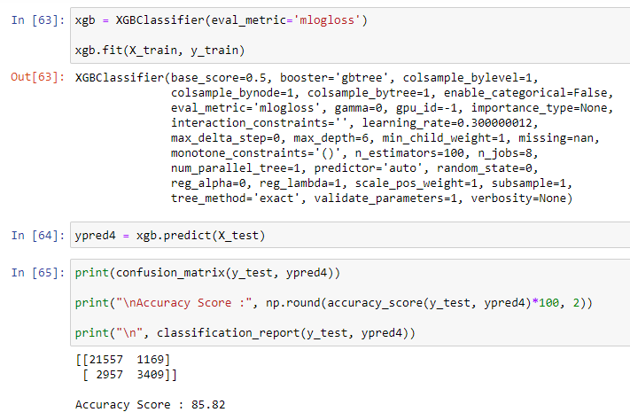
XGBoost Classifier:-
It works on boosting technique. XGBoost is an ensemble learning algorithm meaning that it combines the results of many models, called base learners to make a prediction.

Slide 10

Auto ML Library
It runs on Scikit learn library (Classification, Regression models)
Easy to use
Increases Productivity
Business ready

Slide 11
SYSTEM REQUIREMENTS
Hardware Requirements
CPU : Intel i3 Processor or Higher
RAM : Minimum 4 GB
Software Requirements
Python
Jupyter Notebook / Visual Code / PyCharm
Flask
Heroku Account

Slide 12
CONCLUSION
So, we will create a distinctive and efficient machine learning model which will accurately and precisely predict whether it will rain or not on the next day and deploy our model for the outer world.

Slide 13
References
https://youtube.com/Z1RJmh_OqeA
https://www.analyticsvidhya.com/blog/2021/10/a-complete-guide-on-machine-learning-model-deployment-using-Heroku/
https://www.automl.org/automl/

