Slide 1
Mutual Fund Analytics
Bluestock Fintech Internship Project
Data engineering • EDA • Advanced analytics • Power BI
Final Presentation — Day 7
Bluestock Fintech — Mutual Fund Analytics
1

Slide 2
Problem & Objectives
Business problem
Primary objectives
Turn a multi-source mutual fund dataset into useful insights for fund performance, investor behaviour, SIP activity, risk and portfolio concentration.
• Understand AUM, NAV, inflows and fund-house trends • Evaluate performance and risk metrics • Analyse investor cohorts and SIP continuity • Build actionable dashboard views and recommendations
Final outcome
A reproducible analytics workflow with cleaned data, analytical outputs, visual reports and Power BI dashboards.
Bluestock Fintech — Mutual Fund Analytics
2

Slide 3
Data Sources & Architecture
Raw → Processed → Analysis → Dashboard
01 Raw data
02 Cleaning
03 Analytics
04 Reporting
Fund master, NAV history, AUM, inflows, investors, portfolio & benchmarks
Python + Pandas validation & standardisation
EDA, SQL, risk metrics, cohorts, SIP & concentration
CSV outputs + PNG charts + Power BI dashboards
→
→
→
Key tooling: Python, Pandas, NumPy, Matplotlib, SQL and Power BI.
Processed datasets and report assets are versioned inside the project repository.
Bluestock Fintech — Mutual Fund Analytics
3

Slide 4
Analytics Architecture
Ingestion & validation
Analytical layer
BI layer
Load source CSVs, validate columns and data types, clean transaction/NAV/scheme data and maintain raw vs processed layers.
EDA notebooks, SQL queries and Python calculations generate reusable CSV outputs for performance, investor and portfolio analysis.
Power BI combines KPI cards, trend charts, rankings, cohort views, slicers and interactive fund-level analysis.
Data
ETL
Analytics
BI
Insights
→
→
→
→
Bluestock Fintech — Mutual Fund Analytics
4

Slide 5
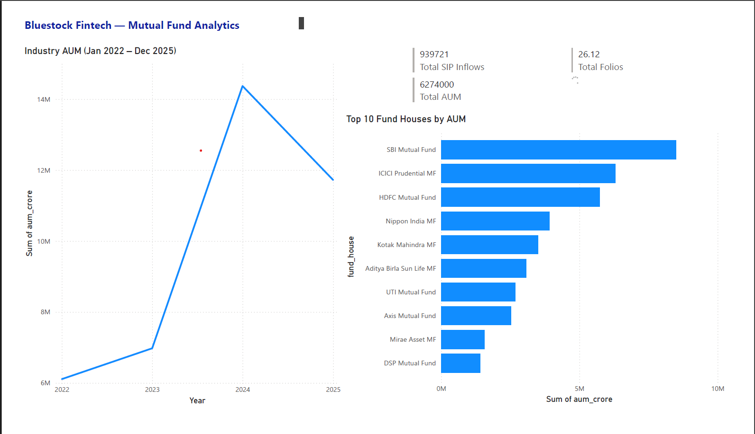
EDA Highlights — Market & Fund Structure
AUM trend
Fund-house ranking
Investor behaviour
The dashboard shows a strong rise in summed AUM from 2022 to 2024, followed by a decline in 2025 within the displayed dataset.
SBI Mutual Fund is the highest-ranked fund house by summed AUM in the dashboard, followed by ICICI Prudential MF and HDFC Mutual Fund.
Investor analytics cover monthly transaction activity, SIP vs lump-sum/redemption mix, age-group SIP behaviour and state-level exploration.
Bluestock Fintech — Mutual Fund Analytics
5

Slide 6
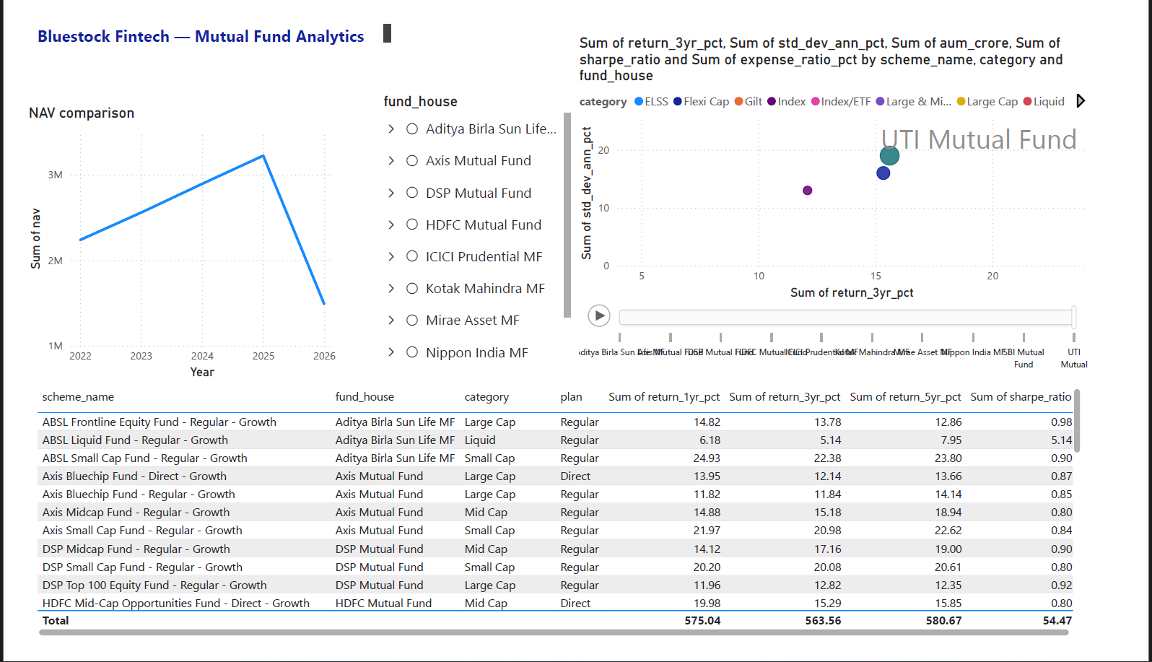
EDA Highlights — Investor & Transaction Behaviour
Bluestock Fintech — Mutual Fund Analytics
6

Slide 7
Performance & Risk Metrics
Historical VaR
Rolling Sharpe
95% VaR and CVaR calculated from historical return distributions.
90-day rolling risk-adjusted return analysis to track changes over time.
Fund scorecard
Advanced outputs
Return, volatility, Sharpe/Sortino, drawdown and benchmark-related fields brought together for comparison.
var_cvar_report.csv, rolling_sharpe_chart.png and supporting analytical CSVs.
Bluestock Fintech — Mutual Fund Analytics
7

Slide 8
Advanced Analytics Delivered
Investor cohort analysis: grouped investors by first transaction year and compared average SIP amount, total invested amount and investor count.
SIP continuation analysis: identified investors with 6+ SIP transactions and measured gaps between transactions.
Recommendation logic: mapped investor risk preference to fund candidates and produced a recommendation output.
Sector concentration: calculated HHI from portfolio sector weights to identify concentration risk.
The outputs were saved as reusable CSV/Python artifacts for reporting and review.
Bluestock Fintech — Mutual Fund Analytics
8

Slide 9
Power BI Dashboard — Industry & Fund Performance
Bluestock Fintech — Mutual Fund Analytics
9

Slide 10
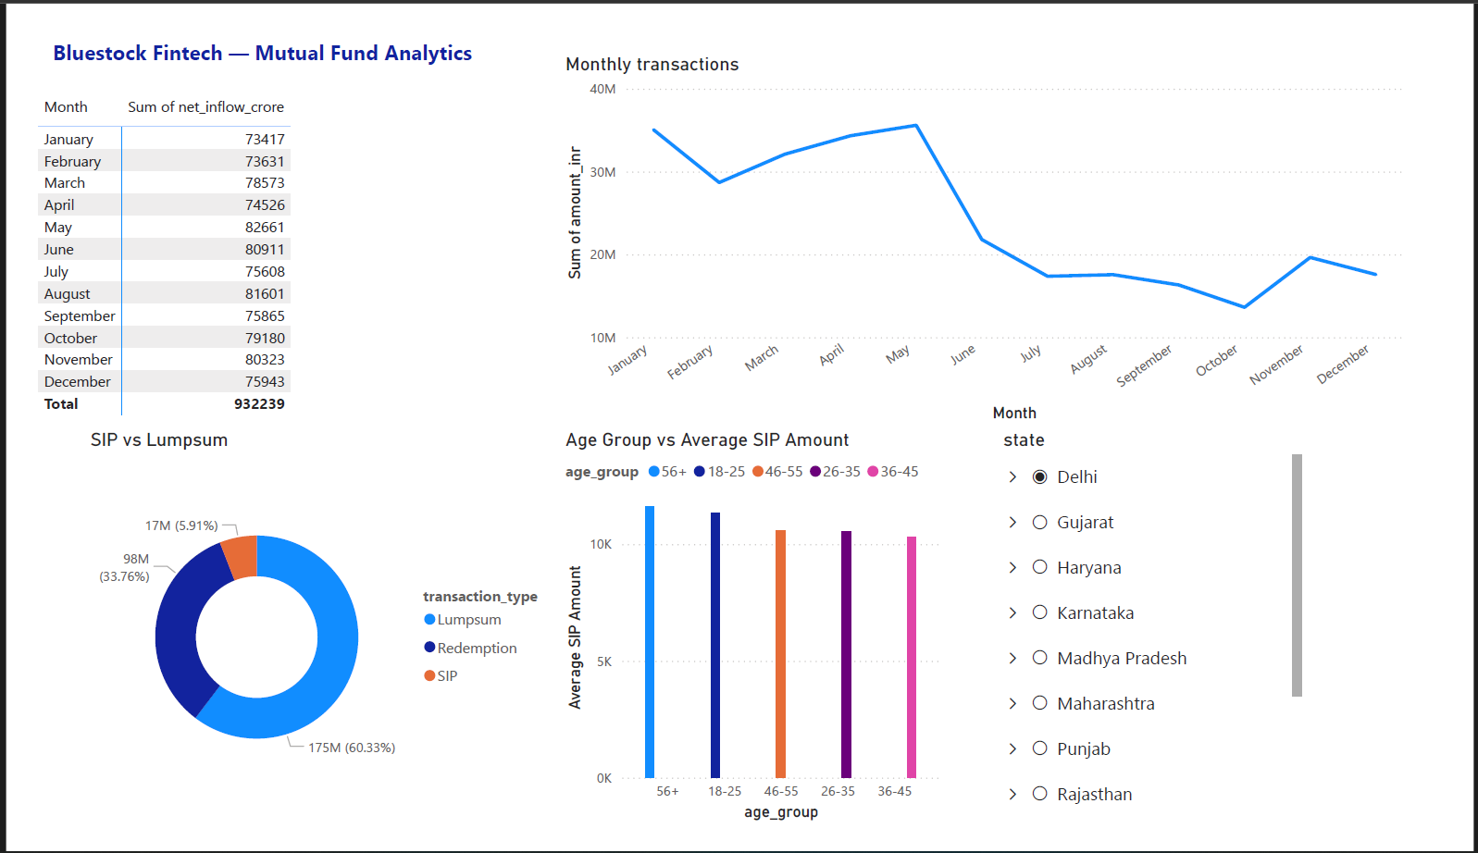
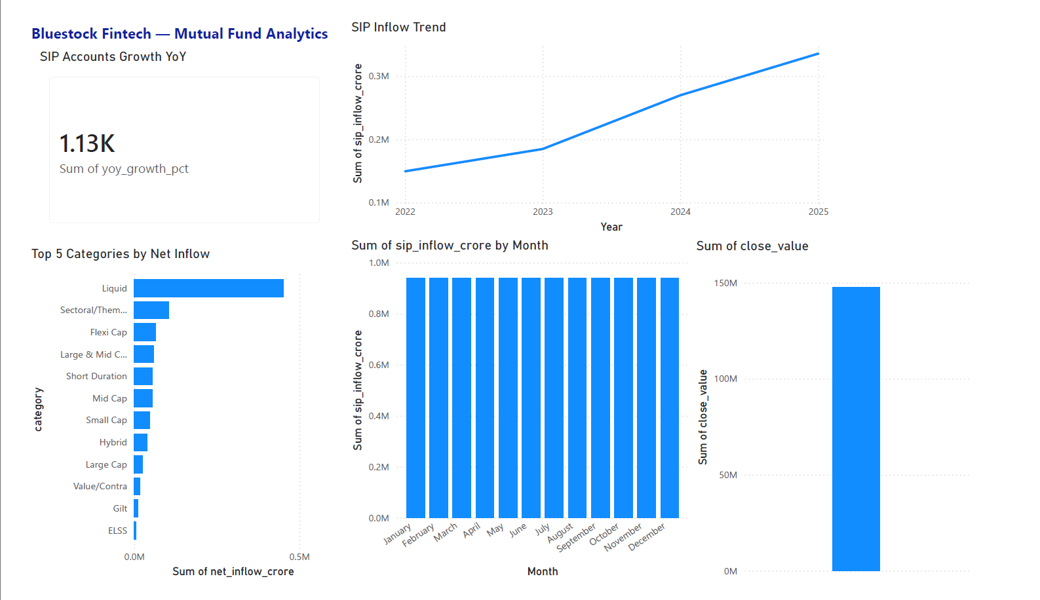
Power BI Dashboard — Investor & Market Views
Bluestock Fintech — Mutual Fund Analytics
10

Slide 11
Key Findings & Recommendations
1. Prioritise high-scale fund houses
2. Watch concentration
Use AUM ranking as a starting point, then combine it with risk-adjusted performance before making recommendations.
Funds with high sector HHI deserve additional diversification review before being treated as low-risk choices.
3. Segment investors
4. Combine performance + behaviour
Age, state, transaction behaviour and SIP continuity provide useful dimensions for targeted investor engagement.
A stronger recommendation engine should consider return, volatility, drawdown, continuity and investor risk preference together.
Bluestock Fintech — Mutual Fund Analytics
11

Slide 12
Thank You
Mutual Fund Analytics — From raw data to actionable investment insights
Bluestock Fintech Internship Project
Bluestock Fintech — Mutual Fund Analytics
12

