Slide 1
Guide to Computer Forensics and Investigations
Fourth Edition
Chapter 1
Computer Forensics and Investigations as a Profession

Slide 2
Objectives
Define computer forensics
Describe how to prepare for computer investigations and explain the difference between law enforcement agency and corporate investigations
Explain the importance of maintaining professional conduct

Slide 3
Understanding Computer Forensics
Computer forensics
  Involves obtaining and analyzing digital information
    As evidence in civil, criminal, or administrative cases
FBI Computer Analysis and Response Team (CART)
  Formed in 1984 to handle the increasing number of cases involving digital evidence

Slide 4
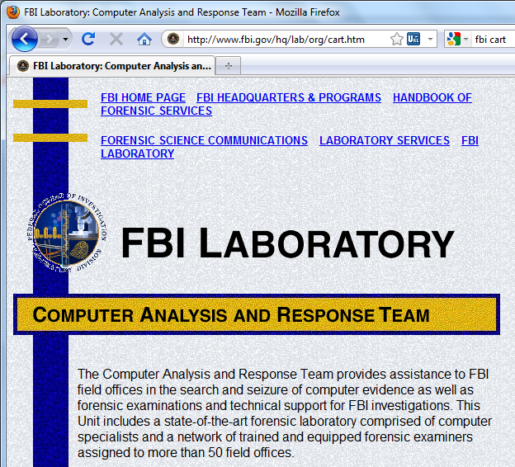
FBI CART Website

Slide 5
Understanding Computer Forensics (continued)
Fourth Amendment to the U.S. Constitution
  Protects everyone’s rights to be secure in their person, residence, and property
    From search and seizure
  Search warrants are needed

Slide 6
Computer Forensics Versus Other Related Disciplines
Computer forensics
  Investigates data that can be retrieved from a computer’s hard disk or other storage media
Network forensics
  Yields information about how a perpetrator or an attacker gained access to a network
Data recovery
  Recovering information that was deleted by mistake
    Or lost during a power surge or server crash
  Typically you know what you’re looking for

Slide 7
Computer Forensics Versus Other Related Disciplines (continued)
Computer forensics
  Task of recovering data that users have hidden or deleted and using it as evidence
  Evidence can be inculpatory (“incriminating”) or exculpatory
Disaster recovery
  Uses computer forensics techniques to retrieve information their clients have lost
Investigators often work as a team to make computers and networks secure in an organization

Slide 8
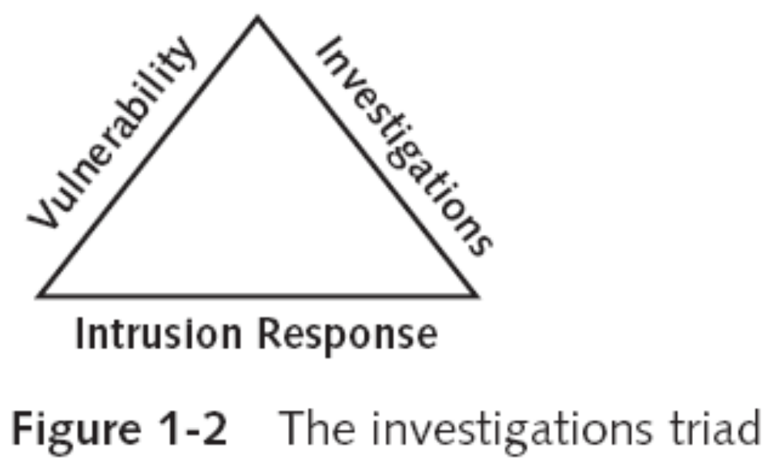
Computer Forensics Versus Other Related Disciplines (continued)

Slide 9
Computer Forensics Versus Other Related Disciplines (continued)
Enterprise network environment
  Large corporate computing systems that might include disparate or formerly independent systems
Vulnerability assessment and risk management group
  Tests and verifies the integrity of standalone workstations and network servers
  Professionals in this group have skills in network intrusion detection and incident response

Slide 10
Computer Forensics Versus Other Related Disciplines (continued)
Litigation
  Legal process of proving guilt or innocence in court
Computer investigations group
  Manages investigations and conducts forensic analysis of systems suspected of containing evidence related to an incident or a crime

Slide 11
History of Computer Forensics

Slide 12
A Brief History of Computer Forensics
By the 1970s, electronic crimes were increasing, especially in the financial sector
  Most law enforcement officers didn’t know enough about computers to ask the right questions
    Or to preserve evidence for trial
1980s
  PCs gained popularity and different OSs emerged
  Disk Operating System (DOS) was available
  Forensics tools were simple, and most were generated by government agencies

Slide 13
A Brief History of Computer Forensics (continued)
Mid-1980s
  Xtree Gold appeared on the market
    Recognized file types and retrieved lost or deleted files
  Norton DiskEdit soon followed
    And became the best tool for finding deleted file
1987
  Apple produced the Mac SE
    A Macintosh with an external EasyDrive hard disk with 60 MB of storage

Slide 14
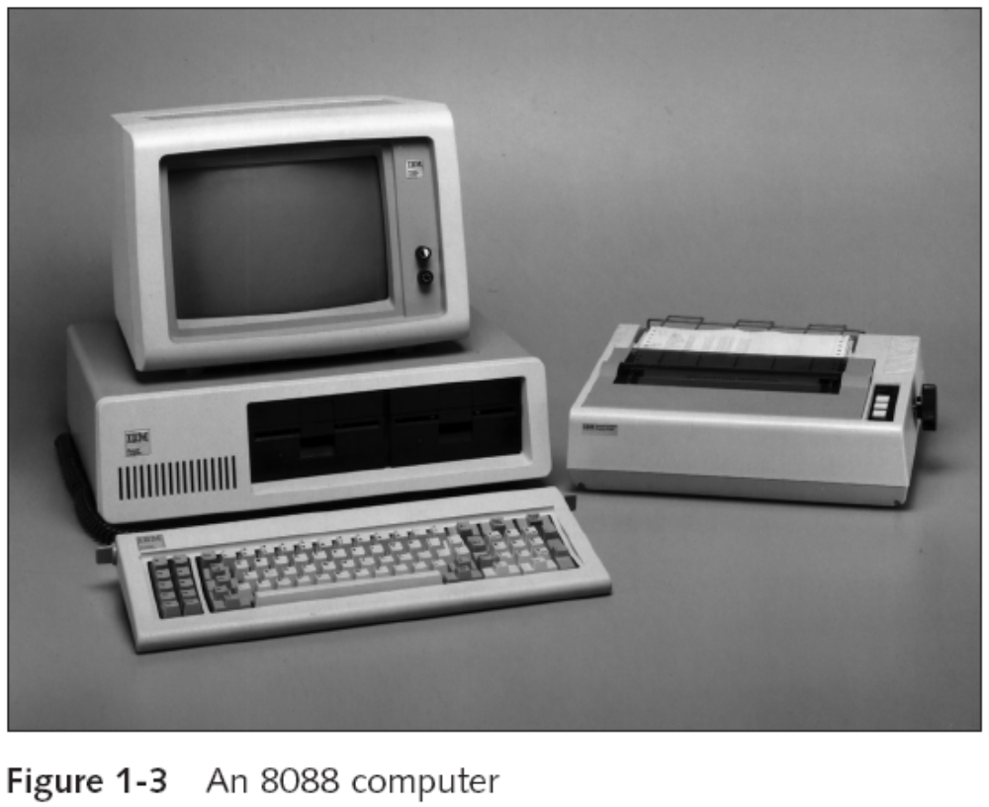
A Brief History of Computer Forensics (continued)

Slide 15
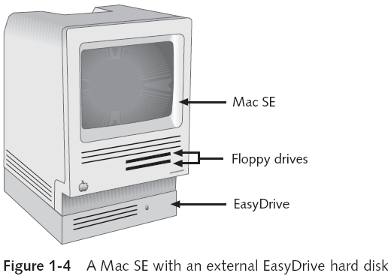
A Brief History of Computer Forensics (continued)

Slide 16
A Brief History of Computer Forensics (continued)
Early 1990s
  Tools for computer forensics were available
  International Association of Computer Investigative Specialists (IACIS)
    Training on software for forensics investigations
  IRS created search-warrant programs
  ExpertWitness for the Macintosh
    First commercial GUI software for computer forensics
    Created by ASR Data

Slide 17
A Brief History of Computer Forensics (continued)
Early 1990s (continued)
  ExpertWitness for the Macintosh
    Recovers deleted files and fragments of deleted files
Large hard disks posed problems for investigators
Now
  iLook
    Maintained by the IRS, limited to law enforcement
  EnCase
    Available for public or private use
  AccessData Forensic Toolkit (FTK)
    Available for public or private use

Slide 18
Computer Forensics Tools

Slide 19


Most Important Commercial Forensic Software Today
EnCase
  link Ch 1a on my Web page
  Go to Samsclass.info, then click CNIT 121
FTK
  Link Ch 1b
  Free demo version (we will use it in this class)

Slide 20
Open Source Forensic Tools
Linux-based
  Knoppix Live CDs
  Helix
  Ubuntu
  Backtrack
Not commonly used as the main tool, but for special purposes

Slide 21
Laws and Resources

Slide 22
Understanding Case Law
Technology is evolving at an exponential pace
  Existing laws and statutes can’t keep up change
Case law used when statutes or regulations don’t exist
Case law allows legal counsel to use previous cases similar to the current one
  Because the laws don’t yet exist
Each case is evaluated on its own merit and issues

Slide 23
Developing Computer Forensics Resources
You must know more than one computing platform
  Such as DOS, Windows 9x, Linux, Macintosh, and current Windows platforms
Join as many computer user groups as you can
Computer Technology Investigators Network (CTIN)
  Meets monthly to discuss problems that law enforcement and corporations face

Slide 24
Developing Computer Forensics Resources (continued)
High Technology Crime Investigation Association (HTCIA)
  Exchanges information about techniques related to computer investigations and security
User groups can be helpful
Build a network of computer forensics experts and other professionals
  And keep in touch through e-mail
Outside experts can provide detailed information you need to retrieve digital evidence

Slide 25
Public and Private Investigations

Slide 26
Preparing for Computer Investigations
Computer investigations and forensics falls into two distinct categories
  Public investigations
  Private or corporate investigations
Public investigations
  Involve government agencies responsible for criminal investigations and prosecution
  Organizations must observe legal guidelines
Law of search and seizure
  Protects rights of all people, including suspects

Slide 27
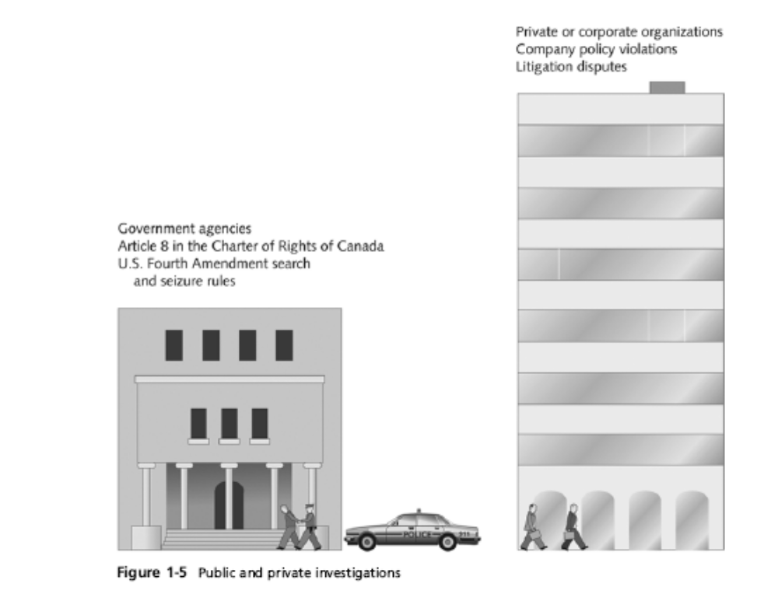
Preparing for Computer Investigations (continued)

Slide 28
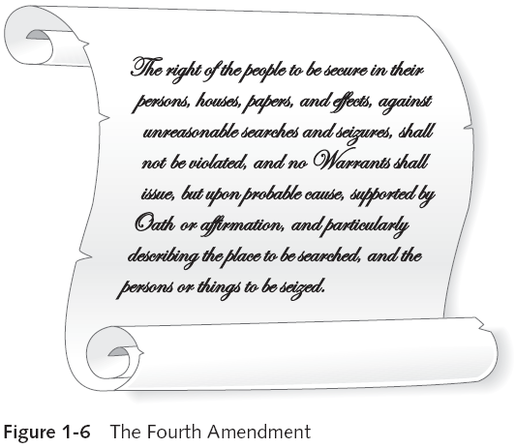
Preparing for Computer Investigations (continued)

Slide 29
Preparing for Computer Investigations (continued)
Private or corporate investigations
  Deal with private companies, non-law-enforcement government agencies, and lawyers
  Aren’t governed directly by criminal law or Fourth Amendment issues
  Governed by internal policies that define expected employee behavior and conduct in the workplace
Private corporate investigations also involve litigation disputes
Investigations are usually conducted in civil cases

Slide 30
Law Enforcement Agency Investigations

Slide 31
Understanding Law Enforcement Agency Investigations
In a criminal case, a suspect is tried for a criminal offense
  Such as burglary, murder, or molestation
Computers and networks are sometimes only tools that can be used to commit crimes
  Many states have added specific language to criminal codes to define crimes involving computers, such as theft of computer data
Following the legal process
  Legal processes depend on local custom, legislative standards, and rules of evidence

Slide 32
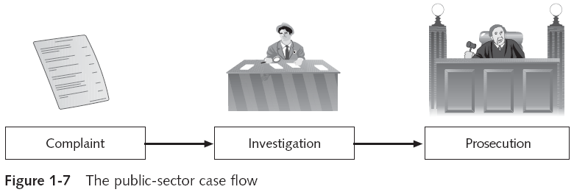
Understanding Law Enforcement Agency Investigations (continued)
Following the legal process (continued)
  Criminal case follows three stages
    The complaint, the investigation, and the prosecution

Slide 33
Understanding Law Enforcement Agency Investigations (continued)
Following the legal process (continued)
  A criminal case begins when someone finds evidence of an illegal act
  Complainant makes an allegation, an accusation or supposition of fact
  A police officer interviews the complainant and writes a report about the crime
    Police blotter provides a record of clues to crimes that have been committed previously
  Investigators delegate, collect, and process the information related to the complaint

Slide 34
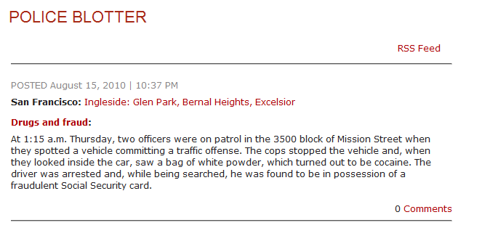
Police Blotter
Link Ch 1c

Slide 35
Understanding Law Enforcement Agency Investigations (continued)
Following the legal process (continued)
  After you build a case, the information is turned over to the prosecutor
  Affidavit
    Sworn statement of support of facts about or evidence of a crime
      Submitted to a judge to request a search warrant
    Have the affidavit notarized under sworn oath
  Judge must approve and sign a search warrant
    Before you can use it to collect evidence

Slide 36
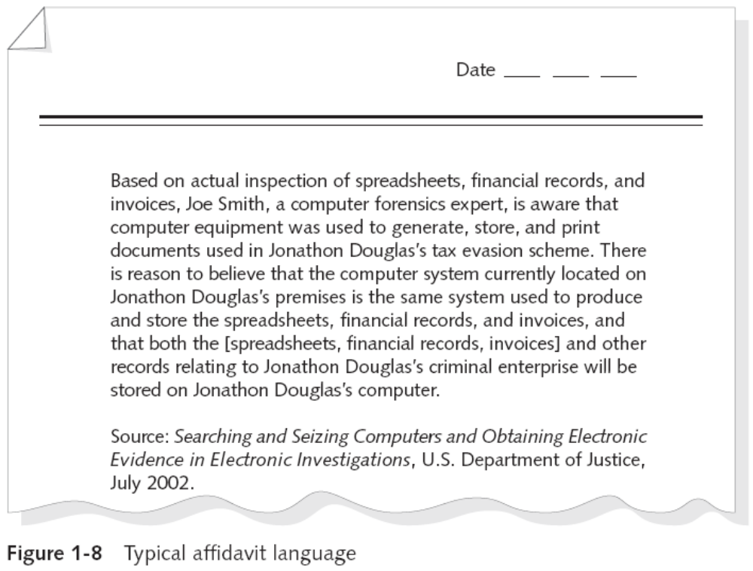
Understanding Law Enforcement Agency Investigations (continued)

Slide 37
Corporate Investigations

Slide 38
Understanding Corporate Investigations
Private or corporate investigations
  Involve private companies and lawyers who address company policy violations and litigation disputes
Corporate computer crimes can involve:
  E-mail harassment
  Falsification of data
  Gender and age discrimination
  Embezzlement
  Sabotage
  Industrial espionage

Slide 39
Understanding Corporate Investigations (continued)
Establishing company policies
  One way to avoid litigation is to publish and maintain policies that employees find easy to read and follow
  Published company policies provide a line of authority
    For a business to conduct internal investigations
  Well-defined policies
    Give computer investigators and forensic examiners the authority to conduct an investigation
Displaying Warning Banners
  Another way to avoid litigation

Slide 40
Understanding Corporate Investigations (continued)
Displaying Warning Banners (continued)
  Warning banner
    Usually appears when a computer starts or connects to the company intranet, network, or virtual private network
    Informs end users that the organization reserves the right to inspect computer systems and network traffic at will
    Establishes the right to conduct an investigation
    Removes expectation of privacy
  As a corporate computer investigator
    Make sure company displays well-defined warning banner

Slide 41
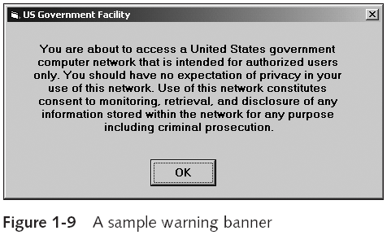
Understanding Corporate Investigations (continued)

Slide 42
Understanding Corporate Investigations (continued)
Designating an authorized requester
  Authorized requester has the power to conduct investigations
  Policy should be defined by executive management
  Groups that should have direct authority to request computer investigations
    Corporate Security Investigations
    Corporate Ethics Office
    Corporate Equal Employment Opportunity Office
    Internal Auditing
    The general counsel or Legal Department

Slide 43
Understanding Corporate Investigations (continued)
Conducting security investigations
  Types of situations
    Abuse or misuse of corporate assets
    E-mail abuse
    Internet abuse
  Be sure to distinguish between a company’s abuse problems and potential criminal problems
  Corporations often follow the silver-platter doctrine
    What happens when a civilian or corporate investigative agent delivers evidence to a law enforcement officer

Slide 44
Understanding Corporate Investigations (continued)
Distinguishing personal and company property
  Many company policies distinguish between personal and company computer property
  One area that’s difficult to distinguish involves PDAs, cell phones, and personal notebook computers
  The safe policy is to not allow any personally owned devices to be connected to company-owned resources
    Limiting the possibility of commingling personal and company data

Slide 45
Professional Conduct

Slide 46
Maintaining Professional Conduct
Professional conduct
  Determines your credibility
  Includes ethics, morals, and standards of behavior
Maintaining objectivity means you must form and sustain unbiased opinions of your cases
Maintain an investigation’s credibility by keeping the case confidential
  In the corporate environment, confidentiality is critical
In rare instances, your corporate case might become a criminal case as serious as murder

Slide 47
Maintaining Professional Conduct (continued)
Enhance your professional conduct by continuing your training
Record your fact-finding methods in a journal
Attend workshops, conferences, and vendor courses
Membership in professional organizations adds to your credentials
Achieve a high public and private standing and maintain honesty and integrity

