Slide 1
TIMs Evolution
Ahmed Aquib

Slide 2
TIM4
TIMD4_HUMAN
T-cell immunoglobulin and mucin domain-containing protein 4
378 AA in length
PS binding receptor expressed on APCs

Slide 3
TIM4 Domain and Evolution
Igv Domain containing protein
Orthologs with significant homology present in vertebrates (42% Homology with Zebra Fish timd4; Alliance of Genome)
No significant homology with invertebrates (C. elegans, and Drosophila; Blast)
Igv Domain containing proteins are present in invertebrates

Slide 4
Multiple Sequence Analysis – Species List
Great Apes: Homo sapiens – Human; Pan troglodytes – Common chimpanzee; Pan paniscus – Bonobo; Gorilla gorilla – Western gorilla; Pongo abelii – Sumatran orangutan; Nomascus leucogenys – Northern white-cheeked gibbon Old World Monkeys: Macaca mulatta – Rhesus macaque; Papio anubis – Olive baboon New World Monkeys: Cebus capucinus – White-faced capuchin; Saimiri boliviensis – Bolivian squirrel monkey; Callithrix jacchus – Common marmoset Strepsirrhines: Lemur catta – Ring-tailed lemur

Slide 5
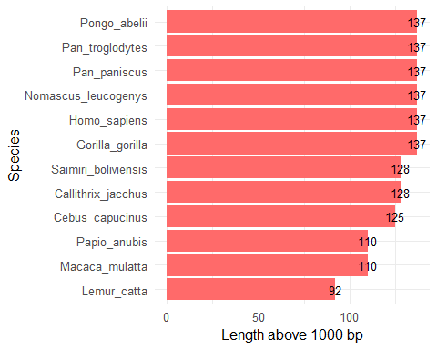
A quick look at the length of CDNA
#Input fasta file save as dna_seqs dna_seqs <- readDNAStringSet("Sequences/Timd4_Raw_Primate.fasta", format = "fasta") df <- data.frame( name = sub(" .*", "", names(dna_seqs)), length = width(dna_seqs) - 1000 ) ggplot(df, aes(x = length, y = reorder(name, length))) + geom_col(fill = "indianred1") + geom_text(aes(label = length), size = 3.5) + labs(x = "Length above 1000 bp", y = "Species") + theme_minimal(base_size = 12)

Slide 6
Multiple Seqence Alignment
print(aln_codon)
## DNAStringSet object of length 12: ## width seq names ## [1] 1155 ATGTCCAAAGAACCTCTCATTCT...AGACGGCCTTTTTACCCTCTAA Homo_sapiens | Hu... ## [2] 1155 ATGTCCAAAGAACCTCTCATTCT...AGACGGCCTTTTTACCCTCTAA Pan_troglodytes |... ## [3] 1155 ATGTCCAAAGAACCTCTCATTCT...AGACGGCCTTTTTACCCTCTAA Pan_paniscus | Bo... ## [4] 1155 ATGTCCAAAGAACCTCTCATTCT...AGACGGCCTTTTTACCCTCTAA Gorilla_gorilla |... ## [5] 1155 ATGTCCAAAGAACCTCTCATTCT...AGACGGCCTTTTTACCCTCTAA Pongo_abelii | Su... ## ... ... ... ## [8] 1155 ATGTCCAAAGAAACTCTCTTTCT...AGATGGCTTTTTCACCCTCTAA Cebus_capucinus |... ## [9] 1155 ATGTCCAAAGAAACTCTGGTTCT...AGACGGCCTTTTCACCCTCTAA Saimiri_boliviens... ## [10] 1155 ATGTCCAAAGAAACTCTTGTTCT...AGATGGCCTTTTTACCCTCTAA Callithrix_jacchu... ## [11] 1155 ATGTCCAAAGAACCTCTCATTCT...AGATGGACTTTTTACCCTCTAA Papio_anubis | Ol... ## [12] 1155 ATGTCCAAAGGACTTCTCGTTTT...AGATGGCCTTTTTACGCTCTAA Lemur_catta | Rin...

Slide 7
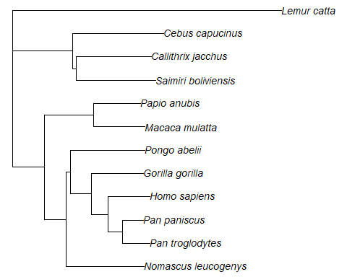
Phylogenetic Tree

