Slide 1
Task 4 Superstore sales Analysis
Analysis Dashboard – Done in Power BI
~ Tarun Jayana

Slide 2
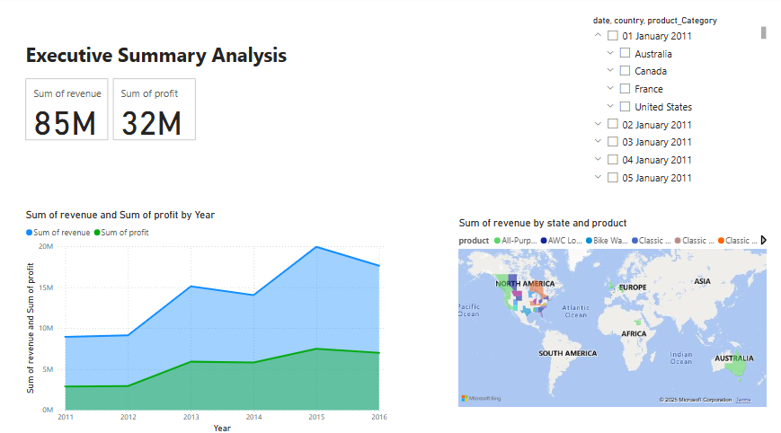
Executive Summary analysis

Slide 3
Summary
Executive Summary Analysis
Total Revenue: $85M
Total Profit: $32M
Key Insights:
Revenue and Profit Growth: Steady increase from 2011–2015, peaking in 2015 before a slight dip in 2016.
Top Regions: High revenue concentration in North America and Australia.
Product Performance: Multiple product categories contribute, visualized by color-coded map segments.
Filters Available: Date (01–05 Jan 2011), Country, and Product Category for detailed analysis.

Slide 4
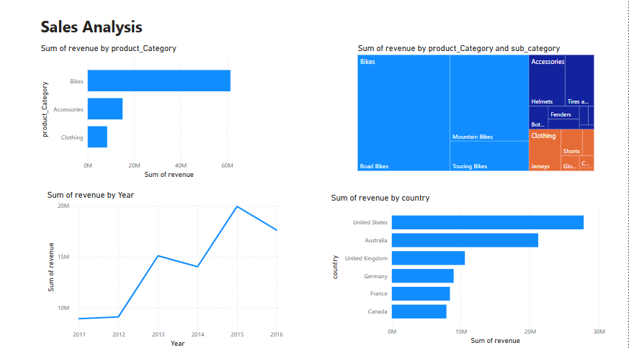
Sales Analysis

Slide 5
Summary
Sales Analysis Summary
Top Product Category:
Bikes lead in revenue, followed by Accessories and Clothing.
Sub-Category Breakdown:
Within Bikes, Road Bikes, Mountain Bikes, and Touring Bikes are top earners
Accessories like Helmets and Tires contribute moderately.
Clothing includes Jerseys, Shorts, and Gloves with smaller shares.
Revenue Trend (2011–2016):
Gradual growth from 2011 to 2015, peaking in 2015, followed by a dip in 2016.
Top Performing Countries:
United States and Australia generate the highest revenue.
Followed by UK, Germany, France, and Canada

Slide 6
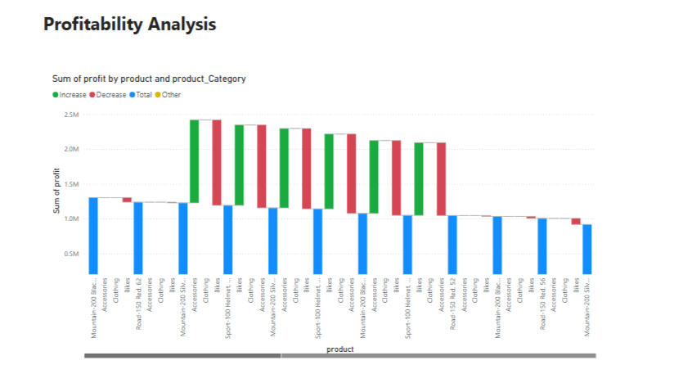
Profitability Analysis

Slide 7
Summary
Profitability Analysis Summary
Profit Trends by Product:
Products are evaluated by sum of profit with bars showing Increase (green), Decrease (red), and Total (blue).
Top Performing Products:
Mountain Bikes and Clothing items show the highest profit increases.
Sports 100 Helmets and other Accessories also contribute significantly to profitability.
Underperforming Products:
Some Road Bikes and specific Clothing products show a decrease in profit.
Overall Insight: Majority of products are profitable, with a few dragging overall margins down slightly.

