Slide 1
SecureCube: A Multi-factor Authenticator
Aniqua Baset, Aashish Ghimire, Pankaj Kumar, Jyoti Phulwani
CS6490: Network Security, Fall 2015
Notes:
11

Slide 2





Multi-factor Authentication
Something
You Know
Something
You Have
Something
You Are
Why we need?
Only password is not secure
Social engineering, guessing, server hack, shoulder surfing, etc.
Notes:
Something you know, have, are – these line should be inder the pictures or above the pictures
We will give example when we talk
When we go to this slide to next slide, we will say that 2fa is common here is example

Slide 3
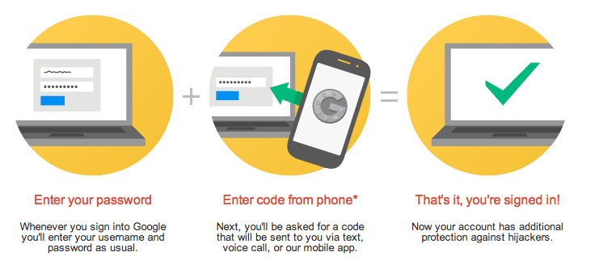
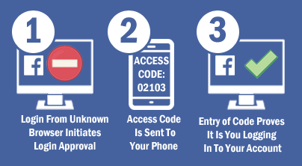

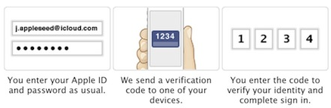
Two-factor authentication example
Notes:
Here

Slide 4
Problem with this approach
Attacker knows/guesses password and
Has user’s phone
User’s phone has a spyware app that can read SMS and send to attacker
User synced phone and laptop and, attacker has access to laptop
Phishing email/SMS that ask for the access token
Notes:
Or the heading can be ‘Problem with this approach’ or just ‘Problem’
Since it’s common for user to enter the token somewhere, user can be fooled to write it in some other place. This type of attacks have been done

Slide 5
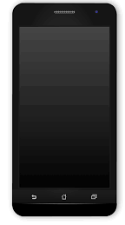

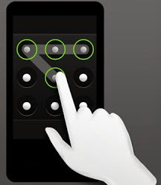


Proposed solution: SecureCube
1. Username,
Password
2. Token
3. User enter pattern
5. Success!
4. Hash(Token, Hash(Pattern))
Notes:
I used hash(token, hash(pattern)) bcz server will save username, hash(password), hash(token) to save against server break-in
So our system is What you know + What you have + What you know
Pattern will be entered in the system while registration, do I need the registration slide??

Slide 6
Threat Model
Attacker has access to password
Guessing/social engineering/phishing
Attacker has access to token
User’s phone
Synced laptop
Compromised the communication of server ↔ phone
So can try an offline-dictionary attack
Notes:
Instead of outsider, insider, we can say attacker 1, attacker 2
Or no need to divide, just merge them

Slide 7

Security Analysis
Eavesdropping
Hashed pattern, token is sent to server
Offline dictionary attack
Matrix | Dots | Possible patterns
3X3 | 9 | 623529
3X4 or 4X3 | 12 | 823059744
4X4 | 16 | 35951249665216 ≈ 2^45
Formula =
N = No. of dots
Secure!
Notes:
One important point -→ password is also hashed, so how got a password but not token ---? Password is common, so password, hash(password) is avaialble, pattern is not that common
Plus, may be got password from some other means
Pattern is only in user memory
What if attacker do social engineering, shoulder surfing to get pattern -→ highly unlikely can get both password and pattern this way
Pattern is introducing extra layer of security
Highly unlikely that a malicious app will present a pattern screen to fool a user to give out token
Highly unlikely that a malicious app will present a pattern screen to fool a user to give out token

Slide 8
Security Analysis
Phishing attack
SMS/email will not work
Malware app
Hijacking the screen while user enters pattern is harder compared to reading an SMS.
Notes:
Pattern is only in user memory
What if attacker do social engineering, shoulder surfing to get pattern -→ highly unlikely can get both password and pattern this way
Pattern is introducing extra layer of security
Highly unlikely that a malicious app will present a pattern screen to fool a user to give out token
Highly unlikely that a malicious app will present a pattern screen to fool a user to give out token

Slide 9
Implementation
Web server — Pyhton’s Flask framework
Database — SQLite
App — Android
Web server ↔ app
Used: Android’s ServerSocket
Formal way: Google Cloud Service (GCM)
Notes:
I want that if we click the Demo a video will appear as a full screen. Don’t know how to do that

Slide 10
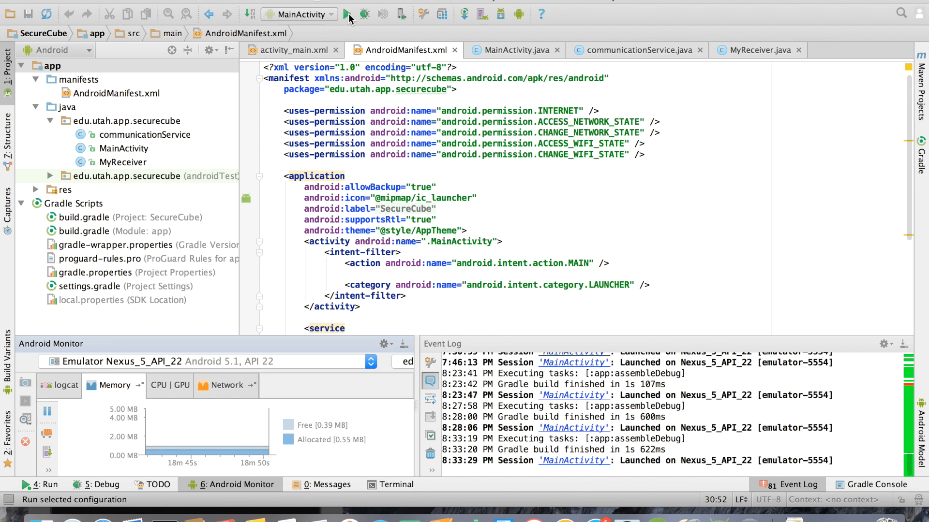
Demo

Slide 11
Limitation
Forgot password and/or pattern or lost phone
Possible solution
Re-registration link to a “secure” email
“Secure” email is not installed in phone
Notes:
What will be the heading, limitation or possible issues

Slide 12


Slide 13


Security Analysis
Server break-in
Hashed pattern is saved in server
Eavesdropping
Hashed pattern, token is sent to server
Offline dictionary attack
Matrix | Dots | Possible patterns
3X3 | 9 | 623529
3X4 or 4X3 | 12 | 823059744
4X4 | 16 | 35951249665216 ≈ 2^45
Formula =
N = No. of dots
Secure!
Notes:
Pattern is only in user memory
What if attacker do social engineering, shoulder surfing to get pattern -→ highly unlikely can get both password and pattern this way
Pattern is introducing extra layer of security
Highly unlikely that a malicious app will present a pattern screen to fool a user to give out token
Highly unlikely that a malicious app will present a pattern screen to fool a user to give out token

Slide 14
Security Analysis
Attacker can not know pattern
Only hashed pattern is saved in server
Highly unlikely that a malicious app will present a pattern screen to fool a user to give out token
Can not do offline dictionary attack
4X4 dot pattern → approx. 2^45 possibilities
Notes:
Pattern is only in user memory
What if attacker do social engineering, shoulder surfing to get pattern -→ highly unlikely can get both password and pattern this way
Pattern is introducing extra layer of security

Slide 15
Security Analysis
Knows password, token but can not know pattern
Hashed pattern is saved in server → Server break-in
Hashed pattern, token is sent to server → Eavesdropping
Highly unlikely that a malicious app will present a pattern screen to fool a user to give out token
Can not do offline dictionary attack
Matrix | Dots | Possible patterns
3X3 | 9 | 623529
3X4 or 4X3 | 12 | 823059744
4X4 | 16 | 35951249665216 ≈ 2^45
Formula =
N = No. of dots
Notes:
Pattern is only in user memory
What if attacker do social engineering, shoulder surfing to get pattern -→ highly unlikely can get both password and pattern this way
Pattern is introducing extra layer of security
Highly unlikely that a malicious app will present a pattern screen to fool a user to give out token

Slide 16
Registration in SecureCube
1. Username, Password, Confirm Password
2. Pattern?
3. User enter pattern 2/3 times
6. Registered!
4. Pattern
5. Saves username, hash(password), hash(pattern)

Slide 17

Multi-factor Authentication
Something
You Know
Something
You Have
Something
You Are
Why we need?
Only password is not secure
Social engineering, guessing, server hack, shoulder surfing, etc.
Notes:
We will give example when we talk
When we go to this slide to next slide, we will say that 2fa is common here is example

Slide 18

Security Analysis
Insider attacker
1. Username,
Password
2. Token
3. User enter pattern
5. Success!
4. Hash(Token, Hash(Pattern))

Slide 19
Security Analysis
Outsider attacker
1. Username,
Password
2. Token
3. User enter pattern
5. Success!
4. Hash(Token, Hash(Pattern))

Slide 20



Multi-factor Authentication
Factors
Something you know
Something you have
Something you are
Why we need?
Only password is not secure
Social engineering, guessing, server hack, shoulder surfing, etc.
Notes:
We will give example when we talk
When we go to this slide to next slide, we will say that 2fa is common here is example

Slide 21

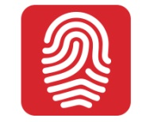

Multi-factor Authentication
Factors
Something you know
Something you have
Something you are
Why we need?
Only password is not secure
Social engineering, guessing, server hack, shoulder surfing, etc.
Notes:
We will give example when we talk
When we go to this slide to next slide, we will say that 2fa is common here is example

