Slide 1

SMART INDIA HACKATHON 2026
TITLE PAGE
Problem Statement ID – SIH26094
Problem Statement Title- AI- powered dynamic mental health monitoring and distress prediction system for atrocities victims
Theme- MedTech / BioTech / HealthTech
PS Category- Software
Team ID- 123850
Team Name – Segmentation Error

Slide 2
AI- powered dynamic mental health monitoring and distress prediction system for atrocities victims
Segmentation
Error
A private, accessible and culturally sensitive web application designed for early support.
Problems Faced:-
People often recognize distress late, hesitate to seek help, or do not know what to do next.
Existing support is often event-driven rather than longitudinal.
The high cost of physical therapy binds low profile patients to reach out for help
Our Solution:-
A guided space for self-reflection, emotional check-ins, coping and support.
Supportive AI conversation, journal and resources.
Dynamic distress-risk layer for trend and escalation.
Human-in-the-loop alerts for defined high-risk conditions.
Why It's Different:-
Personal baseline; Compare changes with your own usual state, not with a general standard.
Multimodal-ready: text, voice and engagement signals.
Privacy-first: minimum data + scoped access.
Explainable: show why risk moved.
ONE-LINE VALUE
Monitor continuously → understand trends → intervene earlier → keep humans in control

Slide 3
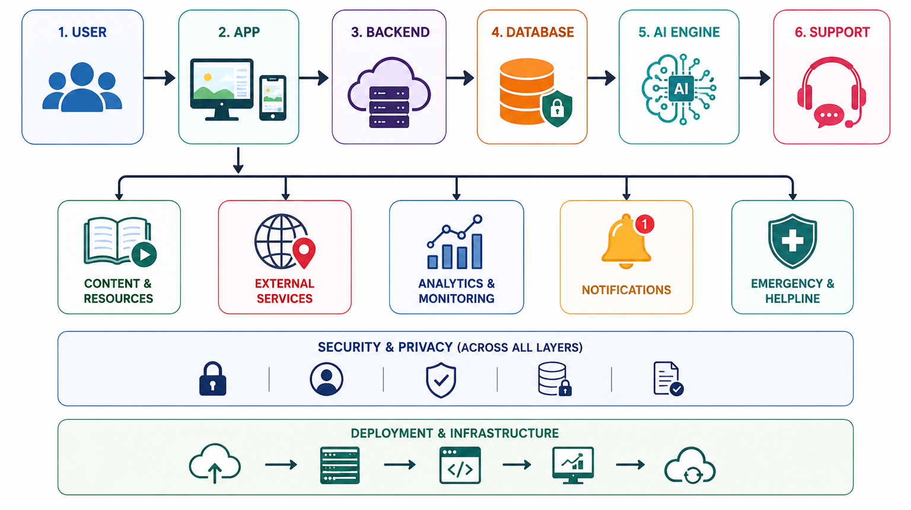
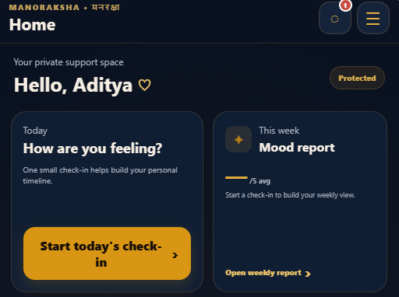
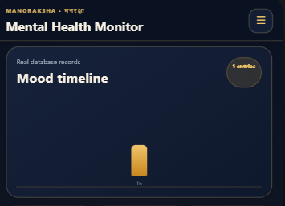
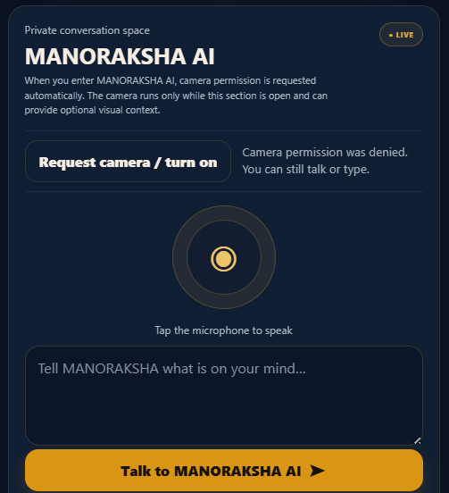
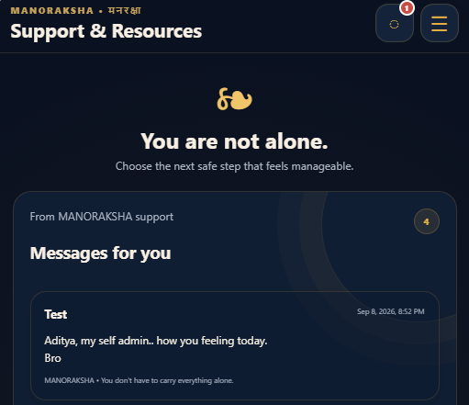
TECHNICAL APPROACH
Segmentation
Error
Technologie To Be Used:-
Frontend
->React.js, JavaScript, Responsive UI
2. Backend
->Node.js, Express.js, REST APIs
3. Database
->SupaBase
4. AI/ML
->Python, AI/ML APIs or models
Here, the data flow within the process is shown
Working Prototype:-

Slide 4
FEASIBILITY AND VIABILITY
Segmentation
Error
Practical • Scalable • Sustainable
Risk → Mitigation
Practical Aspects
FALSE ALARM
Show risk as a signal; use thresholds + human review.
TECHNICAL:-
Existing technologies
React + Node.js
SupaBase database
AI API integration
ECONOMIC:-
Low development cost
No special hardware needed
Easy maintenance
No sign up fees
MISSED CRISIS
Safety prompts, escalation pathways and explicit emergency guidance.
SENSITIVE DATA
Consent, data minimization, encryption and scoped access.
OPERATIONAL:-
Simple user interface
Easy onboarding
24/7 accessibility
Automated support
SCALABILITY:-
Supports multiple users
Modular architecture
Easy feature expansion
BIAS
Evaluate across languages/populations; monitor model drift.
AI OVERREACH
No diagnosis from appearance; no autonomous clinical decision.
Why ManoRaksha?
| Easy to deploy│ Easy to scale │ Secure │
│ AI-assisted │ Cost-effective │ Accessible |

Slide 5
IMPACT AND BENEFITS
Segmentation
Error
Impact On User
Self-Awareness : Helps users recognize changes in their mood and emotional well-being.
Early Awareness : Highlights possible warning signs so users can seek help earlier.
Personalized Support: Adapts guidance and resources according to individual needs.
Better Support Access : Connects users with appropriate professional and community resources.
Benefits Of ManoRaksha
AI-Assisted Guidance : Uses AI to provide quick insights and relevant wellness suggestions.
Private & Secure : Protects sensitive user information through secure data handling.
24/7 Accessibility : Makes wellness resources and initial support available anytime.
Timely Intervention : Helps identify concerning patterns and encourages appropriate support.
One Integrated Platform : Brings assessment, tracking, resources and support together in one place.

Slide 6

RESEARCH AND REFERENCES
Segmentation
Error
Research
The Unspeakable Mind by Shaili Jain, M.D. A psychiatrist explores post-traumatic stress disorder (PTSD). The book looks at how violent and unspeakable experiences fracture the mind and how recovery is possible.
The Body Keeps the Score by Bessel van der Kolk This widely read book explains how trauma impacts both the body and the mind, offering alternative paths to healing.
World Health Organization (WHO): Provides global data, policies, and initiatives regarding brain health and well-being
Tele-MANAS: India's free, 24/7 national tele-mental health service offering confidential counselling by trained professionals (toll-free via 14416).
Reference
ManoRaksha :- https://mano-raksha-v9lt.vercel.app/
QR Code:-
GitHub Repository:-
https://github.com/GitAdmin921/MANO-RAKSHA
YouTube link :-
https://youtu.be/Gjy37EASQxs?si=ZuxNa_hSzDGThd61

