Slide 1
Topological Data Analysis: Character Classification
Aidan Alai
Sonal Reddy Anugu
Caroline Bablin
Steven Caraballo
Hanjoon Choe
Sai Santosh Eedupuganti

Slide 2
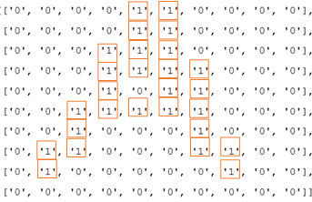
Input Matrix:

Slide 3
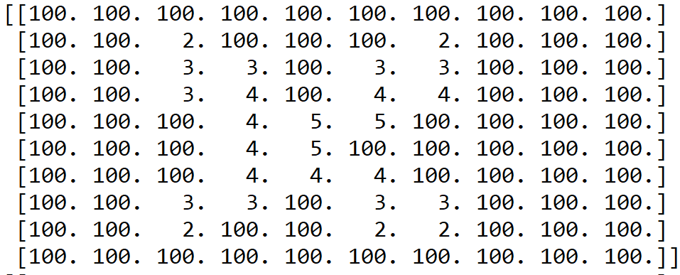
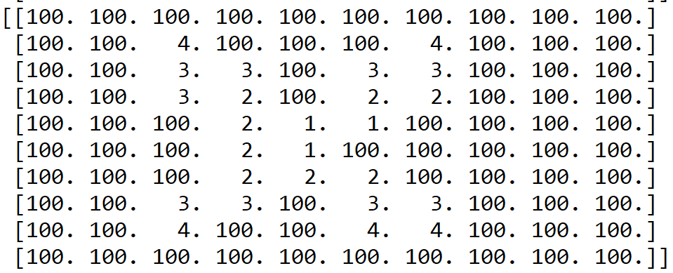
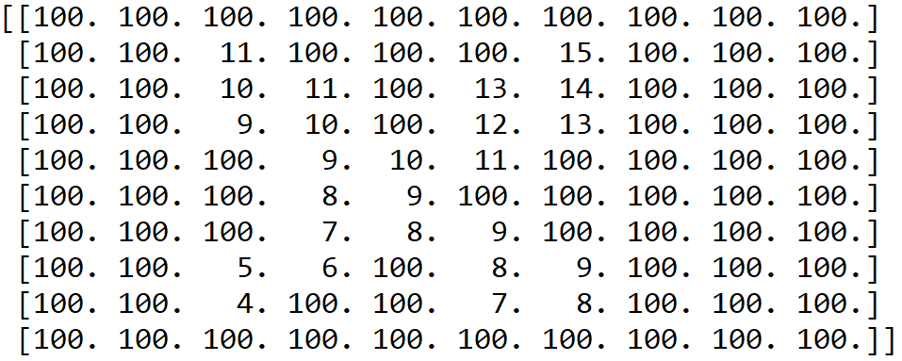
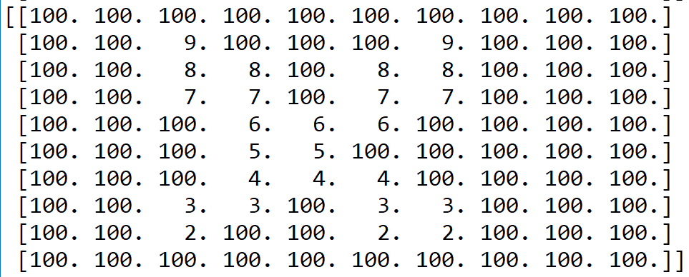
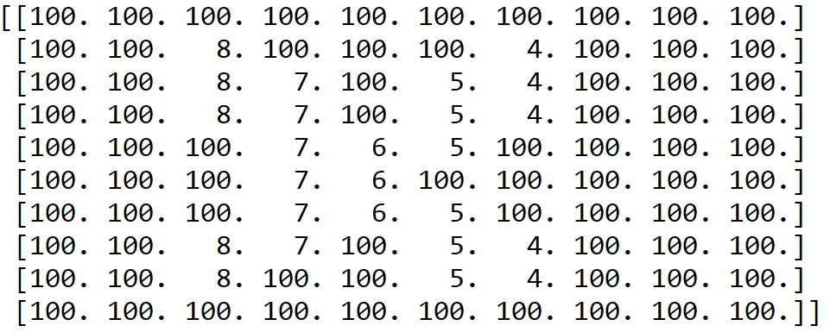
Filtration Techniques:
Out/In
In/Out
Diagonal
Top/Bottom
Right/Left

Slide 4
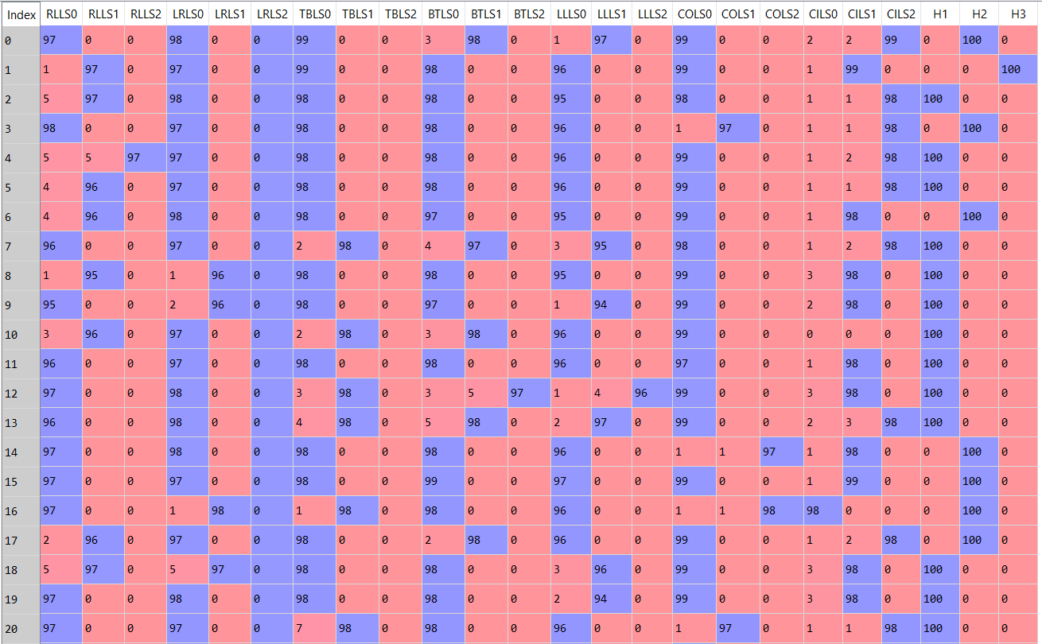
A,B,C’s 24D Vector

Slide 5
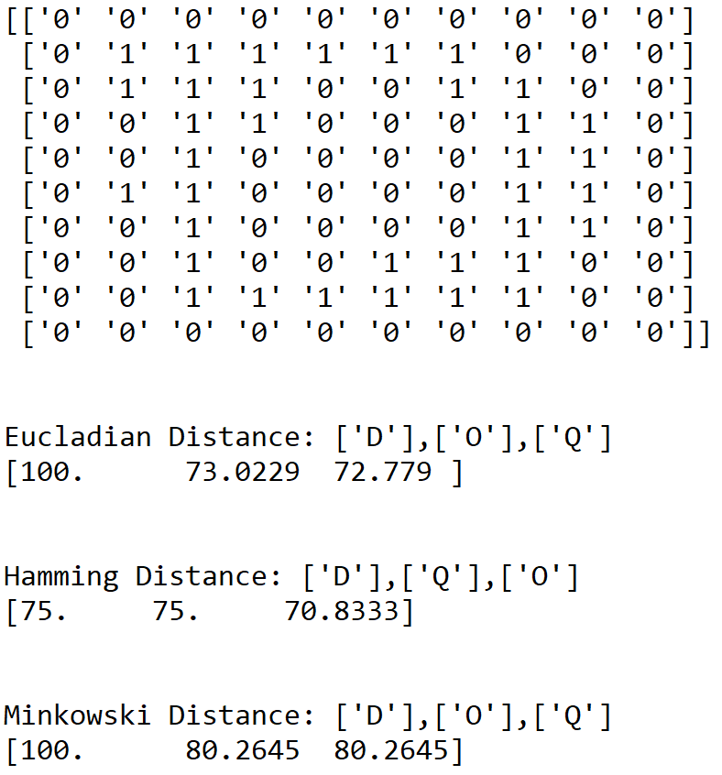
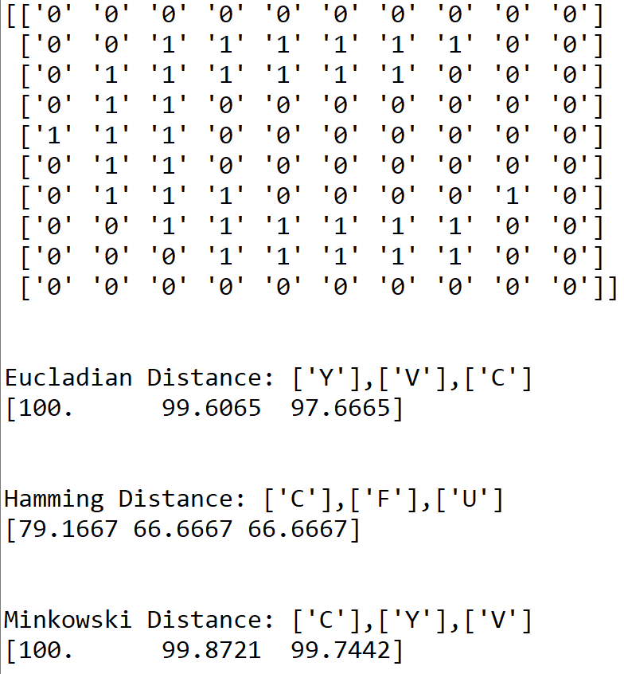
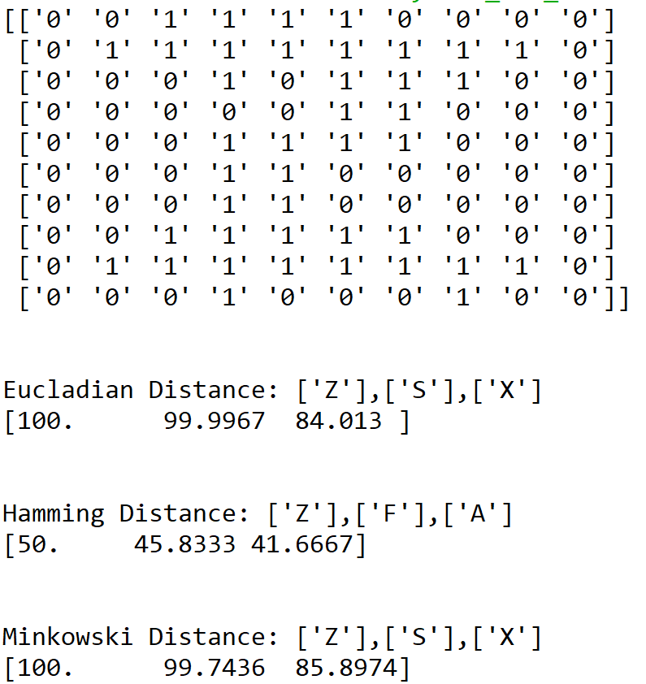
Correctly Classified!

Slide 6
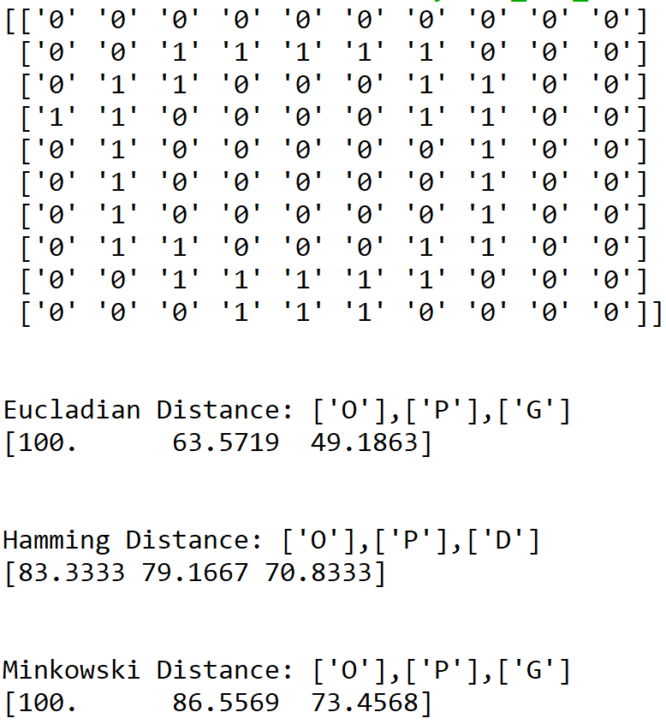
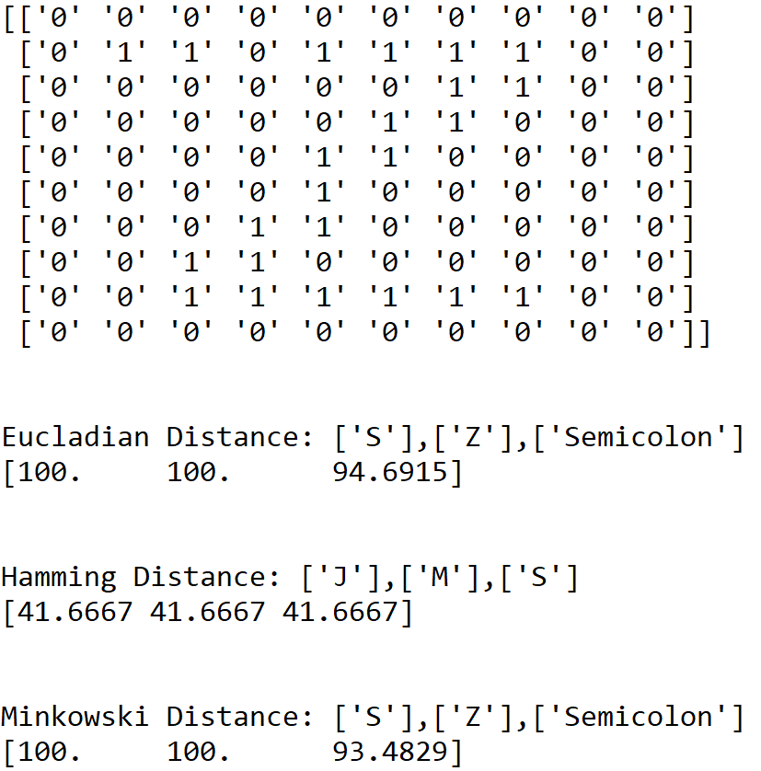
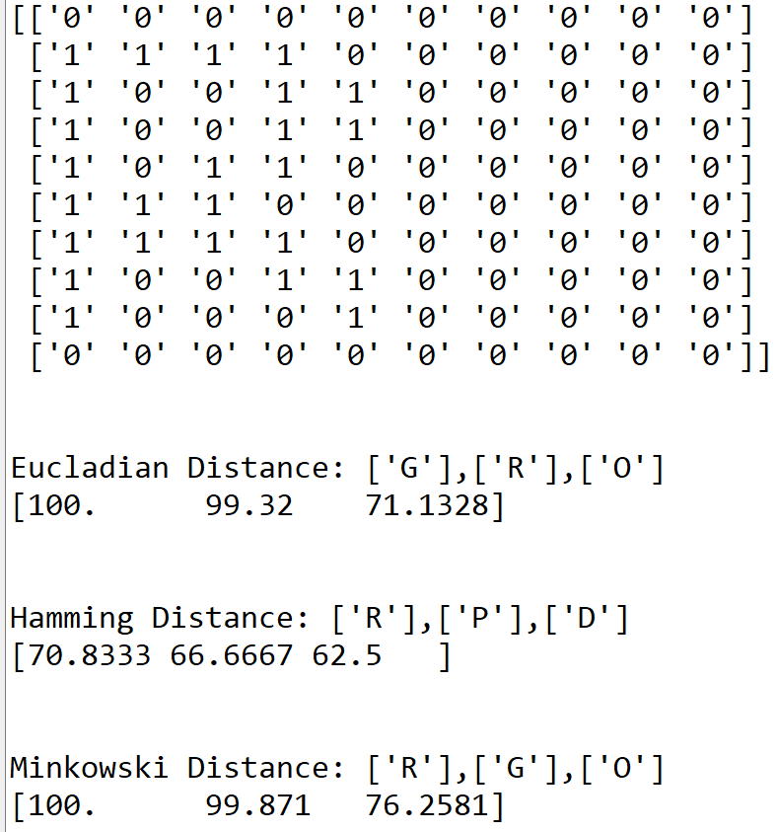
Misclassified...

Slide 7
Thank You!
QUESTIONS?

