Slide 1
(CS5013 GPU Programming )
BANG - GPU Optimization Project
PRESENTED BY:
ANKIT AGRAWAL - CS24MTECH12019
ZAKI HASEEB KAZI - CS25MTECH11021
KHUSHAL BHALIA- CS25MTECH14008
November 2025
UNDER SUPERVISION OF:
MR. KARTHIK V.
PROJECT FACULTY:
DR. JYOTHI VEDURADA

Slide 2
Results
Metric | SIFT100M (L=40) | DEEP100M (Various L)
Overall Speedup | 37.0% Faster (22ms to 13.9ms) | 29% – 35% Faster
Throughput Gain | +42% (508K to 720K QPS) | +31% – 54%
Latency Reduction | 22ms to 13.9ms | Consistent reduction across all L
Recall Accuracy | Identical (90.69%) | Identical (Diff based on L values)

Slide 3
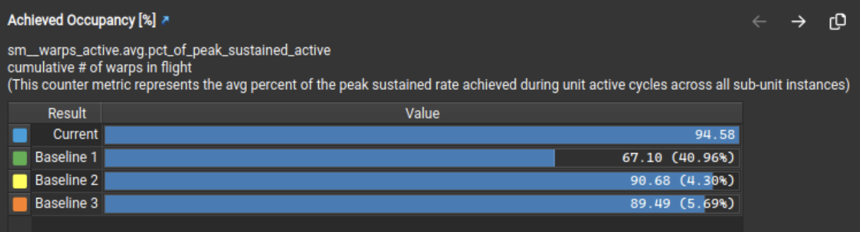
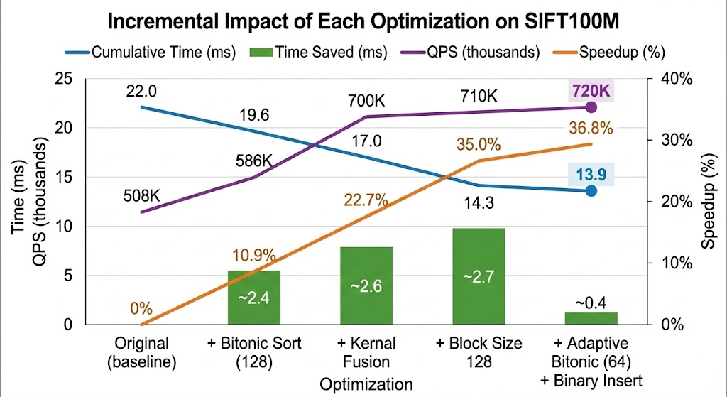
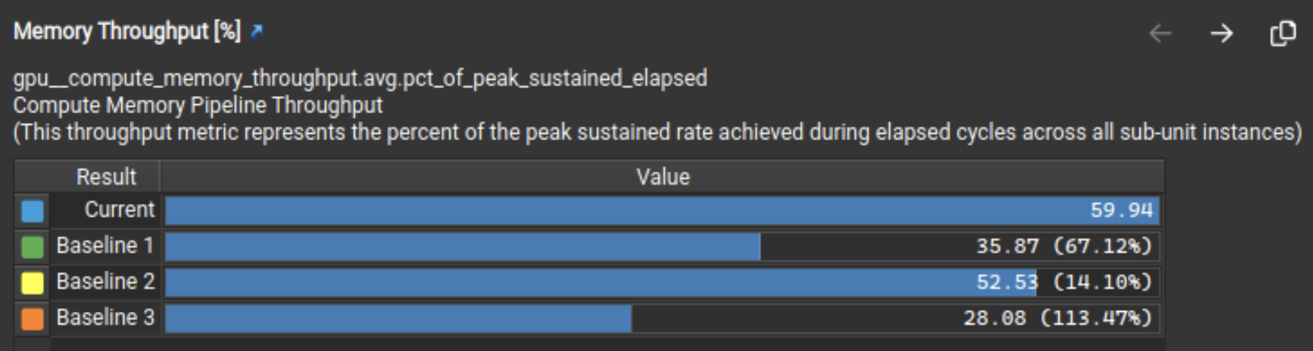
Analysis and Profiling

Slide 4
Optimizations
Switch to Bitonic Sort: Replaced the original Parallel Merge Sort with a GPU-optimized Bitonic Sort.
Kernel Fusion: Combined three separate kernels (filtering, distance computation, sorting) into a single fused kernel to eliminate launch overhead and global memory traffic.
Block Size Tuning: Reduced the number of threads per block from 256 to 128, optimizing GPU occupancy.
Adaptive Sort Sizing: Further optimized the Bitonic Sort by reducing the sort size from 128 to 64 elements, cutting the number of sorting stages from 7 to 6.
Binary Search Insertion: Implemented an O(log n) binary search method to handle the rare "65th element" overflow case.

Slide 5
Individual Contributions
Ankit Agrawal
Kernel Fusion Architecture: Designed the primary fused_search_kernel, consolidating three distinct operations into a single execution pipeline.
Memory Optimization: Replaced high-latency global memory transfers with efficient shared memory management between search phases.
Occupancy Tuning: Optimized thread block dimensions (reduced from 256 to 128 threads) to maximize Streaming Multiprocessor (SM) utilization.
Zaki Haseeb Kazi
Algorithm Transition: Implemented the initial migration from Merge Sort to GPU-optimized Bitonic Sort (128-element padded version).
Tensor Core Experimentation: Led the implementation of WMMA-based distance calculations and analyzed the matrix dimension mismatch (FP16/FP32).
Performance Profiling: Conducted baseline analysis and bottleneck identification (kernel launch overheads) using profiling tools to guide optimization strategies.
Khushal Bhalia
Advanced Algorithmic Optimization: Refined the sorting logic to "Adaptive Bitonic Sort," reducing steps from 7 to 6 by optimizing for 64 elements.
Hybrid Insertion Logic: Engineered the O(log n) Binary Search + Shift mechanism to handle element overflow efficiently without full re-sorts.
Result Analysis and Documentation: Performed Graphical Analysis of the final results and compiled the detailed optimization report and technical documentation.

