Slide 1
The Battle of Neighborhoods
Vamsee

Slide 2
Problem
The challenge is to find a suitable apartment for rent near Mumbai that complies with the demands on location, price and venues.
The data required to resolve this challenge is described in the following section 2, below.

Slide 3
Data required
The following data is required to answer the issues of the problem:
List of Boroughs and neighborhoods of Mumbai with their geodata (latitude and longitude)
List of Subway metro stations in Mumbai with their address location
List of apartments for rent in Mumbai area with their addresses and price
Preferably, a list of apartment for rent with additional information, such as price, address, area, # of beds, etc
Venues for each Mumbai neighborhood ( than can be clustered)
Venues for subway metro stations, as needed

Slide 4
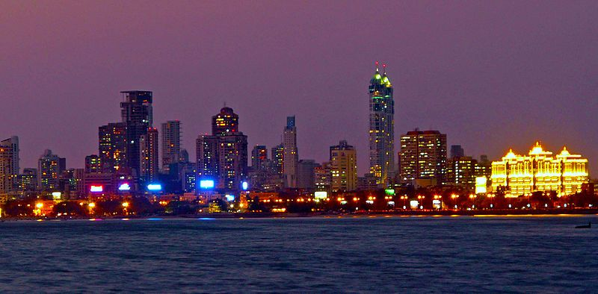
Introduction
Mumbai is the capital of India's Maharashtra state. It has the highest number of millionaires and billionaires among all cities in India. Mumbai is home to three UNESCO World Heritage Sites: the Elephanta Caves, Chhatrapati Shivaji Maharaj Terminus, and the city's distinctive ensemble of Victorian and Art Deco buildings.

Slide 5
DATA
Description of the Data
The following data is required to answer the issues of the problem:
List of Boroughs and neighborhoods of Mumbai with their geodata (latitude and longitude)
List of Subway metro stations in Mumbai with their address location
List of apartments for rent in Mumbai area with their addresses and price
Preferably, a list of apartment for rent with additional information, such as price, address, area, # of beds, etc
Venues for each Mumbai neighborhood ( than can be clustered)
Venues for subway metro stations, as needed

Slide 6
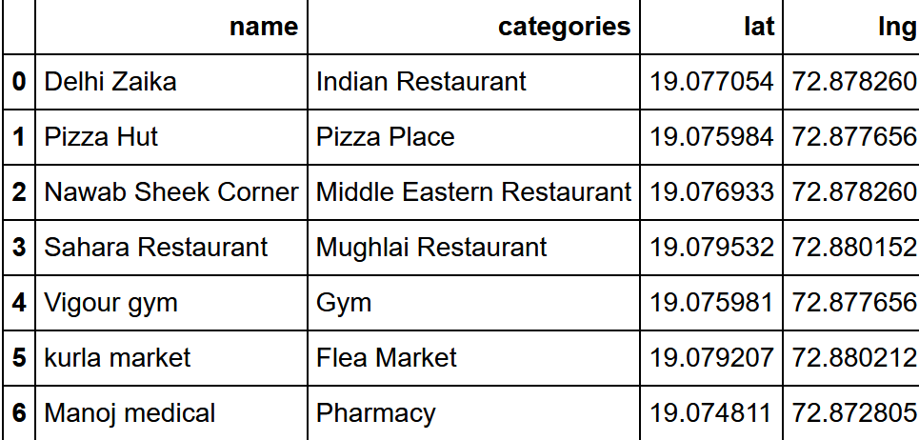
Using FourSquare api obtained venues in each

Slide 7
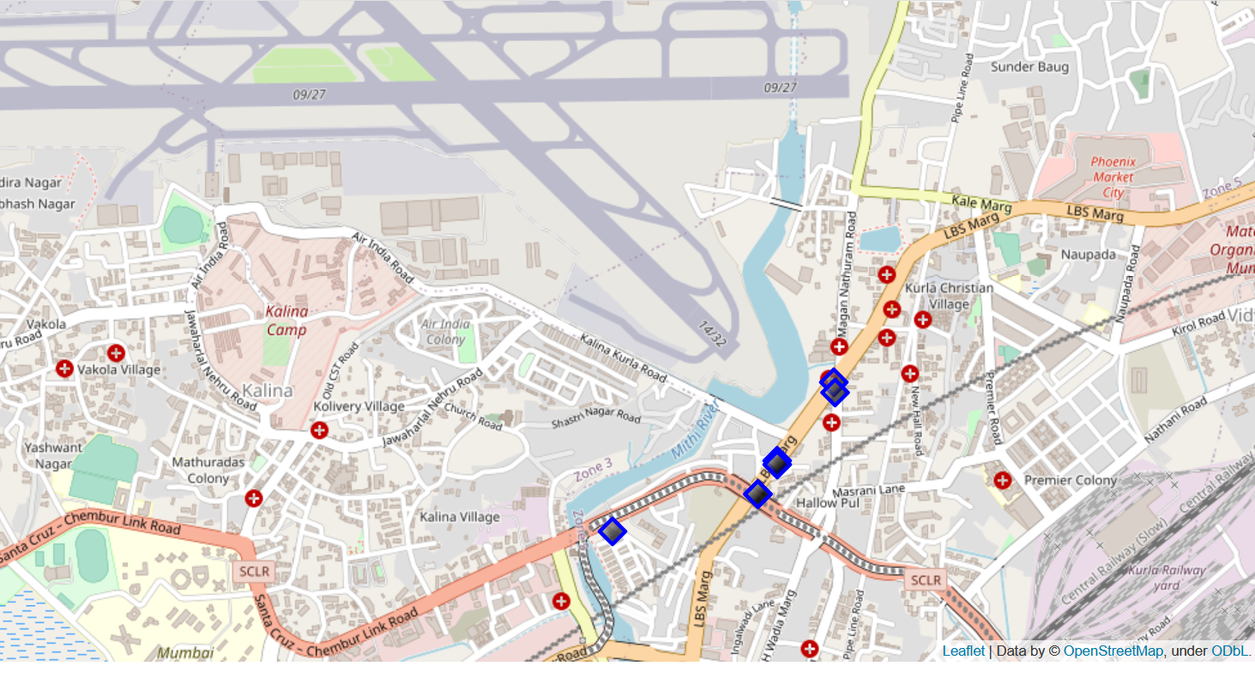
Visualising

