Slide 1
Battle FIELds of neighbourHOOd
Vamsee

Slide 2
Problem
The challenge is to find a suitable apartment for rent near Hyderabad that complies with the demands on location, price and venues.
The data required to resolve this challenge is described in the following section 2, below.

Slide 3
Data required
The following data is required to answer the issues of the problem:
List of Boroughs and neighborhoods of secunderabad with their geodata (latitude and longitude)
List of Subway metro stations in secunderabad with their address location
List of apartments for rent in secunderabad area with their addresses and price
Preferably, a list of apartment for rent with additional information, such as price, address, area, # of beds, etc
Venues for each secunderabad neighborhood ( than can be clustered)
Venues for subway metro stations, as needed

Slide 4
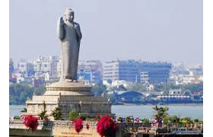
Introduction
Hyderabad is the capital of southern India's Telangana state. A major center for the technology industry, it's home to many upscale restaurants and shops. Its historic sites include Golconda Fort, a former diamond-trading center that was once the Qutb Shahi dynastic capital. The Charminar, a 16th-century mosque whose 4 arches support towering minarets, is an old city landmark near the long-standing Laad Bazaar.

Slide 5
DATA
Description of the Data
The following data is required to answer the issues of the problem:
List of Boroughs and neighborhoods of secunderabad with their geodata (latitude and longitude)
List of Subway metro stations in secunderabad with their address location
List of apartments for rent in secunderabad area with their addresses and price
Preferably, a list of apartment for rent with additional information, such as price, address, area, # of beds, etc
Venues for each secunderabad neighborhood ( than can be clustered)
Venues for subway metro stations, as needed

Slide 6
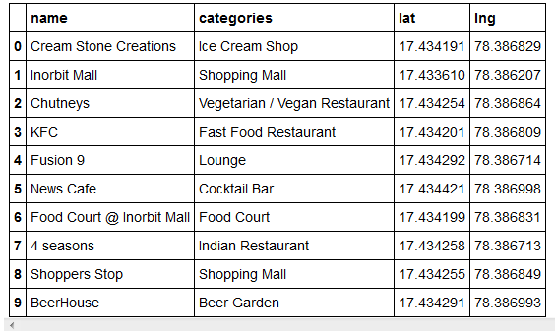
Using FourSquare api obtained venues in each

Slide 7
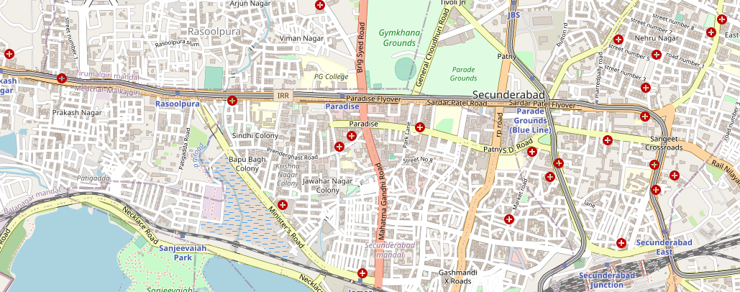
Visualising

