Slide 1

Geometric Algebra Transformers
Master in Artificial Intelligence and Robotics
A study on equilinearity and optimization of Transformers
Course: Deep Learning
Professor: Fabrizio Silvestri
Students: Claudio Schiavella 1884561, Lorenzo Cirillo 1895955, Jacopo Tedeschi 1882789
Notes:
Lorenzo

Slide 2
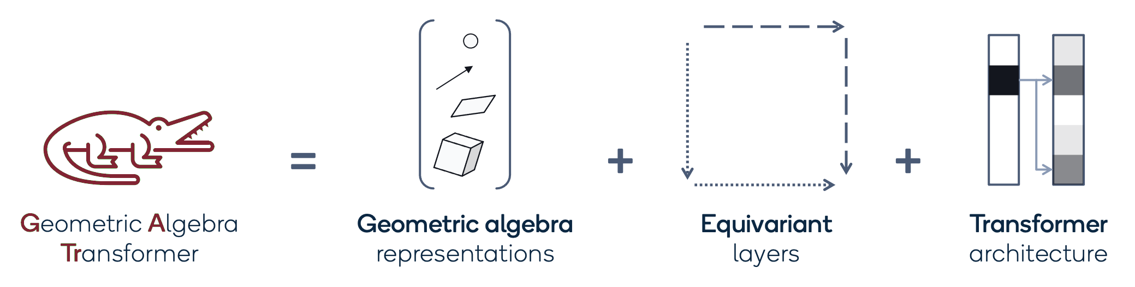
INTRODUCTION
Dealing with geometric data is an ongoing task
GATr to deal with them and guarantee equivariance
Models: Transformer, Metaformer, GATr, MetaGATr
Task: binary calssification on a geometric dataset
Evaluation metrics: accuracy, F1-score, inference time
2
Notes:
Lorenzo

Slide 3
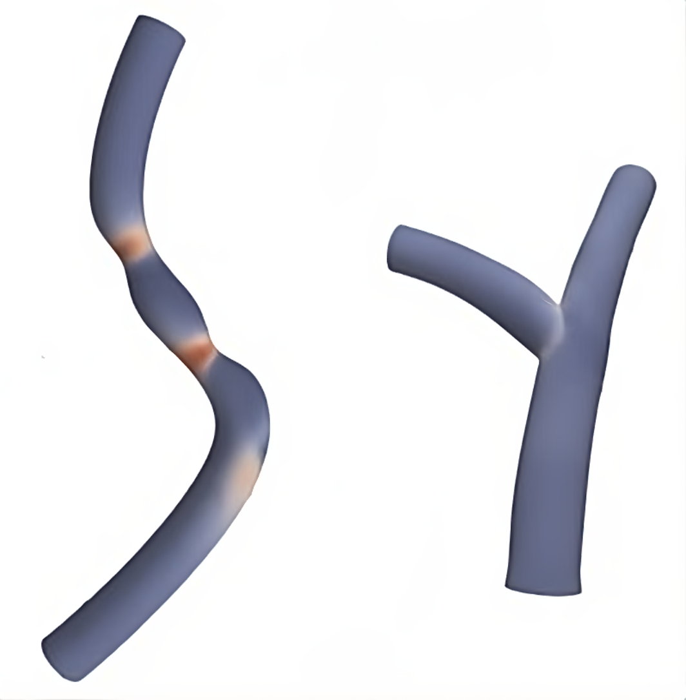
DATASET
Bifurcating and single arteries numeric data
5 properties: position, wss, face, pressure and inlet index
Colab restrictions: dataset divided into partitions and then shuffled
Labels: 0 for single, 1 for bifurcating
Single
Bifurcating
Notes:
Lorenzo

Slide 4
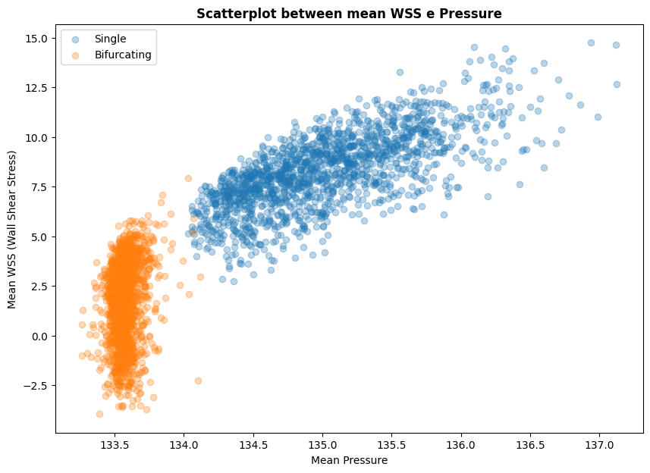
EDA
Knowledge of data from analysis and expert consultation
Leverage earned information to better shape the data
Notes:
Lorenzo

Slide 5
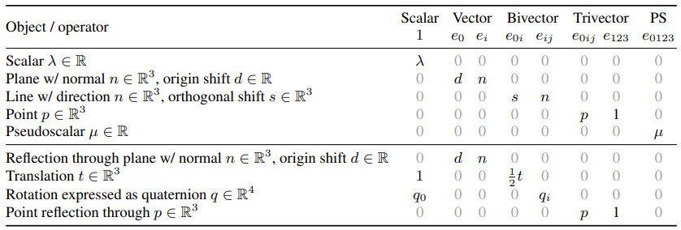
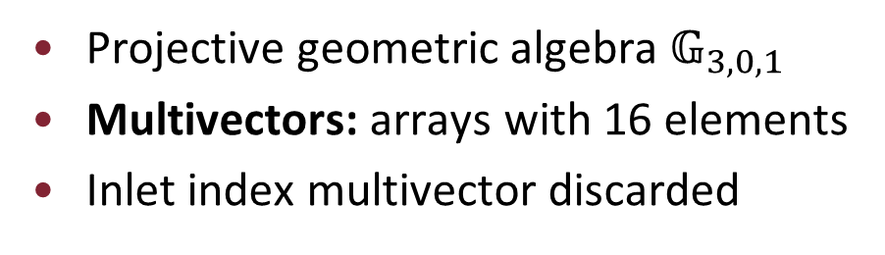
PREPROCESSING
Projective geometric algebra $𝔾_{3,0,1}$
Multivectors: arrays with 16 elements
Inlet index multivector discarded
5
Notes:
Lorenzo

Slide 6
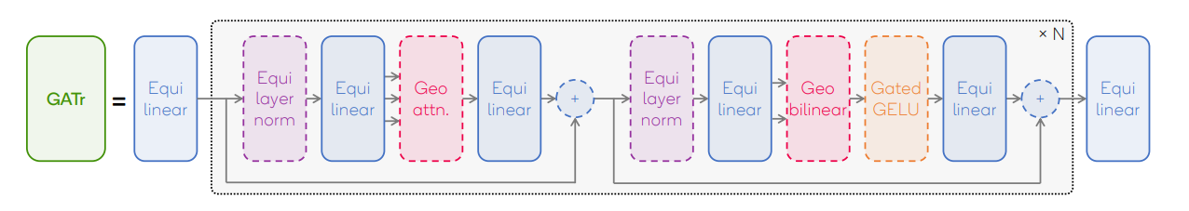
GATr ARCHITECTURE
Equilinear: learn equivariant mapping
Equi-layer norm: equivariant layer normalization
Geometric Attention: perform self attention on data
Geometric Bilinear: ability to distinguish distances
Gated GELU: activation function
Hyperparameter search
6
Notes:
Claudio

Slide 7
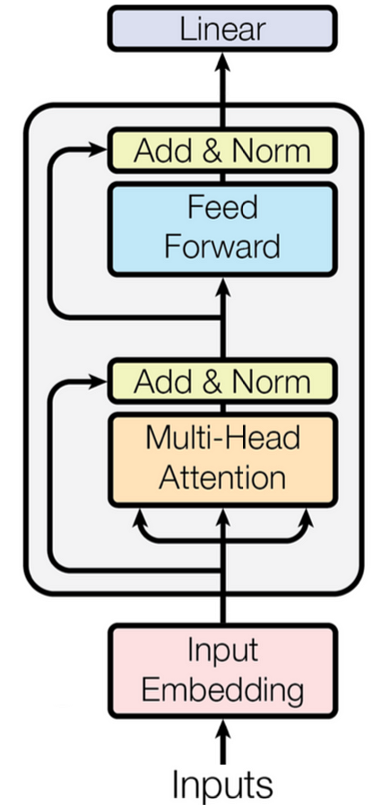
TRANSFORMER ARCHITECTURE
Input FF: input data embedding
No positional embedding
Encoder: Attention and FF
No decoder
Output FF: classification layer
7
Notes:
Jacopo

Slide 8
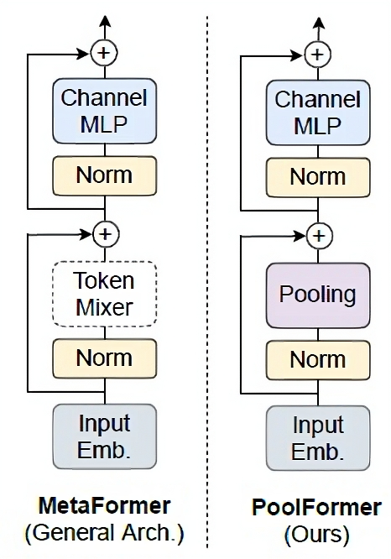
METAFORMER ARCHITECTURE
Replacing attention with a simpler token mixer
PoolFormer: pooling token mixer
Reduces the parameters and network inference time
Increase performances
Aimed at computer vision tasks, but extendable
8
Notes:
Jacopo

Slide 9
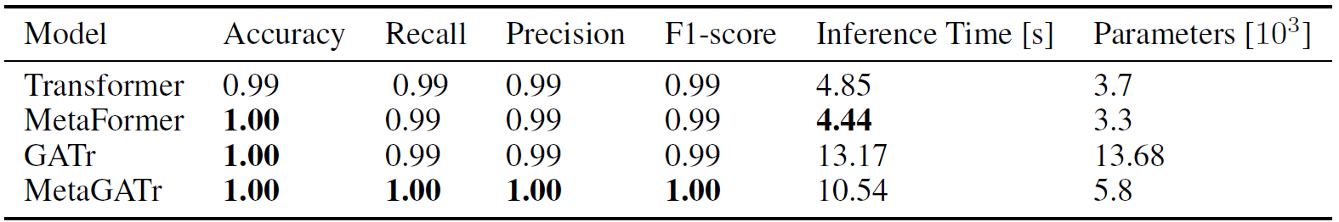
RESULTS - METRICS
Very good results
Easy task, powerful architectures
No performance aggravation
MetaFormer approach boost performances
9
Notes:
Jacopo

Slide 10
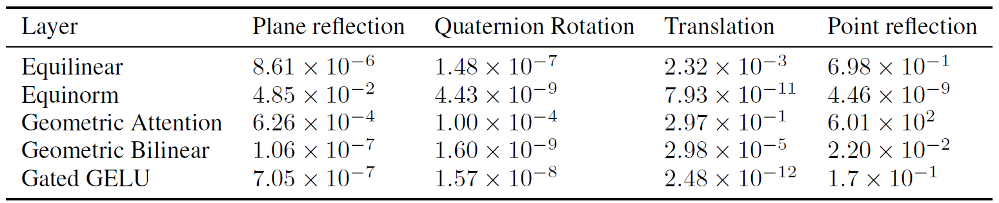
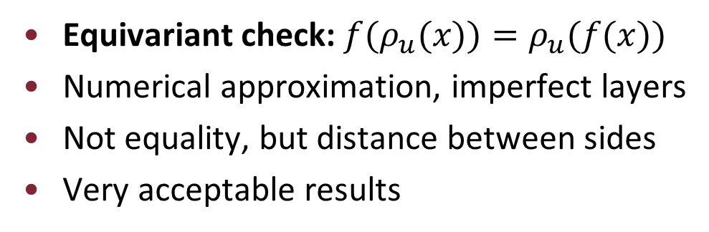
RESULTS - EQUIVARIANCE
Equivariant check: $f(ρ_{u}(x))=ρ_{u}(f(x))$
Numerical approximation, imperfect layers
Not equality, but distance between sides
Very acceptable results
10
Notes:
Claudio

Slide 11
THANK YOU FOR THE (META)ATTENTION
Notes:
Claudio

