Slide 1
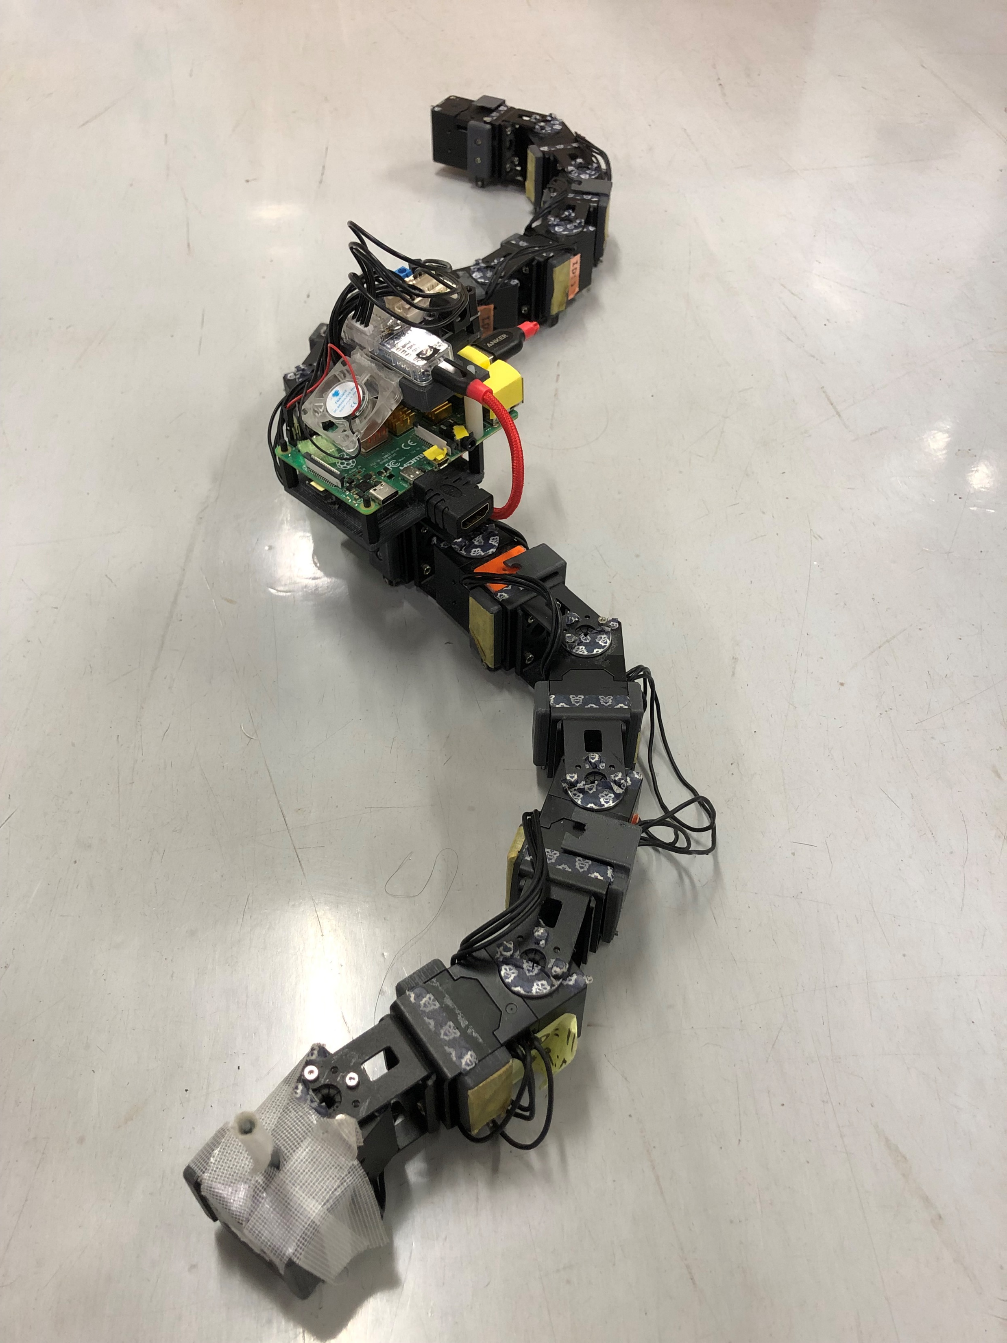
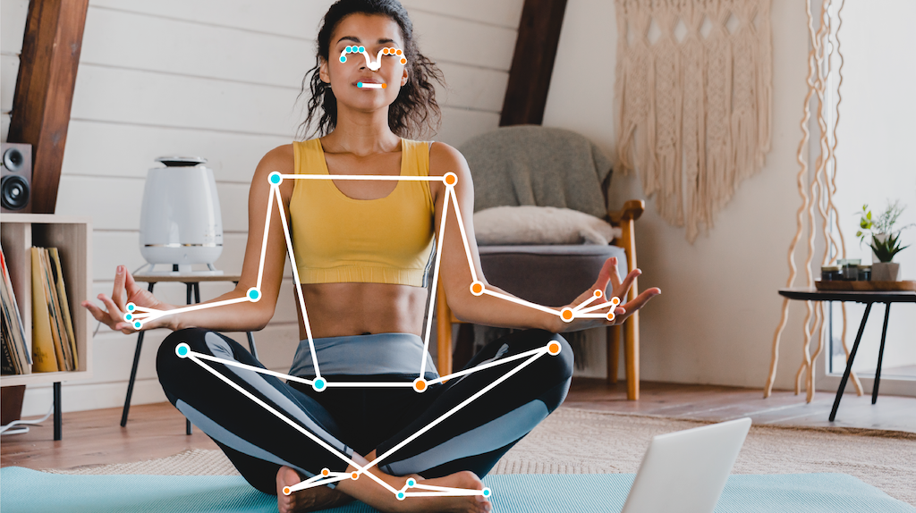
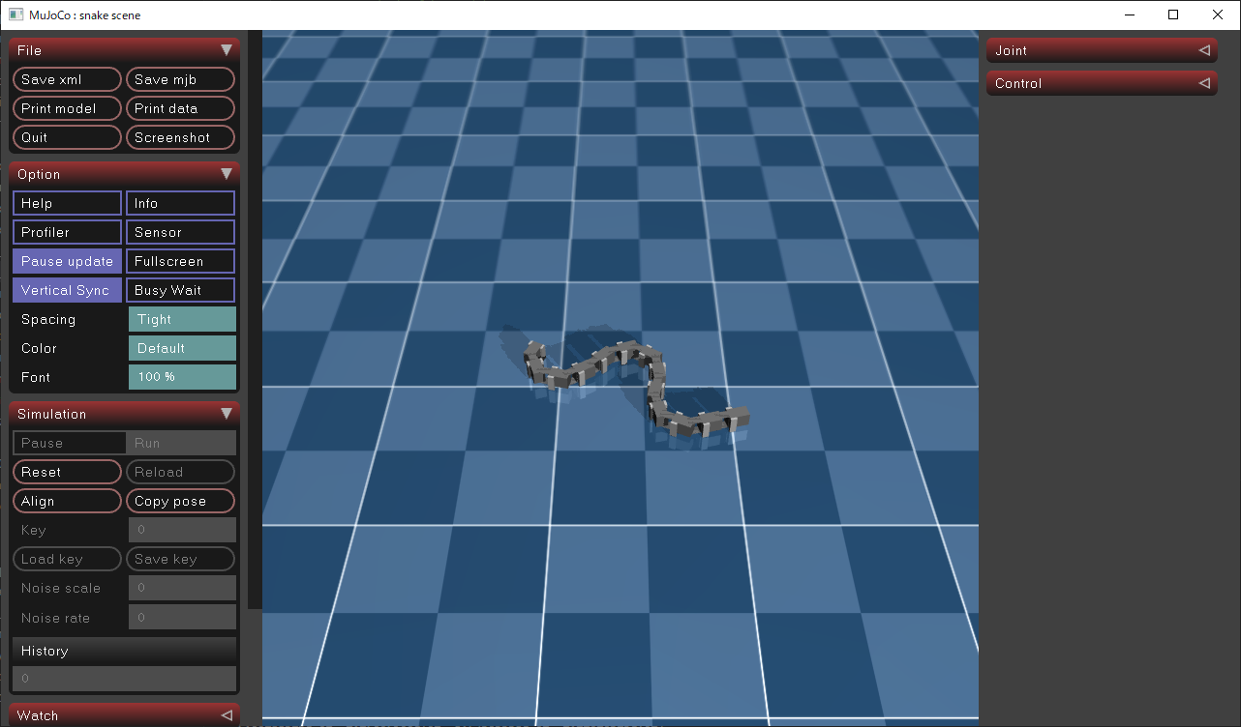
1. Overview
Goal
Control snake robot on MuJoCo using MediaPipe, and solve maze
Control real snake robot using MediaPipe
MediaPipe
MuJoCo
Real Snake Robot
Framework for detecting landmarks of human bodies in image or video
Physics engine for robot simulation

Slide 2
1. Overview
Step 1: Setup
Step 2: Move snake robot on MuJoCo
Step 3: Control snake robot on MuJoCo using MediaPipe
Step 4: Control real snake robot by MediaPipe
Step 5: Make maze on MuJoCo

Slide 3
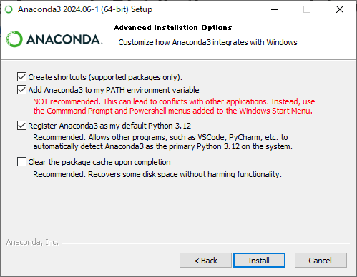
2. Setup | Install Anaconda
Go to the Anaconda Distribution page and download the installer. https://www.anaconda.com/download
Run the installer and follow the instructions. Select “Add Anaconda to my PATH environment variable”.

Slide 4
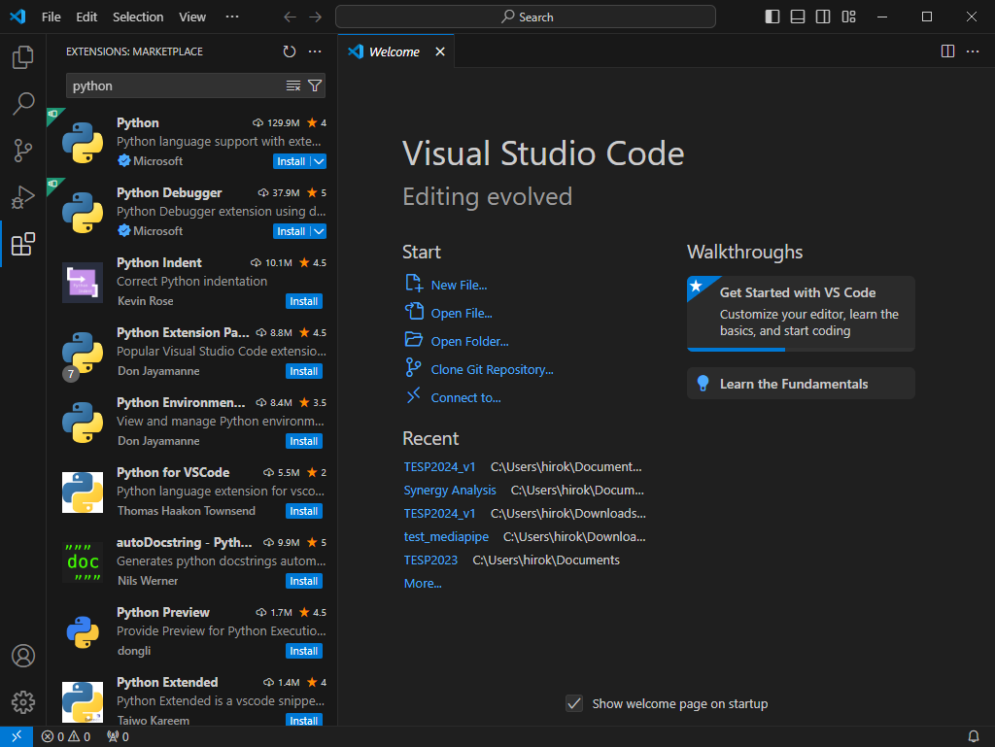
2. Setup | Install VS Code
Go to the Visual Studio Code website and click on the “Download for Windows” button. https://code.visualstudio.com/
Run the installer and follow the instructions.
Install the python extension for VS Code. Open VS Code. Click on the “Extensions” view icon on the Sidebar. Type “python” in the search bar. Find the extension named “python” provided by Microsoft and click “Install”.
2
3
1

Slide 5
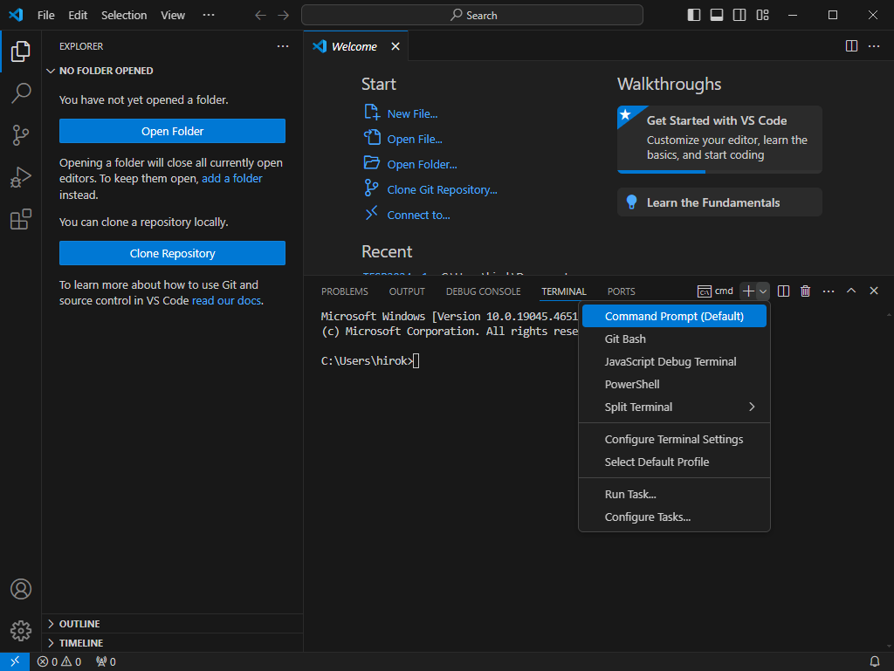
2. Setup | Create Virtual Environment
Open the Integrated Terminal. Click on the “Terminal” menu at the top of the window. Select “New Terminal” from the dropdown menu. If “PowerShell” is open, select “Command Prompt”.
Use the following command to create a new virtual environment. $ conda create -n TESP python=3.12
Use the following command to activate the virtual environment. $ conda activate TESP

Slide 6
2. Setup | Install Packages
Install the MuJoCo package. $ pip install mujoco
Install the MediaPipe package. $ pip install mediapipe

