Slide 1
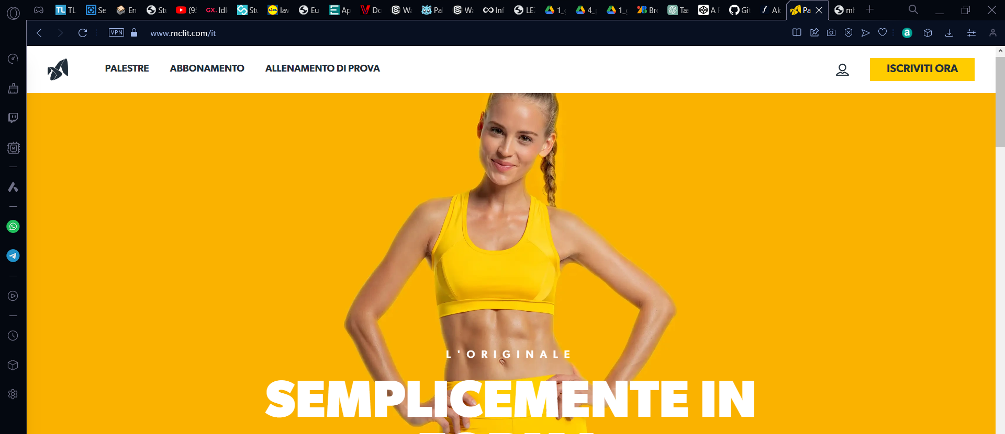
https://www.mcfit.com/it

Slide 2
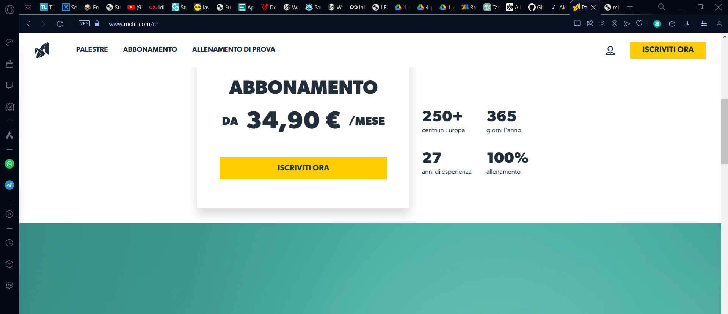
https://www.mcfit.com/it

Slide 3
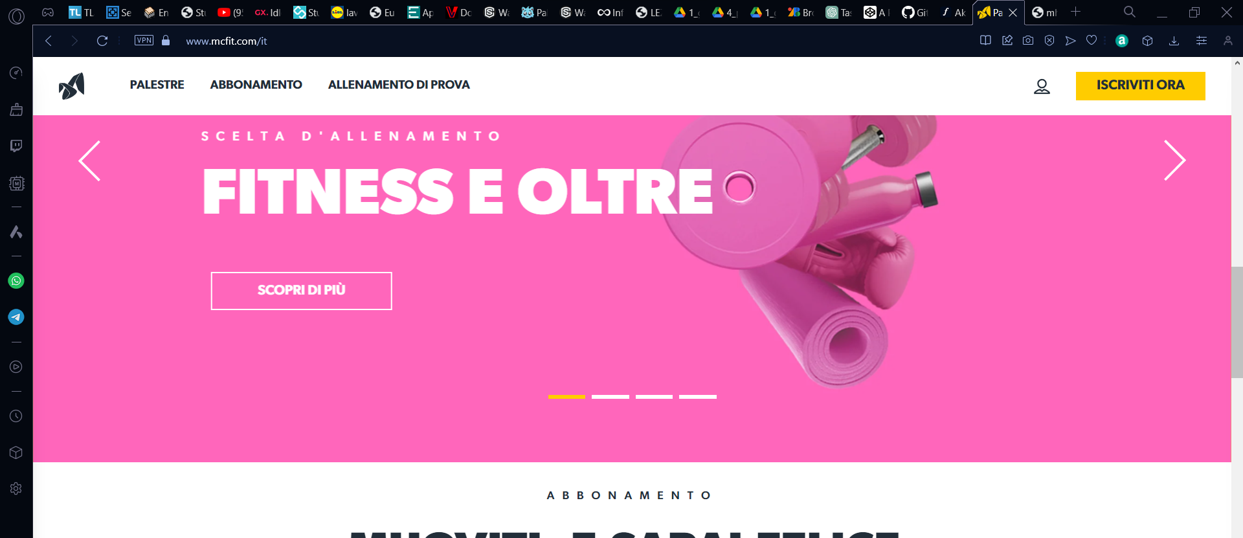
https://www.mcfit.com/it

Slide 4
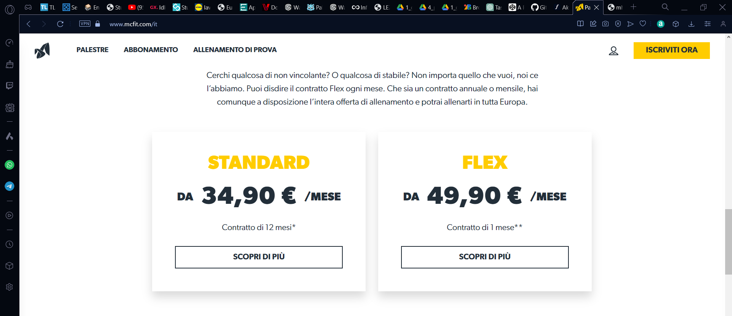
https://www.mcfit.com/it

Slide 5
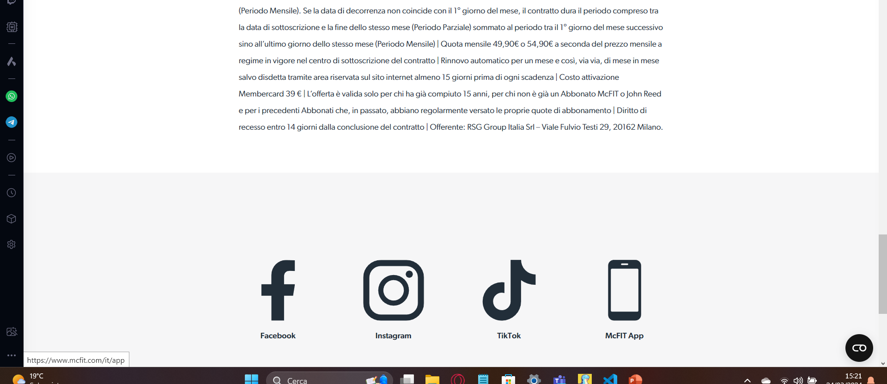
https://www.mcfit.com/it

Slide 6
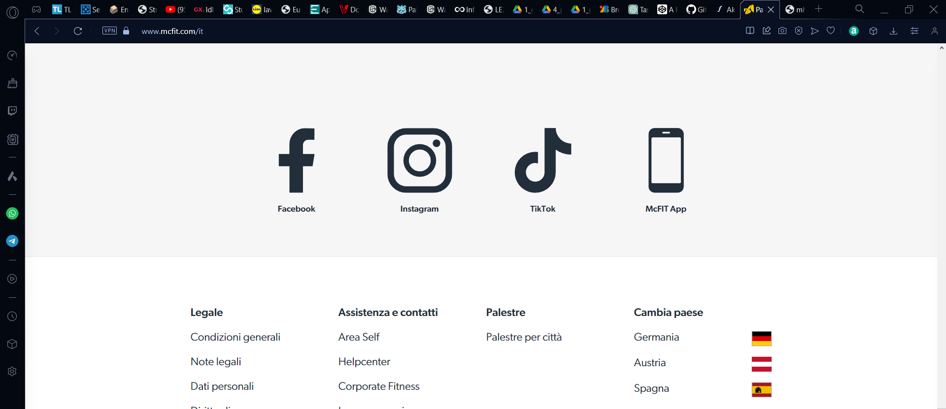
https://www.mcfit.com/it

