Slide 1
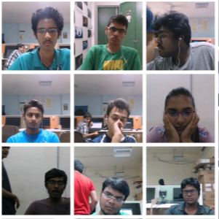
Attention Span Detection in Online Instructor Led Sessions

Slide 2
INTRODUCTION
Online learning is arguably the greatest revolution in contemporary education.
Online education overcomes the biggest drawback of correspondence course, time and allows the students to interact not only with the instructor but with the other students in the class in real time. Online education has emerged triumphant and has been proven to be viable education choice in its every right.
Considering all the factors related to online education the most important drawback of eLearning is student's attention span which has proven to be a major hindrance in terms of student's academic performance.
The purpose of our project is to create a mechanism wherein we will be able to predict the attention span of a student in a video lecture.

Slide 3
PROPOSED SYSTEM
The dataset consists of videos of ninety five students, the video on the whole is about 30 hours and each video is divided into exactly ten seconds. Our project starts by converting these videos to data frames; from each video we extract ten images as data frames. These data frames are given labels and converted into arrays for further processing.
The model is created using ResNet-50 which is a convolutional neural network and is saved for further testing.
The testing process requires loading the model and labels that were saved. A video is given as an input to detect the attention span of the student. The input video is converted to data frames and each data frame is processed. The classified output label will be displayed along with the video.

Slide 4
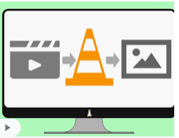

FUNCTIONAL REQUIREMENTS
Converting the video
stream into Images
Processing the images
Differentiate between
different emotions
Predict the emotion of
the student when video
is given

Slide 5


NON FUNCTIONAL REQUIREMENTS
Should accept huge datasets.
Should work on any platform.
Response time for each prediction
should be less.
The software should run smoothly
without any glitches.
Should be adaptable to any level
of mobile data/wifi.

Slide 6

SYSTEM REQUIREMENTS
HARDWARE REQUIREMENTS
Processor : intel Core i5
Hard Disk : 1TB
RAM : 8GB or more
GPU : Intel® HD Graphics 520
SOFTWARE REQUIREMENTS
Operating System : Windows 8/10, Linux
Platform : Hadoop
Technology : Python 3.7
IDE : Spyder
UML : ArgoUML

Slide 7
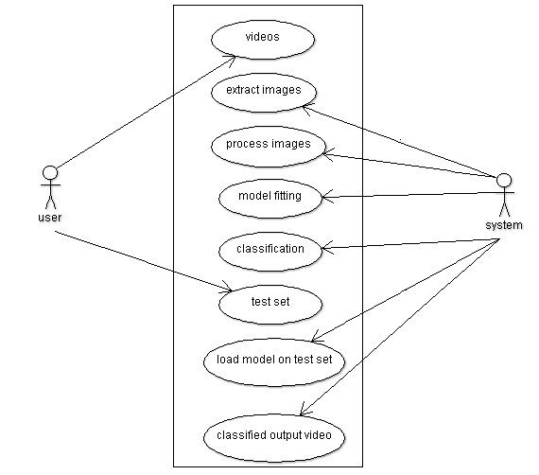
SYSTEM DESIGN
Use case diagram

Slide 8
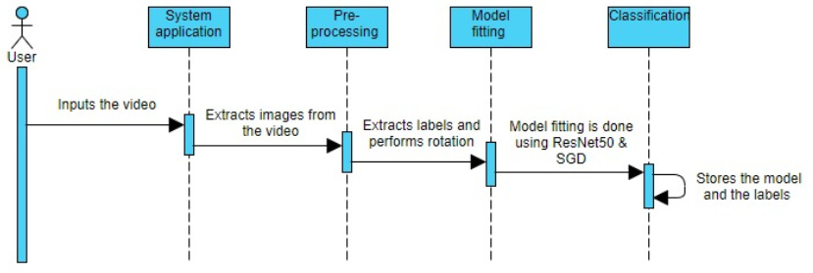
Sequence diagram for training

Slide 9
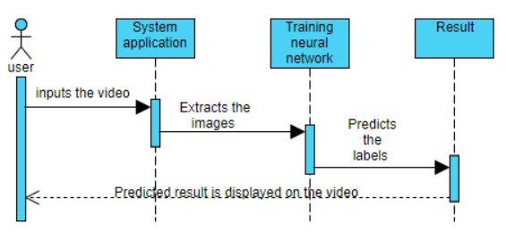
Sequence diagram for testing

Slide 10
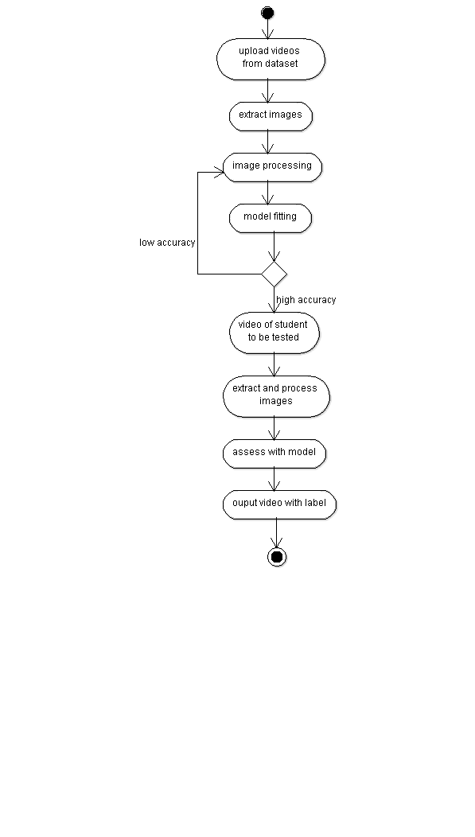
Activity diagram

Slide 11
IMPLEMENTATION
Features of dataset
The dataset has 7338 video snippets, each video snippet being 10 seconds long of 95 students, 5 different locations, and 2 different illumination conditions.
It consists of labelling of four emotional states - engagement, frustration, confusion and boredom. For each of the affective states, there are four labels:
(1) very low
(2) low
(3) high
(4) very high.

Slide 12
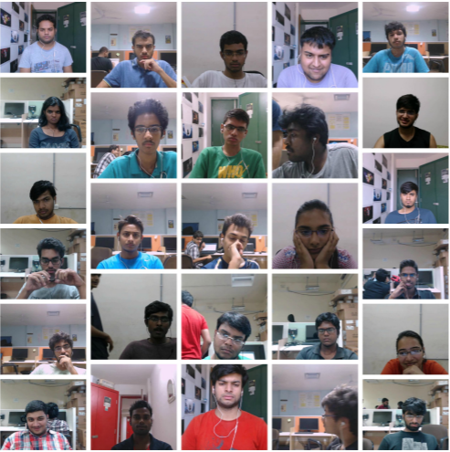
Examples of video snippets from dataset

Slide 13
PACKAGES USED
Pandas
Scikit-learn
openCV
Keras
Imutils
Glob
Pickle
CSV
OS
Matplotlib
Numpy
Pickle
argparse

Slide 14
CNN ALGORITHM
The Convolutional Neural Network (CNN) is a class of deep learning neural networks. They are most commonly used to analyze visual imagery and are frequently working behind the scenes in image classification. CNNs are inspired by biological processes.
CNNs have an input layer, and output layer, and hidden layers. The hidden layers usually consist of convolutional layers, ReLU layers, pooling layers, and fully connected layers.
Convolutional layers apply a convolution operation to the input. This passes the information on to the next layer. Pooling combines the outputs of clusters of neurons into a single neuron in the next layer. Fully connected layers connect every neuron in one layer to every neuron in the next layer

Slide 15
A CNN works by extracting features from images. This
eliminates the need for manual feature extraction.
A CNN
starts with an input image
Applies many different filters to it to create a feature map
applies a ReLU function to increase non-linearity
applies a pooling layer to each feature map
flattens the pooled images into one long vector.
inputs the vector into a fully connected artificial neural network.
processes the features through the network. The final fully connected layer provides the “voting” of the classes that we are after.
trains through forward propagation and back propagation for many, many epochs. This repeats until we have a well-defined neural network with trained weights and feature detectors.

Slide 16

Layers of CNN

Slide 17
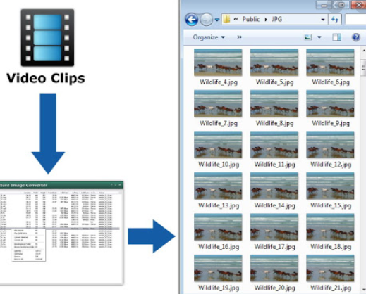
PSEUDO CODE
Creation of images
Collect the videos of
all the students to be
trained.
Loop over all videos and
convert each video into
images.
Extract the labels from
each image.

Slide 18
Training
Loop over all the images extracted from videos
Pre-process the images
Perform one hot encoding on labels
Load ResNet50 pre-trained with imageNet weights as the baseModel
Create a new headModel using the base model
Compile the model with Stochastic Gradient Descent
Save the model and label binarizer
Evaluate the network

Slide 19
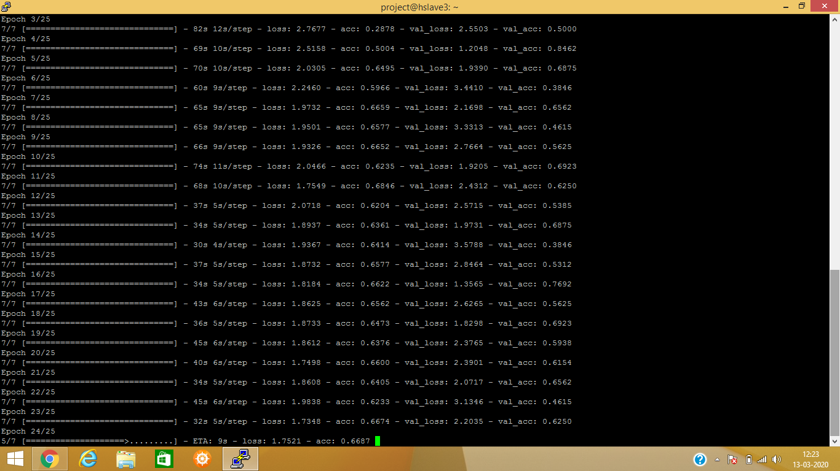
Accuracy while training the model

Slide 20
Testing
Load the model and label binarizer.
Provide the path of student’s video to be tested
Read frames from the video stream and pre-process each frame
Make predictions on the current frame
Find the label with the largest corresponding probability across the average predictions
Draw the prediction on the output frame

Slide 21
SYSTEM TESTING
Testing is the process of evaluating a system or its components with the intent to find whether it satisfies the specified requirements or not.
It is one of the main stages of project development life cycle to provide our cessation utilize with information about the quality of the application. It can be either done manually or using automated tools.
Unit testing
Type of software testing where individual units/ components of a software are tested. Unit Testing of software applications is done during the development of an application

Slide 22
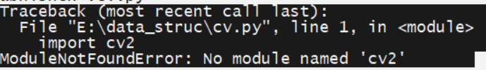
Various errors encountered in the development stage of the
model are:
This error arises when the specified module is not installed in the system. To resolve this error install the specified model according to the python version. If cv2 is already installed and still the above error occurs the python version may not be compatible.

Slide 23
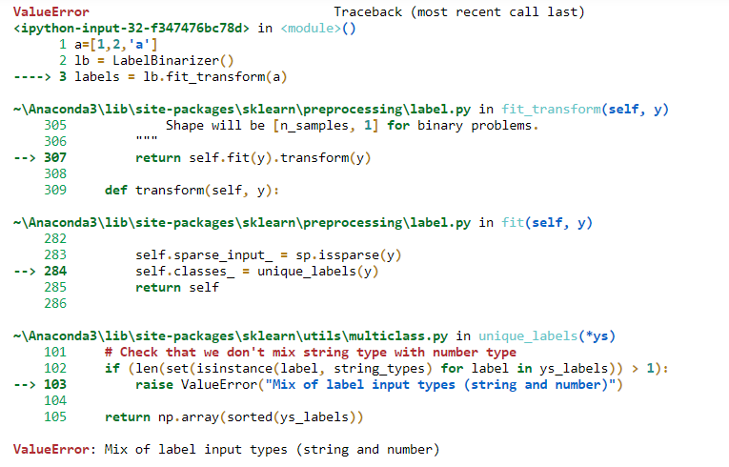
This error arises when we try to mix numbers and strings.

Slide 24
Integration testing:
Integration testing is a level of software testing where individual units are combined and tested as a group. The purpose of this level of testing is to expose faults in the interaction between integrated units.
When the instructor wants to detect the attention of a student, the student’s path is given as the input to the model thereby we obtain a video with the level of attention as a number prefixed with the label obtained.

Slide 25
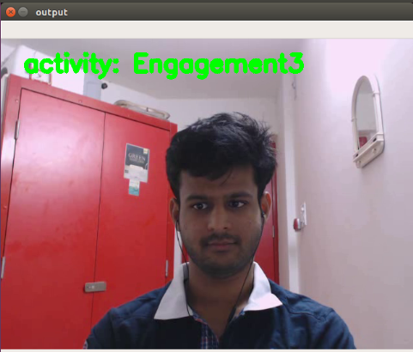
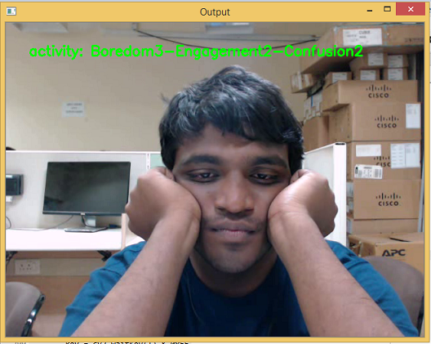
Some of the screenshots of students whose attention span is detected are:

Slide 26
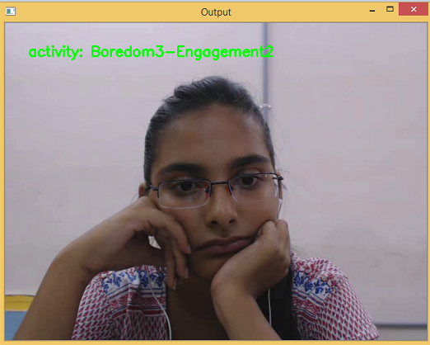
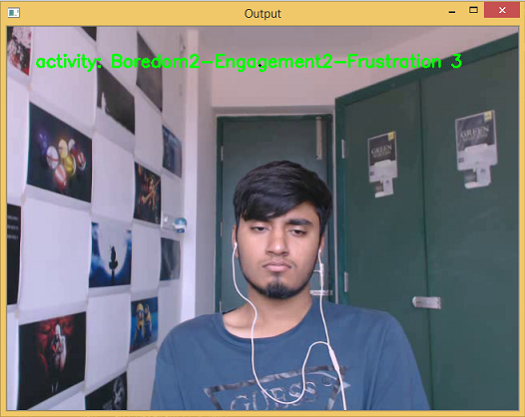

Slide 27
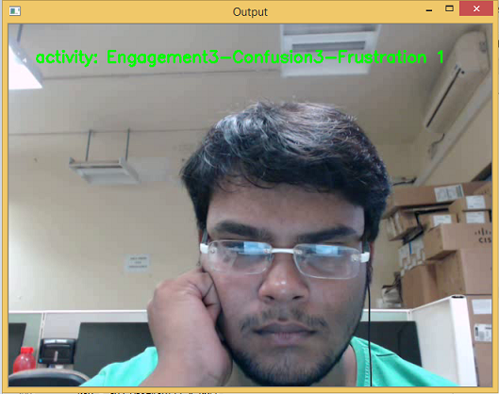
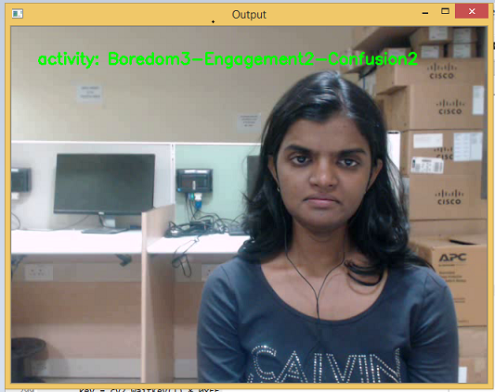

Slide 28
CONCLUSION
The model developed in this project monitors and measures the attention span of the learners in the instructor led online sessions by automatically recognizing students' affective states such as engagement, frustration, confusion and boredom frustration in e-learning environments.
The model takes a video stream as input, converts it into multiple images, processes them, extracts labels from images, fits the model using ResNet-50 as the base model and compiles it. This model is saved and used repetitively to test as well as differentiate the emotions of various students and thus gives the information regarding attention span of the student by analysing each image.
The proposed work can also be relevant to other application domains such as advertising, gaming and entertainment, where these affective states are important.

Slide 29
FUTURE ENHANCEMENTS
The algorithm that has been developed in this project is a basic approach to what can be considered as huge component. Future enhancements for this attention span detection algorithm include capturing videos from the live session, feed and processing it in real-time using web camera of the students’ laptop. Also, a Graphical User Interface can be created which enables an instructor to detect the attention of the students just by clicking on the respective name or roll number or the student instead of changing the path in the testing code.
On successfully testing the videos of the students to detect the attention span we obtained an accuracy of almost 70%. The model can be made more accurate by training more videos from the dataset into the system. By integrating all these enhancements the project could be more presentable and accurate.

Slide 30
THANK YOU
Pooja Ailani - 16BD1A05A6
Gayathri Sarapu - 16BD1A05B3

