Slide 1
D612 – Process Improvement Solution Proposal: Udon-ya Restaurant Order Process
by Tanya Gampert

Slide 2
Business Objective & Challenges
Challenges
Business Objective
01.
02.
High customer volume
Takeout orders
Develop a standardized order process for franchise replication.
Service teams struggles when customer volume is high
No order prioritization
03.
04.
Insufficient food prep
Customer feedback
Ingredients are not consistently available
No customer feedback collection

Slide 3
Analysis Results
Process mining results:
Root causes/bottlenecks:
9,812 cases analyzed
1,094 process variants
Throughput time delays
35.11% conformance rate
Disconnected kitchen & service workflows
Communication gaps
No inventory management system
Inconsistently prepped ingredients
Lack of systematic data collection and monitoring
No physical team coordination point
Conclusion: Severe process inconsistencies
Lean wastes:
Waiting: Coordination delays across all stakeholders, customer waits
Motion: Searching for staff/ingredients
Inventory: Insufficient prepped ingredients
Underutilized talent: No customer feedback

Slide 4
Lean Process Solutions
1. Process Integration
2. Pull System
Eliminates:
High customer volume delays
Disconnected workflows
Communication gaps
No coordination point
Waiting & motion wastes
Replaces once daily batch of ingredients and enables demand-based inventory management
Eliminates :
Insufficient food prep
No inventory management system
Inconsistently prepped ingredients
Inventory waste
Connects kitchen
and service workflows through kanban system.
3. Takeout Order Prioritization
4. Continuous Improvement
Systematic takeout routing through POS system
Eliminates :
Takeout order delays
Customer waiting waste
Customer feedback collection enables ongoing optimization
Eliminates :
Lack of feedback
Lack of systematic feedback collection
Underutilized talent waste
Four improvements working together as one integrated system

Slide 5
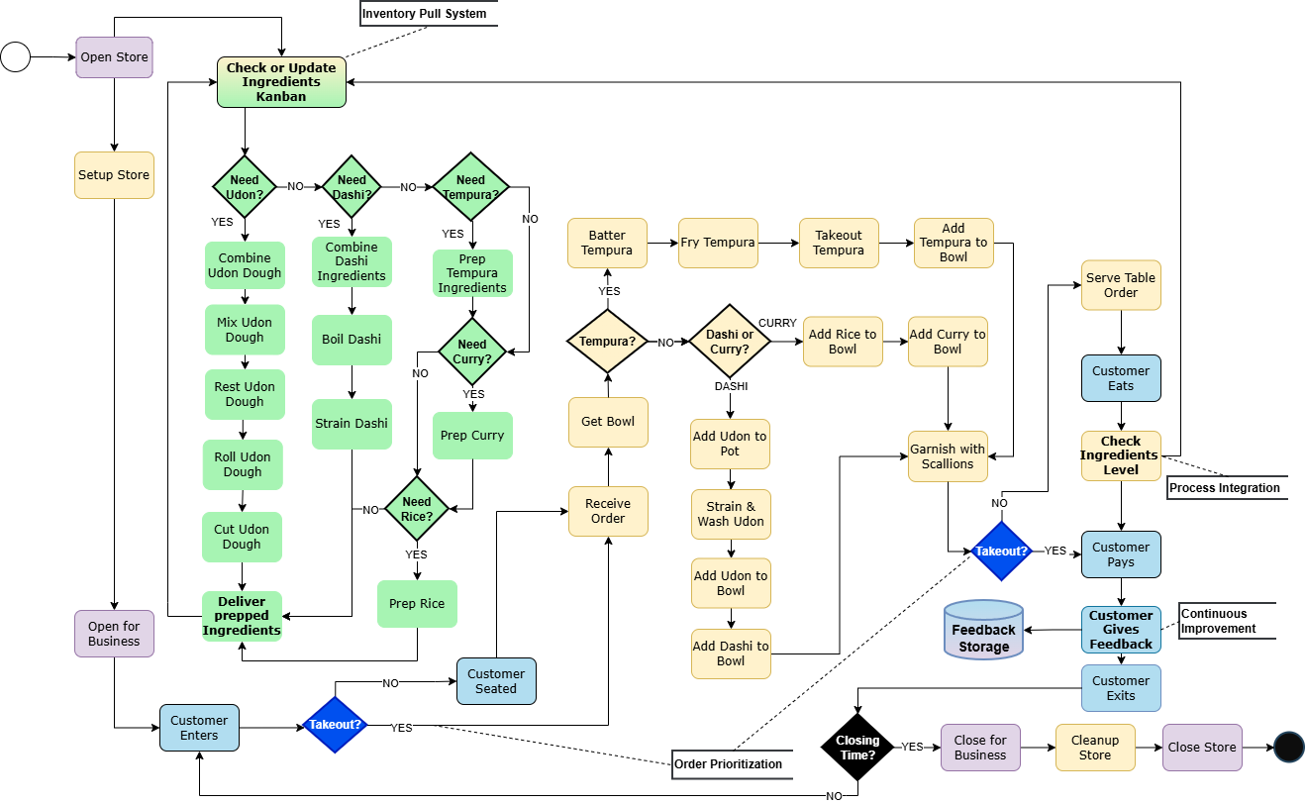
Improved Udon-ya Order Process

Slide 6
Measuring Success – Key Performance Indicators
Key Performance Indicator | Purpose | Goal
Process Conformance Rate | Measures standardization of process | > 80%
Food Preparation Time | Measures pull system effectiveness | < 5 minutes
Ingredients Replenishment Frequency* | Measures demand-based food prep cycle execution | 8-12 cycles per day
Avg Order-to-Table time | Measures continuous flow effectiveness | < 7 minutes
Customer Satisfaction (CSAT)* | Measures customer experience | > 4.0 score
*New metric

Slide 7
Implementation Roadmap
Phase 1
Phase 2
Go live: Phase 1
Go live: Phase 2
Kitchen and service staff training
Service staff training
Week 1
Week 2
Week 3
Week 4
Week 5
Week 6
Kickoff
Install kanban board
Define low ingredients threshold
Weekly staff meetings
Kickoff
Configure POS system
Configure customer feedback collection
Test system changes
Weekly staff meetings
Test process improvements
Continuous
Improvement
Continuous
Improvement
Daily huddle meetings

Slide 8
Managing Challenges & Risks
Risk | Severity | Mitigation Strategy
Kitchen staff resistance to more frequent prep cycles | High | Involve staff in setting kanban thresholds and designing methodology
Kanban signals missed | High | Place kanban board in easily visible location for monitoring by both teams
POS system vendor delays | Medium | Engage vendor early in Week 3

Slide 9

Key Insights
Process mining revealed non-sequential, disconnected workflows invisible to observation alone
Root cause analysis showed coordination failure, not individual performance issues
Lean waste methodology directly addressed all identified bottlenecks
2-phased implementation critical for managing organizational change

Slide 10

Benefits for Udon-ya
Franchise-ready operations
Standardized workflows enable process replication
Improved customer experience
Consistent quality, reduced wait times
Inventory management
Reduced waste, faster service, reliable ingredients
Data-driven improvement
Feedback system enables ongoing optimization

Slide 11

Call to Action
Commit to the process
Udon-ya
Franchise Readiness
Celebrate success
Everyone is a change agent
Aim for perfection

Slide 12
Thanks !

