Slide 1
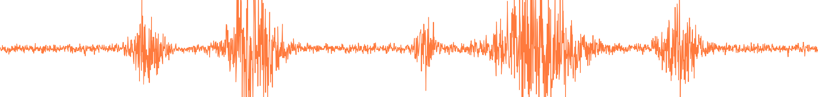
UE24CS352A MACHINE LEARNING · MINI-PROJECT REVIEW · PROBLEM 64
Earthquake signals and Kilauea eruptions
Predicting eruptive events at Pu'u O'o volcano from earthquake data, with a time-ordered evaluation
Prithvish Adhikari
PES1UG24AM206
Piyush Shiv
PES1UG24AM191
Based on Mullet, Singh and Wong, Stanford CS229 (2019), PEEVED · October 2026
Notes:
Introduce the problem (number 64). We adapt the Stanford CS229 PEEVED project: Kilauea earthquakes and eruptions. Our contribution is a leakage-aware, time-ordered evaluation plus a handful of extra experiments.

Slide 2
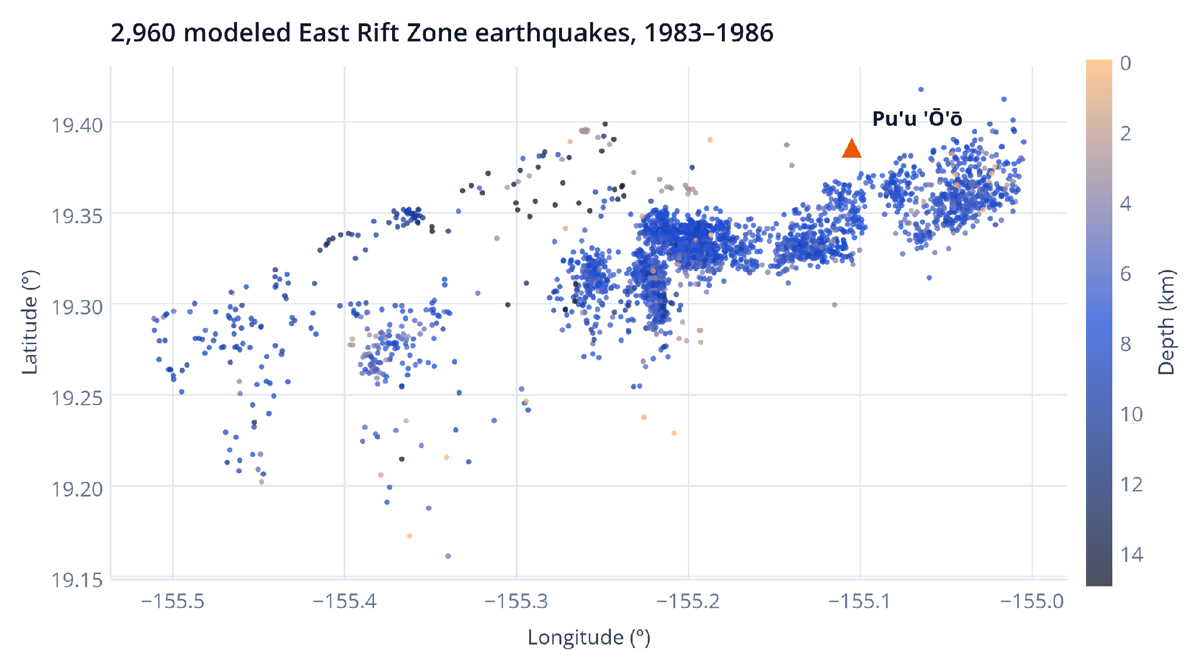
Can earthquakes tell us when Pu'u O'o erupts?
01 · THE PROBLEM
TASK 1 · CLASSIFICATION
Is the volcano erupting right now?
Input: one earthquake and its recent context. Output: erupting (1) or repose (0). Only about 1 in 10 earthquakes is labelled erupting.
TASK 2 · REGRESSION
How many days until the next eruption?
Output: a number of days to the next episode onset (0 if already erupting). Much harder: it needs a precise clock, not just a state.
2,960 modeled East Rift Zone earthquakes, 1983-1986, coloured by depth. Catalog: ANSS via WOVOdat.
WHAT THE PAPER DID
WHY EARTHQUAKES?
Shuffled all earthquakes at random into train/dev/test, then reported random forest as best. Neighbouring quakes from one swarm land on both sides of the split.
Rising magma stresses and cracks the crust, so more or shallower quakes may signal activity.
WHAT WE ADD
A time-ordered holdout, leakage tests, threshold analysis, 4 extra features.
Notes:
Magma moving through the East Rift Zone fractures rock, so seismicity should change around eruptions. Each earthquake has time, location, depth and magnitude. The paper asks two questions; we keep its data and features but change how we evaluate.

Slide 3
Our pipeline: seven steps, one rule
02 · METHOD
1
2
3
4
5
6
7
CATALOGS
CLEAN + FILTER
FEATURES
LABELS
TIME SPLIT
TRAIN + SELECT
TEST ONCE
6,485 ANSS earthquakes and 49 eruption entries from the PEEVED repo
Drop invalid rows and duplicates; keep East Rift Zone only: 3,764 quakes
Location, depth, magnitude and past-only counts over 1, 7, 30 days
Erupting = inside an episode plus 24 h buffer; days to next onset
70/20/10 by time with 30-day gaps and label-availability checks
Fit on train; choose model, features and threshold on development
Freeze every choice, then score the later test window once
DESIGN PRINCIPLE
WHAT WE BUILT
Think like a forecaster
Code you can run
A forecaster only knows the past, so every feature looks strictly backwards.
Models are chosen on development data; the test window is scored exactly once.
Baselines are allowed to win. If nothing beats "predict the average", we say so.
src/data.py: cleaning, past-only features, labels
src/models.py: K-means classifier and regressor wrappers
src/experiment.py: splits, selection, thresholds, metrics
demo.py + 17 unit tests (all pass) + saved results
Notes:
Walk left to right. The single rule: nothing that touches the test labels may influence any choice. Scaling, hyperparameters, features and thresholds are all fixed using training and development data only.

Slide 4
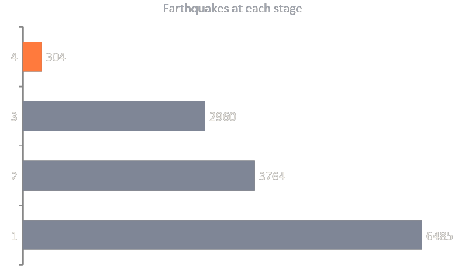
2,960 earthquakes, up to eleven features each
03 · DATA
WHAT THE MODEL SEES
Where
How deep
Longitude, latitude
Depth in km
How big
How busy
Magnitude
Quakes in previous 1, 7 and 30 days
NEW Last 6 hours
NEW Quiet time
Quake count in previous 6 h
Time since previous quake
NEW Typical size
NEW Biggest recent
HOW THE COUNT DROPS
Mean magnitude, previous 24 h
Max magnitude, previous 24 h
3,764 to 2,960: first 30 days (feature warm-up) and everything from 20 Jul 1986 on, where eruption coverage ends.
304 erupting = 10.3%: a strongly imbalanced target.
Original 7 features follow the paper. The 4 NEW features test whether finer-grained recent activity helps.
Notes:
Funnel from raw catalog to modeled rows. The East Rift filter reproduces the paper count of 3,764. The seven original features come from the paper; the four extra features are our experiment, and all use only information before the event.

Slide 5
How labels are built, and two catalog errors we caught
04 · LABELS
CLASSIFICATION TARGET
ERROR 1 · EPISODE 48
Erupting = 1
173,566,800 hours (about 19,800 years)
An earthquake is erupting if it falls inside an episode's catalog duration plus a 24-hour buffer. Everything else is repose (0).
We keep its onset (20 Jul 1986) as the end of coverage and never use the duration. The original code used it as-is.
REGRESSION TARGET
ERROR 2 · EPISODES 35.5 AND 35
Days to next eruption onset
Listed out of date order
Measured to the next recorded onset; 0 if already erupting. Quakes with no known next onset are dropped, never set to zero.
We sort onsets and keep each duration attached to its own onset.
CLASS IMBALANCE
LABEL CHECK AGAINST ORIGINAL CODE
10.3% erupting overall, 6.4% in test
100% match on the 2,960 modeled rows
Test holds 296 quakes, 19 erupting. Always guessing "repose" is 93.6% accurate, so accuracy alone is misleading.
On all 3,764 quakes the original rule gives 22.4% erupting; ours is 10.3% after removing 282 episode-48-only labels and 522 warm-up quakes.
Notes:
Labels follow the original PEEVED rule plus a 24 hour uncertainty buffer. Episode 48 has an impossible duration; the original code used it, which labels every later quake as erupting. We keep its onset only as the end of coverage.

Slide 6
Preventing data leakage: features look only backwards
05 · LEAKAGE CONTROL
EXAMPLE · 7-DAY COUNT FOR ONE EARTHQUAKE
Strictly-before windows
Counts use [t - window, t); events at the same timestamp are excluded.
counted: [t - 7 days, t)
Label availability
never used: the future
A training label must be observable before the next window starts.
quake to score (time t)
30-day gaps
Past and future quakes sit on the same time axis. Only the teal window feeds the 7-day count; the quake at t itself is excluded.
Gaps separate train, development and test so windows do not touch.
What have we learnt
Unit tests
"All temporal features use only information available before the prediction timestamp, so future earthquake activity never predicts the current state."
17 unit tests pass, covering window boundaries, ties, labels, the buffer rule and the splits.
Notes:
Likely viva question. For a quake at time t, every feature uses only events before t. Quakes at exactly t are excluded too. Training labels must be known before the next window starts, and there are 30-day gaps between windows. The 17-test suite checks these boundaries.

Slide 7
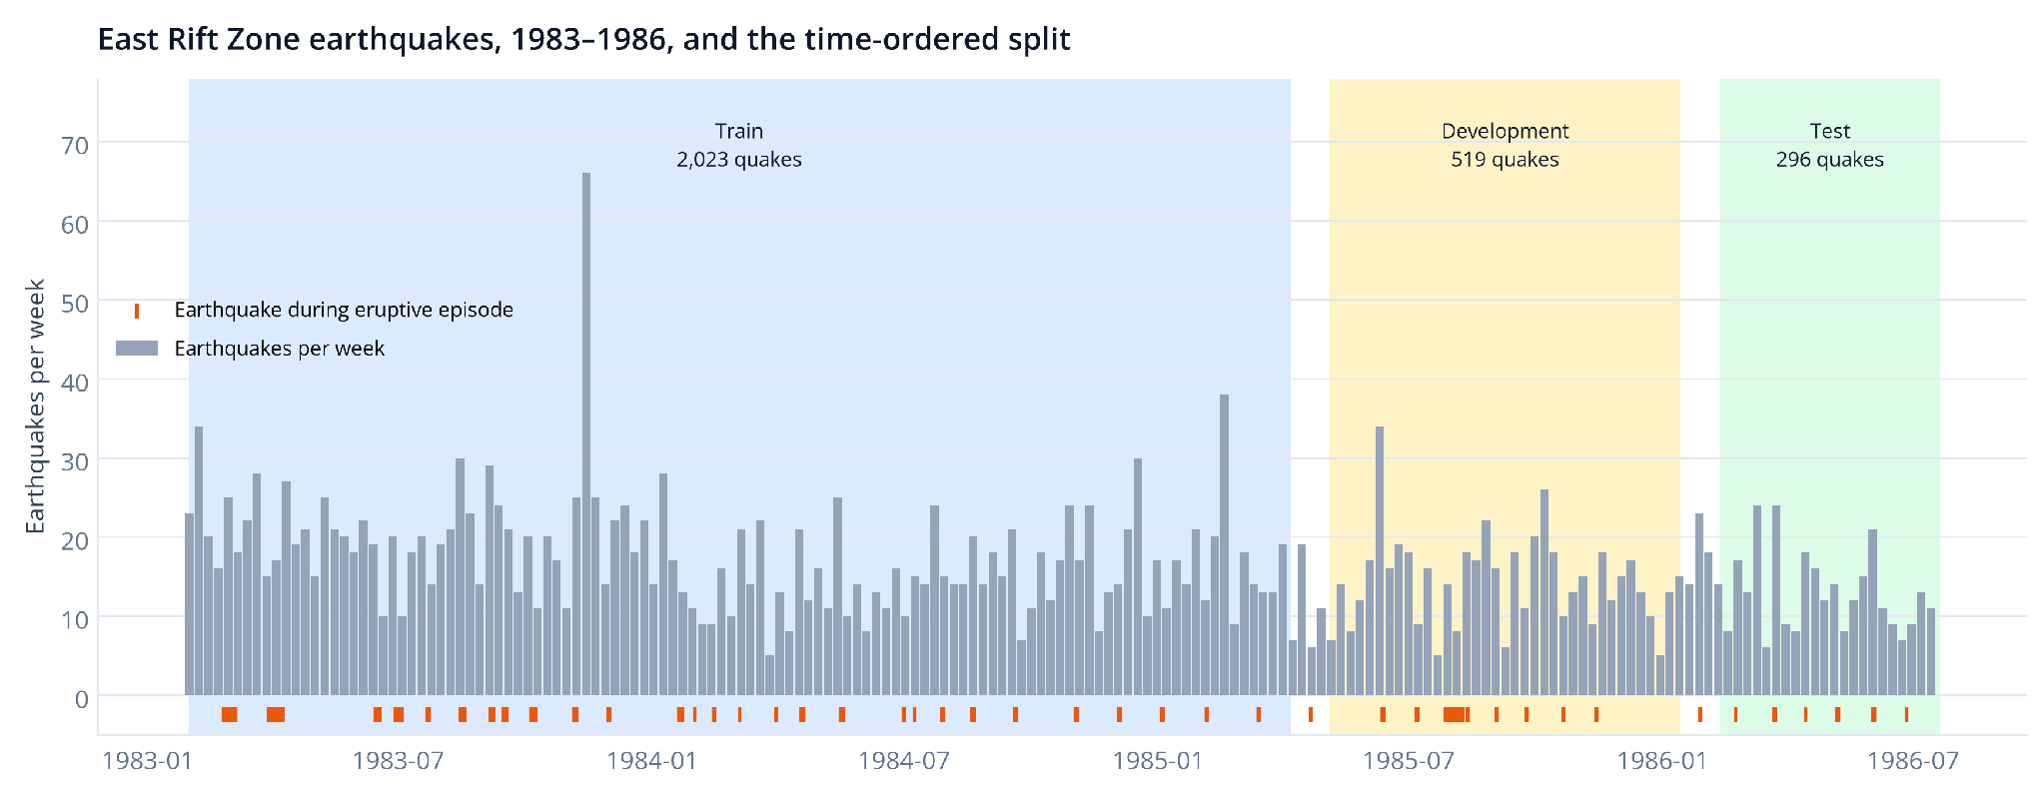
We test on later earthquakes, not shuffled ones
06 · EVALUATION DESIGN
GAPS
30 days
Between windows, so near-identical quakes cannot sit on both sides.
LABEL RULE
Known in time
Training labels must be observable before the next window opens.
TRAIN
DEVELOPMENT
TEST
WHY IT MATTERS
2,023 quakes · 230 erupting
519 quakes · 46 erupting
296 quakes · 19 erupting
Swarms are bursty. A random split lets a swarm leak across train and test.
Jan 1983 - Apr 1985
May 1985 - Jan 1986
Feb 1986 - Jul 1986
Fit every candidate model
Choose model, features, threshold
Scored once at the very end
Notes:
Chronological 70/20/10 with 30-day gaps. Train is Jan 1983 to Apr 1985, development May 1985 to Jan 1986, test Feb to Jul 1986. The random split from the paper is kept only as a comparison.

Slide 8
Seven model families, chosen on development data
07 · MODELS
FAMILY | IDEA IN ONE LINE | HOW WE USED IT
Prior / mean baseline | Always predicts the base rate or training average | The floor every model must beat
Logistic regression | Weighted sum of features turned into a probability | C = 0.1, 1, 10; balanced class weights; scaled
Random forest | Many decision trees vote on random data subsets | 200 trees; depth 5, 15 or none
Extra Trees | Like a forest but with extra-random split points | Small development grid
Gradient boosting | Small trees added one by one, each fixing the last | Small development grid; n=100, depth=2 was AUROC pick
Class-conditional K-means | Cluster each class; score by closeness to its centroids | k = 2 to 8; raw or scaled inputs; 2 distance scores (regression: joint centroids)
Neural network (MLP) | Two hidden layers (32 and 16 units) | alpha = 0.001, 0.1; scaled; 400 iterations
1
FIT
2
SELECT
3
TEST ONCE
Train each setting on the training window only. Scaling is fit on training data inside each pipeline.
Development data only. Classification has two procedures: AUROC alone, or development F1 with feature set (7 vs 11) and threshold. Regression: development RMSE.
Freeze the choice, then score the test window once. No peeking, no re-tuning.
Notes:
Classification candidates: prior baseline, logistic regression, random forest, Extra Trees, gradient boosting, class-conditional K-means, and a small MLP. Regression: mean baseline, random forest, joint K-means and MLP. Fit on train, pick on development, then freeze. Classification reports two selection procedures: development AUROC (retained baseline, picks gradient boosting) and development F1 with feature set and threshold (reported, picks logistic regression on 11 features).

Slide 9
How we judge a model, in plain English
08 · METRICS
AUROC
Average precision
Cohen's kappa
Pick one erupting and one repose quake at random. AUROC is the chance the model scores the erupting one higher. 0.5 = coin flip.
How clean the top of the ranking is. Compare to the base rate: 6.4% in test.
Agreement with the truth beyond chance. 0 = no better than chance; 1 = perfect.
Precision and recall
Threshold and FPR
RMSE, MAE, R squared
Precision: of the quakes flagged erupting, how many truly were. Recall: of the truly erupting, how many we caught.
A score becomes a yes/no at a threshold. FPR is the share of repose quakes wrongly flagged (false alarms).
Average error in days. R squared below 0 means worse than just predicting the mean.
WHY NOT ACCURACY
277 / 296
0 / 19
On the test window, "always repose" scores 277 of 296 correct (93.6%) yet finds 0 of 19 eruptions. That is why every result reports AUROC and kappa.
correct (93.6%)
eruptions found
Notes:
Accuracy is useless here: predicting repose for every quake is 93.6 percent accurate on test. So we use ranking metrics and chance-corrected agreement. Be ready to explain AUROC, kappa, precision and recall in the viva.

Slide 10
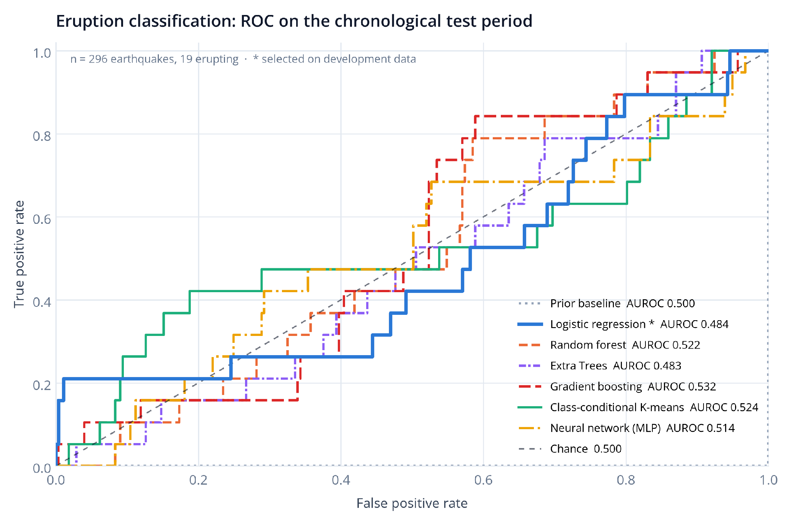
Eruption status: every model is close to chance
09 · RESULTS · CLASSIFICATION
MODEL (TEST PERIOD) | TEST AUROC
Prior baseline | 0.500
Logistic regression (dev-F1 pick) | 0.484
Random forest | 0.522
Extra Trees | 0.483
Gradient boosting (dev-AUROC pick) | 0.532
Class-conditional K-means | 0.524
Neural network (MLP) | 0.514
Both selected models are highlighted: they come from different objectives.
SELECTED BY DEVELOPMENT F1 (REPORTED)
SELECTED BY DEVELOPMENT AUROC (BASELINE)
Logistic regression, 11 features, C=10
Gradient boosting, n=100, depth=2
Threshold 0.611 set on development. Test: AUROC 0.484, kappa -0.006, found 4 of 19, 62 false alarms (precision 0.061, recall 0.211).
Development AUROC 0.603; test AUROC 0.532. A different objective, so not automatically an improvement over the F1 procedure.
Notes:
Test ROC curves for all seven classifiers; everything sits between 0.48 and 0.53 AUROC. IMPORTANT: two selection objectives give different winners. Development F1 (with feature set and threshold) picks logistic regression on 11 features; development AUROC alone picks gradient boosting. They optimise different things, and neither is an improvement. With 19 test positives the differences are noise.

Slide 11
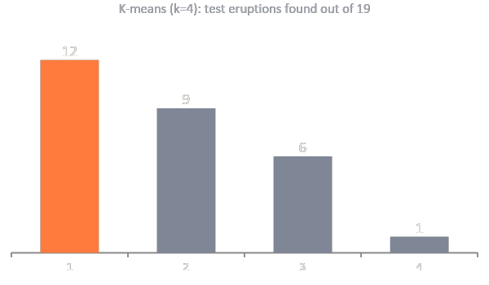
Negative result: tuning K-means did not help on later data
10 · RESULTS · K-MEANS
KEY NEGATIVE RESULT
Better on development, not on test
0.668
0.515
development AUROC
(k=3, raw, relative distance)
frozen test AUROC
(original k=4: 0.524)
Test AP 0.068, recall 0.158, FPR 0.177. The search improved development ranking only.
THE TRADE-OFF
RECALL-FIRST (FPR CAP, SET ON DEVELOPMENT)
The fixed 0.5 rule catches 12 of 19 but raises 194 false alarms. Stricter thresholds, all set on development data, raise fewer alarms and miss more eruptions.
Cap 0.10: MLP, test recall 0.053, FPR 0.090. Cap 0.20: logistic, threshold 0.611, test recall 0.211, FPR 0.224. Test FPR was not constrained.
Development scores overstate later performance, which is why every choice is frozen before test.
Notes:
Key negative result. A search over k in 2 to 8, raw vs scaled inputs and two distance scores raised development AUROC to 0.668, but the frozen test AUROC was 0.515, no better than the original k=4 (0.524). Thresholds change decisions, not ranking, so K-means AUROC is 0.524 in every threshold row. All thresholds, including the recall-first ones, were chosen on development data only.

Slide 12
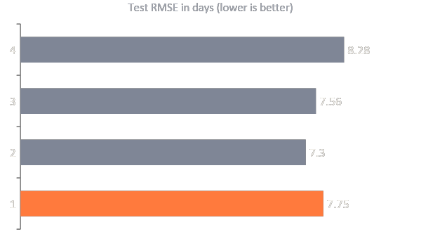
Time to eruption: no model beats the average
11 · RESULTS · REGRESSION
MODEL | RMSE (d) | MAE (d) | R SQUARED
Mean baseline | 7.75 | 6.60 | -0.179
Random forest (depth 5) | 7.30 | 6.25 | -0.048
Joint K-means (k=10) | 7.56 | 6.40 | -0.121
MLP (alpha 0.1) | 8.28 | 6.93 | -0.345
WHAT R SQUARED BELOW 0 MEANS
Predicting the test-period average would have been better than the model. Predictions barely vary with the true time to eruption.
SELECTION RULE
WHY IT IS HARD
Development RMSE decides
Eruption timing needs a precise clock. Seven or eleven catalog features carry little of it.
The baseline won on development (RMSE 10.41 d vs 10.69 d for the forest), so it stays selected.
Notes:
Development selected the mean baseline. The forest has lower test RMSE, but it was worse on development, so switching after seeing test would be tuning on test. All R squared values are negative on test.

Slide 13
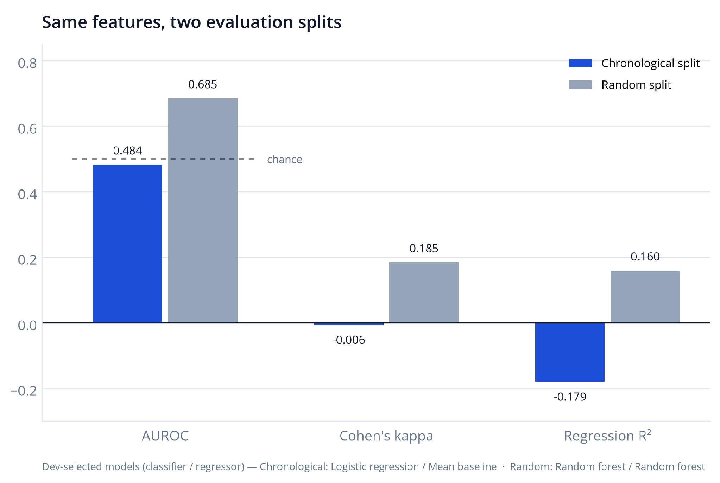
A random split makes the same features look better
12 · RANDOM VS TIME-ORDERED
TEST METRIC | TIME-ORDERED | RANDOM (OURS) | PAPER
AUROC | 0.484 | 0.685 | 0.71
Kappa | -0.006 | 0.185 | 0.52*
Regression R squared | -0.179 | 0.160 | 0.38
* Paper figures, test set; its text quotes kappa 0.42. Each of our splits selects its own models (random: random forest for both tasks).
WHY THE GAP
Swarms leak across a random split
Quakes from the same swarm land in both train and test, so the test is easier than forecasting a later period.
LESSON
Evaluation design changes the story. A time-ordered test is the fair test for forecasting, even though it gives the less flattering number.
Notes:
The paper used a random split and reported strong random-forest numbers. Under the same features, a random split gives AUROC 0.685 and kappa 0.185, while time-ordered gives 0.484 and -0.006. We do not claim to reproduce the paper numbers; its RMSE is on a standardized target so only R squared is comparable.

Slide 14
What we conclude
13 · CONCLUSION
1
2
3
Catalog features are not enough
Evaluation design changes the story
Tuning did not transfer
On later earthquakes classification AUROC is 0.484 (chance 0.5) and no regressor beats the mean (R squared −0.179).
A random split reports AUROC 0.685 on the same features. Time-ordered testing is the fair test.
K-means search raised development AUROC to 0.668 but test AUROC was 0.515 (original 0.524). Thresholds leave AUROC unchanged.
LIMITS
WHAT WOULD HELP NEXT
Only 19 eruptive quakes in the test window; AUROC bootstrap interval is roughly 0.37-0.68.
Only 49 eruption entries and a single volcano.
Scores are not calibrated hazard probabilities. This is not a warning system.
Ground deformation and gas emission measurements.
Focal mechanisms of the earthquakes.
A longer catalog with more eruptions.
Proper probability calibration for any alarm.
Notes:
Main finding: catalog features alone do not forecast eruptions on later earthquakes. Methodological lesson: evaluation design matters. Be honest about limits: 19 test positives, 49 eruptions, one volcano.

Slide 15
Live demo and reproducibility
14 · DEMO
WHAT THE DEMO SHOWS
RUN IN THE PROJECT FOLDER
A saved model scores a real held-out earthquake: eruption score, class, estimated days, and the true catalog labels beside them.
python -m unittest discover -s tests -v
# 17 tests, all passing
python demo.py --row 0
# score one held-out earthquake
python -m src.experiment --protocol chronological \
--output-dir tmp/live
# full retrain without touching saved results
python scripts/build_figures.py
# rebuild charts from saved results
REPOSITORY
notebooks/walkthrough.ipynb
graphs.html: all charts and tables
output/pdf and output/slides
requirements.txt (scikit-learn 1.7.2)
HONEST FRAMING
Historical classroom demonstration. Scores are not calibrated probabilities, and the project is not a volcano warning system.
Notes:
For the live demo: run the tests, then demo.py on a held-out row. Use --output-dir for a live retrain so committed results are not overwritten. Everything pins scikit-learn 1.7.2.

Slide 16
References
15 · SOURCES
Mullet, B., Singh, A., & Wong, Y.-Q. (2019). Predicting Eruptive Events at Volcanoes from Earthquake Data. Stanford CS229 project report.
PEEVED code and bundled catalogs: github.com/bmullet/PEEVED
Earthquake catalog: Advanced National Seismic System (ANSS), hosted by WOVOdat. Eruption history: Hawaii Center for Volcanology (as bundled in PEEVED).
Pedregosa, F. et al. (2011). Scikit-learn: Machine Learning in Python. JMLR 12, 2825-2830.
Prithvish Adhikari (PES1UG24AM206) · Piyush Shiv (PES1UG24AM191)

