Slide 1
Earthquake signals and Kilauea eruptions
UE24CS352A MACHINE LEARNING · MINI-PROJECT REVIEW
Adapting the PEEVED study with a time-ordered evaluation
Prithvish Adhikari PES1UG24AM206
Piyush Shiv PES1UG24AM191
October 2026
Notes:
Title. We adapt Mullet, Singh and Wong's Stanford CS229 project (PEEVED, 2019) on Kilauea earthquakes and eruptions, and add a time-ordered evaluation.

Slide 2
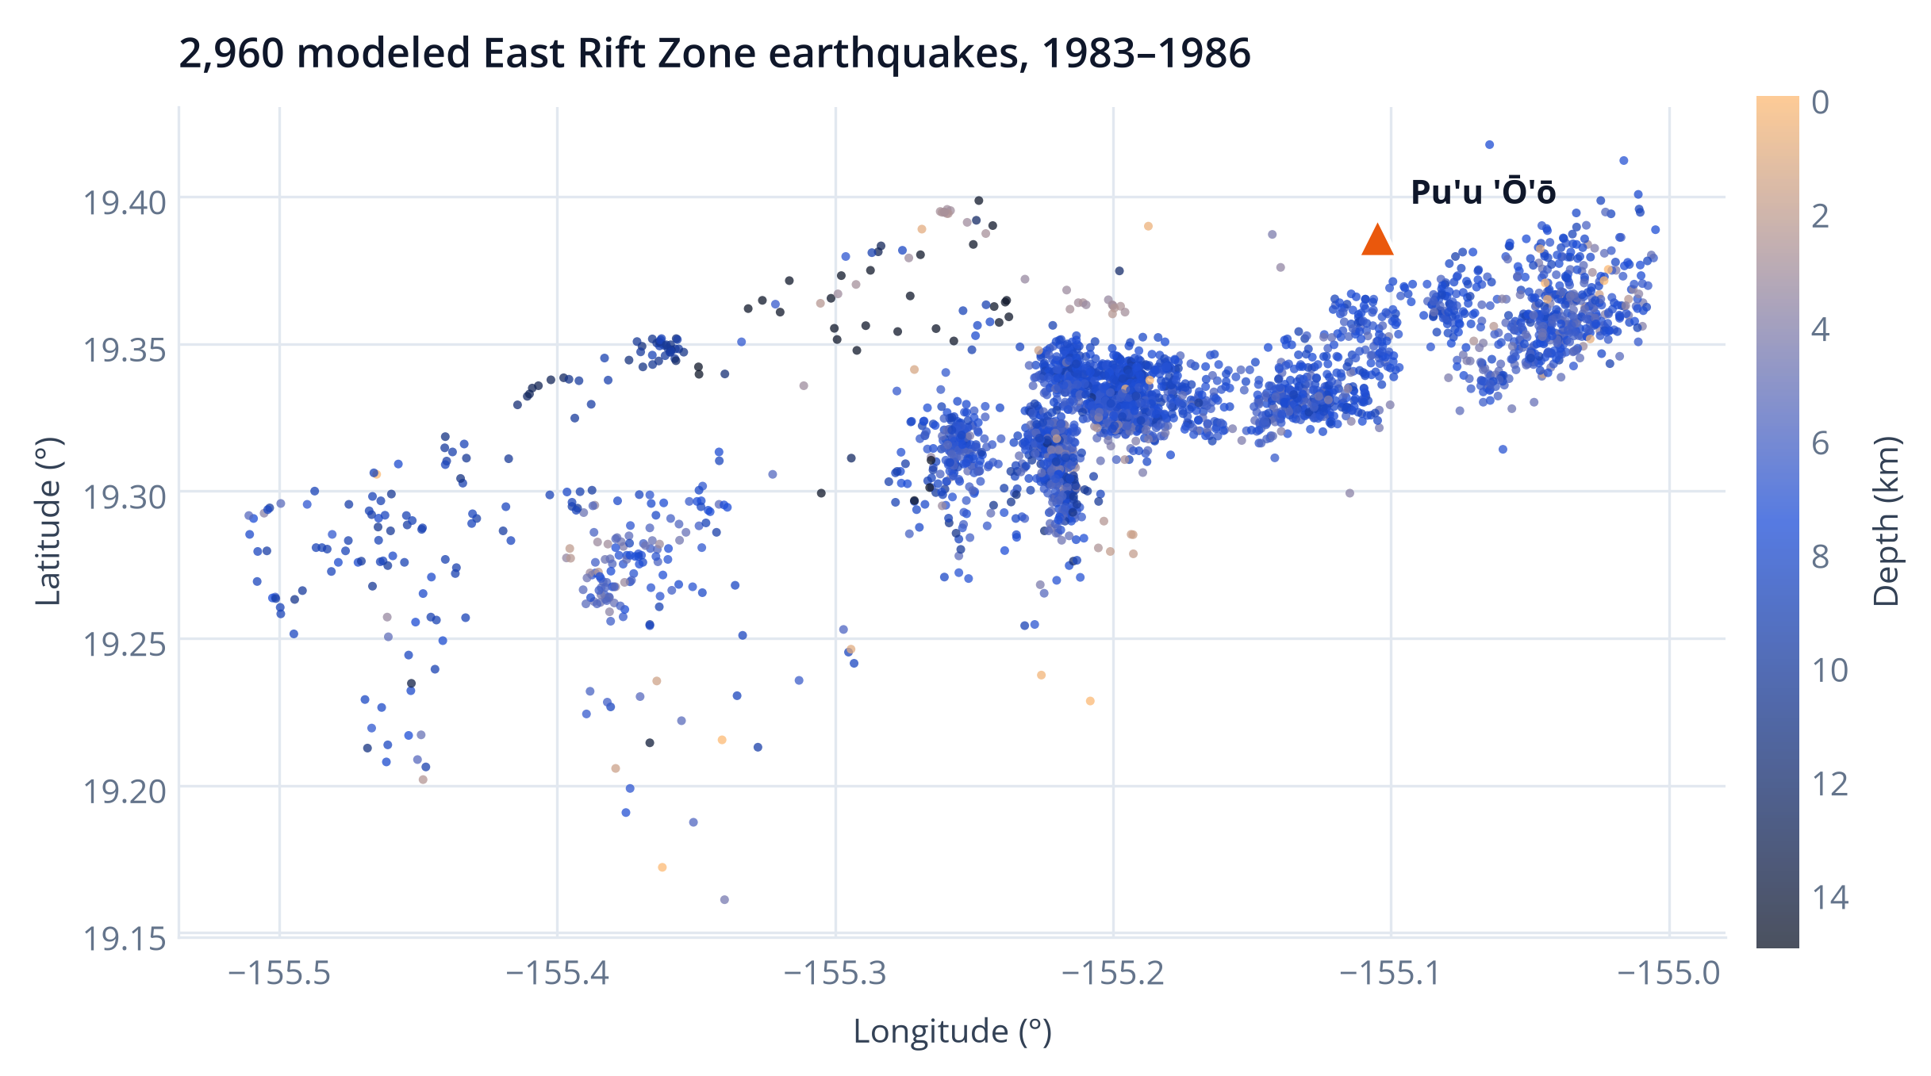
Can earthquakes tell us when Pu'u 'Ō'ō erupts?
TASK 1 · CLASSIFICATION
Is the volcano erupting when this earthquake happens?
TASK 2 · REGRESSION
How many days until the next eruptive episode begins?
Epicentres coloured by depth; triangle marks Pu'u 'Ō'ō. Catalog: ANSS via WOVOdat.
Source study: Mullet, Singh & Wong, Stanford CS229 (2019). We keep its data and features and change how it is evaluated.
Notes:
Two tasks from the PEEVED paper. Each earthquake has time, location, depth and magnitude. Map drawn from our modeled rows; Pu'u 'O'o coordinates from the original RunMLTests notebook.

Slide 3
2,960 earthquakes, seven features each
WHAT THE MODEL SEES
Where
Longitude, latitude
How deep
Depth (km)
How big
Magnitude
How busy
Earthquakes in the previous 1, 7 and 30 days
East Rift filter keeps 3,764 earthquakes, the same count as the paper. A 30-day warm-up and the end of reliable eruption coverage (20 July 1986) leave 2,960; 10.3% occur during an eruptive episode.
Counts look strictly backwards in time, so no feature uses a later earthquake.
Notes:
Audit from results/chronological/metrics.json: 6485 raw rows, 3764 East Rift, 2960 modeled, 304 erupting. Labels: inside an episode's duration plus a 24-hour buffer.

Slide 4
Two catalog errors, handled explicitly
EPISODE 48 DURATION
EPISODES 35.5 AND 35
173,566,800 h
Out of order
About 19,800 years. We keep the onset (20 July 1986) as the end of coverage and never use the duration.
Listed 27 July before 26 July 1985. We sort onsets and keep each duration attached to its own onset.
LABEL CHECK AGAINST THE ORIGINAL CODE
100%
22.4% → 10.3%
The gap comes from 282 labels created only by the episode-48 error and 522 warm-up earthquakes from January 1983.
of our 2,960 labels match the original PEEVED rule
erupting share: original rule on all rows vs ours
Notes:
Re-implemented PuuOo.was_erupting from reference/PEEVED/util/datautil.py; on our modeled rows the labels agree 100%. On all 3,764 East Rift quakes it gives 22.4% positives (paper: about 20%).

Slide 5
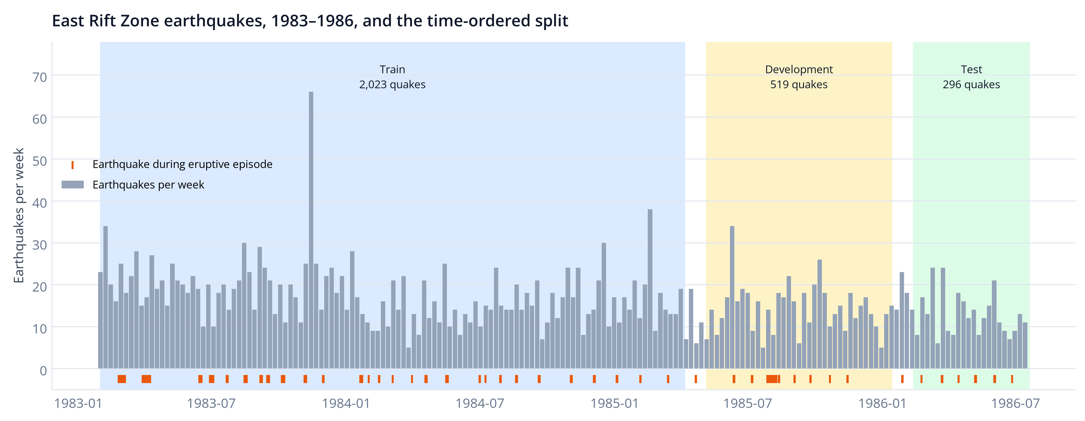
We test on later earthquakes, not shuffled ones
TRAIN
DEVELOPMENT
TEST
2,023 earthquakes · 230 erupting
519 earthquakes · 46 erupting
296 earthquakes · 19 erupting
Jan 1983 – Apr 1985
May 1985 – Jan 1986
Feb 1986 – Jul 1986
Notes:
70/20/10 by time, 30-day gaps, and training labels must be known before the next window starts. The random split from the paper is kept only as a comparison.

Slide 6
Five model families, chosen on development data
Family | Classification settings | Regression settings
Baseline | Class prior | Training mean
Logistic regression | C = 0.1, 1, 10 (balanced) | —
Random forest | Depth 5, 15, none · 200 trees | Depth 5, 15, none · 200 trees
K-means | Per-class centroids, k = 4, 8 | Joint centroids, k = 6, 10
Neural network (MLP) | 32-16 units, α = 0.001, 0.1 | 32-16 units, α = 0.001, 0.1
1
Fit
Train each setting on the training window only
2
Select
Pick the best family by development AUROC or RMSE
3
Test once
Scaling is fit on training data inside each pipeline. Baselines are allowed to win.
Freeze the choice, then score the test window
Notes:
Grids from src/experiment.py candidates(). Selection metric: development AUROC for classification, development RMSE in days for regression.

Slide 7
Eruption status: close to chance on later earthquakes
0.524
−0.012
test AUROC
Cohen's kappa
AT A 0.5 THRESHOLD
12 of 19
eruptive earthquakes found
194 of 277
repose earthquakes flagged as erupting
Blue: selected on development data (K-means, k=4).
Notes:
From results/chronological/metrics.json. Test window has 296 earthquakes, 19 erupting. Bootstrap 95% interval for AUROC roughly 0.37-0.68. Random forest falls below chance (0.373).

Slide 8
Time to eruption: no model beats the test-period mean
7.75 d
−0.179
RMSE of the selected mean baseline
R² (below 0 = worse than the test mean)
EVERY MODEL, TEST R²
Mean baseline −0.179
Random forest −0.048
Joint K-means −0.121
MLP −0.345
The forest's test RMSE is lower, but development data chose the baseline; switching after seeing the test would be tuning on it.
Blue: selected on development data (Mean baseline).
Notes:
Regression test metrics from results/chronological/metrics.json. MAE of the selected baseline: 6.60 days.

Slide 9
A random split makes the same features look better
Test | Time-ordered | Random | Paper
AUROC | 0.524 | 0.682 | 0.71
Kappa | −0.012 | 0.114 | 0.52*
R² | −0.179 | 0.160 | 0.38
Random splits put earthquakes from the same swarm in both training and test sets, so the test is easier than predicting a later period.
* Paper's Figures 4–5 (random forest, test). Its text quotes kappa 0.42; its RMSE is on a standardized target, so only R² is comparable. Each of our splits selects its own models.
Notes:
Random split, scikit-learn 1.7.2: selected forest (depth=None) for classification and forest for regression; RMSE 11.01 days.

Slide 10
What we conclude
Seven catalog features are not enough
Evaluation design changes the story
What would help next
On later earthquakes, classification is near chance (AUROC 0.524) and no regressor beats the mean (R² −0.179).
The paper-style random split reports AUROC 0.682; a time-ordered split is the fair test for forecasting.
Ground deformation, gas emissions and focal mechanisms, and a longer catalog with more eruptions.
LIMITS
Only 19 eruptive earthquakes in the test window (AUROC bootstrap interval roughly 0.37–0.68). Scores are not calibrated hazard probabilities, and this is not a warning system.
Notes:
Close with the main finding, the evaluation lesson, and limits.

Slide 11
Live demo and reproducibility
notebooks/walkthrough.ipynb
RUN IN THE PROJECT FOLDER
Every step with saved outputs
python -m unittest discover -s tests -v
# 5 pipeline checks, ~1 s
python demo.py --row 0
# score one held-out earthquake
python -m src.experiment --protocol chronological \
--output-dir tmp/live
# full retrain (~15 s) without touching saved results
graphs.html
Results page with all charts and tables
output/pdf
Two-page write-up
requirements.txt
Pinned versions (scikit-learn 1.7.2)
Notes:
For the live demo, run the tests and demo.py. Use --output-dir for a live retrain so the committed results and models are not overwritten.

Slide 12
References
Mullet, B., Singh, A., & Wong, Y.-Q. (2019). Predicting Eruptive Events at Volcanoes from Earthquake Data. Stanford CS229 project report.
PEEVED code and bundled catalogs: github.com/bmullet/PEEVED
Earthquake catalog: Advanced National Seismic System (ANSS), hosted by WOVOdat. Eruption history: Hawaii Center for Volcanology (as bundled in PEEVED).
Pedregosa, F. et al. (2011). Scikit-learn: Machine Learning in Python. JMLR 12, 2825–2830.
Fonts: Montserrat and Open Sans, SIL Open Font License.
Prithvish Adhikari (PES1UG24AM206) · Piyush Shiv (PES1UG24AM191)
Notes:
Sources for all data, code and methods.

