Slide 1



Slide 2


where precision meets potential

Slide 3
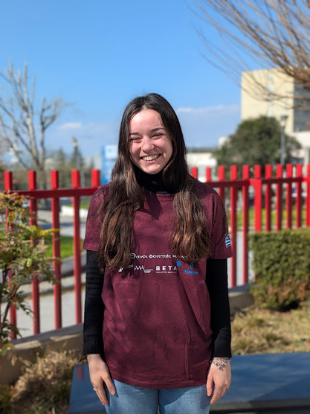
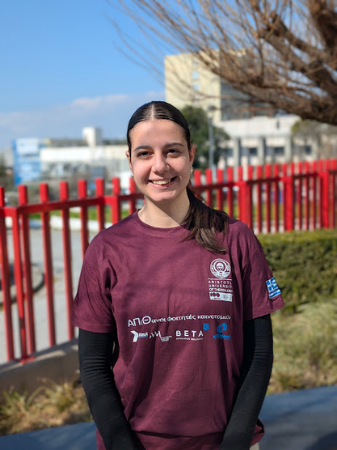
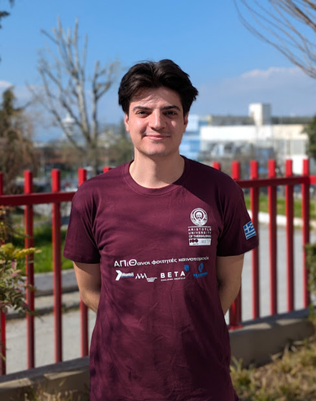
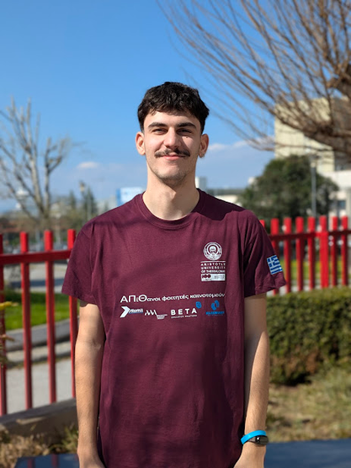
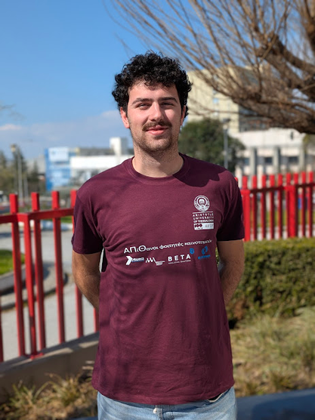
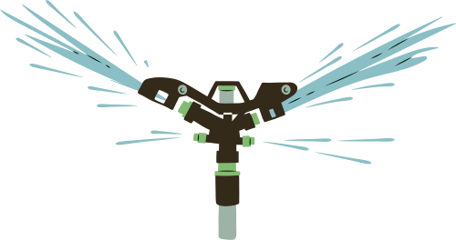
Stela
Ramolli
Natalia-Eirini
Tayeh
Vasilis
Zoidis
Savvas
Tzanetis
Iasonas
Lamprinidis
Electrical & Computer
Engineering
Electrical & Computer
Engineering
Electrical & Computer
Engineering
Agriculture
Phychology

Slide 4
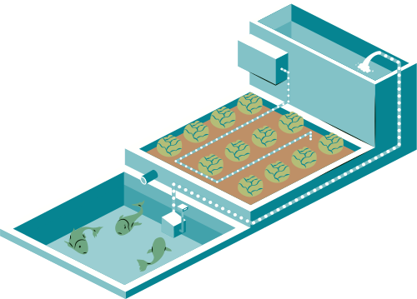
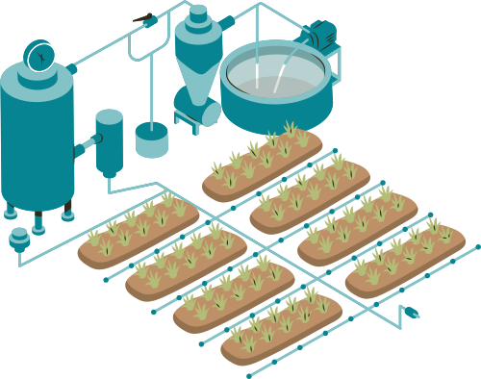
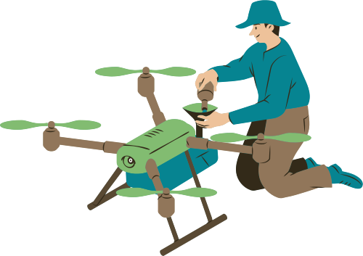
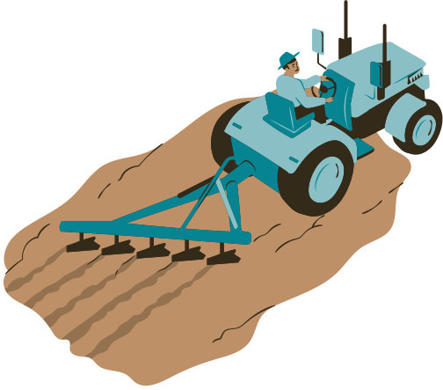
INVENT FOR THE PLANET
Smart
Farming
Irrigation and Fertilizers

Slide 5
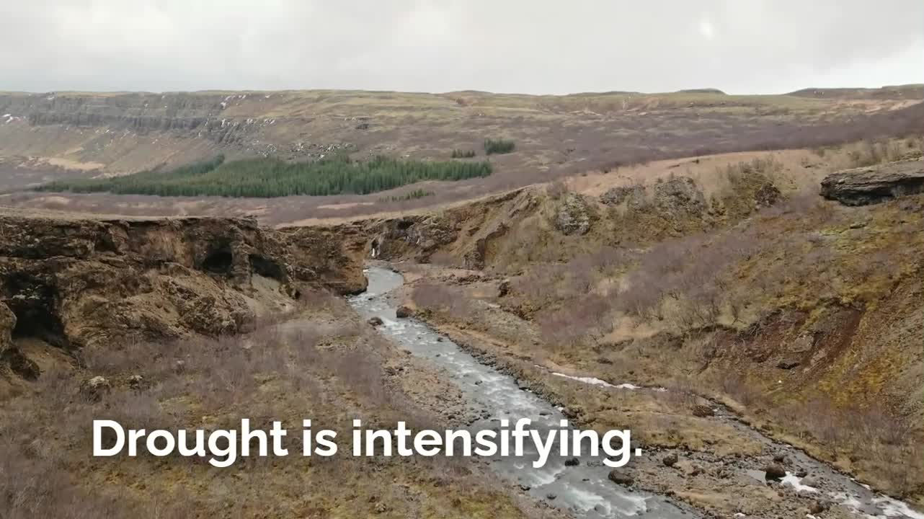

Slide 6
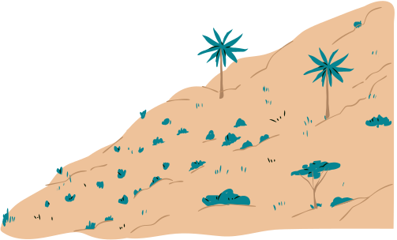
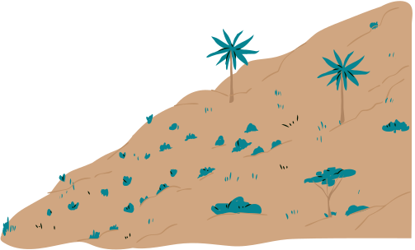
Producers face multiple chalenges when growing in irregular and dry environments

Slide 7





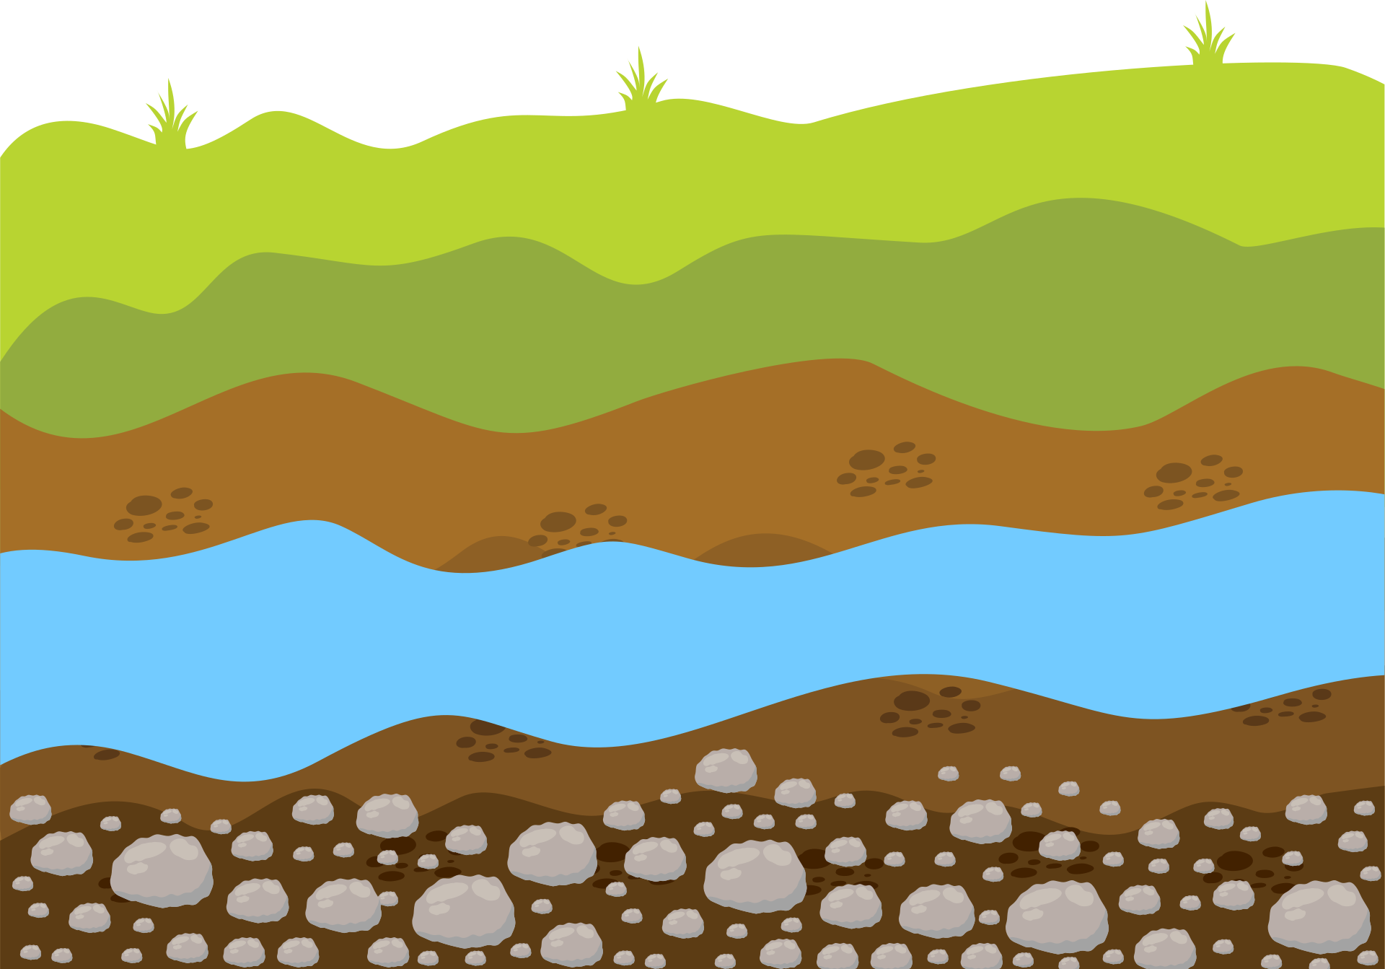


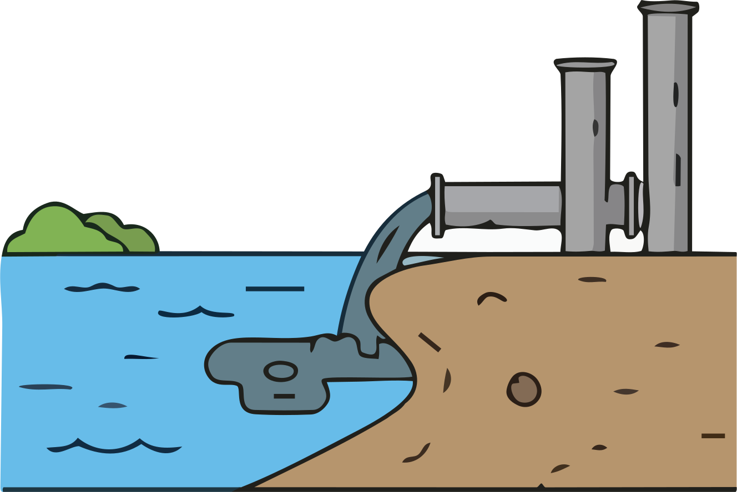
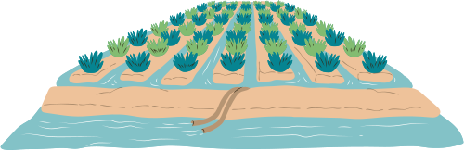
Producers face

Slide 8
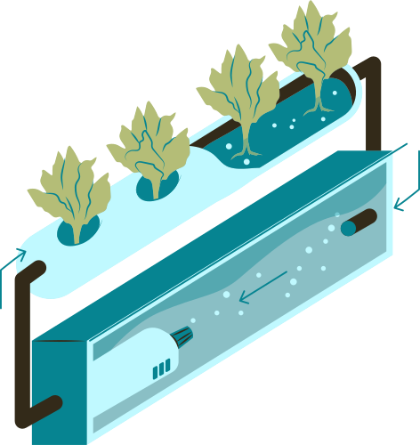
The United Nations claim that global water use will increase by 30% by 2050
“The health of the Planet: Challenges and Oppertunities in the Mediterranean Area.” - G.Vinci et al.

Slide 9
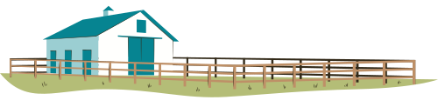

40–70% of nitrogen,
80–90 % of phosphorus,
50–70 % of potassium
...are lost to the environment...
...causing financial & environmental damage.
““Biopolymer nanocarriers for sustained release of agrochemicals: Review on materials and social science perspectives for a sustainable future of agriculture” T. O. Machado

Slide 10
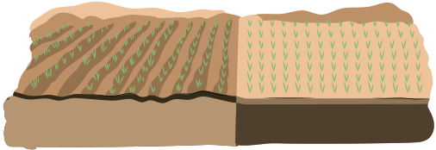
Gaia aims to convert Infertile soil
Fertile & Productive soil

Slide 11




GAIA LEVERAGES SMART IRRIGATION & FERTILISATION TO INCREASE YIELDS IN HIGH VALUE SPECIES WITH MAJOR WATER NEEDS THAT ARE USUALLY GROWN IN DRY PLACES

Slide 12
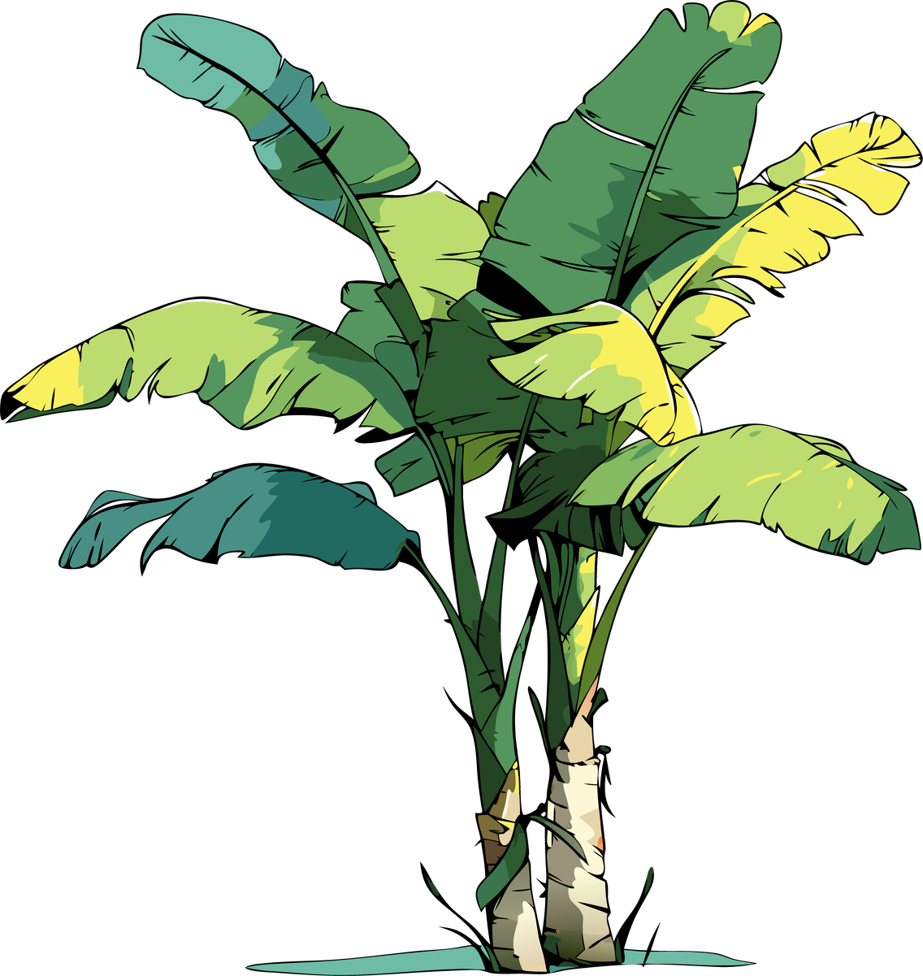
Comparator
Electronic Valve
Temperature Sensor
Soil Moisture Sensor
Soil NPK Sensor
CHILD NODE (SPRINKLER)
MASTER NODE (CONTROL)
SERVER
Relay/Transistor
Capacitive Soil
Moisture Sensor
Water and Nutrient Source
Water Reservoir
Array of valves for mixing nytrients with water
NPK Reservoir

Slide 13
MATERIALS
  SPRINKLER COMPONENTS
    DC Gear Motor 3V
    Capacitive soil moisture sensor
    Fittings
    Potentiometer
    Comparitor
    DC 12V Electric Water Solenoid Valve
  PARENT NODE COMPONENTS
    PT1000 RTD (Temperature SEnsor)
    Esp32 Based Micro-controller
    Rs485 (Soil Moisture Sensor)
    Water pipe with a tank per acre
  FERTILIZER MIXER
  SERVER

Slide 14
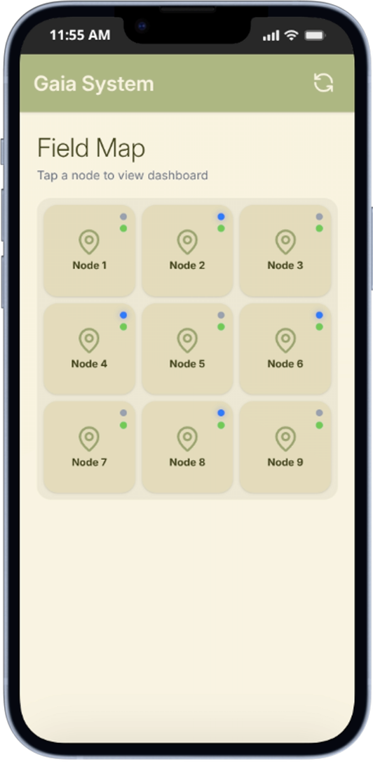
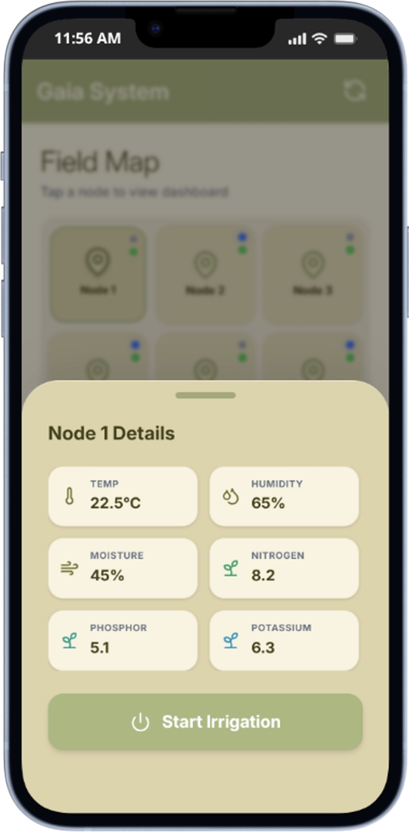
Web Application
  Per Parent Node (Acre) Control
  Intiuative Deisgn
  Easy access to vital information
  Total control of the smart irrigation system in one place

Slide 15
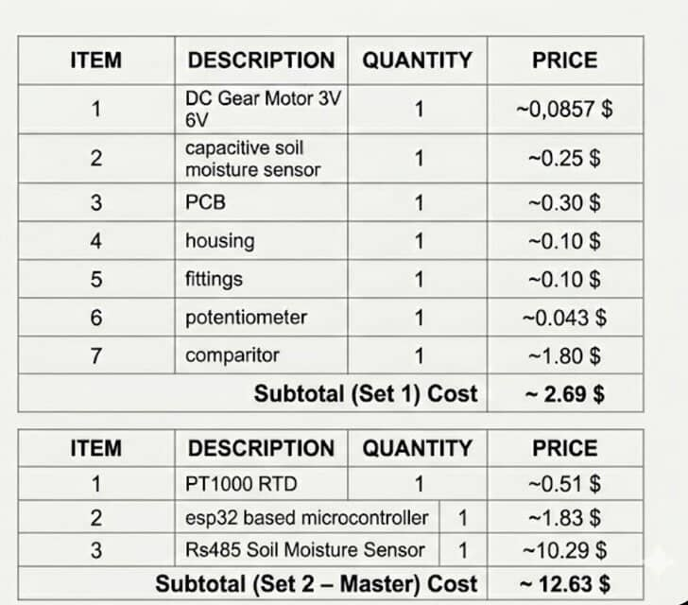
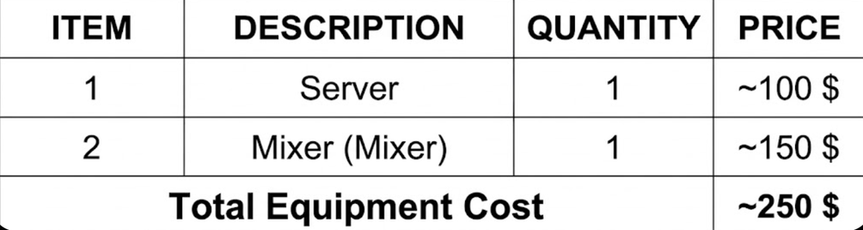

TOTAL COST :
C= 250 + n*148,72
n= Number of acres

Slide 16

“Converting dry land to an irrigated one... income is increased by more than 70%”
“”Irrigation systems perfamance in greece”, A. Karamanos et al.
“Implementing variable-rate irrigation (VRI) can save 26.3% water annually”
“Soil water status mapping and two variable-rate irrigation scenarios”, C. Hedley et al.

Slide 17

Business Model :
  Sensors and Actuators: Complete Smart Irrigation and Fertilazation system (900$ sustainastainable server , 250$ /acre.)
  Subscription: Monitoring App, Historical database and Data Analysis (15$/month)
  Add-ons: Surveying and consultation leveraging AI and full spectral photography

Slide 18
GO TO MARKET PLAN
1-2nd month
  Live demostrations
Aproach potential customers
  Face to face
  On the Phone
3-5th month
  Automated marketing campanes
  Social Media (Instagram, TikTok, LinkdIn)
6th month onwards
  Agriculture and Sustainability Exhibitions
  Techological Confrences
  Affiliate Marketing

Slide 19
Our Competition:
  Farma B
  AgroApps360
  Raven
  Cyberspace dynamics
  Agenso
Limitations :
  Too complicated
  Complex equipment
  Prior expertise needed
  High cost

Slide 20
Average expect profit per client
3.305$/year
Target Producers
1000-3000
Yearly Savings of Producers
12.544$/ year
Tons of water potentially saved
275 ton /acre.
35% less fertilizers used

Slide 21
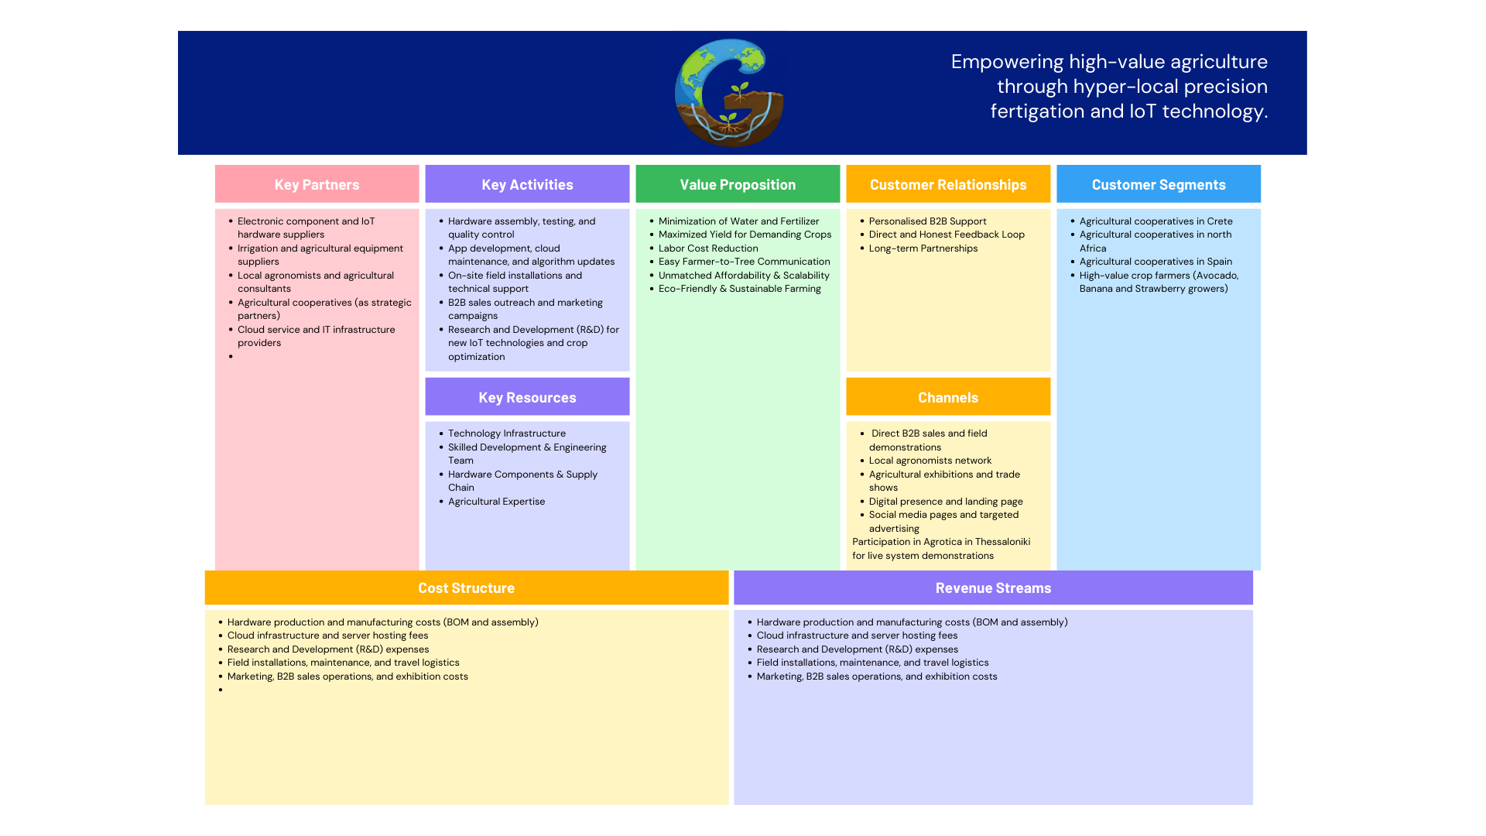

Slide 22
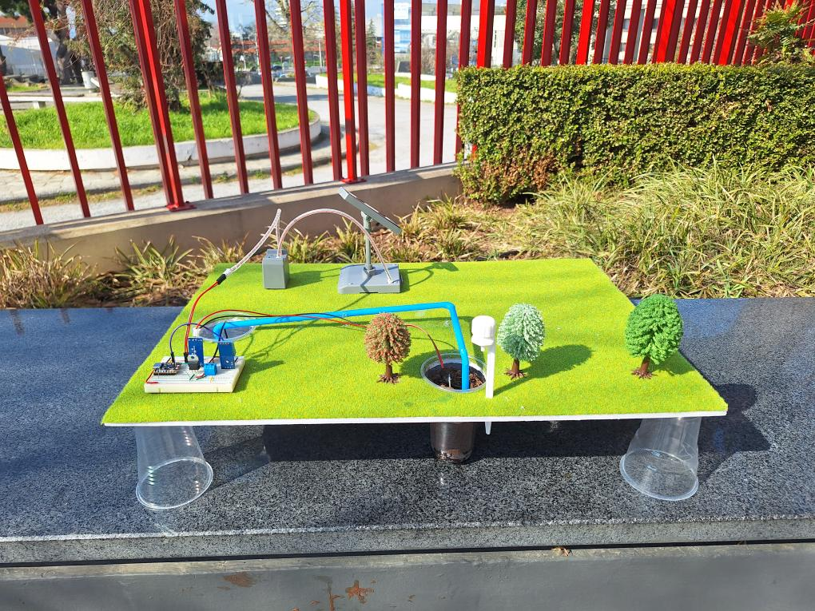

Slide 23
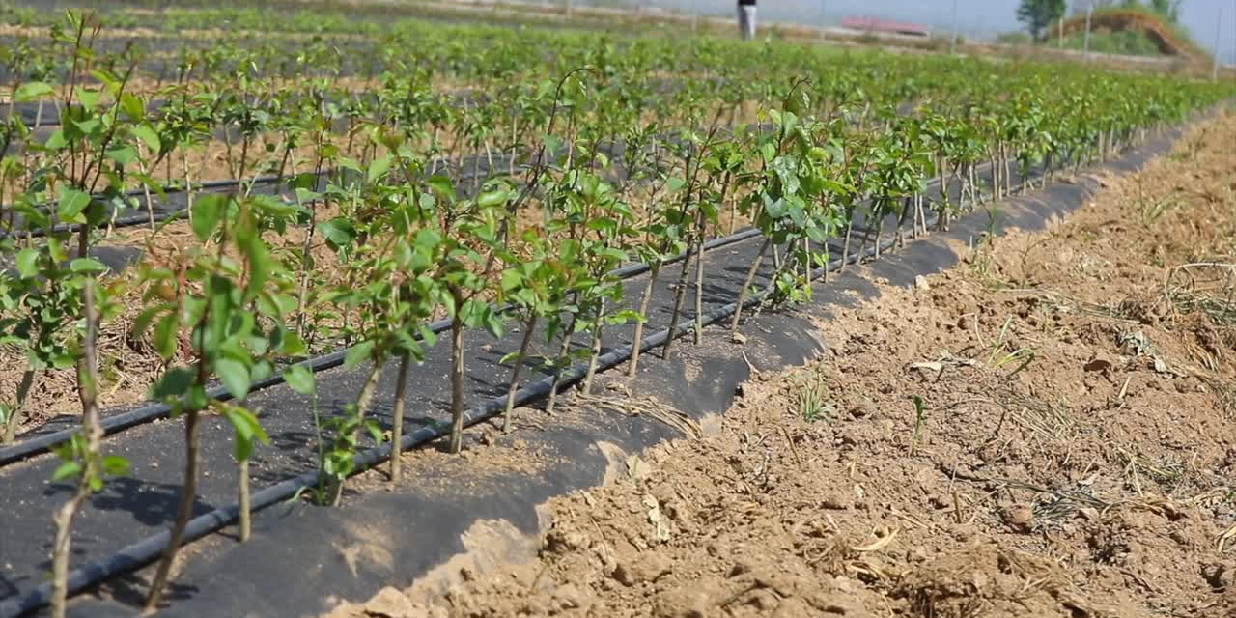
Thank you for listening!

