Slide 1
CSEE W4140
Networking Laboratory
Lecture 2: ARP
Jong Yul Kim
01.28.2009

Slide 2
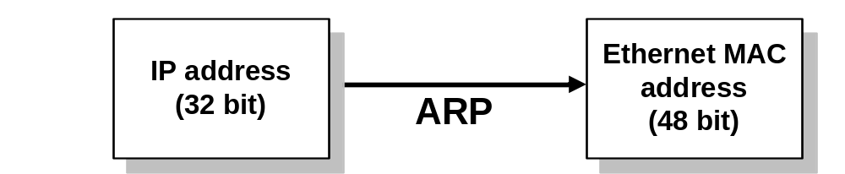
What is ARP?
What does it stand for?
  Address Resolution Protocol
What does it do?
  Finds the MAC address of the owner of an IP address
Why do we need to find the MAC address?

Slide 3
ARP Players
ARP module
  Processes ARP packets
ARP cache
  Stores <MAC addr, IP addr> in memory
  Deletes entry after timeout
  (Typically 20 minutes)
ARP protocol
  Specifies the behavior of senders and receivers
  Defines the format of ARP packet
  Implemented in ARP module

Slide 4
ARP Demo
http://www.osischool.com/protocol/arp/basic/index.php
Request is broadcast at layer 2
Reply is unicast at layer 2
ARP is plug-and-play.
Administrators love plug-and-play.

Slide 5
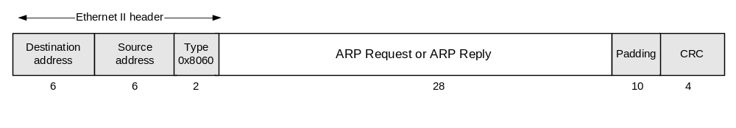
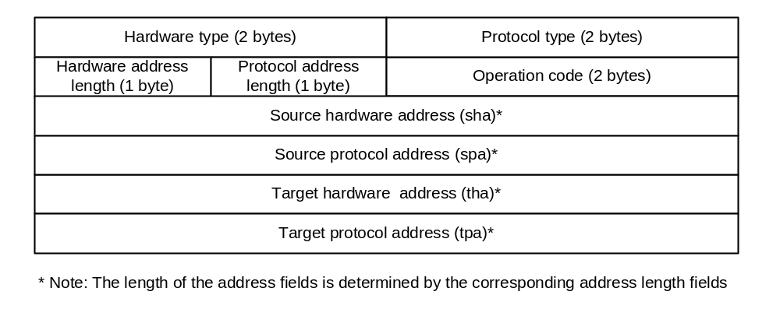
ARP Packet Format
Notes:
Same format for request and reply.
We can learn a lot about a network protocol from the packet format.
Hardware type field exists → means ARP is not just for Ethernet. It’s also used in Frame Relay and ATM networks (Inverse ARP)
Protocol type field exists → means ARP is not just for IP although it’s the most dominant use. (There used to be other protocols that competed with IP.)
Hardware address length and protocol address length → redundant but included for consistency checking and network debugging.
Op code → tells the host whether this packet is a request or a reply
The rest is filled to match IP address to MAC address
Source Info = assertion
Target fields = question
Some questions:
What would you change if you were to design the ARP packet format?

Slide 6
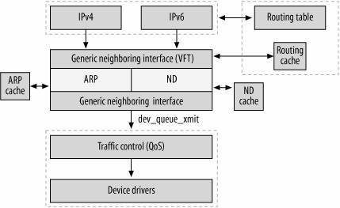
Transmitting within a LAN
(Flow diagram for Linux)
Figure 26-5 from “Understanding Linux Network Internals” (O’Reilly)
Notes:
IPv4 layer consults the ARP module when there is a miss in ARP cache.
If there is a value in cache, then it would use the value (bypassing the ARP module).

Slide 7
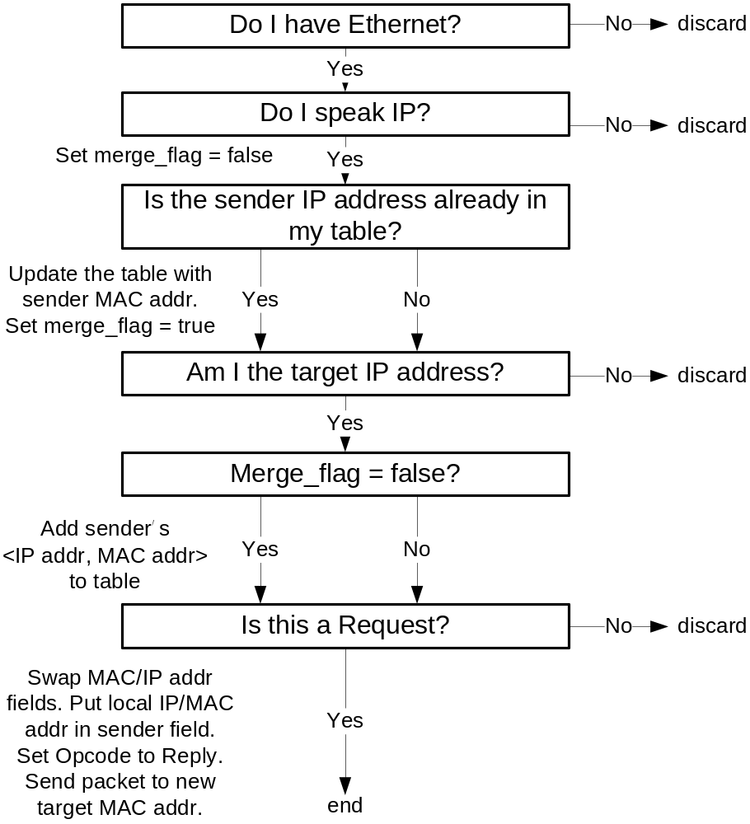
ARP Reception Algorithm in Ethernet and IP networks
Notes:
What if ARP requests that are broadcast to the network are not discarded but processed and added to table?

Slide 8
Reverse ARP (RFC 903)
Used before DHCP was invented
How would a host without an IP address request it reusing the ARP packet format?
How would a server reply?

Slide 9
IPv4 Address Conflict Detection (RFC5227)
ARP can be modified slightly to detect IPv4 address conflicts
Two types
  Precaution before setting my IP address
  → ARP Probe
  Detection while using my IP address
  → ARP Announcement

Slide 10
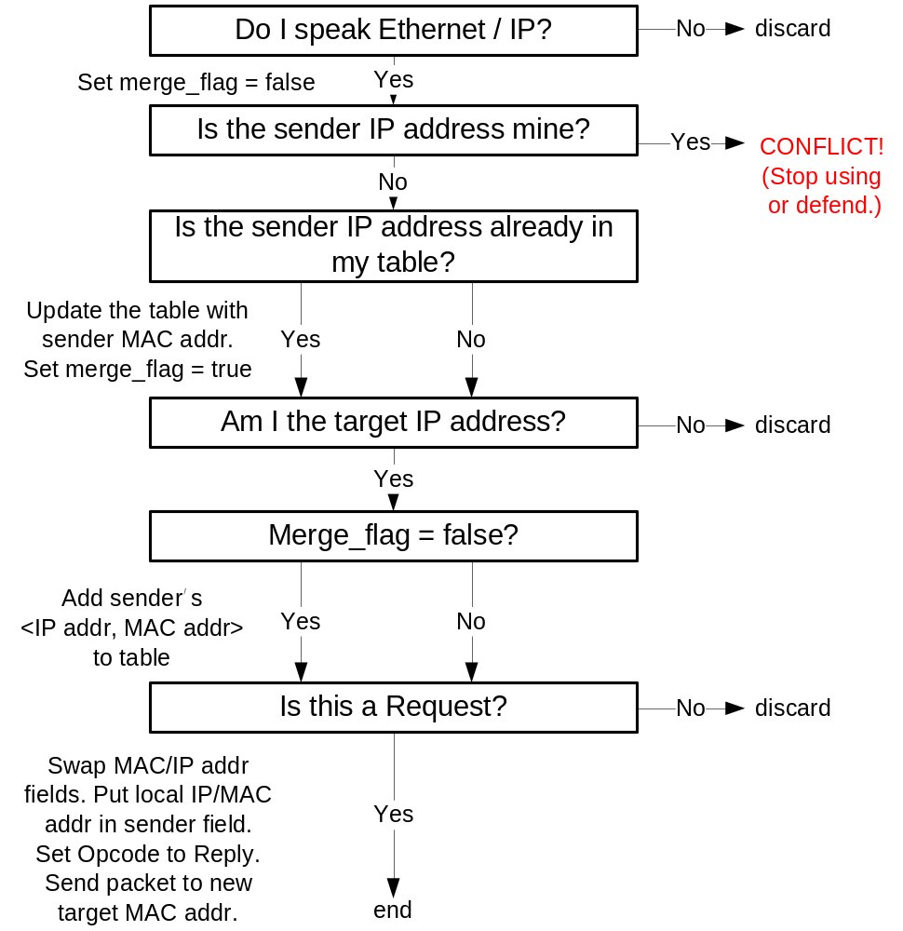
Modified ARP Reception Algorithm in Ethernet and IP networks

Slide 11
ARP Probes
“Is anyone using this address? If not, I’d like to use it.”
Sent when there is any change in connectivity
Should not send periodically
Don’t use address if:
  you see an ARP request or reply with same address I probed for in sender IP address field
  you see another ARP probe looking for the same IP address
Notes:
ARP Request packet
Broadcast
Sender IP → all zero (avoid polluting ARP caches)
Sender HW → filled with my own
Target IP → Address I’m trying to probe
Target HW → ignored. (recommended: all zero)

Slide 12
ARP Announcements
“I’m using this address.”
Sent when probe was successful
(No other hosts using the address)
Purpose: update stale cache entries in other hosts
Notes:
ARP Request packet
Broadcast
Sender IP → Address I’m currently using
Sender HW → filled with my own
Target IP → Address I’m currently using
Target HW → ignored. (recommended: all zero)

Slide 13
Ongoing Conflict Detection
If ARP request or reply has my IP address inside sender IP address field, there is an ongoing conflict.
Options:
  Cease using your IP address
  Defend your address
  (awesome.. but what are the consequences?)
Ignoring is worst than ceasing. Why?

Slide 14
ARP Spoofing
Malicious host sends unsolicited ARP replies to take over another host’s IP address
To do what?
  Passive sniffing
  Modifying packets
  Denial-of-service attack

Slide 15
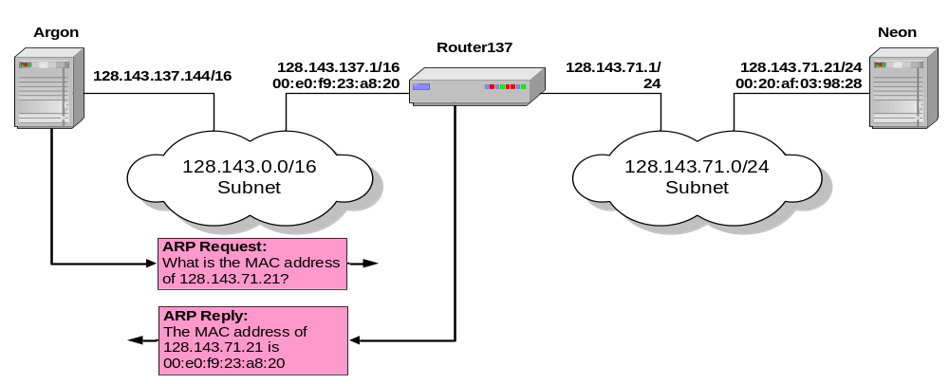
Proxy ARP
Host or router responds to ARP Request that arrives from one of its connected networks for a host that is on another of its connected networks.

Slide 16
Additional Questions
Why not broadcast ARP replies?
When does it make sense to broadcast ARP replies?
(Hint: detection of address conflict)
Why do we even have MAC addresses?
(This is more related to Ethernet than ARP)

Slide 17
Other topics
ARPING
  Software tool to ‘ping’ another host using ARP
Inverse ARP (InARP)
  Layer 2 → layer 3
  “What IP address are you using?”
  Used in frame relay and ATM networks
Notes:
ARP reply means host is alive. No reply means host may be dead.

Slide 18
Announcements
Lab roster is on class homepage
  3 spaces left in Friday lab
Lab report template will be on homepage
TAs will grade prelabs before your lab
Any questions about labs, lab reports, prelab homeworks?

Slide 19
Main Points of Lab 2
Network tools
  tcpdump
  wireshark
  netstat
  ifconfig
ARP and netmasks
Security of network applications

Slide 20
Homework
Prelab 2 due on Friday (01.30.2009)
Lab report 1 due by beginning of
lab 2 next week
Read Textbook Introduction
  Pages 25 ~ 34 (tcpdump, wireshark) – lab 2
  pages 34 ~ 43 (Cisco IOS) – lab 3

Slide 21
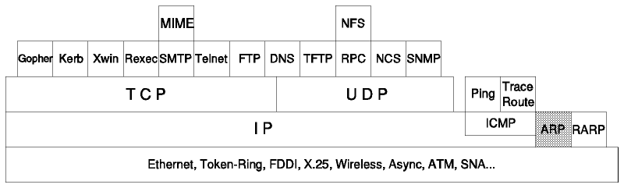
ARP in the network stack
Figure from TCP/IP Tutorial and Technical Overview

Slide 22
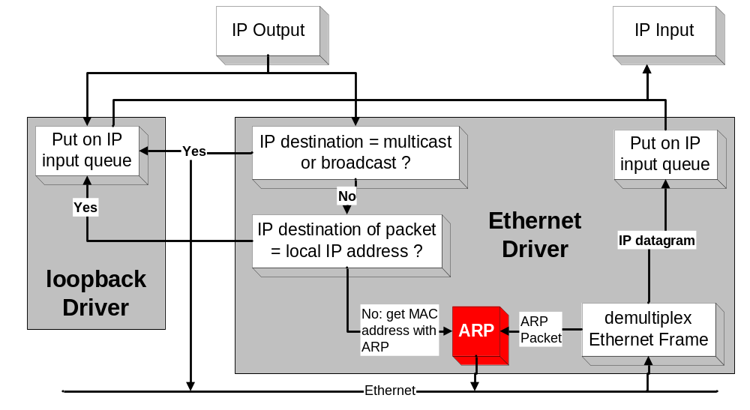
Processing of IP packets by network drivers

